Slide 1
JFG Haiku Hunt San Kei En 三景園
PRIME x NICT x BPOC
Collaborative culture coding project
PRAGMA October 2013

Slide 2
Collaborative
Pacific Rim Undergraduate Experiences (PRIME) at UC San Diego
Balboa Park Online Collaborative (BPOC)
National Institute of Information and Communications and Technology (NICT)
San Diego Japanese Friendship Garden (JFG)
Information Services International Dentsu (ISID)

Slide 3
Coding
Allow users to experience the garden with a “riddle” based game on their mobile device
Design intuitive interface on Android mobile platform
Utilize ISID PlaceSticker technology for location beacon
Integrate ISID’s API for PlaceSticker communication
Notify users when they are in range of garden feature on their tour
Allow users to access additional metadata at each feature location

Slide 4
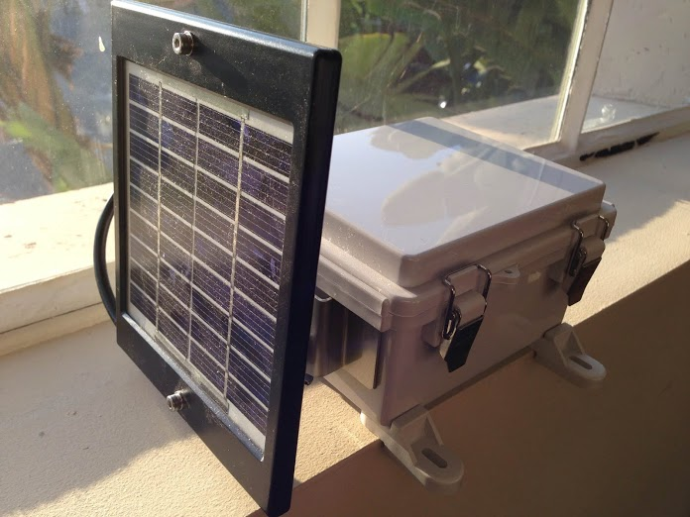
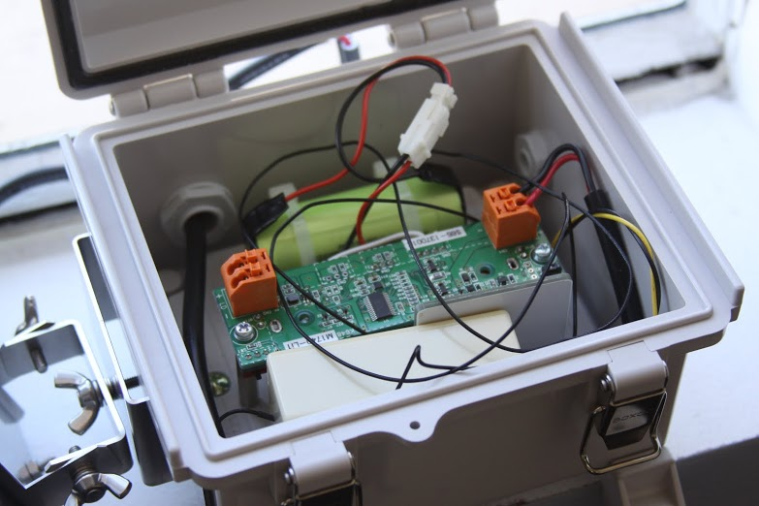
Coding Hardware
Solar powered PlaceSticker device (ISID, Tokyo, Japan)

Slide 5
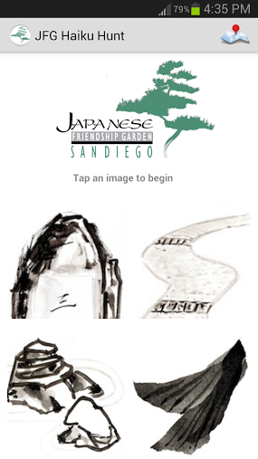
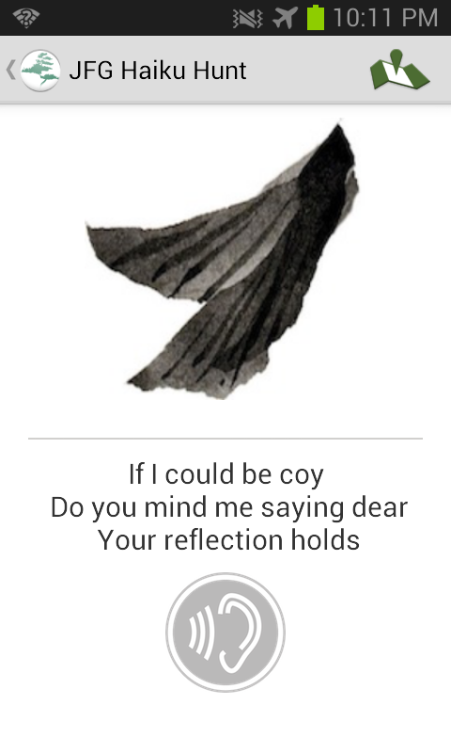
Culture The Interface

Slide 6
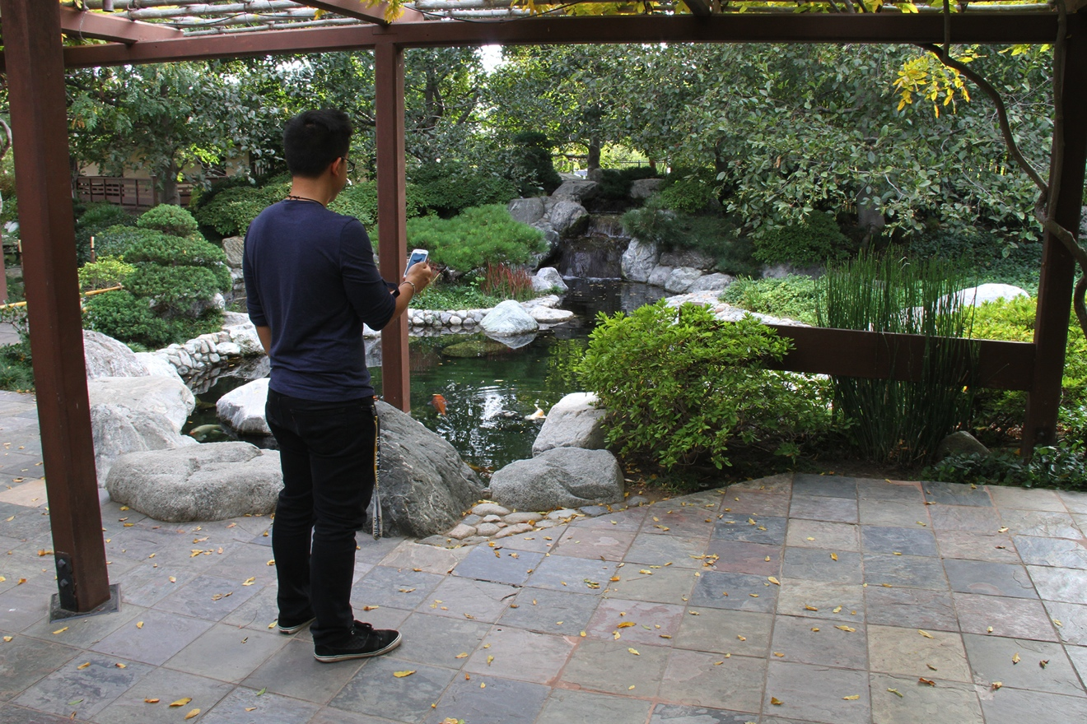
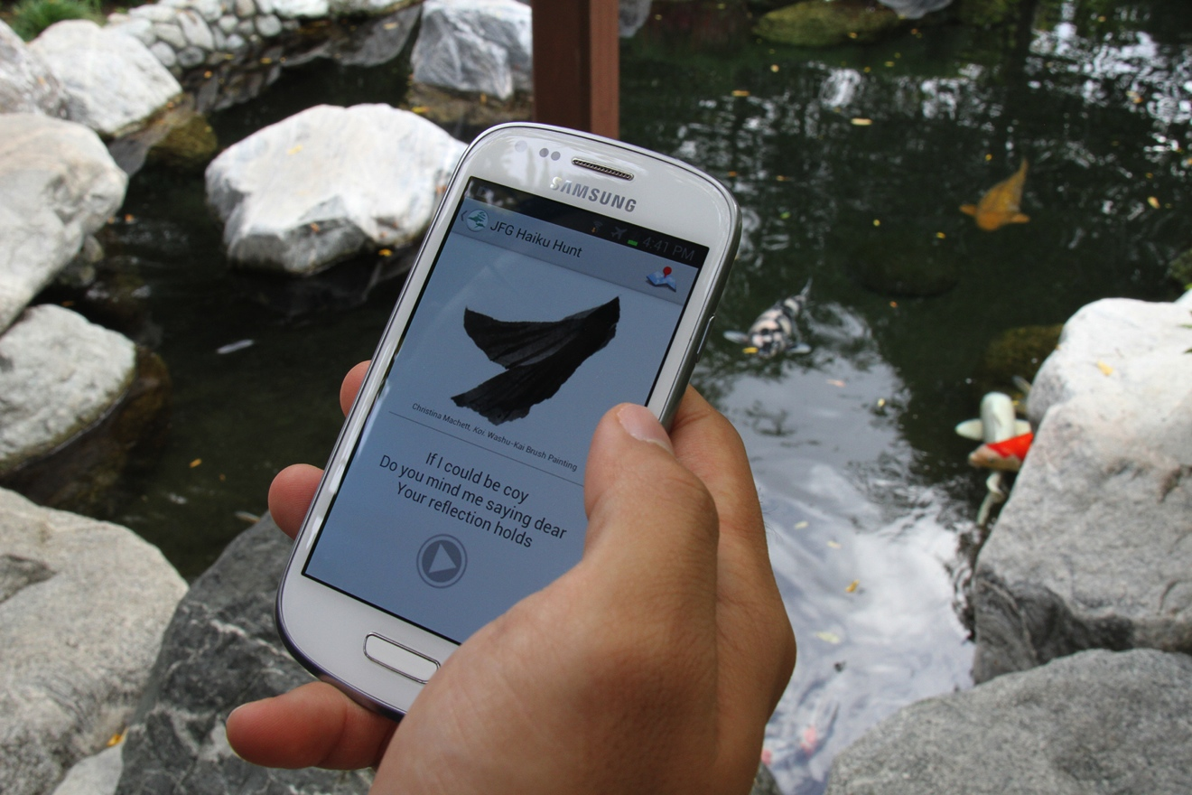
Culture The Interface

Slide 7
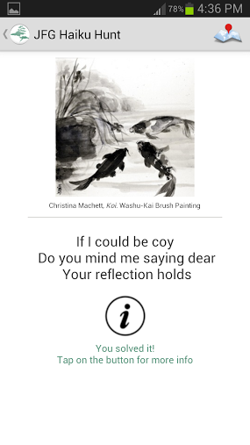
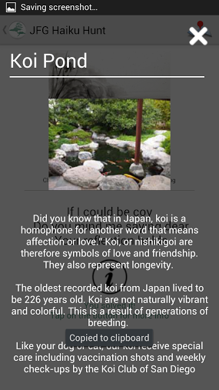
Culture The Interface

Slide 8
Video Demo
PLAY VIDEO

Slide 9
Future Work
Tentative launch Nov 2013
Kickstarter ($2500 USD)
Test as fundraising mechanism
Some funds for public launch
More user testing and application refinement
Test the environmental durability of PlaceSticker devices

Slide 10
Acknowledgements
UCSD
Jesus Rios
Dr. Jason Haga
Dr. Gabriele Wienhausen
Dr. Peter Arzberger
BPOC
Vivian Kung Haga
Christina DePaolo
Wesley Hsu
NICT
Dr. Shinji Shimojo
Yoshinori Kobayashi
Tomoaki Takata
ISID
Kazuhiro Toda
Seiji Kumagai
JFG
Luanne Kanzawa
Marisa Espinosa
Marisa Takeuchi
ADDITIONAL SUPPORT
U.S. IMLS

