Slide 1
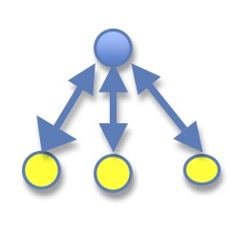

Provenance Collection Framework for Biodiversity Analysis On PRAGMA Cloud for Data Sharing
Quan Zhou and Beth Plale
Data to Insight Center, Indiana University Bloomington
Notes:
Provenance of digital scientific data is a critical component to broaden sharing and reuse of scientific data. For our case, LifeMapper expands its computing resources onto virtual machines running at San Diego Supercomputer Center (SDSC). This rich interdisciplinary application gives us the opportunity to study automated provenance capture as the biodiversity analysis is carried out and data products moved, consumed, and generated..

Slide 2
Why provenance?
Infrastructure VS Data
Failure Trace
Algorithm Versioning
Version Control
Enable Data Reuse
Data Lineage
Check Data Reliability
Data Quality
Notes:
Data lineage: can our provenance approach properly capture complete mappings between output data, input data and algorithms used to enable data reuse?
Data quality: can our provenance approach capture provenance sufficient to check input biodiversity dataset quality to verify the reliability of output data?
Version control: can our provenance approach capture algorithm or program versioning?
Failure trace: Can our provenance approach determine whether output dataset is affected by some infrastructure problems such as node failure, etc.?

Slide 3
Karma Provenance Collection Tool
Scientific Processing
Data Files
Log Files
Metadata
Other Sources
Karma Adaptor(s)
Rule
File
Event Notifications
Karma Visualization Client
Karma Service
Karma Retrieval and Visualization Plug-in
Provenance Events
Relational Provenance Store
Notes:
The Open Provenance Model (OPM) is a community-driven data model for Provenance that is designed to support inter-operability of provenance technology. Under OPM, is a notion of directed graph, used to represent data products and processes involved in past computations, and causal dependencies between these. It contains three kinds of nodes and five kinds of edges. Edges have specific source and specific destination. Foe example, Used has an Artifact as source, and a Process as destination.

Slide 4
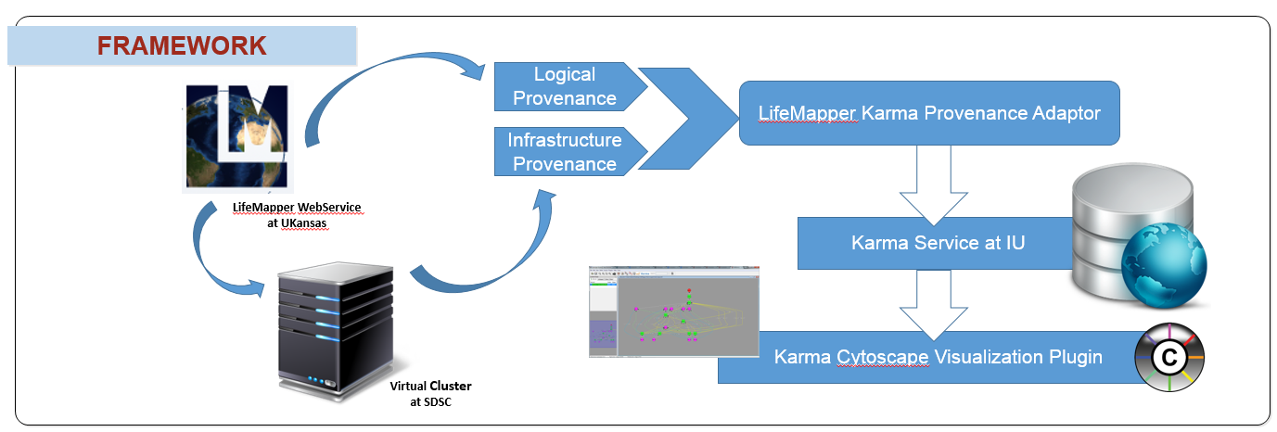
Framework
Notes:
The provenance information collected from LMPF consists of two provenance types: logical provenance and infrastructure provenance. Logical provenance consists of the input data items and executable program or function that creates an output data item inside one job. It can exactly provide users with provenance information about data lineage and version control. Moreover, logical provenance is stored at the granularity of files with the file identifier and metadata for each file. The warnings and errors such as missing parameters in the dataset can be recorded at this granularity level which can address the provenance challenge of checking data quality. Infrastructure provenance, on the other hand, is information about when a job is executed and what parts of the infrastructure were involved in the execution of the job. In this case, information includes machine hardware, software, and activity such as amount of memory, operating system and statistics regarding machine load, etc. This information can be used to address the provenance challenge of failure trace.
parse those log files, capture logical and infrastructure provenance for individual LifeMapper jobs, and aggregates provenance and metadata for the multiple jobs that form an experiment workflow; and 4) returns collected provenance back to the KARMA server at IU for storage. This provenance collection framework also provides users a Cytoscape Karma plugin to access and visualize the provenance information stored in the Karma server.

Slide 5
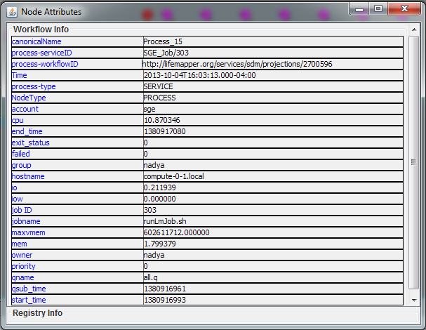
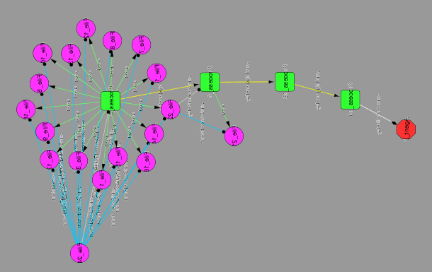
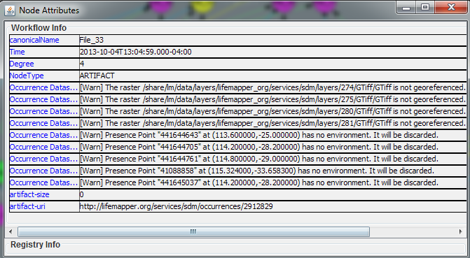
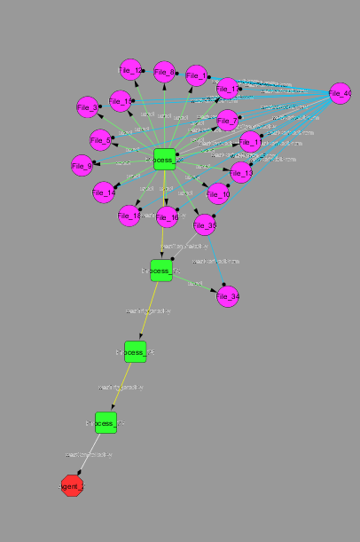
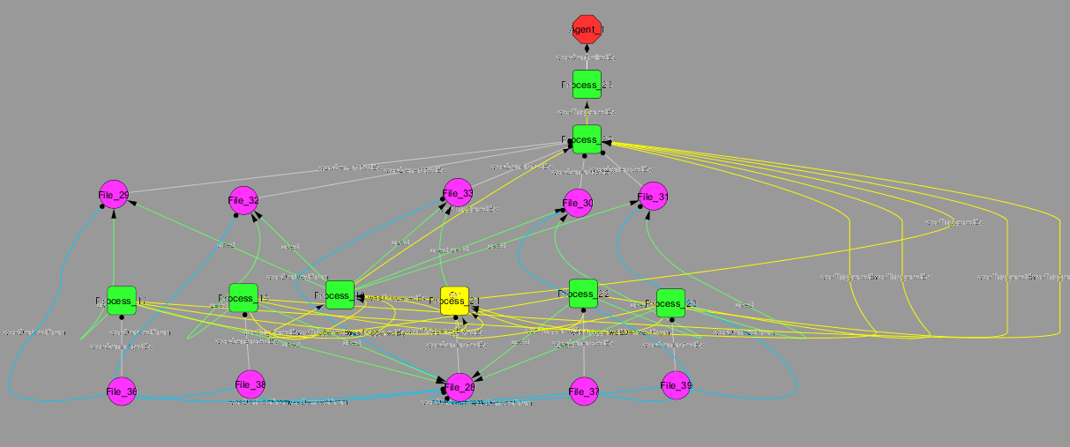
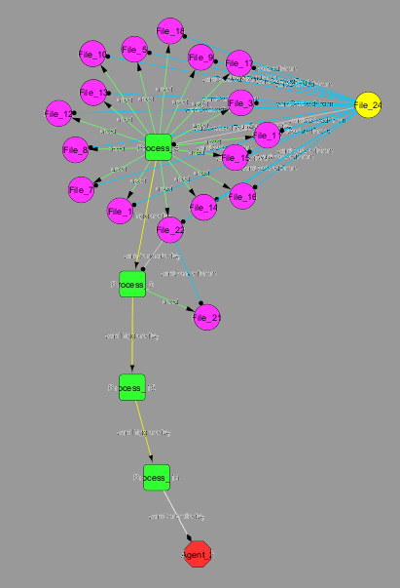
Component Process Provenance
Data Provenance
Process Provenance
Experiment Provenance

Slide 6
Future Work
Extending the Karma adaptor for LifeMapper to perform more system-based gathering of provenance by improving the provenance granularity level
Migrating from Open Provenance Model (OPM) to the W3C PROV data model for provenance representation. PROV allows richer expression of relationships, semantic annotations and semantic inferencing

Slide 7

Thank You !

