Slide 1
Biosciences Working Group
Final Update for PRAGMA 25
Wilfred W. Li, Ph.D., UCSD, USA
Habibah Wahab, Ph.D., USM, Malaysia
Hosted by CNIC, CAS
Beijing, China Oct 16-18, 2013

Slide 2
Breakout Sessions
Presentations (Day 1, 2:40 – 4:15 pm, Rm 514)
  Active Folder
    Daeyoung Heo, Kookmin University
  PRAGMA workshop activities from Konkuk University
    Jaebum Kim, Konkuk University
  IDigBio: Integrated Digitized Biocollections
    Andrea Matsunaga, U Florida
Planning (Day 2, 11:10 am – 12:30 pm)
  UCSD Research Cyberinfrastructure Program
    Wilfred Li, UCSD
Join Sessions (Day 2, 3:50 – 4:30 pm, Cyber Learning)
  Group discussion

Slide 3
Breakout Session 1
Introduction
Registration
  https://groups.google.com/forum/#!forum/pragma-biosciences-working-group
  Search for “PRAGMA Biosciences Working Group” at groups.google.com
  36 members
Other participants
  Ngai Shing Mok, University of Hong Kong
  Dong Hwan Lee, Kookmin University
  Gyu Yeun Choi, Kookmin Univeristy

Slide 4
Active Folder: Integrating All Activities of Simulation on File System
Active Folder – good for case comparative study
  Tasks
    Described as regular folders and files
  Product
    Input or output of simulation
    Can be handled like regular file by using legacy software
    Contains provenance information (meta data, task info, etc)
    Can be reproduced by the task which is extracted from the provenance information
  Resource
    Computing server(Local, Grid, Cloud, what ever, …) is registered as regular folders and files
    To submit a Job(task), just Drag & Drop the task folder to the folder which represents computing server

Slide 5
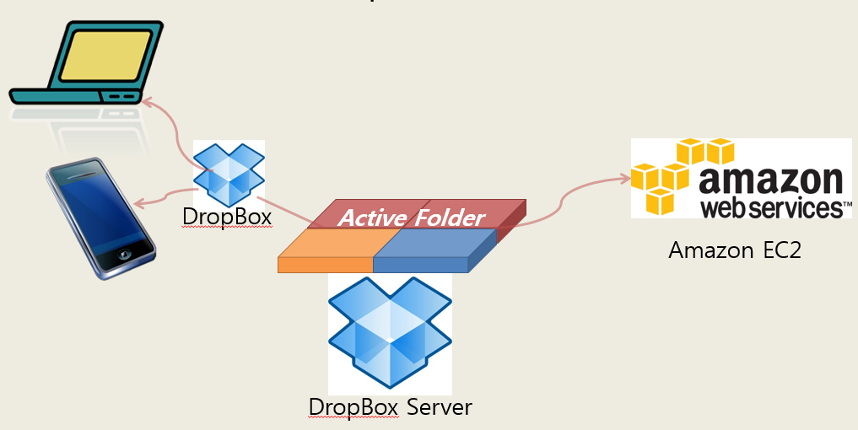
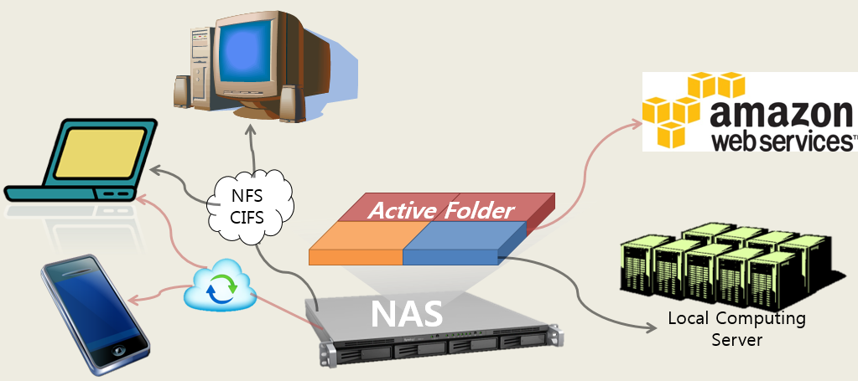
Active Folder: Integrating All Activities of Simulation on File System
  Active Folder on DropBox+EC2
  Cost & Performance Problem with very large files
at PRAGMA 24
at PRAGMA 25
Active Folder on NAS
NAS(Network Attached Storage)
  Large Volume Storage
  Network File System ( NFS, SMB/CIFS, AFP … )
  Most vendors support Cloud solution like DropBox

Slide 6
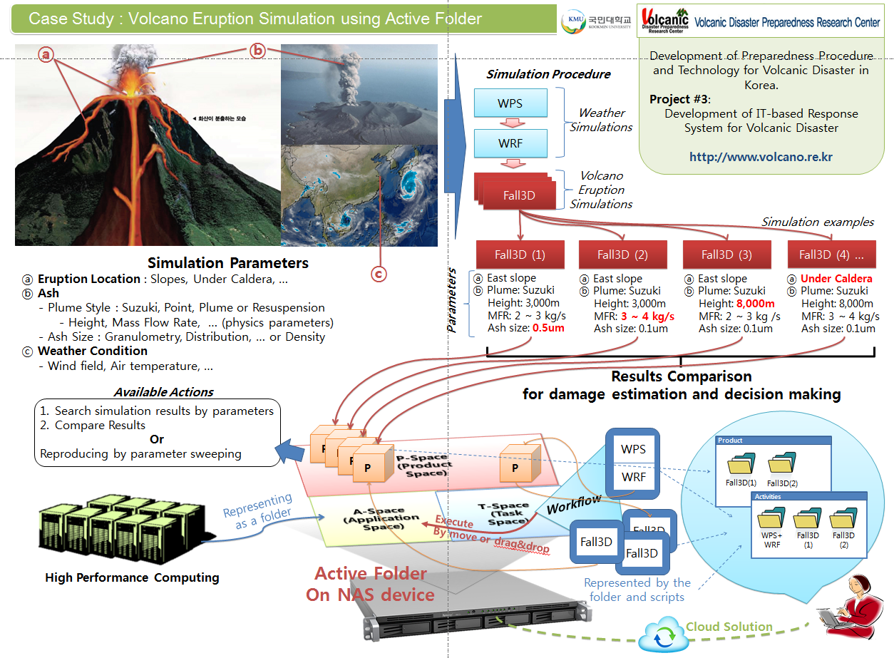

Case Study : Volcano Eruption Simulation using Active Folder

Slide 7
Update from Konkuk University
Prepared a proposal for a government grant
  Development of novel technologies for studying metagenomics based on cloud computing (Institutes: CBRU and BDRC at Konkuk University, SDSC and Calit2 at UCSD)
Workshop proposal for PRAGMA26
  Theme: NGS, Metagenomics, HPC, Clouds and Collaboration, CFP out early next year.
Jaebum Kim Ph.D. (jbkim@konkuk.ac.kr)

Slide 8
Update from Konkuk University
Plan for an international consortium
  Time: Jan. 2014 (tentative)
  Place: Konkuk University, Korea
  Topic: Environment- and toxicity-related microorganism and bioinformatics
  Institutes: UW-METC (Dr. Yu), Konkuk University, and more (tentative)
  More information will be out soon
  If you are interested let us know. We can invite you (jbkim@konkuk.ac.kr)

Slide 9


A Computational- and Storage-Cloud for Integration of Biodiversity Collections
Andréa Matsunaga,
Alex Thompson,
Renato Figueiredo,
Charlotte Germain-Aubrey, Matthew Collins,
Reed Beaman,
Bruce MacFadden,
Greg Riccardi,
Pamela Soltis,
Lawrence Page,
José A.B. Fortes
Supported by NSF Award EF-1115210
PRAGMA 25
Beijing, China
16-18, October, 2013

Slide 10
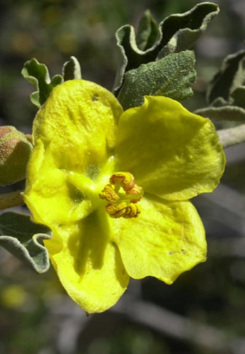

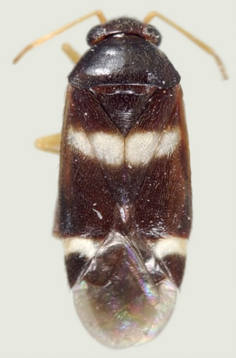
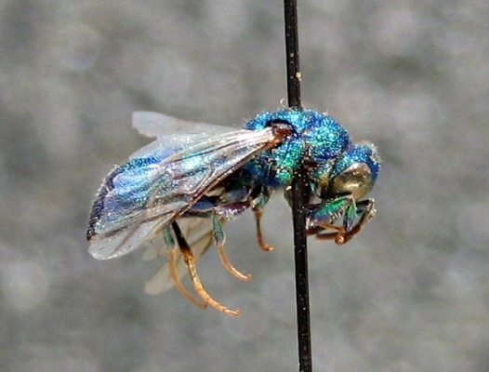
Integrated Digitized Biocollections (iDigBio)
10-year effort to digitize and mobilize the scientific information associated with vouchered specimens held in U.S. neontological and paleontological research collections
InvertNet
Paleoniches
Southwest Collections of Arthropods Network
Tri-Trophic Associations
New England Vascular Plant
North American Lichens and Bryophytes
Macrofungi Collection Consortium
Future TCN
FIC
MHC
Colorado Lichens and Bryophytes
VACS
HUB (Home Uniting Biocollections)
Florida Herbaria
TCN (Thematic Collections Network)
PEN (Partners to Existing Network)

Slide 11


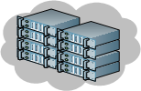
iDigBio Cyberinfrastructure
Flexible to meet the diverse needs of TCNs
Horizontally scalable to meet future demands to access the data
Agile in taking advantage of and integrating proven open-source technologies, thus minimizing system development and maintenance risk
Resilient to certain types of failures
Based on standards where they exist to enable interoperability and reuse of tools, libraries, and services
Community Portal
Specimen Data Portal
Appliances
Project Management
User-facing Application Layer
Web Conferencing
Source Code Management
Web Map Service
Social Media
Data API
Media API
Text Indexing
Geospatial Indexing
Authentication
Cloud Service Layer
HTTP High Availability
HTTP Load Balancing
Relational Database
File System
System Provisioning
System Monitoring and Alerting
Machine Virtualization
Distributed Document Store
Distributed Object Store
Storage
Servers
Hardware Layer
iDigBio Hosting
External Hosting
Network

Slide 12
Breakout Session 2
Developing Sustainable Data Services in Cyberinfrastructure for Higher Education

Slide 13
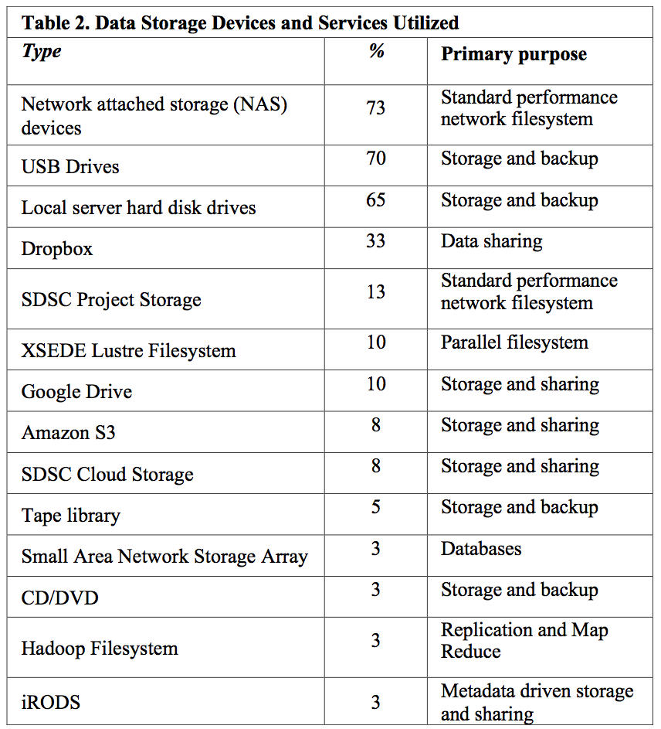
How do You Handle Data Storage/Backup?
Storage Devices
  Network accessible storage (NAS), USB and server local drives dominate
  Use of Dropbox for sharing
  Others use Google Drive, Hadoop, XSEDE, SDSC co-location
  Email attachment
Backup modes
  Replicated copies in two NAS
  A copy in the NAS,
  A copy in local hard drive (laptop/workstation),
  And a copy in a USB drive
  Maybe a copy in email/Dropbox
Problems:
  Out of sync
  Lost track of its location
  Lost version control
  High cost of recovery
  No metadata
Numbers reflect percentages of PIs surveyed that utilize each solution ;
Individual PIs use multiple solutions, so %’s add up to >100%.

Slide 14
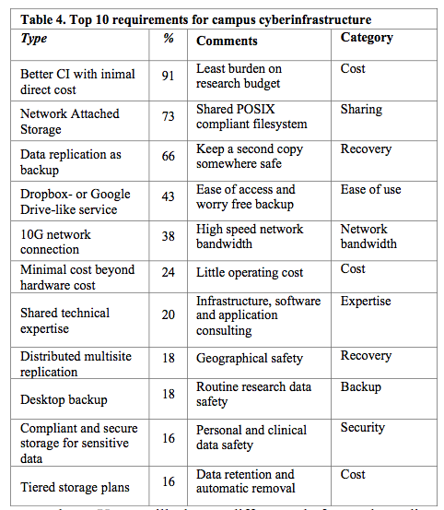
Top 10 Requirements for Campus Cyberinfrastructure
Cost effectiveness tops the list
Ease of use follows
“Cost is King, Ease of Use Follows”
Reliable, NFS/CIFS storage most common platform
Many responses relate to data durability – backups/copies/tiered storage
High-speed networking enhances quality of service
“Compliant” environment (storage/computing)
Tiered storage options is desirable

Slide 15
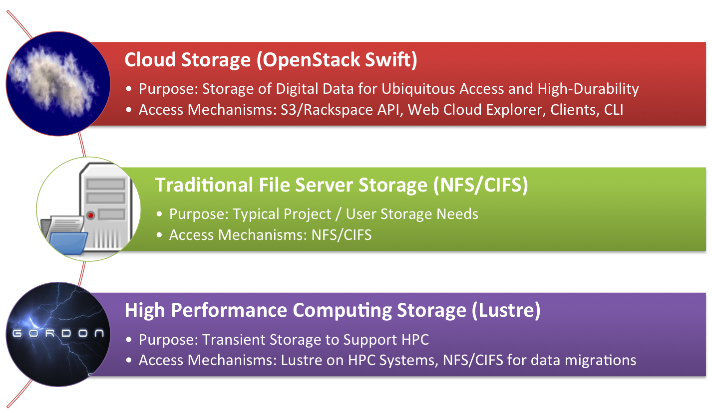

SDSC Data Services
New $12 million dollar award to SDSC, online in 2015

Slide 16

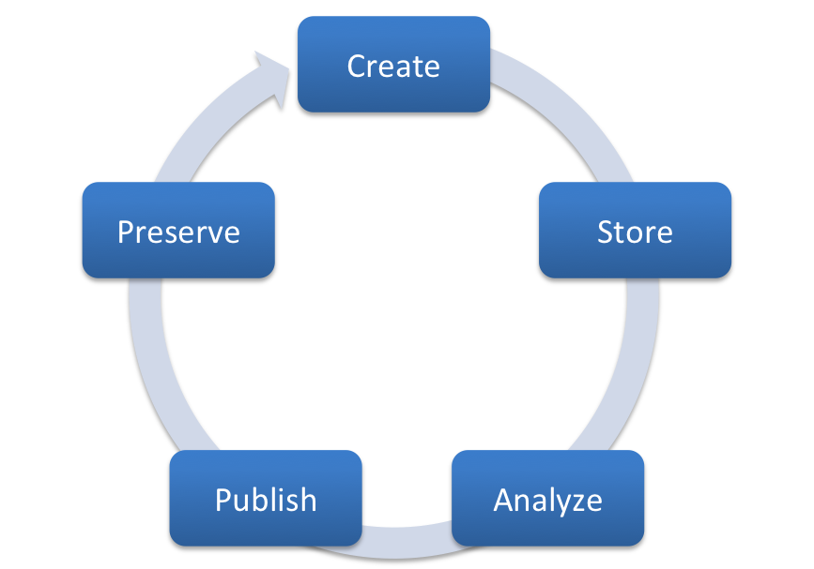


TSCC
Networking
Colocation
Curation
Chronopolis
Storage
Networking
Colocation
Your data
Your data
Curation
Storage
Colocation
SDSC Cloud
TSCC
Curation
Network is everywhere

Slide 17
Planned Activities
Interested in using the virtual clusters in PRAGMA cloud for NGS and metagenomics analysis
  Dr. Jaebum Kim, Konkuk University
Using Globus Online for data transfer to virtual cluster and compute/storage resources
  Dr. Jaebum Kim, Dr. Wilfred Li
Using Active Folder for data synchronization and job execution
  Dr. Daeyoung Heo, Dr. Wilfred Li
Using PRAGMA virtual cluster comprising multiple sites using ViNE for Map Reduce Blast analysis
  Dr. Andrea Matsunaga

Slide 18
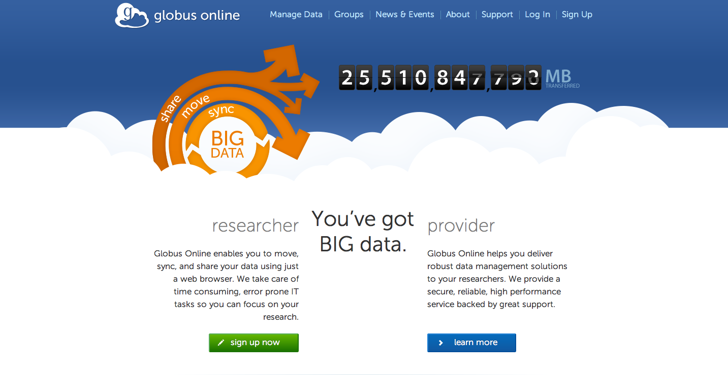
Globus Online, Dropbox for Science

Slide 19
Joint Session
Evaluate the Cyber Learning group resources and Data Synchronization for Research
  Dr. Ruth, Dr. Daeyoung Heo
Planning for next Cyber Learning workshop at next PRAGMA
  Dr. Ruth Lee
Share information on MOOC development in education and learning
  Dr. Putchong Uthayopas, Dr. Wilfred Li

