Slide 1
telescience WG Report
Fang Pang Lin
Shinji Shimojo
Pragma 25

Slide 2
Structure
Day 1
information exchange
Discussion for collaborative project.
Day2
SDN session with Resources
Joint with GeoScience WG

Slide 3
Day1
Jason Haga, “JGC Haiku Project”
Fang-Pang Lin, “Fish4Knowledge”, “OLAP not OLTP”
Yoshiyuki Kido, “SDN usage in SAGE”
Xiaohan Liu (CNIC), “e-science” Environment monitoring system in China, Flux
Mohd Bazil Ab Karim, “Distributed Parallel file system”

Slide 4
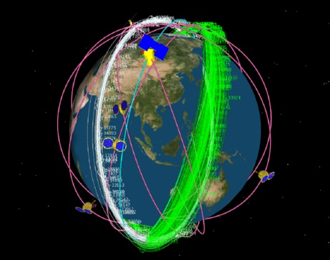
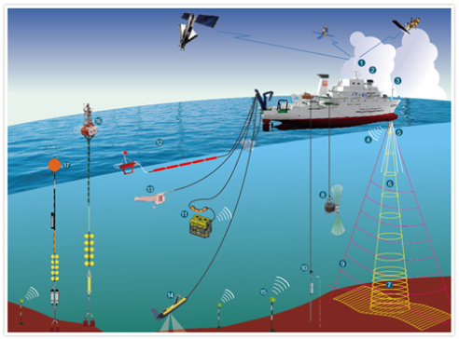
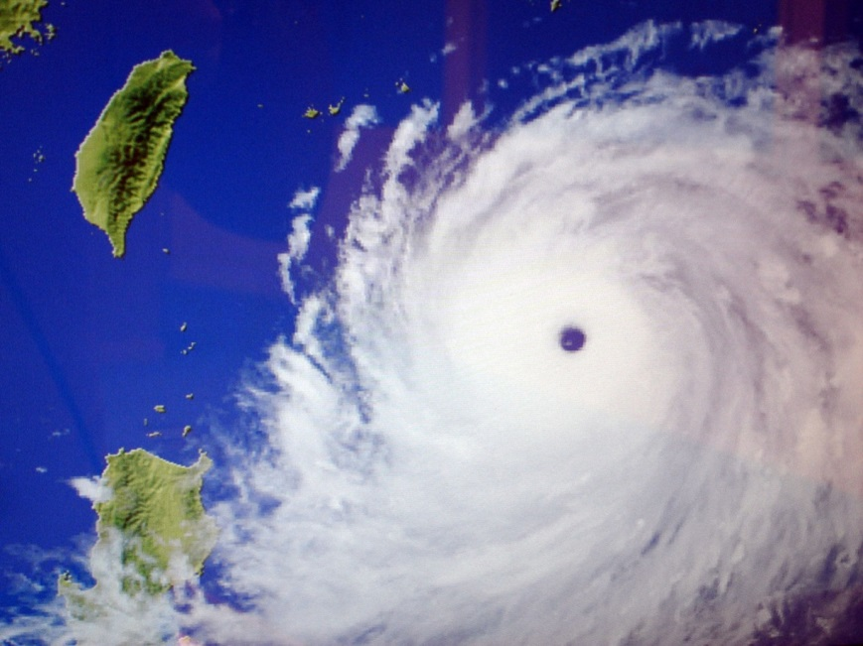
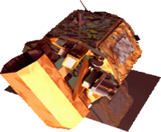
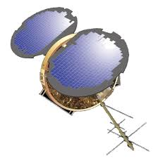
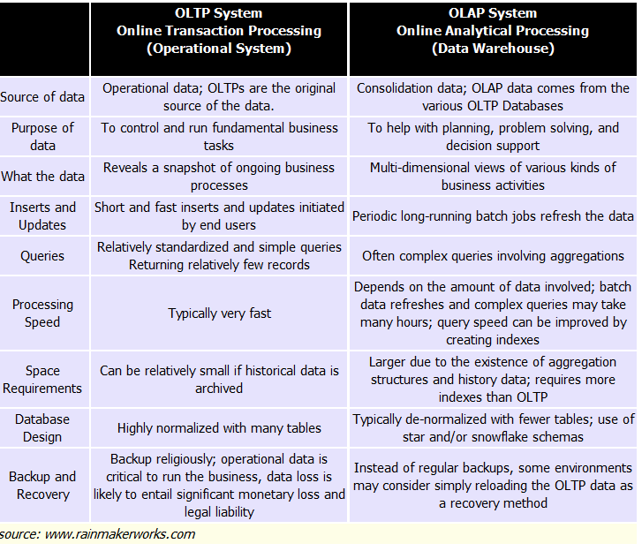
On Line Analytic Process (OLAP) based stores
Most current model stores are build based on the assumption of Transaction Needs.
The store we need nowadays should be for Analytics.
System has to be Real time & Intelligent .
Notes:
Hadoop, parallel file system.
Kasandra
Networking

Slide 5

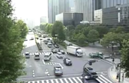



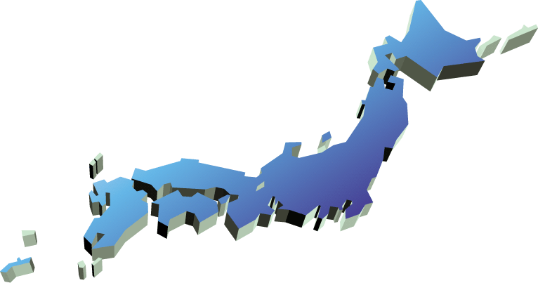

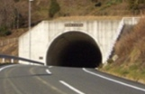
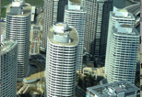
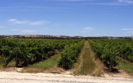


An Overview of JOSE(Japan-wide Orchestrated Smart/Sensor Environment)
Provide a Japan-wide open testbed consists of a large number of wireless sensors, storage and computation resources in distributed data centers connected via high-speed network with SDN feature to establish technologies for practical large-scale smart ICT service platform for future smart society
(Starts from Apr. 2014)
Examples of new technologies to verify：
・Analysis method of real world situation
・M2M/IoT/sensor network algorithms
・Large-scale stream processing methods
・Large-scale network/storage algorithms
Smart Cities
Smart Health
Smart Planet
Smart Living
Future Smart ICT Services
Smart Industry
Smart Structures
Smart Buildings
Smart Agriculture
Field trials
Field trials
Field trials
Provide facilities to verify & evaluate new smart ICT service technologies by the practical field trials on large-scale real environment

Slide 6







System overview of JOSE
Data center in Kyoto
Mgmt segment
Big data archive for cross-domain mining
Data segment
Archive data eliminating privacy information
Internet segment
OpenFlow Switch
FW/IPS
Analysis module
Analysis module for each field trial
Access point module
Yokosuka
Kanazawa
Kyoto
Sensor data
Analysis/Processing for each sensor type
Servers for data processing
Tokyo
Osaka
400Servers/4000VM
400Servers/4000VM
400Servers/4000VM
JGN-X / RISE
Store sensor data for each location
Gateway
modules for each field trial
Servers for data storage / access
FW/IPS
10Servers
10Servers
10Servers
10Servers
10Servers
Vibration
data
Environmental
data
VPN
Vital
data
Internet
Virtualized wireless access point
Camera video stream
Content
GW
Researchers
Participatory
Sensors
Internet
users
Multiple types of wireless sensor network
User terminals
Environmental
sensors
Mobile
sensors
Camera sensors
Notes:
SDN
eco system
sensor scenario
architecture
standard temperature
visualization
Data visualization is a key to tackle heterogeneouty
Use case
smart city
OLAP

Slide 7
Discussion with GeoScience
Disaster mitigation/management system is an OLAP system
Visualization helps people to collaborate.
We need architecture, tools, and experiences.
SEAIP meeting will be next step.

Slide 8
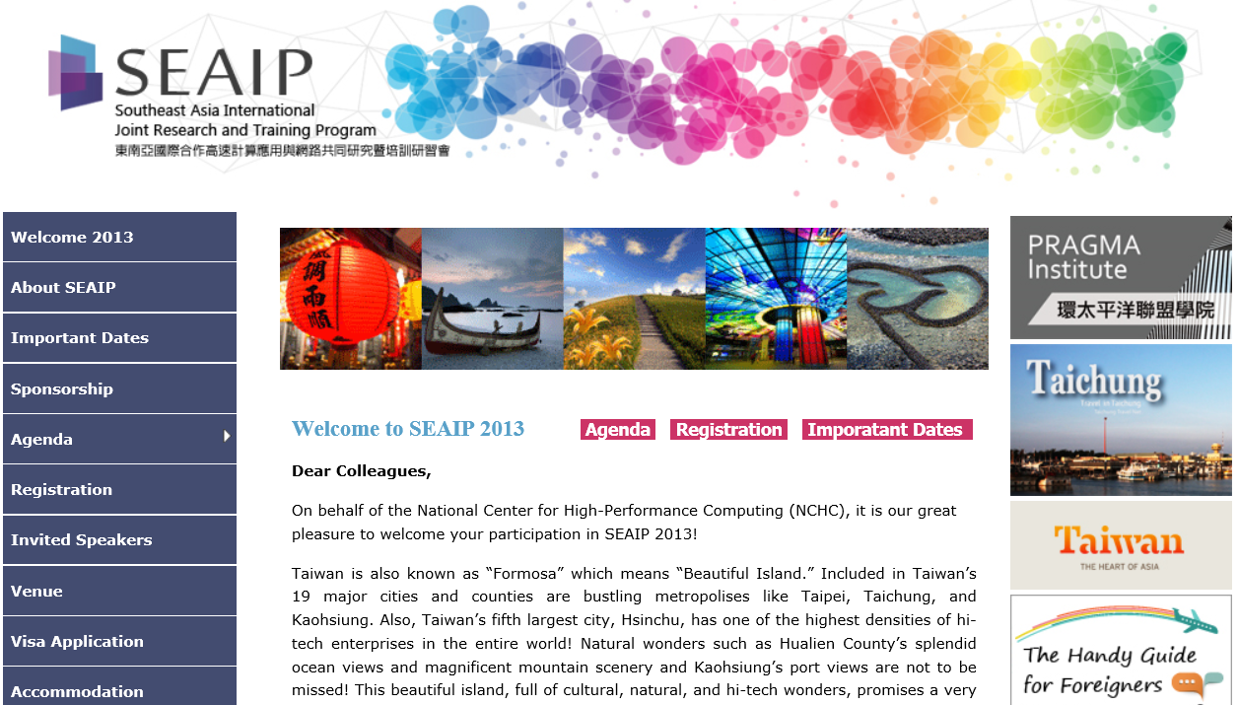
Southeast Asia Joint Discovery (2-6, Dec)

