Slide 1
PRAGMA 25 Working Group Updates Resources Working Group
Yoshio Tanaka (AIST)
Phil Papadopoulos (UCSD)
Most slides by courtesy of Peter, Nadya, Luca, and Pongsakorn

Slide 2
Past, Current, and Future of Resources WG
Phase 1
Succeeded in manual port (sharing) of VM images
2008
2009
2010
2011
PRAGMA16
GT & VOMS
PRAGMA 18
Experiments on Rocks + Xen roll
Phase 2
Automation of the deployment
Use Gfarm for sharing VM images
PRAGMA17
Panel on Grid to Cloud
PRAGMA 19
Extending VM sites
2012
2013
2014
2015
Routine Use of Network Overlay
CI for Scientists
Sustained infrastructure
SDN (OpenFlow, ViNE)
Start using github
Network Overlay
ViNE, IPOP
Phase 3
Expanding sites
Prototyped VC deployments
Phase 4
VC Sharing automation w/ apps
Lifemapper, Docking Simulation

Slide 3
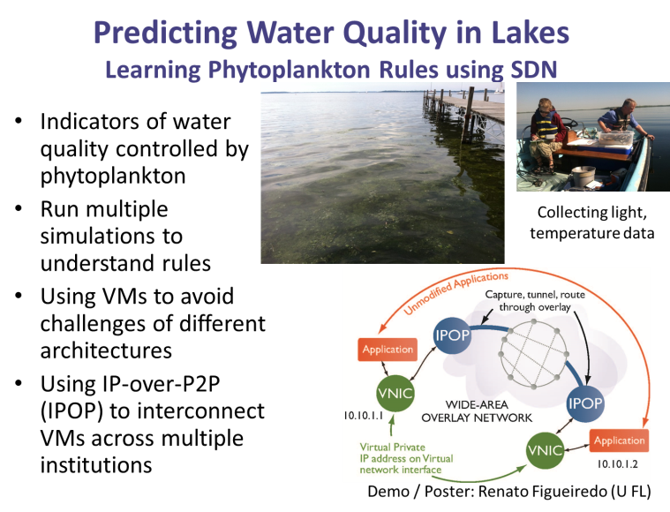
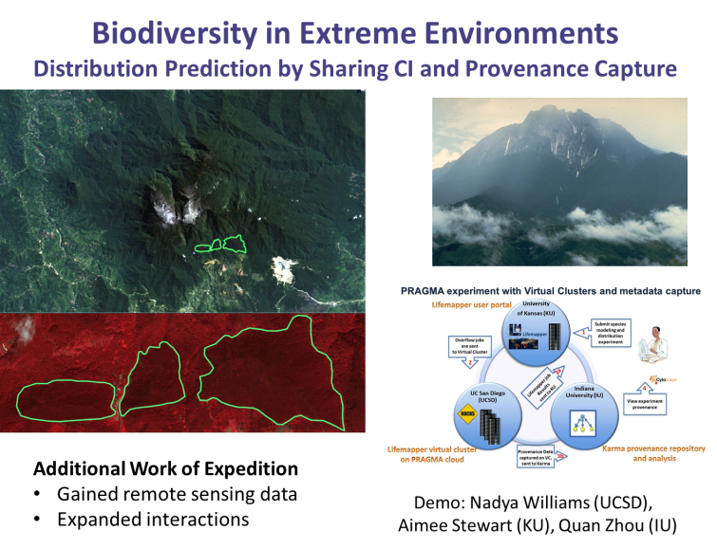
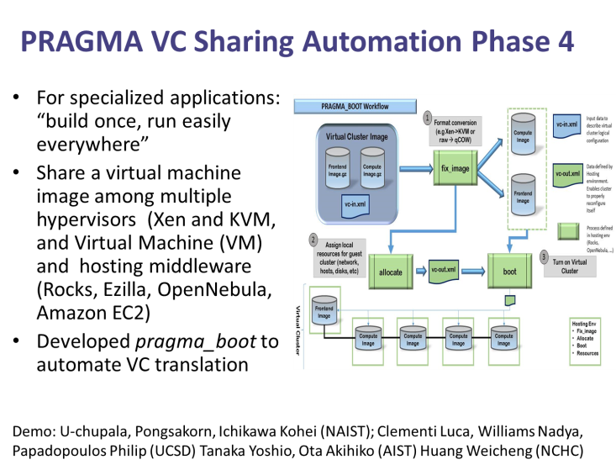
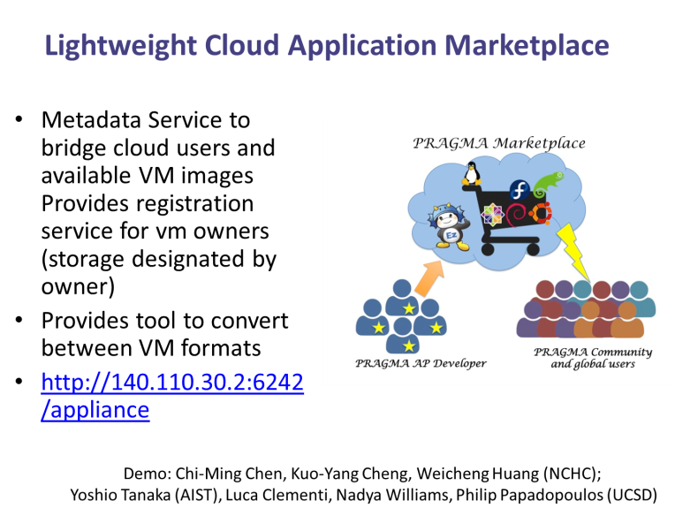
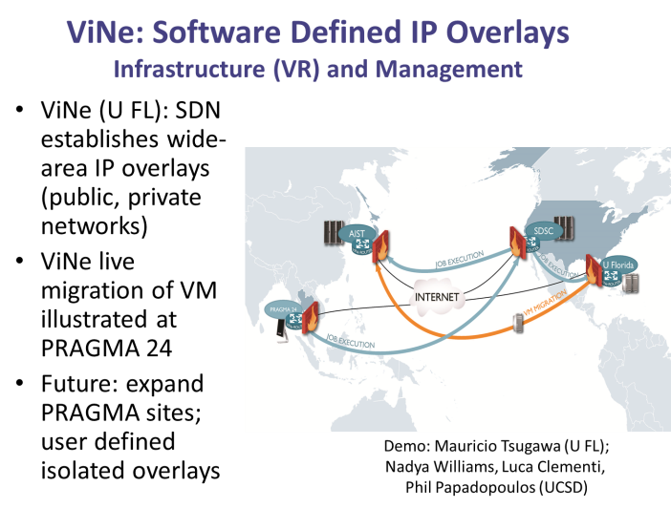
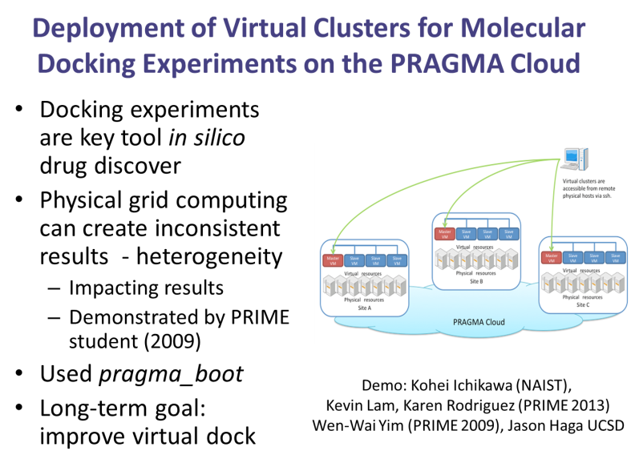
Resources in PRAGMA 25 at a glance

Slide 4
Summary of the 2nd day Discussion @ PRAGMA24
Scenario: Three different labs want to share computing and data
What are the resources (data, computing)
How do they author their software structure (VM/VC) to do what they need (e.g. LifeMapper Compute Nodes)
How do they provide network privacy
How do they control their distributed infrastructure
Main contributors:
Nadya (UCSD), Aimee(KU), Quan (IU)
See the demo today!!

Slide 5





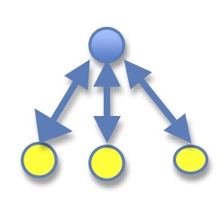
PRAGMA experiment with Virtual Clusters and metadata capture
Lifemapper user portal
University
of Kansas (KU)
UC San Diego (UCSD)
Indiana University (IU)
Submit species
modeling and
distribution
experiment
1
Overflow jobs
are sent
to Virtual Cluster
2
Lifemapper job
Results
sent to KU
3a
4
View experiment
provenance
Lifemapper virtual cluster
on PRAGMA cloud
Provenance Data
captured on VC,
sent to Karma
Karma provenance repository
and analysis
3b
Notes:
Testing does not “destroy” the lifemapper server and a cluster can go down without ill effects on the server

Slide 6
Summary of VC Sharing Discussion @ PRAGMA 24
Demonstrated booting VC images on two cloud hosting environments.
Rocks/KVM by SDSC
OpenNebula/KVM by AIST
Next steps
Review the design of the scripts and re-implement by python.
Do this in San Diego in July (SDSC, AIST, NCHC).
Detailed schedule TBD.
Anybody interested in is welcome to join.
SDN integration with VC (NAIST/Osaka)
Done in Sep. and Oct.
Main contributors:
Luca (UCSD) & Built (KU->NAIST)
See demo tomorrow!!

Slide 7
Rocks Implementation
Virtual Cluster Image
1
Compute
Image
Format conversion
(e.g Xen->KVM or raw qCOW)
Frontend
Image.gz
Compute
Image.gz
injection
Frontend
Image
vc-in.xml
2
Assign local resources for guest cluster (network, hosts, disks, etc)
allocate
boot
vc-out.xml
Frontend
Image
Compute
Image
Compute
Image
Compute
Image
3
Turn on Virtual Cluster

Slide 8
OpenNebula Implementation
Virtual Cluster Image
allocate
Frontend
Image.gz
Compute
Image.gz
1
Inject vc-out.xml generation script
vc-in.xml
2
Translate configurations to OpenNebula format
Frontend
Image
Compute
Image
Configurations
3
Instantiate
Virtual Cluster
OpenNebula
Frontend
Image
Compute
Image
Compute
Image
Compute
Image

Slide 9
Agenda of breakouts
Thursday 14:00-16:15
Discussion: VC sharing
Detailed demo by Luca and Built
Discussion for improvements and next steps based on insights gained through the demonstration
Friday 11:10-12:30
Discussion: CI for Scientists
Detailed demo by Nadya, Aimee, and Quan
Overlay network demo by Renato
Discussion for improvements and next steps based on insights gained through the demonstration
Friday 14:00-15:30
Discussion: What services should PRAGMA provide?
How users use PRAGMA Cloud?
What persistent infrastructure should PRAGMA provide / use?
Github, Gfarm, Marketplace
What kind of services (data, computing, etc.) are available?

