Slide 1
Challenges of deploying Wide-Area-Network Distributed Storage System under network and reliability constraints – A case study
Mohd Bazli Ab Karim
Advanced Computing Lab
MIMOS Berhad, Malaysia
email bazli.abkarim@mimos.my
In PRAGMA Student Workshop
PRAGMA26, Tainan, Taiwan
9-11 April 2014

Slide 2
Outline
Distributed Storage System?
PRAGMA25
DFS over Local Area Network
Ceph vs. GlusterFS
PRAGMA26
DFS over Wide Area Network
DFS over WAN vs. DFS over LAN

Slide 3
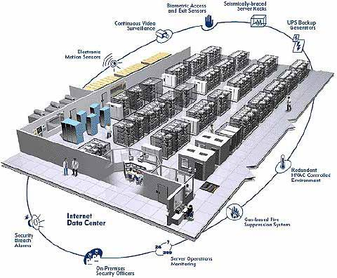

Distributed File System
R/W
SAN/NAS
One/Multiple Virtual Volume(s)
Disaster Recovery Site(s)
Data Striping and Parallel R/W
SAN/NAS
Local/DAS
Local/DAS
...
Local/DAS
Data Center
Data Center 1
Data Center 2
Data Center n
Replications

Slide 4
PRAGMA 25 – DFS on LAN
Dell PowerEdge T110 II
Proc: Intel Xeon E3-1220v2 3.10 GHz
Memory: 8 GB
Hard Drives: Seagate Constellation ES 2TB 7200RPM SATA
RAID Controller: LSI Logic SAS2008
Network: 1GbE
Operating System: Ubuntu 12.04
Ceph: 0.61.7 (Cuttlefish)
GlusterFS: 3.4.0
Experiment Hardware Specification

Slide 5
PRAGMA 25 – Ceph vs GlusterFS

Slide 6
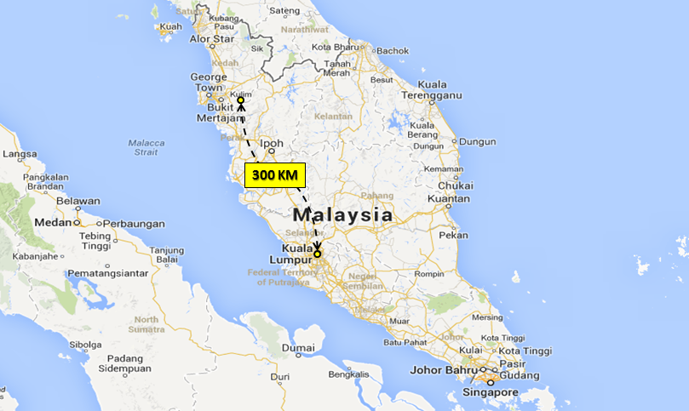

PRAGMA 26 – DFS over WAN
350km
MIMOS Headquarters in Kuala Lumpur and its branch office in Kulim. From Google Map

Slide 7
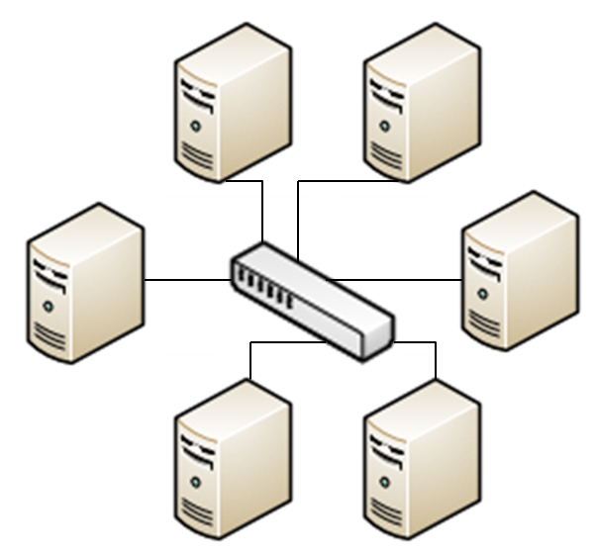


PRAGMA 26 – DFS over WAN (Setup)
OSD
OSD
Datacenter 1 in HQ office
SGI ALTIX XE 310
2 x Dual Core Intel Xeon CPU X5355 2.66 GHz 16 Gb RAM
3.5 SATA Drive 250GB
OSD
OSD
OSD
OSD
OSD
OSD
WAN
CLIENT
MON/MDS
Datacenter 1 in Kulim office
OSD
SGI ALTIX XE 310
2 x Dual Core Intel Xeon CPU X5355 2.66 GHz 16 Gb RAM
3.5 SATA Drive 250GB
OSD
CLIENT
MON/MDS
OSD
OSD
The storage pool was set with 3 replica counts with minimum number of replica counts required is 2.
Datacenter 2 in HQ office
DELL
2 x Dual Core Intel Xeon CPU 5130 2.00 GHz 12 Gb RAM
3.5 SAS Drive 73GB
CLIENT
MON/MDS

Slide 8
PRAGMA 26 - DFS over WAN (Networking)
Round-trip time in ms | Bandwidth (Mbps) | 2 TCP Iperf | Min | Avg | Max | Mdev
DC1 KL to DC1 Kulim | 250 | 96% | 13.149 | 13.491 | 16.167 | 0.684
DC2 KL to DC1 Kulim | 250 | 96% | 13.176 | 14.004 | 17.665 | 1.079
DC1 KL to DC2 KL | 1000 | 86% | 0.422 | 0.490 | 1.203 | 0.136

Slide 9
CRUSH Map - default
root@poc-tpm1-mon1:~/ceph-deploy# ceph osd tree # id weight type name up/down reweight -1 2.12 root default -2 0.23 host poc-tpm1-osd1 0 0.23 osd.0 up 1 -3 0.23 host poc-tpm1-osd2 1 0.23 osd.1 up 1 -4 0.23 host poc-tpm1-osd3 2 0.23 osd.2 up 1 -5 0.23 host poc-tpm1-osd4 3 0.23 osd.3 up 1 -6 0.06999 host poc-tpm2-osd1 4 0.06999 osd.4 up 1 -7 0.06999 host poc-tpm2-osd2 5 0.06999 osd.5 up 1 -8 0.06999 host poc-tpm2-osd3 6 0.06999 osd.6 up 1 -9 0.06999 host poc-tpm2-osd4 7 0.06999 osd.7 up 1 -10 0.23 host poc-khtp-osd1 8 0.23 osd.8 up 1 -11 0.23 host poc-khtp-osd2 9 0.23 osd.9 up 1 -12 0.23 host poc-khtp-osd3 10 0.23 osd.10 up 1 -13 0.23 host poc-khtp-osd4 11 0.23 osd.11 up 1

Slide 10
CRUSH Map Rules - default
# rules
rule data {
ruleset 0
type replicated
min_size 1
max_size 10
step take default
step chooseleaf firstn 0 type host
step emit
}
rule metadata {
ruleset 1
type replicated
min_size 1
max_size 10
step take default
step chooseleaf firstn 0 type host
step emit
}
Pick one leaf node
of type host

Slide 11
CRUSH Map - New
root@poc-tpm1-mon1:~/ceph-deploy# ceph osd tree # id weight type name up/down reweight -1 2.12 root default -23 0.92 datacenter tpm1 -2 0.23 host poc-tpm1-osd1 0 0.23 osd.0 up 1 -3 0.23 host poc-tpm1-osd2 1 0.23 osd.1 up 1 -4 0.23 host poc-tpm1-osd3 2 0.23 osd.2 up 1 -5 0.23 host poc-tpm1-osd4 3 0.23 osd.3 up 1 -24 0.28 datacenter tpm2 -6 0.06999 host poc-tpm2-osd1 4 0.06999 osd.4 up 1 -7 0.06999 host poc-tpm2-osd2 5 0.06999 osd.5 up 1 -8 0.06999 host poc-tpm2-osd3 6 0.06999 osd.6 up 1 -9 0.06999 host poc-tpm2-osd4 7 0.06999 osd.7 up 1 -25 0.92 datacenter khtp1 -10 0.23 host poc-khtp-osd1 8 0.23 osd.8 up 1 -11 0.23 host poc-khtp-osd2 9 0.23 osd.9 up 1 -12 0.23 host poc-khtp-osd3 10 0.23 osd.10 up 1 -13 0.23 host poc-khtp-osd4 11 0.23 osd.11 up 1

Slide 12
CRUSH Map Rules – New
# rules
rule data {
ruleset 0
type replicated
min_size 2
max_size 10
step take default
step chooseleaf firstn 0 type datacenter
step emit
}
rule metadata {
ruleset 1
type replicated
min_size 2
max_size 10
step take default
step chooseleaf firstn 0 type datacenter
step emit
}
Pick one leaf node
of type datacenter

Slide 13
DFS on WAN vs. DFS on LAN

Slide 14
Hypothesis:
Write performance is slower than read performance. This is due to write operation requires a creation of new file and also to store overhead information known as metadata, which typically consists of directory information, and space allocation.
DFS IO performs better in LAN compared to WAN due to limited capacity of WAN bandwidth and its latency, jitter etc.
Results:
DFS in LAN provides better overall I/O rates compared to DFS in WAN due to its better network connectivity and bandwidth size.
DFS in WAN scores better in writing 64K and 128K block sizes compared to DFS in LAN.
Analysis:
DFS in WAN performances in I/O is still acceptable e.g. smaller files size with 16K, 32K, 64K, 128K block sizes, where DFS in LAN only performs slightly better than in WAN.

Slide 15
Summary
Distributed file system in wide area network works at acceptable I/O rates and it is ideal for usage of smaller file sizes.
Investigating distributed file system in wide area network, focusing on features like:
support cloud deployment architecture,
ability to provide parallel read and write operations on a distributed file system with different geographical locations.

