Slide 1
An Integrated Computing Platform Prototype Supporting In Silico Drug Discovery Activities
^{Authors:}
Ari Wibisono, Muhammad H. Hilman, Alhadi Bustamam,
Arry Yanuar, Kevin Burrage, Xue Li, and Heru Suhartanto
Presented at : PRAGMA26, Tainan, Taiwan
by Heru Suhartanto and Arry Yanuar

Slide 2
background
In our world, there are about 40,000 species of plants, of which 30,000 species live in the islands of Indonesia. Among the 30,000 species of plants that live on the islands of Indonesia, it is known that there are at least 9600 species of medicinal plants. [Braz, 2010, Cotelle, 2006]. Focus -> insilico drug discovery based on medical plants.
Succesfull facts:
Computational Based Drug Design accelerates the process of discovery of new drugs. Raltegravir, an antiretroviral drug to HIV-1 infection, was identified through a process using computational docking program AutoDock in 2004 by Prof. McCammon (Schames et al., 2004).
It has obtained a license for clinical use by the FDA on October 12, 2007 (merck.com, 2007). Raltegravir acts as integrase inhibitor, where integrase is an enzyme that presents only in viruses that play a role in the introduction of genetic material (DNA) into host cell DNA (human).
Challenges
Reliable, achievable, easy to use preparation environment, high performance computing resources integrated with medical plant database

Slide 3
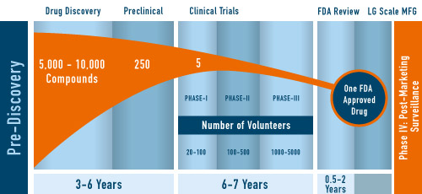
Another target: Speeding up Drug Development Process

Slide 4
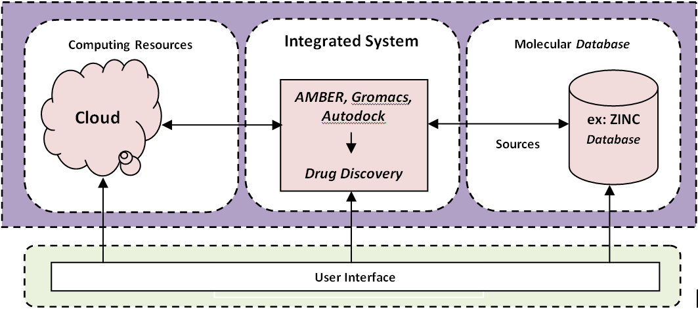
The Design

Slide 5
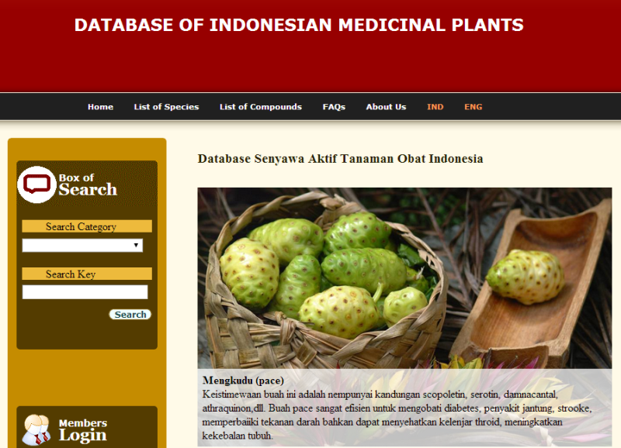
Previous Results
http://herbaldb.farmasi.ui.ac.id/

Slide 6
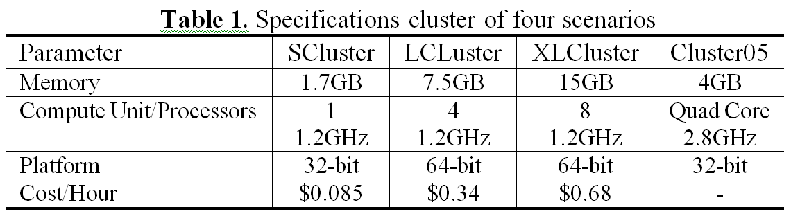
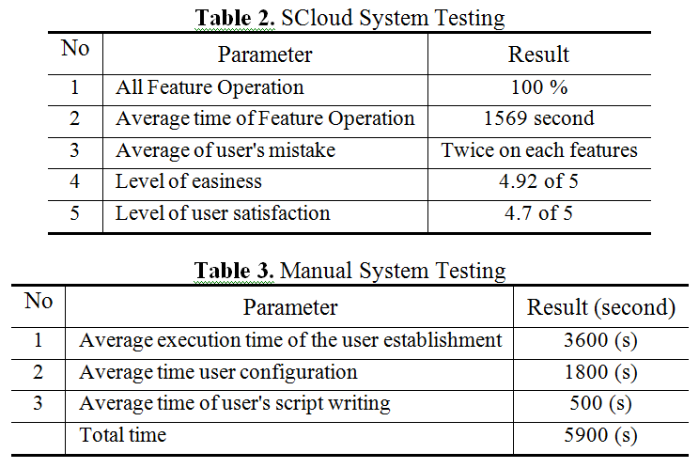
Previous Results : Infrastructure and user acceptance tests

Slide 7
Previous Results : Virtual Screening of Indonesian Herbal Database as HIV-1 Reverse Transcriptase Inhibitor
Rezi Riadhi Syahdi, Abdul Mun’im,
Heru Suhartanto, Arry Yanuar, Bioinformation 8(24), 2012:
top ten compounds were
mulberrin, plucheoside A, vitexilactone, brucine N-oxide, cyanidin 3-arabinoside, alpha-mangostin, guaijaverin, erycristagallin, morusin and sanggenol N.

Slide 8
Recent Results : Virtual Screening of Indonesian Herbal Database as HIV-1 Protease Inhibitor
Arry Yanuar1*, Heru Suhartanto2, Abdul Mun’im1, Bram Hik Anugraha1 & Rezi Riadhi Syahdi1,, Bioinformation 10(2), 2014:
top ten compounds were
8-Hydroxyapigenin 8-(2'',4''-disulfatoglucuronide), Isoscutellarein 4'-methyl ether, Amaranthin, Torvanol A, Ursonic acid, 5-Carboxypyranocyanidin 3-O-(6''-O-malonyl-beta-glucopyranoside), Oleoside, Jacoumaric acid, Platanic acid and 5-Carboxypyranocyanidin 3-O-beta-glucopyranoside.

Slide 9
Future works
Accomodating GPUs into the infrastructure,
Building automated workflow of drug discovery activities.
Improving user interface of the molecular database system.
Analyzing the performance of commercial cloud as computational resource.
Bridging each entities with interfaces to provide access,
Continuing with in vitro activities….

