Slide 1
Towards Multi-domain Virtual SDN Testbeds
Hiroaki Yamanaka, Eiji Kawai, Shuji Ishii,
and Shinji Shimojo
National Institute of information and Communications Technology (NICT)
2014/04/11

Slide 2

Self-introduction
A researcher in National Institute of Information Communications Technology (NICT)
Research interest: SDN, network virtualization
NICT provides a wide-area SDN testbed in Japan
Research Infrastructure for Large-Scale Experiments (RISE)

Slide 3
PragmaENT and Virtualization
PragmaENT is a multi-domain SDN infrastructure
Virtualization is necessary to support multiple experiments on shared infrastructures
Large-scale virtual SDN testbeds over multi-domain infrastructures
Experiment X
Experiment Y
Experiment Z
Virtualization
SDN infrastructures
Domain of Univ. A
Domain of Univ. B
Domain of Univ. C

Slide 4
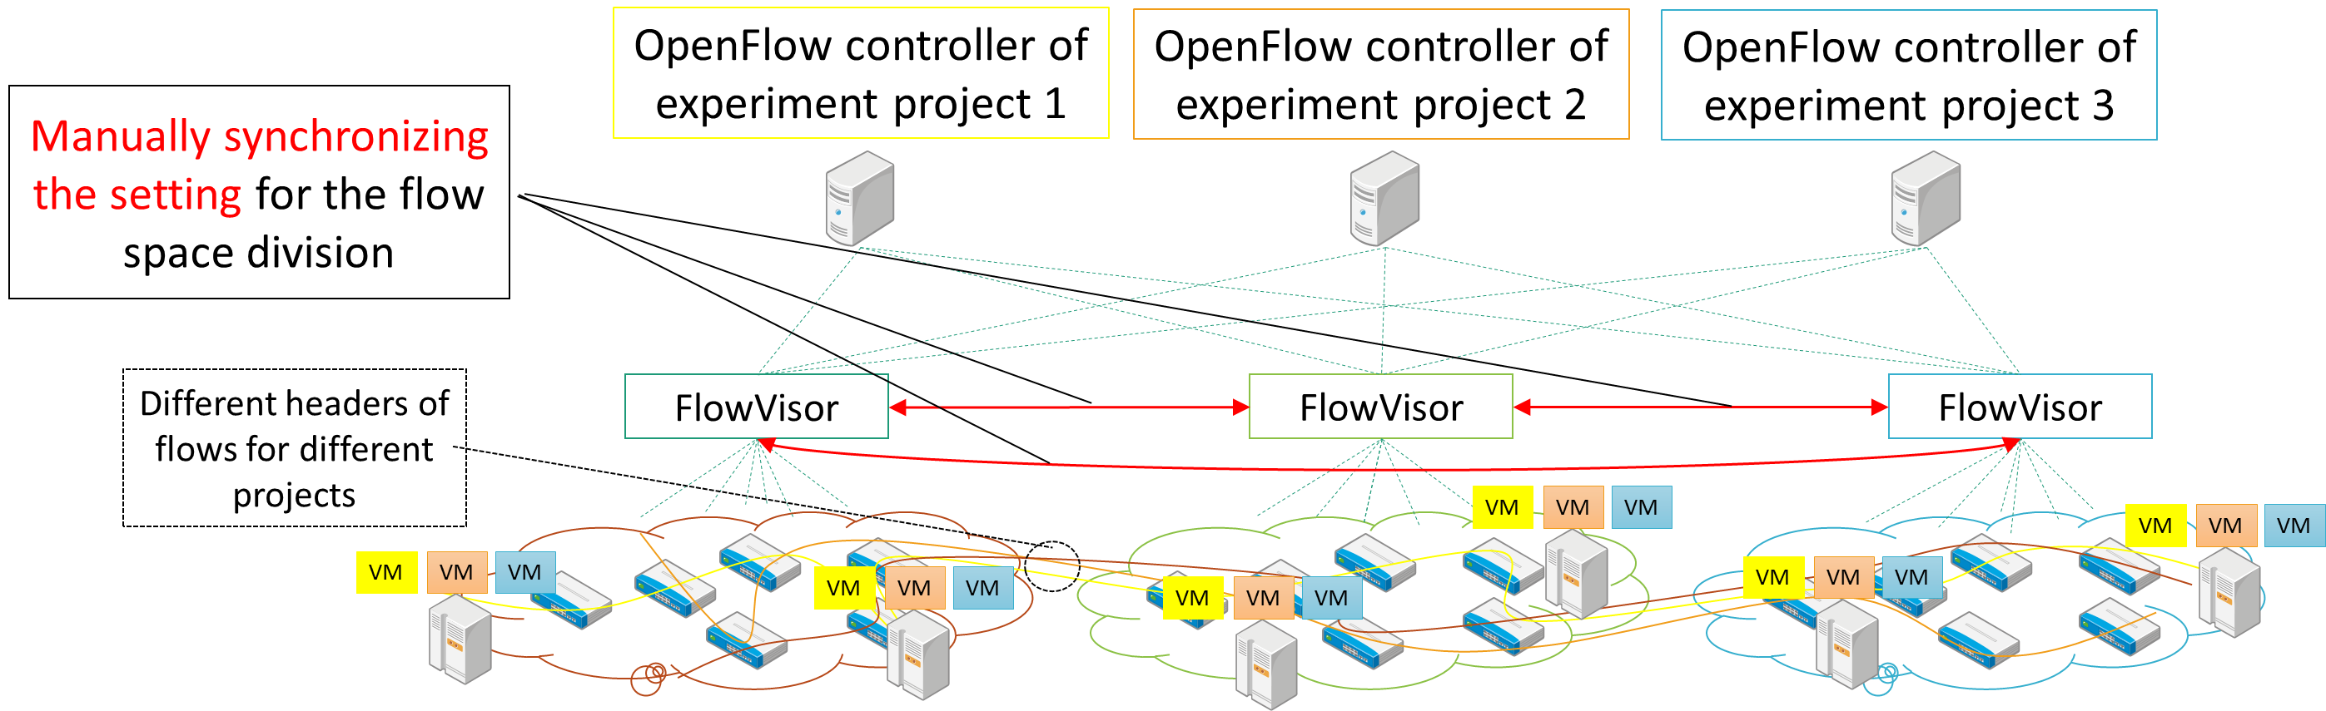
An issue to deploy Virtualization
FlowVisor
Setting the division header value (i.e., MAC, IP, TCP/UDP addresses) space for each experiment project is required
Manual synchronization of the setting for division in all domains is required
High operational costs

Slide 5
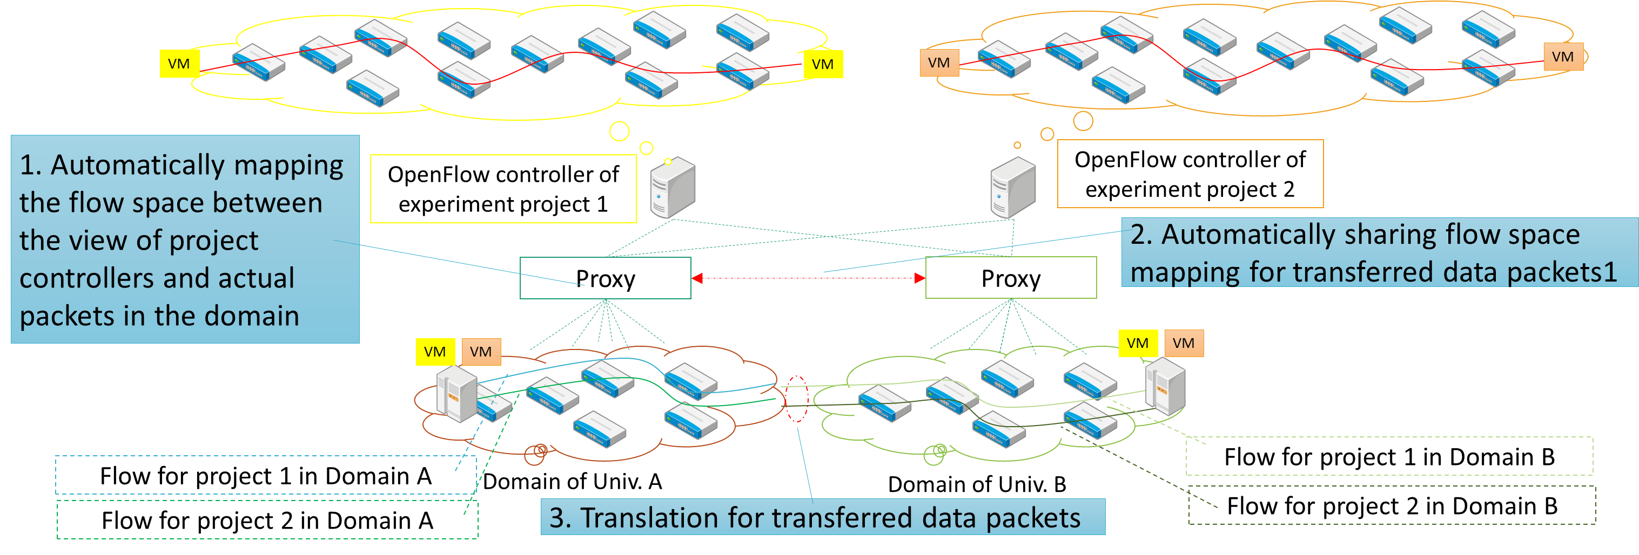
A proposal to reduce operational costs
Virtualizing the flow space => no need to consider the header value division
Automatically synchronize the setting => no need to manual synchronization of setting
Lowering the operational costs

Slide 6
Status and Future Plan
Just finished development of the prototype
Now I am setting the prototype on RISE for my experiments
I believe the proposed technique recues the operational costs in PragmaENT.
Detailed discussion is appreciated.
I have a poster in front of the room 4.

