Slide 1

Simulation-based Cyber-Learning/
Distance Education WG Update
Sept. 9, 2016
Ruth J Lee (KISTI),
Hsi-ching Lin (NCHC),
Putchong Uthayopas (KU)

Slide 2
1. Review of CL/DE WG@PRAGMA 30
Breakout Session I : 14:00~15:30, Sept. 08(Thur), 2016 @ Hall
  Participants : 6 People from US(1), Taiwan(1), Indonesia(1) and Korea(3)
  Presentation and Demo on EDISON and by Ruth Lee
  Discussions on how to collaborate with each other, how to contribute to the PRAGMA community and etc
Demo : 13:45~14:10, Sept. 09(Fri), 2016
  EDISON 2.0 : Toward a Science Open Platform for Online HPC simulations in Computational Science and Engineering
Breakout Session II : 14:30~16:00, Sept. 09(Fri), 2016
@ Hall
    Participants : 6 People from Indonesia, HongKong, Taiwan and Korea
    Discussion how to install and use EDISON platform in their own countries
    Discussion about initiating the EDISON user community in PRAGMA

Slide 3
2. To do list by PRAGMA 32 and afterward
Try to translate and upload User/Install/Developer’s manual in English
Try to use EDISON portals in your area
  EDISON portals: EDISON_CFD, EDISON_Chem & EDISON_NanoPhysics
  Try to deploy EDISON platform 2.0 on top of the PRAGMA resources
  Upload any materials such as simulation SWs and contents developed by member of PRAGMA community who are willing to share and open among us
Other things to do and continuously consider …
  How to get more people interested in simulation-based CL/DE WG from PRAGMA members?
  How to and what to collaborate and integrate with other WGs?

Slide 4
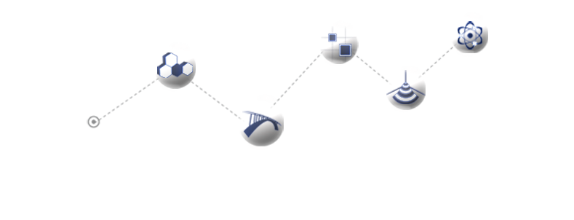
Thank You!!!

