Slide 1
Japan-Taiwan Satellite Image Transmission through PRAGMA Network testbed
Kohei Ichikawa (NAIST), Shinji Shimojo (Osaka University), Stoca Chang, Li-Chi Ku, Whey-Fone Tsai, Fang-Pang Lin (NCHC)

Slide 2
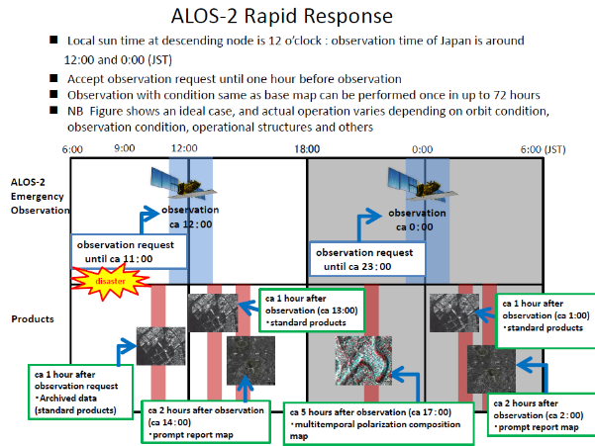
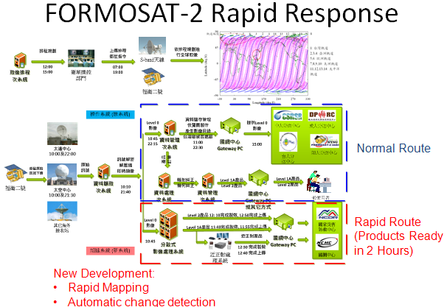
Satellite Image Rapid Response to Disaster Event
Satellite image transmission for rapid response to natural disasters, such as tsunami and earthquake is very critical in Asia Pacific areas. JAXA, Japan and NSPO, Taiwan have planned for possible collaboration of multiple satellites.
Application case: Emergency Observation and Near real-time satellite image processing are critical for supporting to disaster response between Japan (Tsunami, Earthquake) and Taiwan (Flood, Landslide).
Complementary utilization of SAR (ALOS-2) (Operated by JAXA, Japan) and Optical (FORMOSAT-2) satellite image. (Operated by NSPO, Taiwan)
SAR
Optical

Slide 3
Emergency Observation
Complementary utilization of SAR (ALOS-2) and Optical (FORMOSAT-2) satellite image
Rapid Response
ALOS-2: accept EO request until one hour before observation, and provide data one hour after observation.
FORMOSAT-2: accept EO request until 13:00, and provide data two hours after observation.
Satellite Image transmission speed and efficiency in oversea affect the time of response to a natural disaster.
*Synthetic-aperture radar (SAR) is a form of radar which is used to create images of an object, such as a landscape. SAR can penetrate cloud during observation.

Slide 4
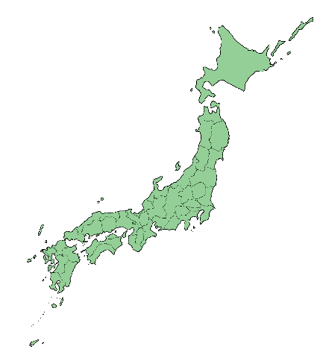
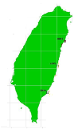
Idea Plan (unofficial) for Satellite Image Receiving & Oversea Transmission for data sharing between two satellites.
Satellite image receiving
Satellite image receiving
NSPO
Tokai U.
NCHC
NAIST/Osaka U.
PRAGMA Network Testbed
First stage to test the performance of Network for image transmission between NAIST/Osaka U. and NCHC>

Slide 5
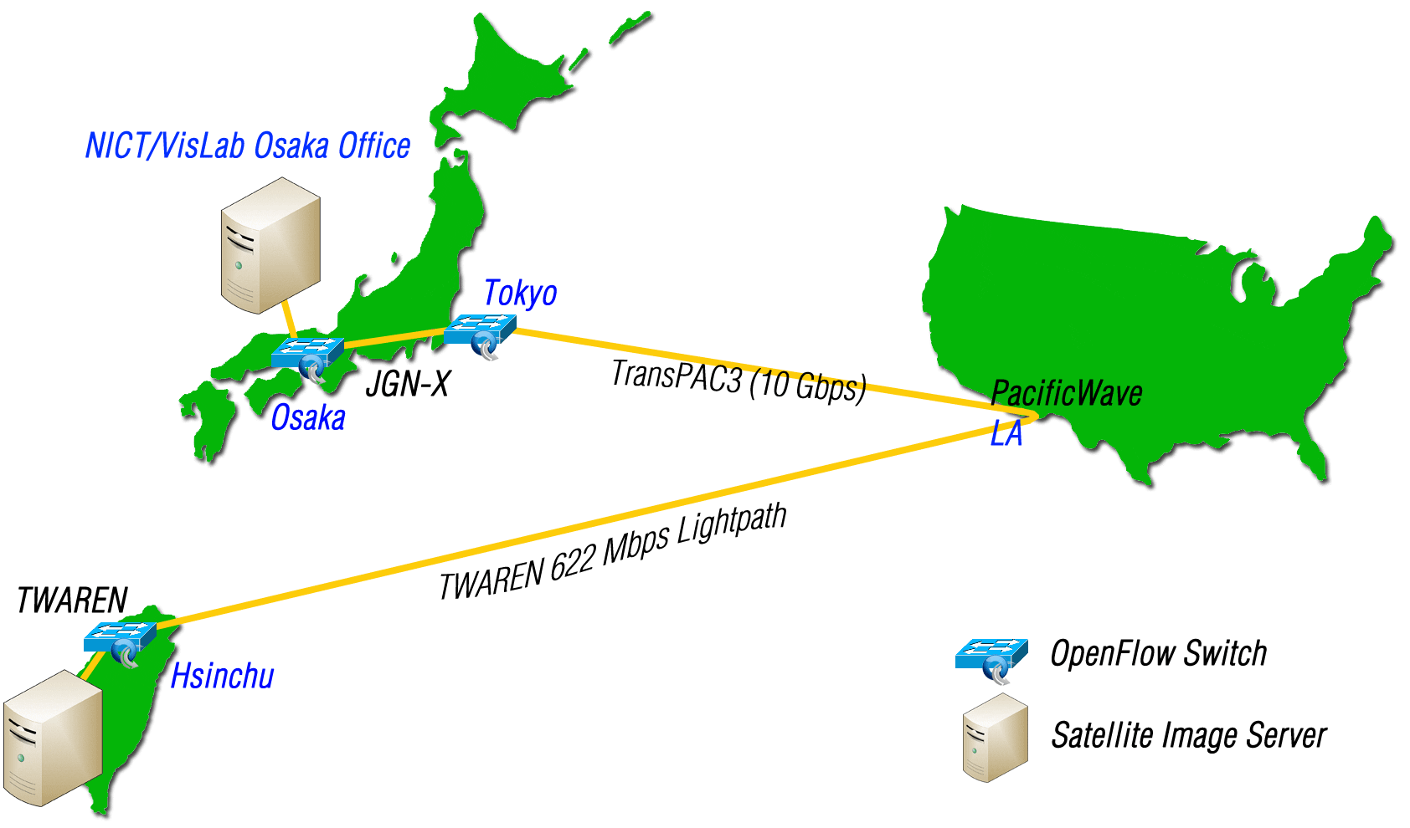
Network Topology
Through PRAGMA-ENT testbed (end to end SDN)
TWAREN and JGN-X direct peering in Los Angeles
Using a dedicated 622 Mbps lightpath

Slide 6
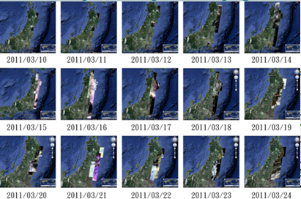
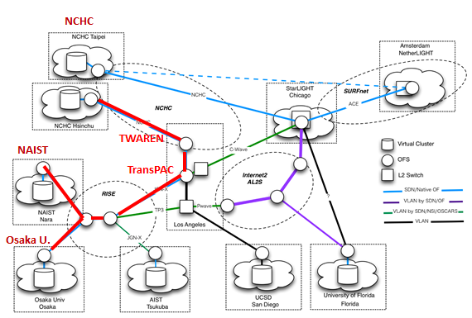
Satellite Image Transmission through PRAGMA Network Testbed
Collaborators: Kohei Ichikawa (NAIST), Shinji Shimojo (Osaka U.), Stoca Chang (NCHC), Li-Chi Ku(NCHC), Whey-Fone Tsai (NCHC), Bo Chen (NSPO), Fang-Pang Lin (NCHC)
This DEMO connecting network between NAIST & Osaka U-Umeda and NCHC through access of the PRAGMA network testbed via TWAREN and TransPAC networks in oversea.
Formosat-2 Satellite images associated with 2011 Tohoku earthquake are used as the demo case for performance study of the network testbed.

Slide 7



Demo environment
Virtual Network Slices
User OpenFlow Controller
User OpenFlow Controller
AutoVFlow
Slice plane
Japan&NCHC
AutoVFlow
UCSD
AutoVFlow
UF
AutoVFlow
Data plane

Slide 8
FS-2 IMAGE for Japan Earthquake
Method:
rsync
Data set:
Total size: 10.7 GB, 59 files.
Dataset details:
1. Aomori(青森市): 5 files, 422 MB.
2. GOI (五井,市原市): 1 file, 10.2 MB
3. Japan Enhancement: 8 files, 6.18 GB.
4. Iwate(岩手縣) : 39 files, 3.18 GB.
5. Sendai(仙台市) : 6 files, 922 MB.

Slide 9
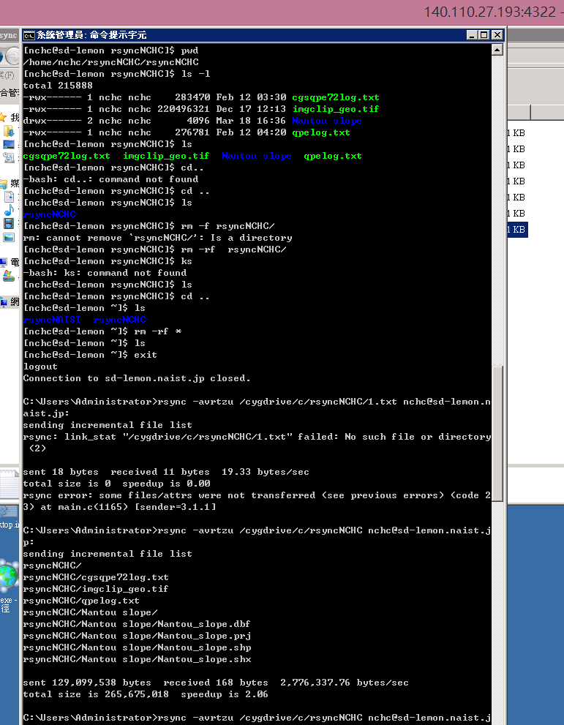
Network speed test: CASE 1 (Internet)
NCHC -> NAIST
Data: 260 MB
Speed (Internet):
2.06 MB/s
Time: 2min/10sec

Slide 10
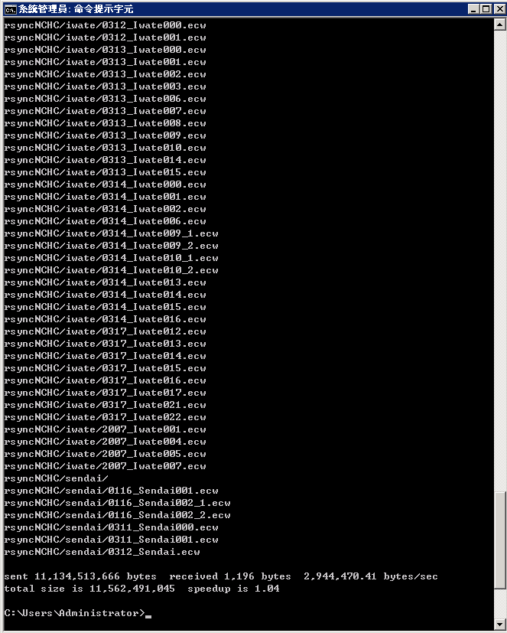
Network speed test: CASE 1 (Internet)
NCHC -> NAIST
Data: 10.7 GB
Speed (Internet):
2.94 MB/s
Time: 1hour/3min/2sec

Slide 11
Network speed test: CASE 2 (PRAGMA NETWORK TESTBED)
NCHC -> NAIST
Data: 3.54GB
Speed (PRAGMA):
5.43 MB/s
Time
10min/51.5sec

Slide 12
Network speed test: CASE 2 (PRAGMA NETWORK TESTBED)
NAIST -> NCHC
Data: 442MB
Speed (PRAGMA):
6.11 MB/s
Time
72.49sec

Slide 13
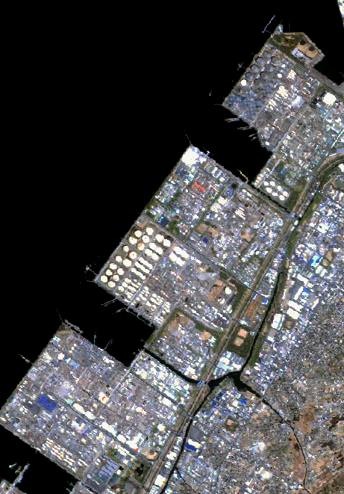
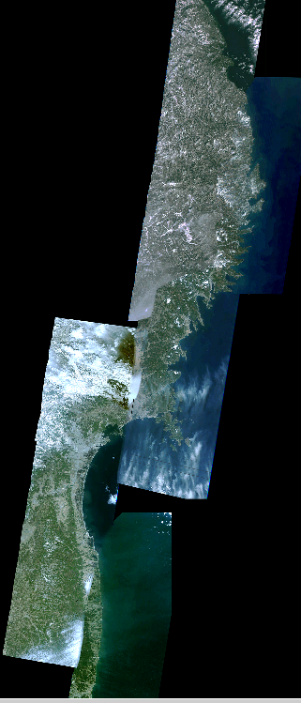
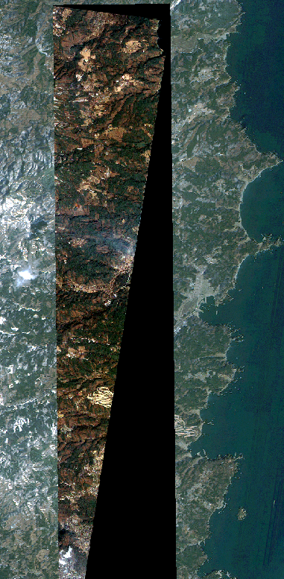
Japan enhancement
(Tsunami area)
GOI (五井,市原市)
Sendai

