Slide 1
How to Find Research Topics in Computer Science
Kohei Ichikawa
ichikawa@is.naist.jp
2015/04/08

Slide 2
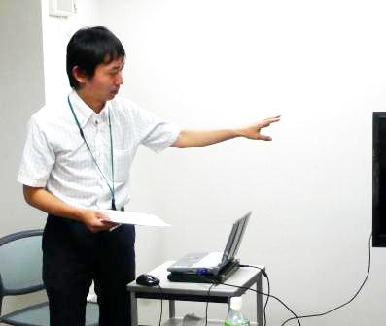
Speaker:
Kohei Ichikawa
(市川昊平)

Slide 3
How to Find Research Topics?

Slide 4
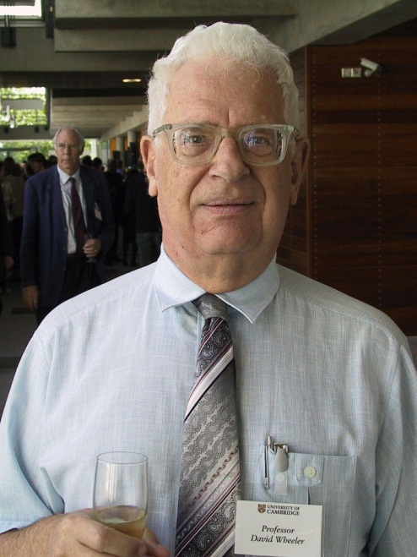
A famous phrase of
David Wheeler:
All problems in computer science can be solved by another level of indirection
Notes:
but that usually will create another problem

Slide 5
All problems in computer science can be solved by another level of indirection
but that usually will create
another problem

Slide 6
An example at that time…. Pointer
10
func(a)
Variable: a
{10, 11, 12,…}
{key=>”aa”, value=>”bb”,…}
func(p)
reference
Variable: a
Pointer: p

Slide 7
{10, 11, 12,…}
Another level of indirection
{key=>”aa”, value=>”bb”,…}
func(p)
reference
Variable: a
Pointer: p
Advantage:
Easy to pass a large dataset
Allows the func to modify the original data
Disadvantage:
Introduces improper memory access & operation

Slide 8



Virtualization
Programmable control for resource assignment
Dynamic assignment
Automation
Improve utilization
Apps
Apps
Apps
OS
OS
OS
New
VM
VM
VM
Hypervisor
Physical machine
Resource Pool
Many CPUs
Large Storage
Wide Network
Cloud Data Center

Slide 9
Another problem
Apps
Apps
Apps
OS
OS
OS
Overhead:
CPU (calculation)
Memory access
Storage access
Network access
New
VM
VM
VM
Hypervisor
Physical machine
Efficiency:
Memory usage
Storage usage
Para-virtualization
Security:
Intrusion
Virus
Memory ballooning
De-duplication
Hypervisor-level security monitor
Every problem creates new research topics

Slide 10
SDN (Software-Defined Networking) Before OpenFlow
decides behavior
Controller
Data
decides behavior
Controller
Controller
Data
Data

Slide 11

SDN (Software-Defined Networking) After OpenFlow
Control Plane
OpenFlow
Controller
programming
Controled by OpenFlow protocol
Network Operator
decides behavior
Data Plane
OpenFlow Switch
OpenFlow Switch
OpenFlow Switch
Data
Data
Data
Notes:
A centralized programmable remote controller dictates the forwarding behavior to multiple OpenFlow switches. This architecture separating forwarding plane from control plane allows flexible management to network operator.

Slide 12
Finding research topics
Apps
Apps
Apps
OS
OS
OS
New
VM
VM
VM
Hypervisor
Physical machine
Another problem
Another problem
Find what kind of indirection layer is proposed to solve a problem
What other problems are introduced by the indirection layer

