Slide 1
Deployment of a Multi-Site Cloud Environment for Molecular Virtual Screenings
Anthony Nguyen, Andréa Matsunaga, Kohei Ichikawa, Susumu Date, Maurício Tsugawa, Jason H. Haga
Cyber-Physical Cloud Research Group, AIST
Software Design and Analysis Lab, NAIST
Advanced Computing and Information Systems Laboratory, University of Florida

Slide 2
Background
Drug Discovery and Development
Process is driven by wet-lab tests
Provide understanding protein-ligand interactions
Very costly, time consuming process
Simulation programs such as DOCK act as a screening method prior to wet-lab
Can greatly reduce overall cost
Multi-Site Cloud Environment
Restrictions of DOCK on grid-computing
Variablity in results due to heterogeneity of computing environment
Hardware limits system scalablity
Virtual Machines and Cloud Computing
Allow for homogeneity in computing environment
Access to virtually unlimited resources
Using multiple providers (i.e. multi-site cloud)
Optimize screenings under time and money constraints

Slide 3
Methods and Approach
Virtual Machine Preparation
Launching of Virtual Machines on Different Clouds
Establishing Full Connectivity Between Clouds
Performance and Flexibility tests of Multi-Site Environment
MPI Approach for Virtual Screenings

Slide 4
Virtual Machine Deployment
Scientific code fingerprinting tool (UCSD)
Analyzed dependencies of DOCK software on 32-bit CentOS5 and packaged it to be executed on a 64-bit CentOS6 environment
DOCK output on both environments consistent
Cloud locations utilized
NAIST (Nara Institute of Science and Technology)
UF (University of Florida)
UCSD (University of California, San Diego)
Microsoft Azure (WestUS Resource)
Cloud selection requirements
Free cost
Easy accessibility

Slide 5
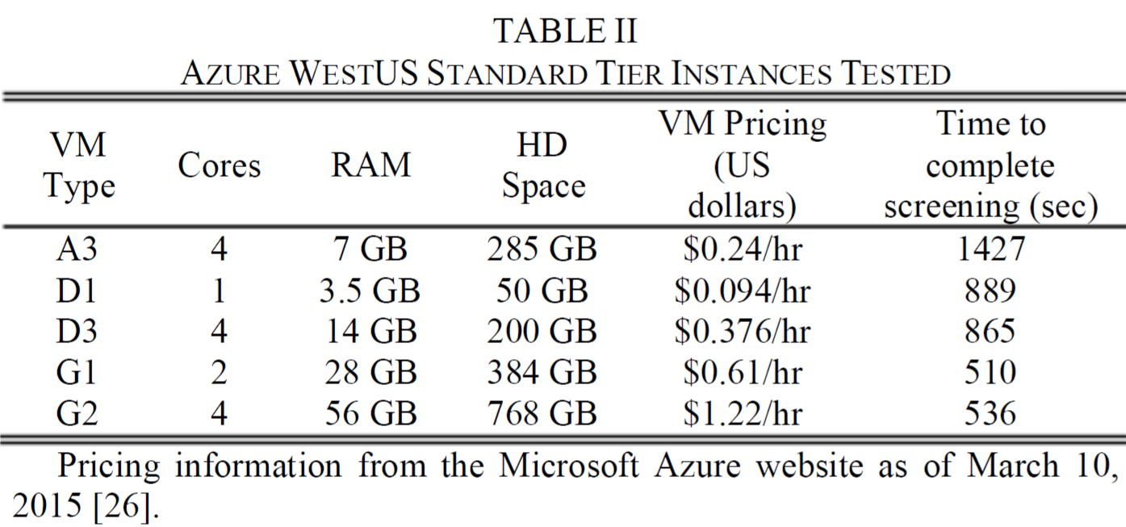
Azure Pricing Analysis
A-series should be avoided
D-series if cost is a factor
G-series if time is a factor

Slide 6
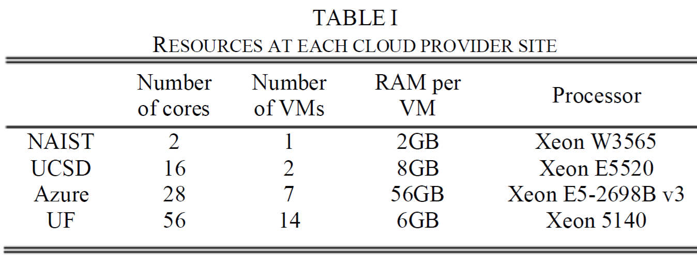
Virtual Machine Deployment
General information hardware configuration at various cloud provider sites

Slide 7
Multi-Site Virtual Cluster Connectivity
ViNe (UF)
Requires no change to specifications of the VM
Allows connection beyond boundaries like firewalls
Deployment of ViNe
Virtual router (VR) host formed on each cloud
Accompanied by list of virtual IP addresses
Each VM receives a virtual IP address
Creates connectivity within one cloud through the VR
All VRs in setup join the same virtual network
Creates connectivity across entire environment through VRs

Slide 8
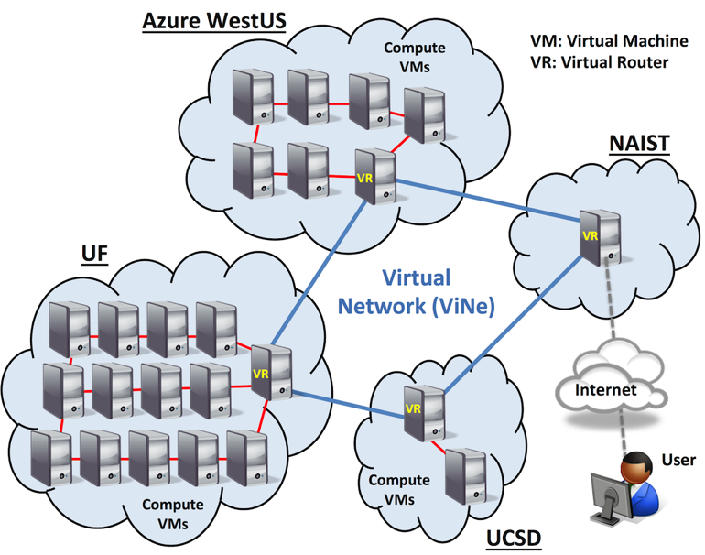
Multi-Site Virtual Cluster Connectivity
Overall multi-site cloud system connected with ViNe

Slide 9
Molecule Preparation and Tests
Molecule prepared using molecular visualization program Chimera
Used SSH-2
SSH-2 tested with random selection of chemical compounds from ZINC database
“Clean Drug-Like” Subset
30,000 compounds

Slide 10
Molecule Preparation and Tests
Test Parameters
Correspond to a low accuracy screening
Docking completion times 10-20 seconds/compound
Will be referred to as effective “Processing Rate”
Tests (using mpi)
Effect of geographic location of master node
Effect of how system effected by different loads
Scalability of the system

Slide 11


How mpi Enabled DOCK Works
Diagram Key
Blue Circle: Job that has not yet been processed
Red/Green/Purple Circle: Processed Job (Result)
Red: Azure
Green: UCSD
Purple: UF
Circle Movement Time: Latency (i.e. time it takes for jab/result to send)
Master Node Compute Node

Slide 12

How mpi Enabled DOCK Works
Jobs/Molecules to be Distributed
Processed Results
NAIST
Azure
UCSD
UF

Slide 13
How mpi Enabled DOCK Works
Jobs/Molecules to be Distributed
Processed Results
NAIST
Processing Times
Latency Times
Latency Times
67 ms
64 ms
12 s
5 s
67 ms
7 s
3 s
64 ms
15 s
95 ms
6 s
95 ms
Azure
UCSD
UF

Slide 14
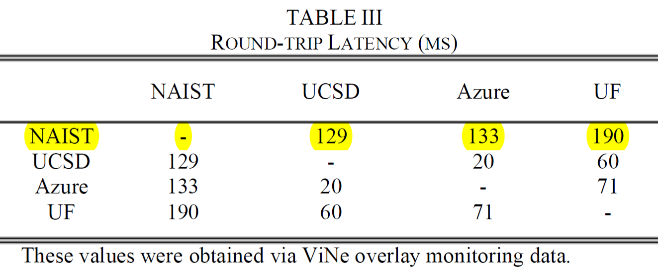
How mpi Enabled DOCK Works
Latency Times

Slide 15
Example Run with 32 Molecules
Jobs/Molecules to be Distributed
Processed Results
NAIST
Molecules Processed on Each Node
4
3
2
5
6
5
2
2
4
2
3
1
1
7
1
1
6
5
4
3
3
1
2
4
4
5
2
6
3
4
1
3
Azure
UCSD
UF
Notes:
Latency times and processing times don’t correspond to any actual exact times/tests
Latency times and processing times were selected for the sake of being able to visual show how mpi DOCK works

Slide 16
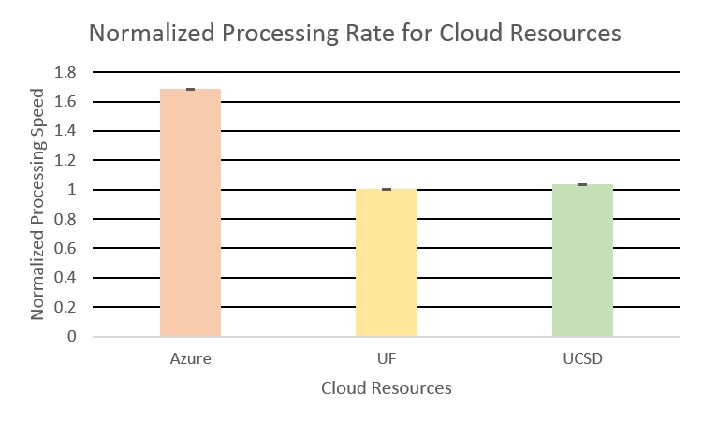
Results
Individual Site Performance
UF and UCSD process at the same rate, but Azure is noticeably faster

Slide 17
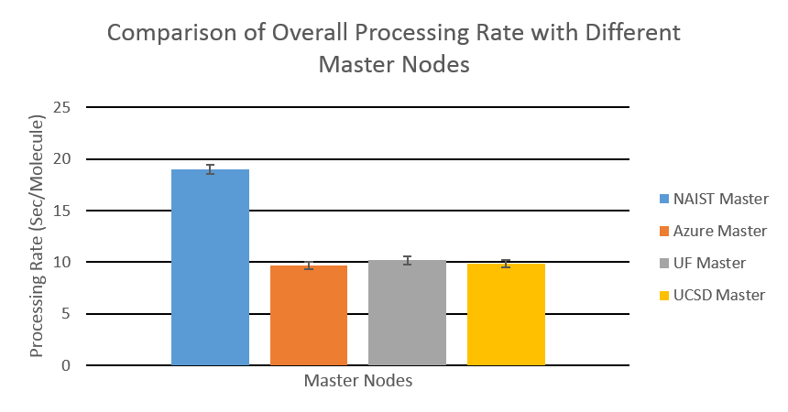
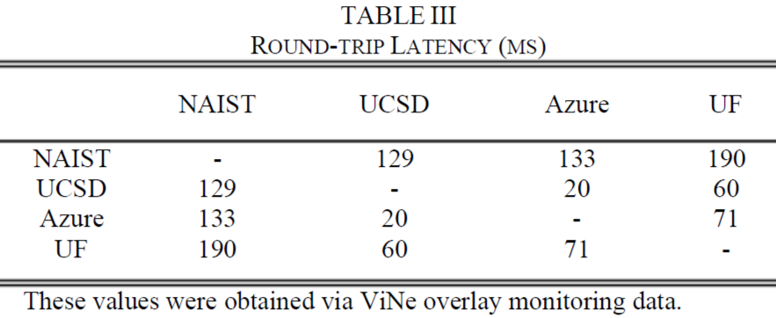
Results
Multi-site Performance Test
Geographic location of Master Node
United States locations had higher network links with lower latency
Traveling network links from Japan to the United States resulted in significant latency

Slide 18
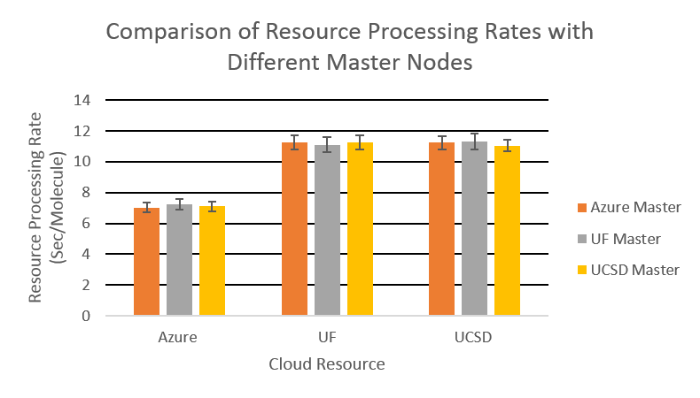
Results
Multi-site Performance Test
Geographic location of Master Node
For United States resources, no significant difference in performance of each resource for different Master Nodes

Slide 19
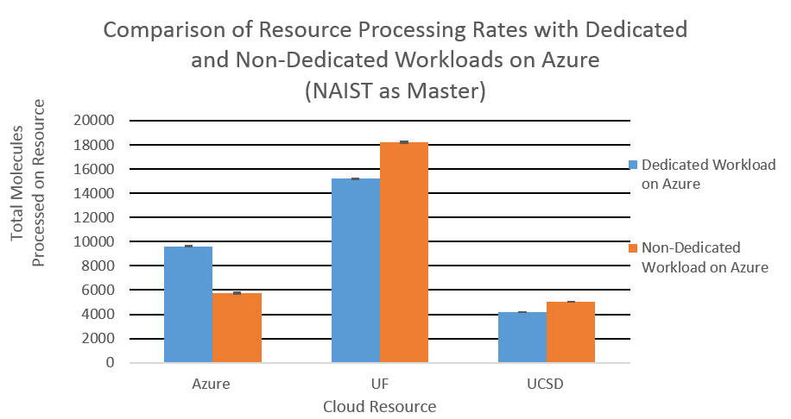
Results
Multi-site Performance Test
Workload Test (Dedicated/Non-Dedicated Resource)
When Azure is “Non-Dedicated”, the resources processes less molecules while UF and UCSD process more

Slide 20
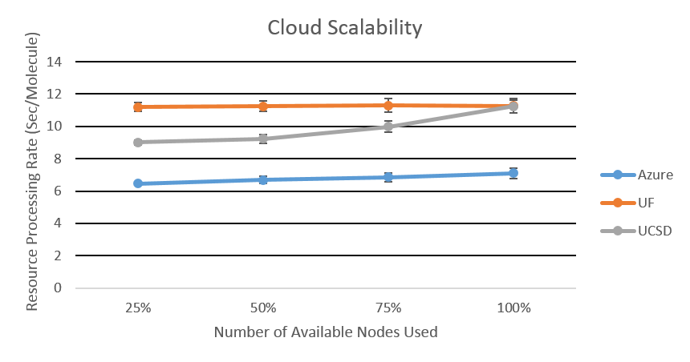
Results
Multi-site Performance Test
Scalability
Processing rate maintained as more nodes used except on UCSD

Slide 21
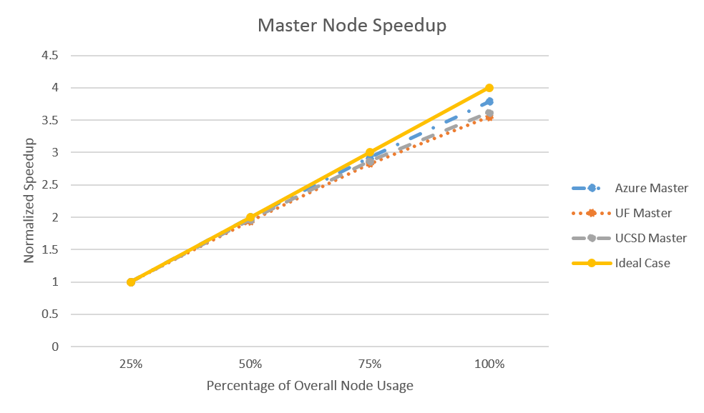
Results
Multi-site Performance Test
Scalability
All resources show a scalability trend similar to the ideal scalability case (based on Master Node Output)

Slide 22
Conclusion
Multi-site cloud environment using private and commercial cloud deployed
Results show that individual resources have different workloads and performances
However, overall environment minimizes the differences
Alongside mpi, Hadoop as also been incorporated and used for multi-site testing with DOCK

