Slide 1
Application of pattern recognition technology in the field scientific bird video
Can CHEN
Computer Network Information Center, Chinese Academy of Science
General Group for Advancing e-Science Application
chencan@cnic.cn

Slide 2
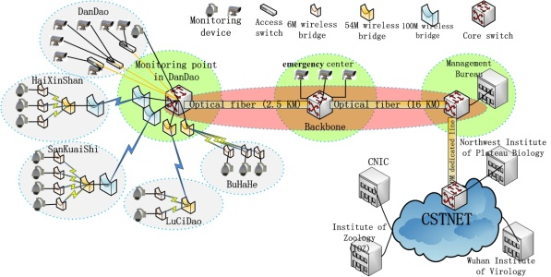
Background
Observation activities of animals often need to last a long time;
The outbreak of bird flu; no records of birds’ behaviors when outbreak of bird flu;
We deployed network video monitoring system in main area of Qinghai Lake, monitoring birds hatching, breeding, and feeding;
large number of video

Slide 3
Outline
Morphology classification and behaviors identification of birds in scientific video
breeding behavior of bar-headed geese
Preliminary classification of birds video in Qinghai Lake

Slide 4
Morphology classification and behaviors identification
Research Status
Movement and behavior analysis of animals such as mice in the fixed independent scene；
Aiming at action and mutual interaction of different kinds of animals in fixed scene

Slide 5
How to do?
Target detection and tracking
Morphology Classify
Birds Behaviors Identification

Slide 6
Target detection and tracking
Animal target tracking plays a significant role in subsequent links as animal motion parameters extraction, animal behavior analysis, etc. Through the analysis and comparison of all kinds of algorithms, we choose and improve the camshift algorithm to do animal target tracking.
In order to realize multi-targets tracking, and solve the problem of target tracking failure, we improve the camshift algorithm. We use binary difference method to update the history information of target motion, with the specified target size threshold and constrained relationship, we can realize multi-targets tracking and when the target tracking failure it will not appear abnormal.

Slide 7
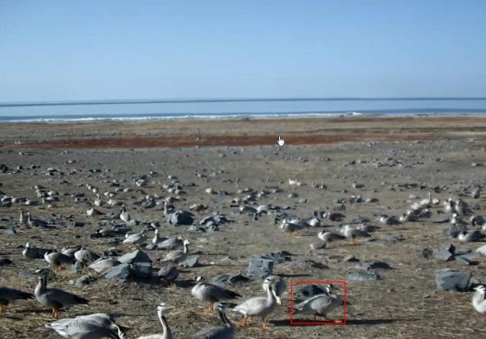
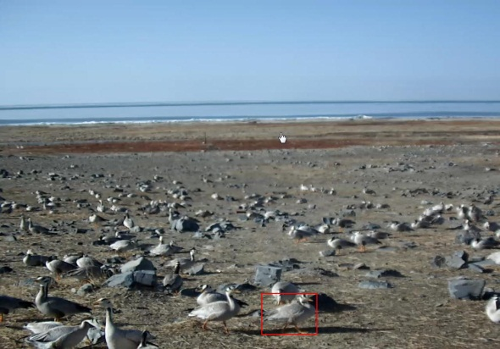
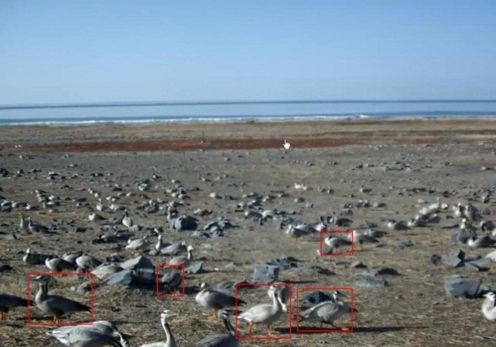
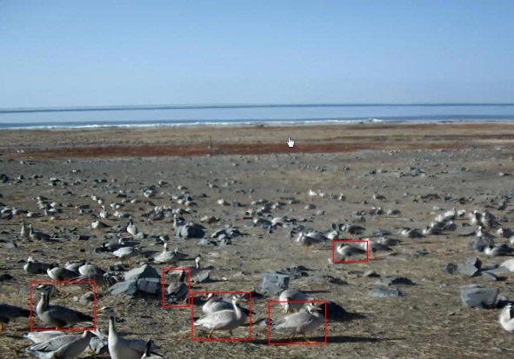
Target detection and tracking
We implemented the algorithm based on the OpenCV library. We analyzed the video of Qinghai Lake, detection and tracking the bar-headed geese target in the video. Using two modes:
Manually click on the target in the video window; program will automatically track the click on the target.
Input the threshold of the size of the moving target, program can track all moving targets which conform to the threshold value. We improved the Camshift algorithm, by comparing the difference of adjacent image frames; we got all the search windows which center position and size are changed, the program tracked the windows which size bigger than the threshold value.

Slide 8
Morphology Classify
we research the animal target posture classification and recognition technology; research the shape feature extraction technology, to extract effective features from the animals, as input parameters of a posture classifier. Research data classification technology; build training and testing samples for classifier.

Slide 9
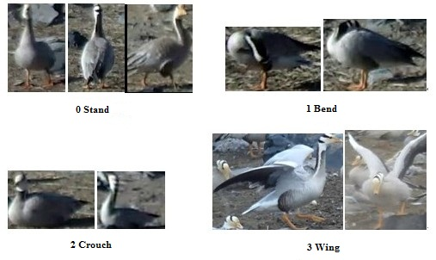
Morphology Definition
We defined four kinds of morphologies in total, and they are standing, bending, crouching and winging respectively. The morphologies and their descriptions are shown as Fig. 3.1 and Table 3.1.

Slide 10
Morphology Classify
Support Vector Machine (SVM) is an excellent supervised learning method for classification problems. It takes a training set composed of a list of records as its input and builds a model as the output. Each record is a feature vector containing a series of attributes and a hand marking label.
Morphology
Classification Model
Feature Extraction
Prediction

Slide 11
Feature Extraction
Feature extraction is very important for model building in SVM. Appropriate features can highly promote the computing efficiency and prediction accuracy. In our experiment, we extract 9 features in total. They are area factor F which defines as the number the target’s area divide perimeter, aspect ratio R representing the number length divide width, and 7 Hu invariant moments.

Slide 12
Data Sets
We collect 289 records for training set and 95 records for test set. Their distributions are shown as the table, in which 0,1,2,3 are the indexes of 4 morphologies.

Slide 13
Data Sets
Each record is a 10-D vector, 9 of which are features, and the 10th is the index label of morphology. The index labels of training records are known before training a model, while in test records, they are unknown waiting for prediction by the model.

Slide 14
SVM Training
Kernel function is the core of SVM algorithm, by which SVM reaches the purpose of classification with little computation. In our experiment, we use RBF kernel function because experiment results indicate that it can reach an ideal classification effect without prior knowledge. RBF kernel function is like:

Slide 15
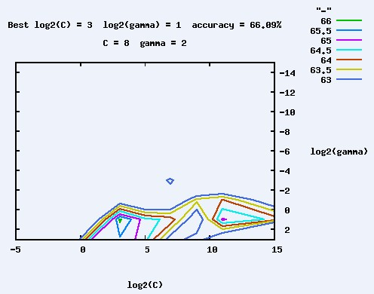
SVM Training
In such case, there are 2 arguments needed to be determined, one is penalty factor C and another is core parameter σ. The procedure of determining parameters is shown as

Slide 16
Model Evaluation
In order to verify the performance of the model, we need to use the test set prepared in advance. The prediction result is

Slide 17
Model Evaluation
According to Table 3.4, there are 95 records whose labels need to be predicted in total, in which 19 are standing, 24 are bending, 27 are crouching, and 25 are winging. While in the result, there are 62 records whose label are predicted correctly which means the accuracy of the model is 65.3%.

Slide 18
Model Evaluation
In order to evaluate the model’s performance of specific morphology, we define two parameters, one is precision σp, and another is recall σr, their definitions are as follows:
Suppose there are m records of morphology A (A can be one of standing, bending, crouching and winging), and in the prediction result there are n A records, in which p are correct, then σp=p/n, and σr=p/m.

Slide 19
Model Evaluation
The precision and recall of 4 morphologies are
No. | sample | result | correct | precision | recall
0 | 19 | 25 | 14 | 56% | 73.7%
1 | 24 | 24 | 14 | 58.3% | 58.3%
2 | 27 | 25 | 19 | 76% | 70.4%
3 | 25 | 21 | 15 | 71.4% | 60%

Slide 20
Birds Behaviors Identification
Bar-headed geese in Qinghai Lake are mainly for reproduction. Through long-term observation on breeding behavior of bar-headed geese, we summarized some basic behaviors of bar-headed geese in the breeding season: standing watch; walking; hatching; fighting. These behaviors can be identified by the basic postures mentioned in the previous section and finite time or location condition.
Posture | Decision conditions | Basic behavior
Stand | the duration t | standing watch
Stand | continuous change of location | walking
Crouch | the duration t | hatching
Bend | the duration t | hatching
Wing | the duration t | fighting

Slide 21
Birds Behaviors Identification
Combining with the results of target detection, target tracking, posture classification and decision conditions of basic behaviors. We achieved a recognition system of bar-headed geese behaviors in monitor video. Through the validation using some 2012 monitor video, the recognition rate of 4 basic behaviors can reach about: standing watch 56%; walking 56%; hatching 64.7%; fighting 71.4%. Considering the complexity of the field real-time monitoring and the influence of many other factors, this rate is satisfying.

Slide 22
Next…
Study the factors, which affect the recognition rate. Improve the basic behavior recognition rate.
Establish the normal behavior database of birds this year.

Slide 23
Outline
Morphology classification and behaviors identification of birds in scientific video
breeding behavior of bar-headed geese
Preliminary classification of birds video in Qinghai Lake

Slide 24
Preliminary classification of birds video in Qinghai Lake
Massive amounts of scientific video need to pre-processing
Preliminary classification of birds video
Improve researchers efficiency in work

Slide 25
Preliminary classification of birds video in Qinghai Lake
Fast compare speed of image
Traditional methods base on pixels of image, low efficiency
Fast method: base on image hashing

Slide 26
Preliminary classification of birds video in Qinghai Lake
Perceptual hash algorithm
Generate fingerprint character string for image
Compare strings
Close result, Close image

Slide 27
Preliminary classification of birds video in Qinghai Lake
Concrete Measures
Extract one frame every 20 second, 15 frames for one video section
Do hashing for 15 frames of image, get 15 hashing strings
Compare with checking database, get 4 groups compare results (15*30 for every group)
Calculate 4 average compare results, judge the bird species.

Slide 28
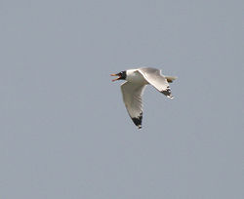
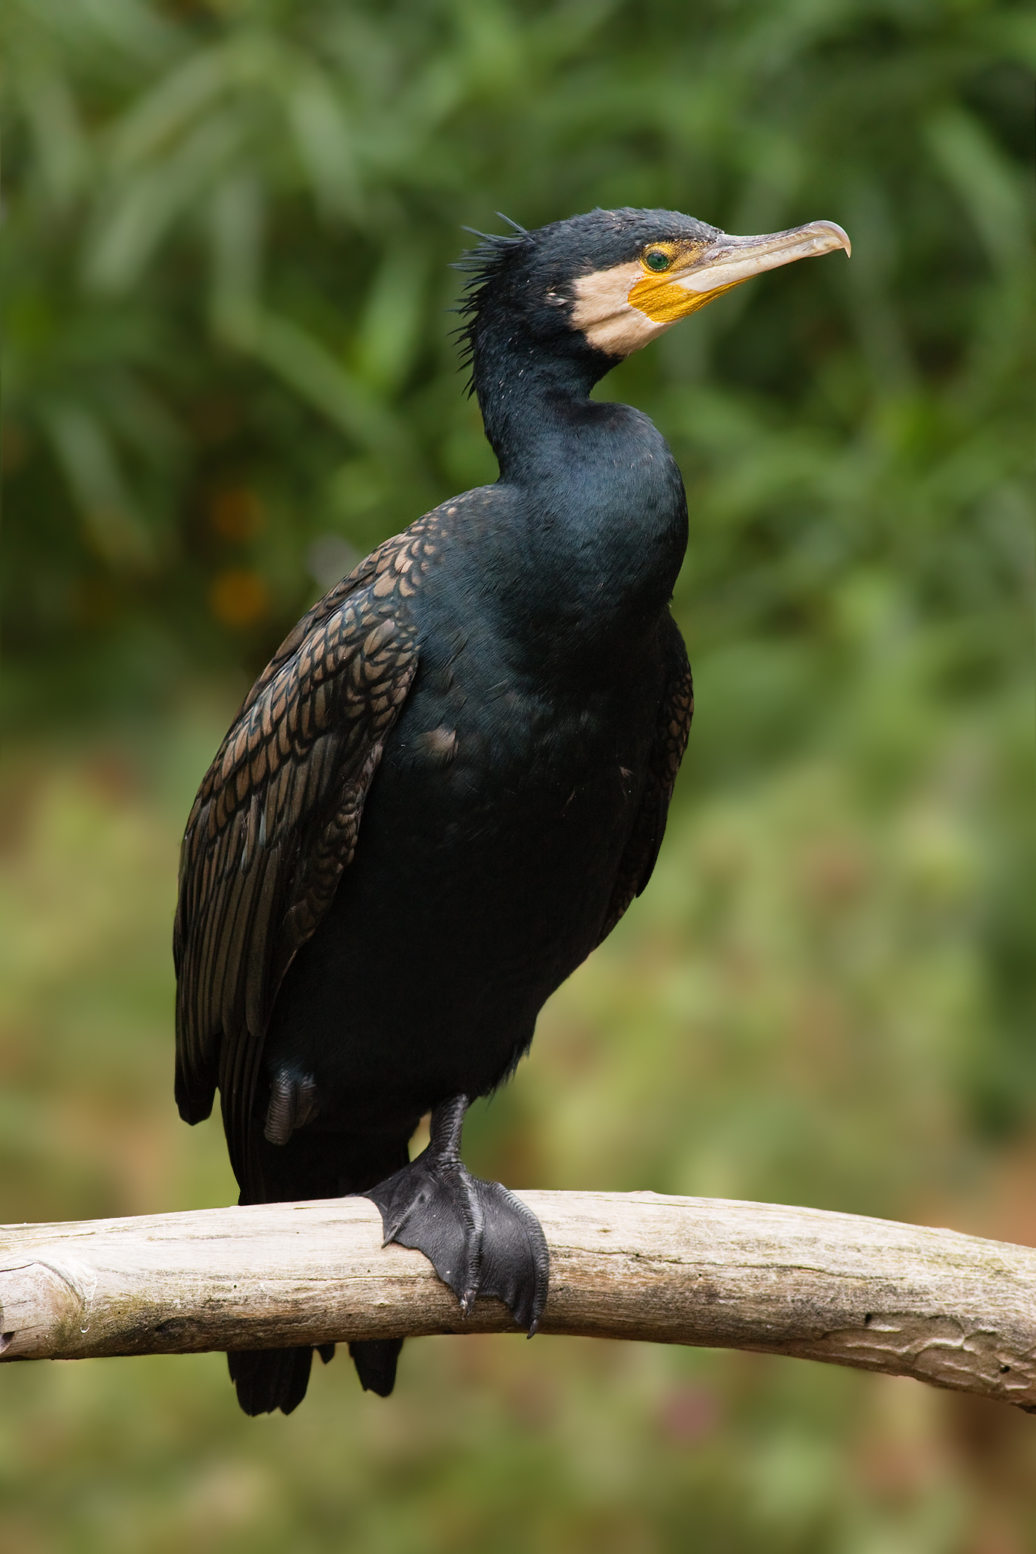
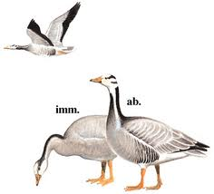
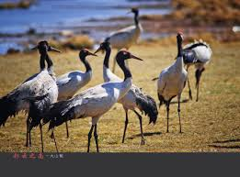
Preliminary classification of birds video in Qinghai Lake
Checking Database
Four species of birds: Bar-headed Goose, Black-necked Crane, Cormorant, Pallas’s Gull
Cut 30 images from video for every species, contain different postures and different angles
Hash this 120 images, get 120 hash strings as checking database

Slide 29
Preliminary classification of birds video in Qinghai Lake
Experiment Result
 | CD: Bar-headed Goose | CD: Black-necked Crane | CD: Cormorant | CD: Pallas’s Gull
Video 1 (Bar-headed Goose) | 9.86 | 3.47 | 6.53 | 7.83
Video 2 (Black-necked Crane) | 2.46 | 13.65 | 1.24 | 2.98
Video 3 (Cormorant) | 4.35 | 2.65 | 12.68 | 6.78
Video 4 (Pallas’s Gull) | 7.45 | 3.35 | 5.89 | 11.67
CD=Checking Database

Slide 30
Preliminary classification of birds video in Qinghai Lake
Analysis
Classification for the video of Bar-headed Goose has poorer result:
Color of bar-headed goose close to the color of background
Crowded together
Time efficiency (test on DELL R510)
Frames getting & Hashing: 830ms
Compare: 1834ms

Slide 31
Preliminary classification of birds video in Qinghai Lake
Next
Improve the accuracy rate
Realize one system for preliminary classification of birds video

Slide 32
Thanks!
Contract me: chencan@cnic.cn

