Slide 1
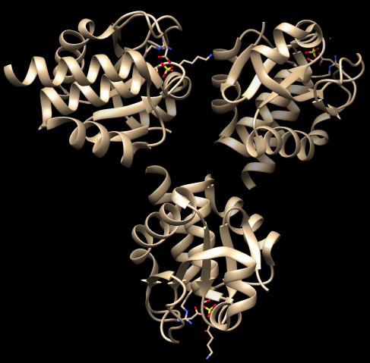




Multi-cloud Hadoop-based Dock Experiment
Andréa Matsunaga, UF, ammatsun@ufl.edu
Maurício Tsugawa, UF, tsugawa@ufl.edu
Anthony Nguyen, UCSD, acn004@ucsd.edu
Kohei Ichikawa, NAIST, ichikawa@is.naist.jp
Jason Haga, AIST, jh.haga@aist.go.jp
PRAGMA 28
April 10, 2015

Slide 2



Science: Dock
Searches databases of ligands for compounds that bind a particular protein
SSH2 (2NT2 @PDB)
Low Accuracy
Prepare using Chimera
High Accuracy
Drugs Now:
12,244,362 compounds
50 GB
Amber
 | Time/mol | Time for ZINC | Time for ZINC on 100 cores | Time for 1% ZINC on 100 cores
Low Accuracy | 10 sec | 3.88 CPU-years | 14.2 days | 14.2 days
High Accuracy | 6.6 min | 153.7 CPU-years | 1.53 years | 5.58 days
Amber | 30 min | 698.9 CPU-years | 6.98 years | 25.47 days
 |  | Total: | 8.55 years | 45.25 days
 |  | Azure Price (D): | $1.3 million | $19,155
 |  | Azure Price (G): | $1.9 million | $28,168
①
②
Notes:
On demand allocation
D: $127/core/month
G: $498/2core/month

Slide 3
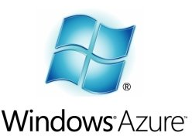





Multi-Cloud Setup
Azure WUS VR 231
UF VR 341
westus-g1
wa-ff-1
. . .
. . .
wa-ff-32
westus-g8
LM Data Server
ViNe
DNS Server
UF VR 6
wa-master
wa-uf-1
compute-0-0
pragma-vc-3
compute-0-1
. . .
compute-0
UCSD VR 741
UF VR 361
wa-uf-14

Slide 4
Dock on a Multi-Cloud
Approach:
VM created on Azure contains Dock 6.2 compiled on 32-bit OS wrapped with UCSD fingerprinting tool to run on a 64-bit VM (make experiment reproducible)
VM converted to KVM image for UCSD and UF
Small modification to Dock source code to read molecule data through STDIN
Dock runs on Hadoop with streaming extension, and a pattern-based input splitter reused from CloudBLAST
Hadoop ecosystem deployed through Ambari
All VMs with all-to-all connectivity and DNS

Slide 5
Multi-Cloud Hadoop Motivation
Take advantage of distributed pool of resources (private and public clouds)
Have fault-tolerance during execution of dock
Gain the ability to increase or decrease the number of resources used
Reproducibility of experiment (by keeping consistency with previous environment and by having a homogeneous software stack)
Make use of distributed storage

Slide 6
HDFS & Replication
Replication factor: 3
Fixed block size: 128 MB
ZINC input file:
Microsoft Azure
UF
UCSD

Slide 7
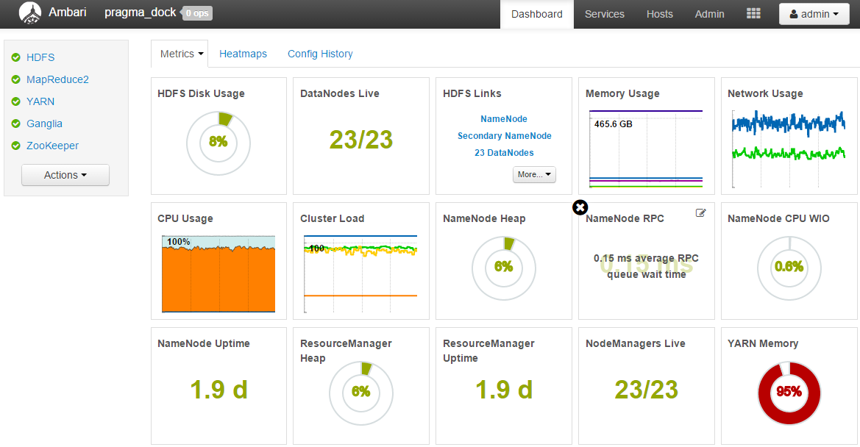
Ambari Dashboard

Slide 8
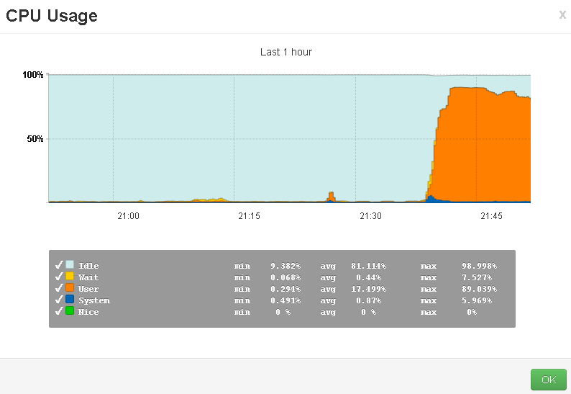
Load on the Multi-Cloud Platform via Dashboard

Slide 9
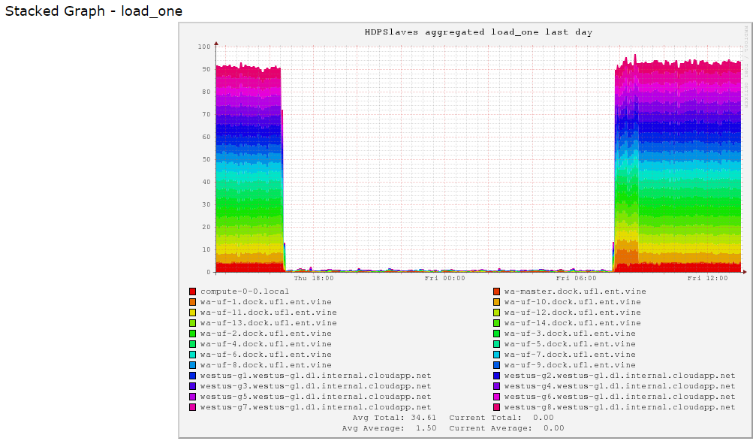
Load on the Multi-Cloud Platform via Ganglia

Slide 10
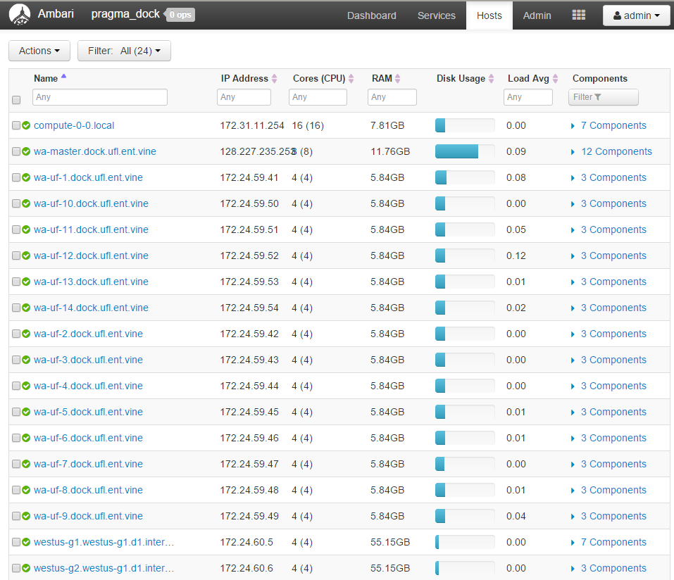
View Hosts

Slide 11
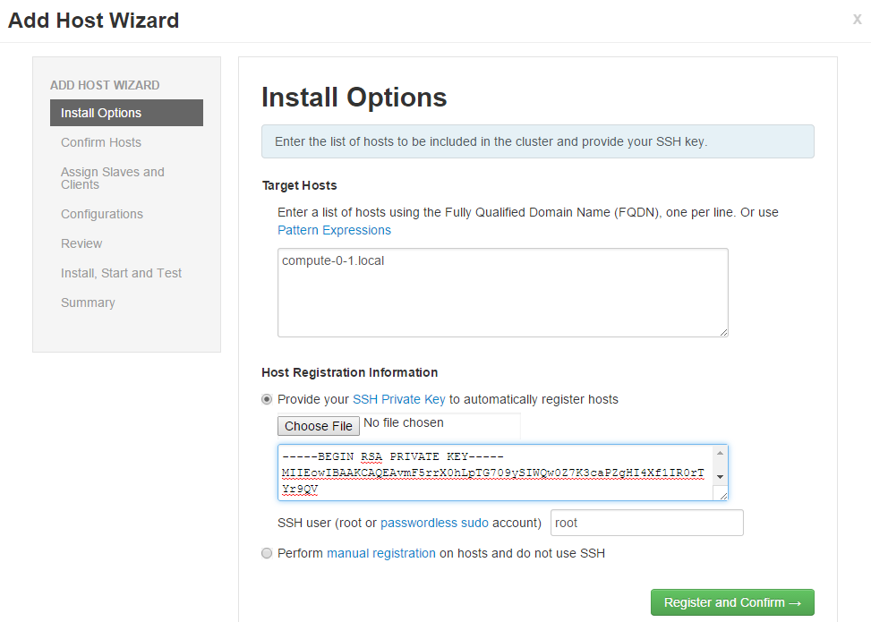
Add a Host

Slide 12
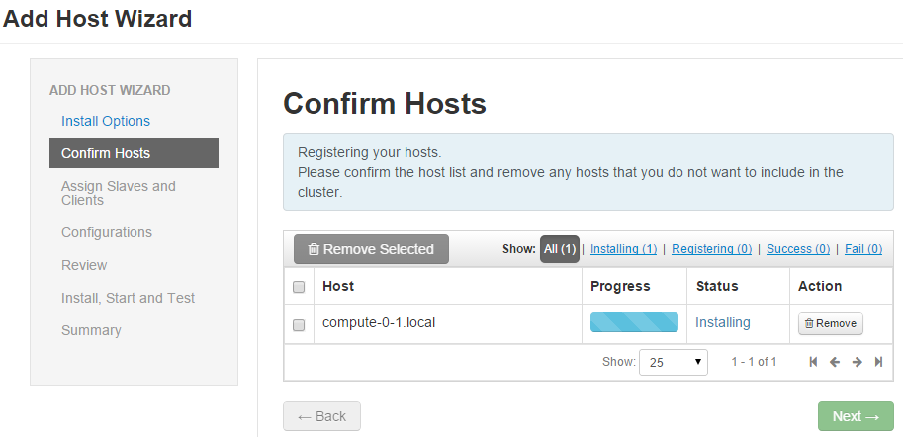
Install Ambari Agent

Slide 13
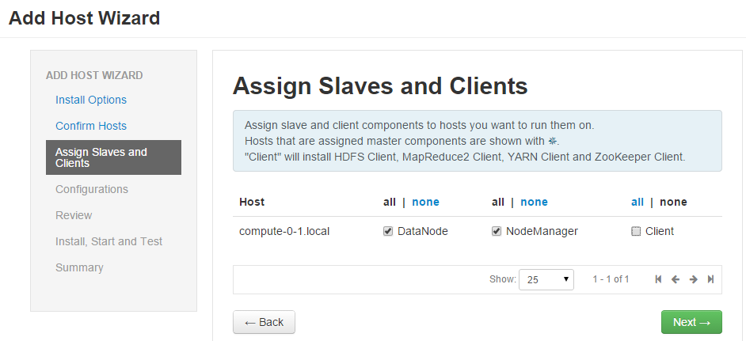
Add Host as DataNode and NodeManager

Slide 14
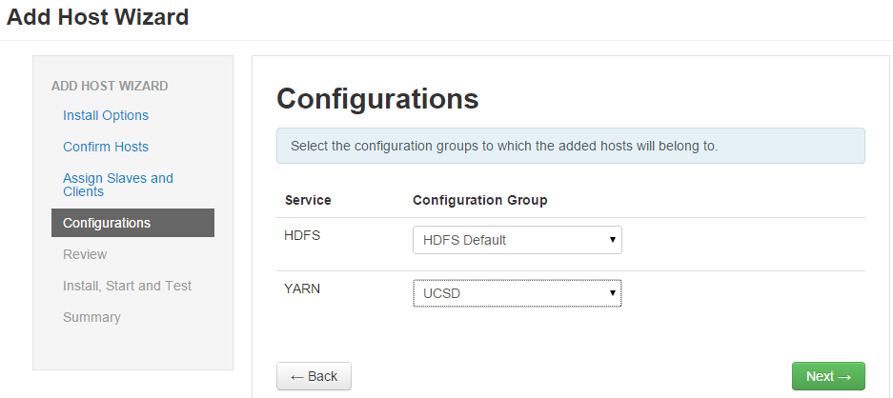
Choose UCSD YARN Configuration Group

Slide 15
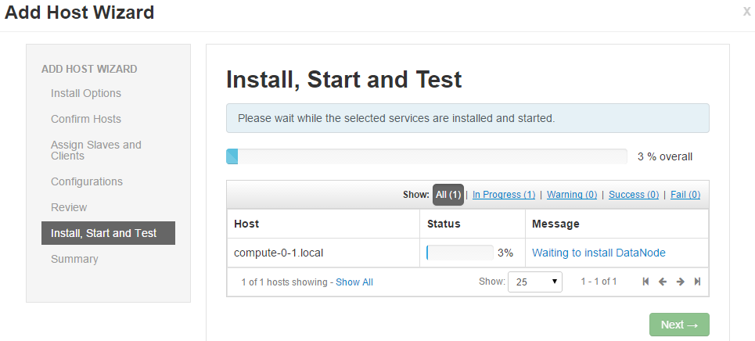
Install Services on New Host

Slide 16
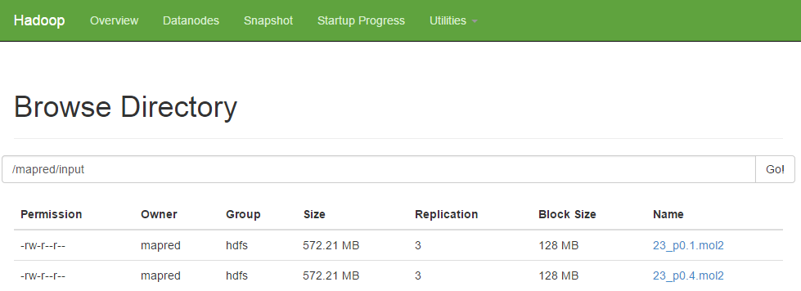
Browsing HDFS

Slide 17
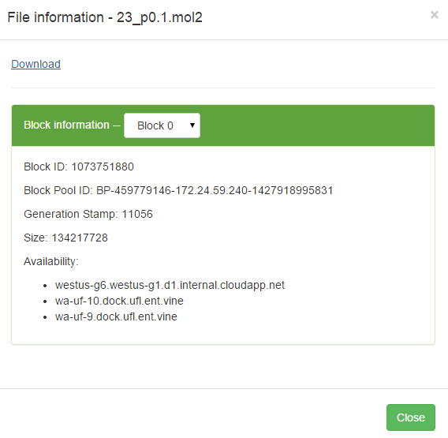
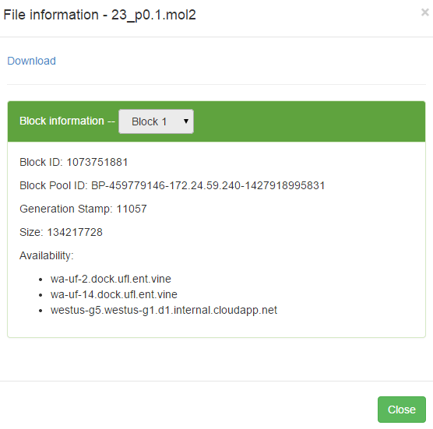
HDFS Data Replication
3 Replicas

Slide 18
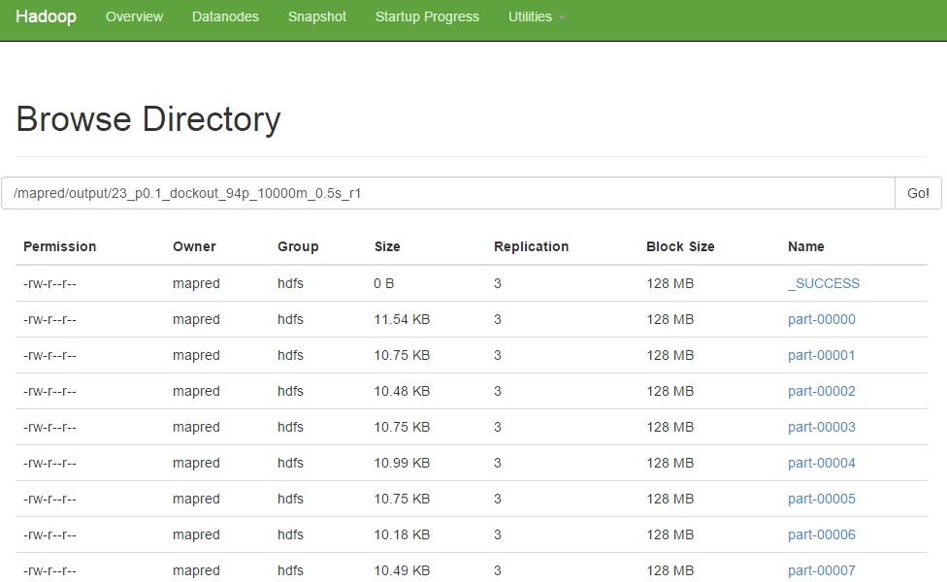
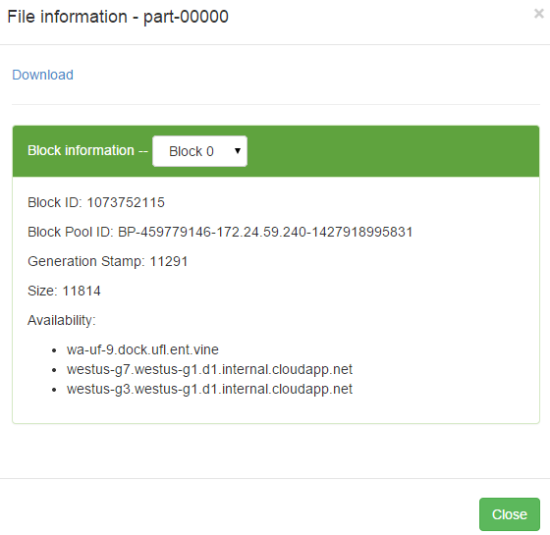
HDFS Stores Output Replicated

Slide 19
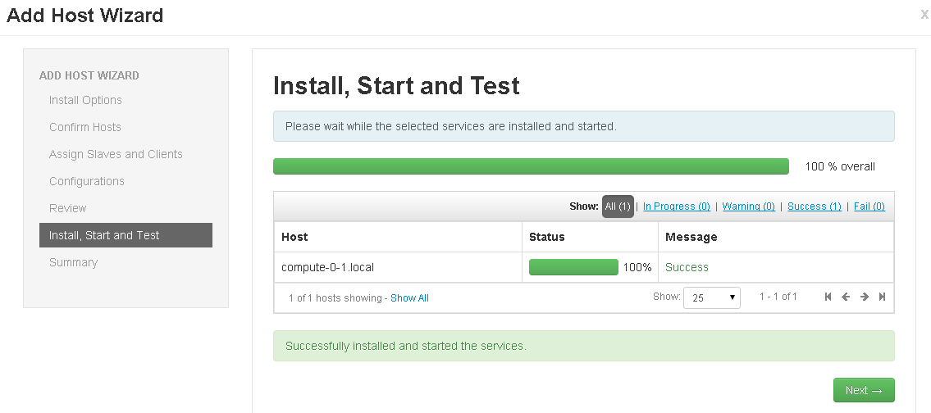
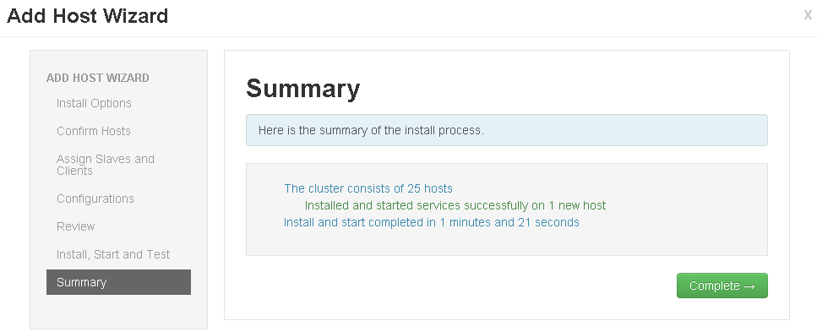
Add Host Complete

Slide 20
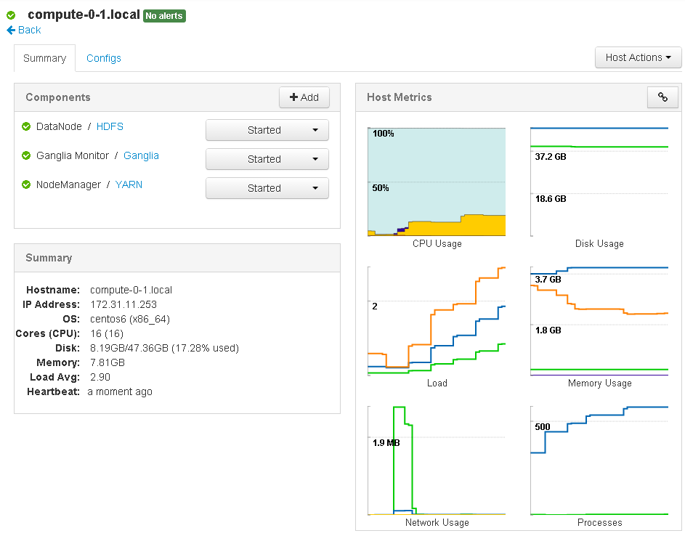
Computation Starts to Flow to New Host

Slide 21
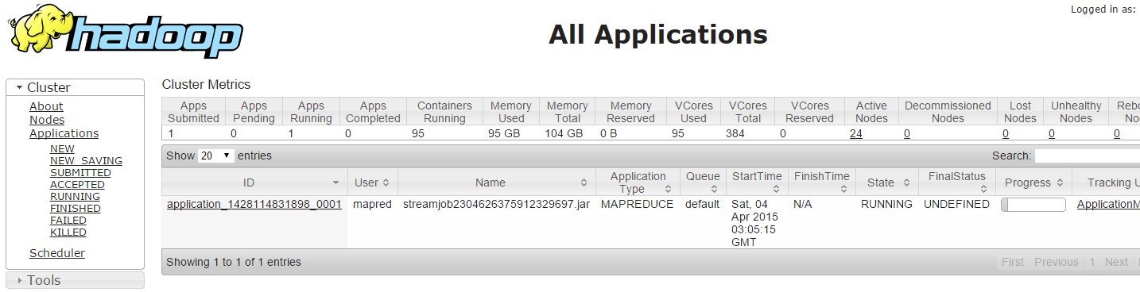
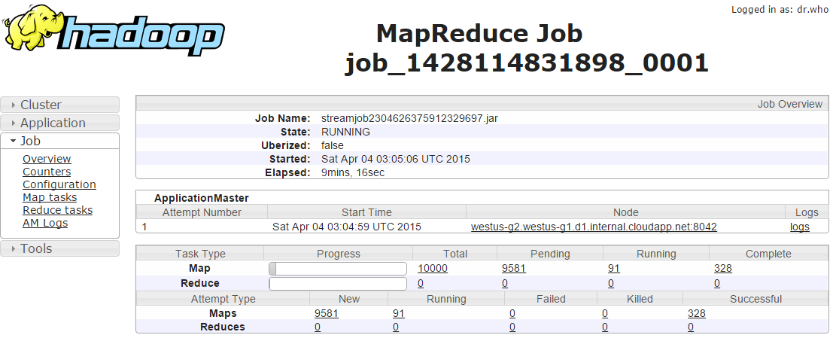
View Jobs and Its Completion Status

Slide 22
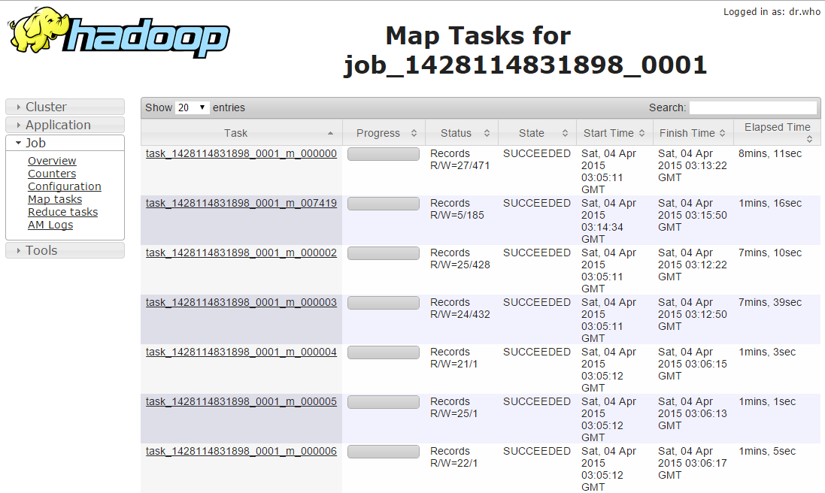
View Map Execution Time

Slide 23
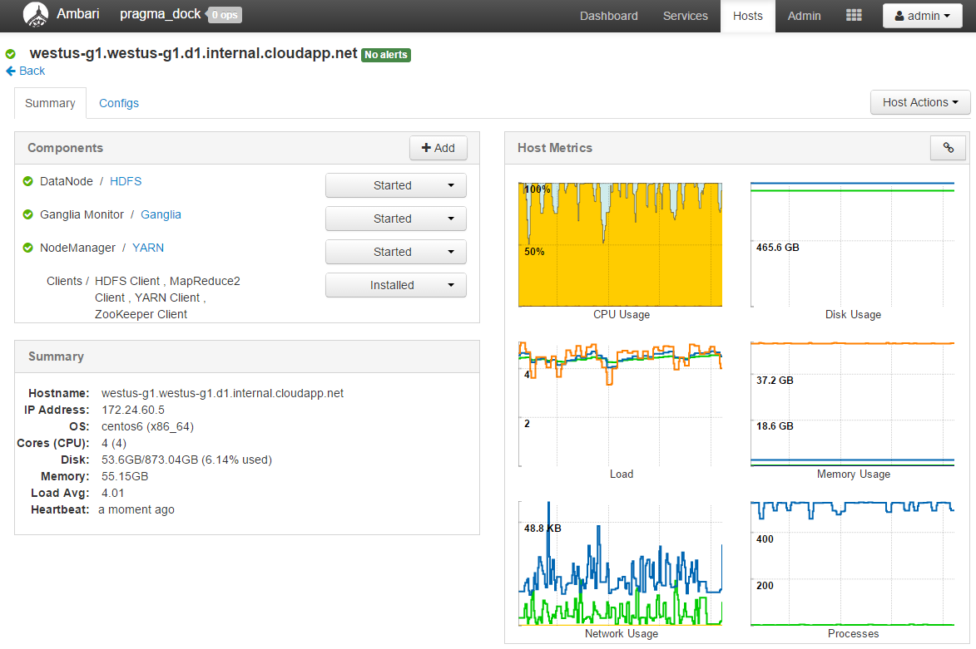
View and Control Services on Each Host

Slide 24
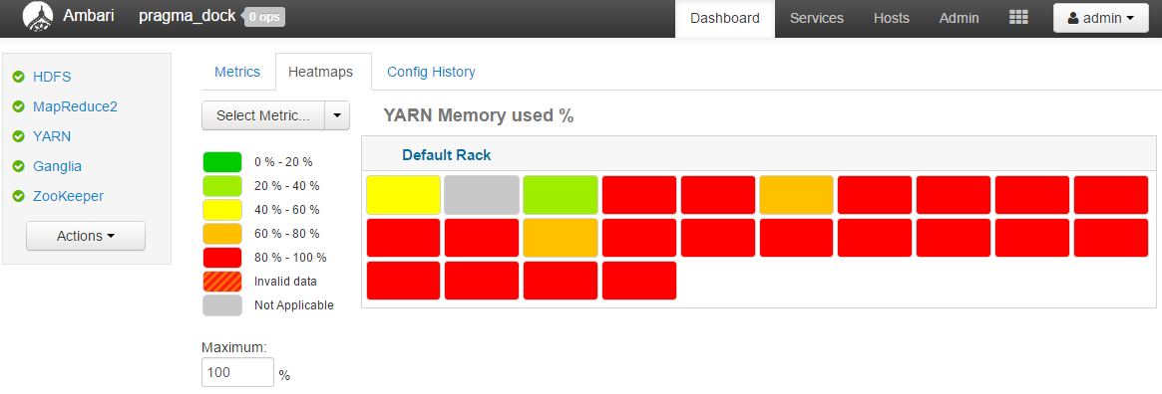
Lookup Service Usage via Heatmaps

Slide 25
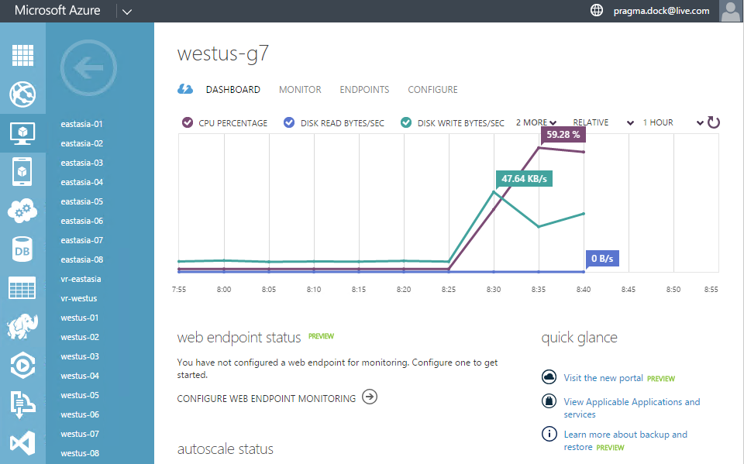
Microsoft Azure Interface

Slide 26

Questions?
Acknowledgements
Thank you!

