Slide 1
PRAGMA31 TASK#1
Student Hackathon 5th – 6th September, 2016
Notes:
Hello Everyone we pround to present about our task it’s about extend the pragma clound site to our machine. So let’s start with introduce ourselves

Slide 2
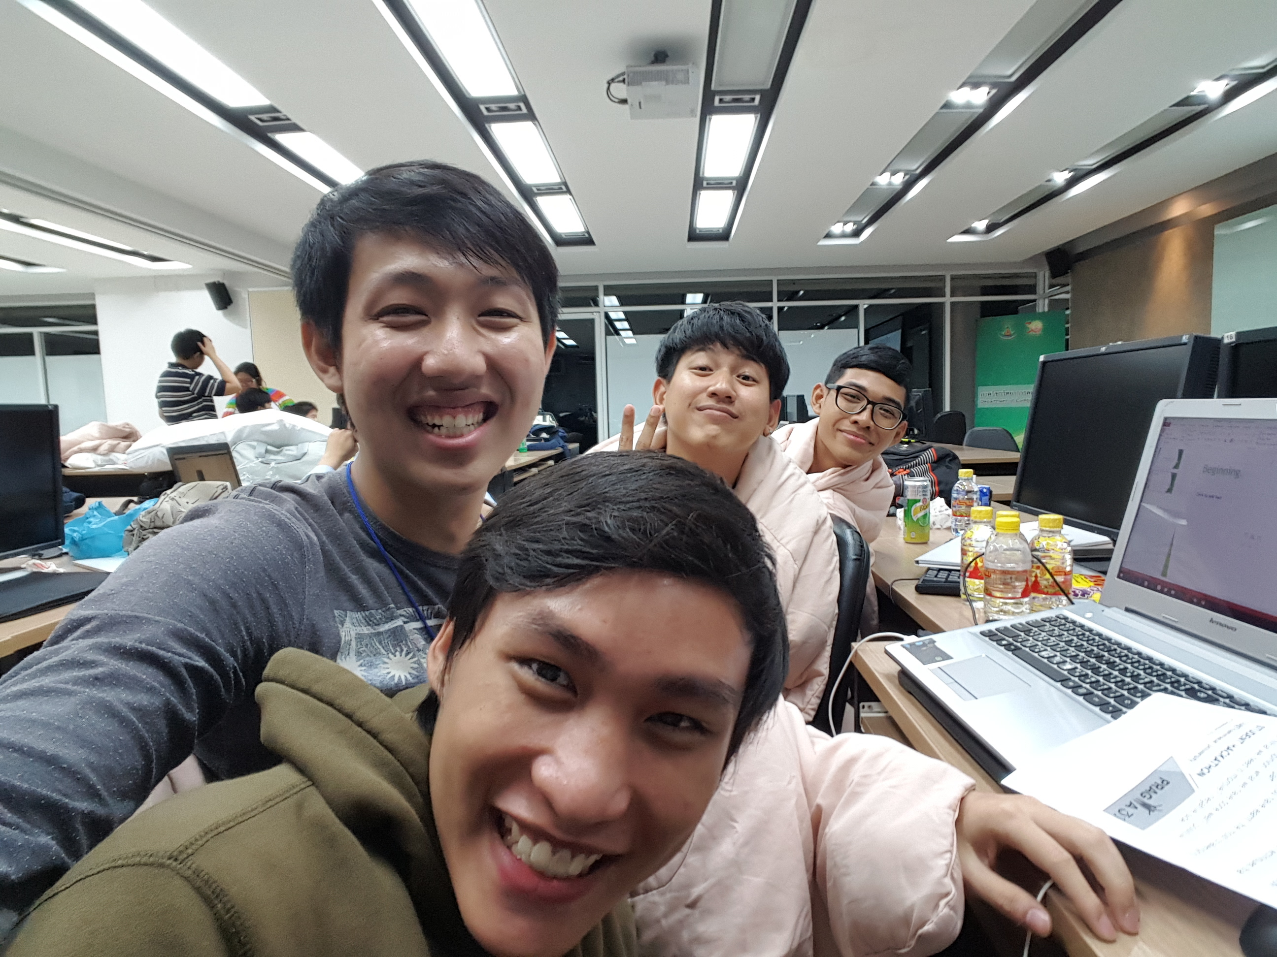
Beginning of “us” for pragma31
Notes:
We had never heard about PRAGMA until teacher Vanida and teacher Prapaporn told us about this Hackathon contest. We got the details from them and it seemed very challenging to us, so we decided to volunteer to do this.
สิ้นสุดการสนทนาผ่านแชท

Slide 3
Proof of Success
Notes:
Here is what we have done and its proof of success

Slide 4
ROCK OS
ZOTAC
VM
10.1.1.1/16
112.121.136.23/24
10.112.0.6/16
eth0
eth1
ens5
br0
10.1.1.1/16
112.121.136.22/24
eth0(br)
eth1(br)
10.112.0.4/16
peth0
peth1
tap0
163.221.11.93:6653
Gre: 203.131.208.4
Host@TU
controller
internet
pragma

Slide 5
ROCK OS
ZOTAC
10.1.1.1/16
112.121.136.22/24
eth0(br)
eth1(br)
peth0
peth1
internet
Notes:
First, we installed the Rock Cluster OS to the physical machine, set up the network and the roll

Slide 6
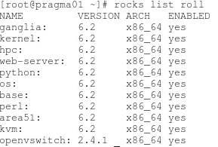
1. Rock Cluster Frontend
Notes:
We can check the roll we installed by using the command “rocks list roll”. The initial roll number should be 10.

Slide 7
ROCK OS
ZOTAC
VM
10.1.1.1/16
112.121.136.23/24
eth0
eth1
10.1.1.1/16
112.121.136.22/24
eth0(br)
eth1(br)
peth0
peth1
internet
Notes:
Second, we created the VM by using the image we got. Then, set up PRAGMA boot by checking out the GitHub repository and booted the VM to test if we configured correctly.

Slide 8
2. PRAGMA Boot
1. Checkout the repository
Check the contents of files site_conf.conf and kvm_rocks.conf
2. Check the configuration
Try using command “pragma boot hku_biolinux 0 loglevel=DEBUG”
Check the log at /var/log/pragma_boot/
Notes:
In these steps, we can validate by checking the contents of file site_conf and kvm_rocks and by trying to use the command “pragma boot hku_biolinux 0 loglevel=DEBUG” and check its log.

Slide 9
ROCK OS
ZOTAC
VM
10.1.1.1/16
112.121.136.23/24
10.112.0.6/16
eth0
eth1
ens5
br0
10.1.1.1/16
112.121.136.22/24
eth0(br)
eth1(br)
10.112.0.4/16
peth0
peth1
tap0
internet

Slide 10
ROCK OS
ZOTAC
VM
10.1.1.1/16
112.121.136.23/24
10.112.0.6/16
eth0
eth1
ens5
br0
10.1.1.1/16
112.121.136.22/24
eth0(br)
eth1(br)
10.112.0.4/16
peth0
peth1
tap0
163.221.11.93:6653
GRE: 203.131.208.4
Host@TU
controller
internet
pragma
Notes:
Next, we installed and configured the Open vSwitch . Firstly, got the roll file of Open vSwitch from the GitHub and installed it. Then, we created the “openflow” subnet and the bridge interface. Next, we connect the bridge interface of the physical machine to the GRE and the VM. Finally, we configured the interface ens5 in the VM and it’s all done.

Slide 11
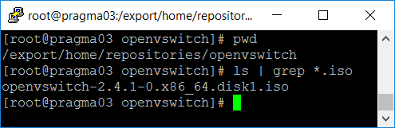
3. Open vSwitch
1. Checkout the roll file
Notes:
For the step of building the Open vSwitch, we can validate it by checking the roll file in the repository directory

Slide 12
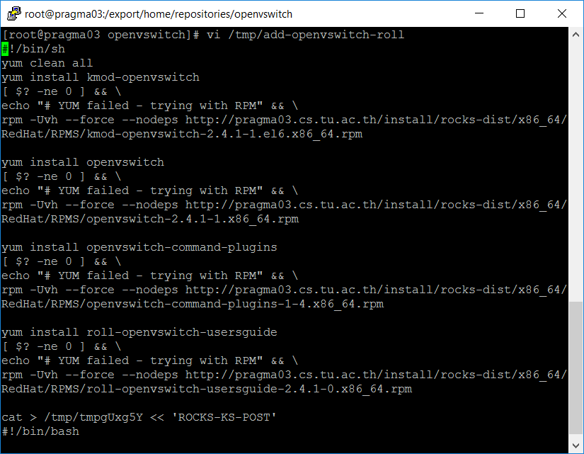
3. Open vSwitch
2. Create the Open vSwitch repository

Slide 13
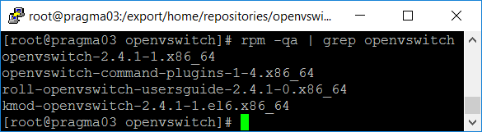
3. Open vSwitch
2. Install Open vSwitch
Notes:
For installing the Open vSwitch, we can use the command rpm –qa | grep openvswitch to check the installation.

Slide 14
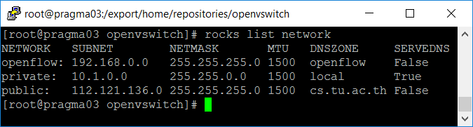
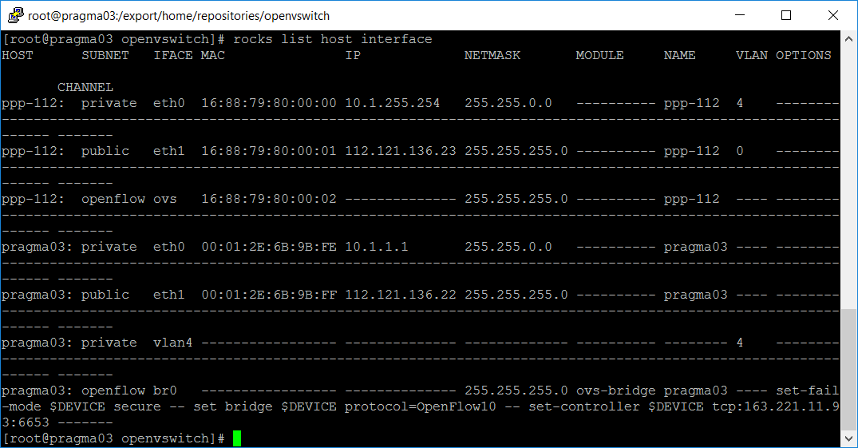
3. Open vSwitch
3. Configure the Open vSwitch
Notes:
For the configuration of the Open vSwitch, we can check the result by using “rocks list network” to check the openflow subnet and the command “rocks list host interface” to check the bridge interface.

Slide 15
3. Open vSwitch
4. Setup GRE
Sanity check (ping 112.121.136.22)
ping Tap0 (ping 10.112.0.4)
5. Configure virtual cluster
Sanity check (ping 10.112.0.6)
ping Tap0 (10.112.0.4)
ping physical host (ping 112.121.136.22)
Notes:
After we setup the GRE we use the physical machine to ping itself for sanity check and ping Tap0 for checking the network.
And after we are done setting the virtual cluster setting, we can validate it by ping commands.

Slide 16
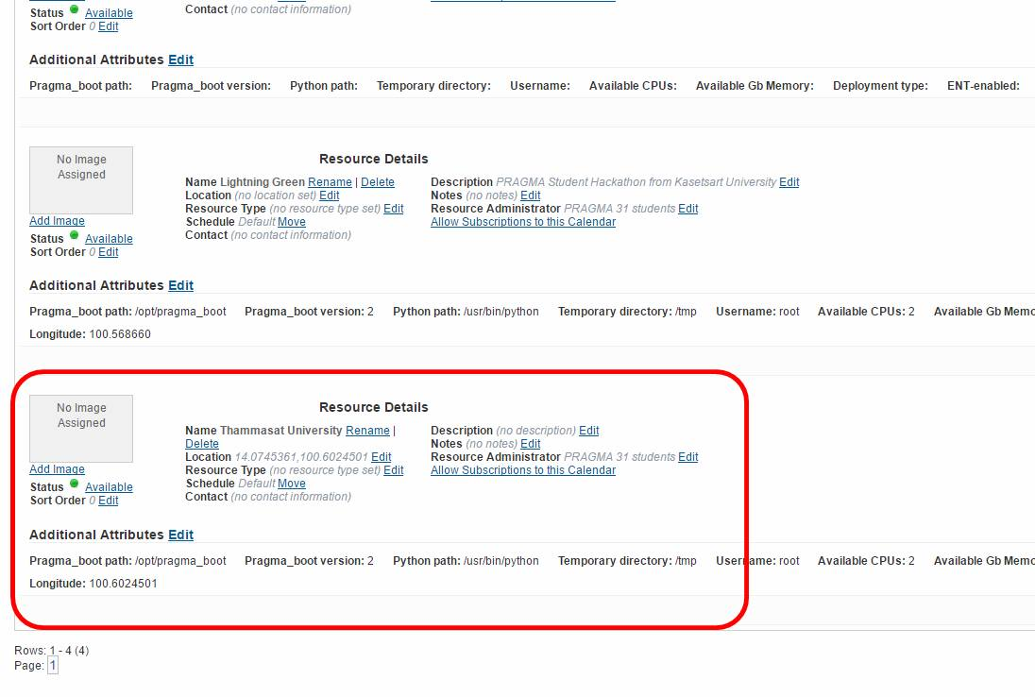
4. Registering to Cloud Scheduler
Notes:
For the registration step, we can just check the details on the Cloud Scheduler page

Slide 17
The Most Challenging Part(s)
Manual partitioning of Rocks Cluster
Physical link of the Open vSwitch
Notes:
We got the rough times twice in a roll. First, when we installed the Rocks Cluster, we somehow decided to use the manual partitioning and it mess up everything. We couldn’t launch the VM, when we checked the log we found that we got the permission denied on a root user at the directory /home/kvm
Second, when we were following the Open vSwitch instruction. We accidentally continued on the physical link part and messes thing up again. We deleted some file and config. The eth1 disappeared after the reboot and we totally had no idea why. We had to restore the deleted things and removed the wlan interface to make it work again.

Slide 18
The Easiest Part
Rocks Cluster installation
Notes:
And the easiest part. We think every part is new for us. But which one that we think it’s the least hardest is The rock Cluster installation Because it have GUI to help us install easier .But remember don’t use manual partition if you not an expert.

Slide 19
Our Impression
Instructions is clear and easy to follow
Every steps have a proof of success
No instruction about manual partitioning
Notes:
But for the Rocks Cluster instruction, it doesn’t tell us specifically that we have to use auto partitioning so we think it’s as easy as Windows or Ubuntu and try something different.

Slide 20
Q&A

Slide 21
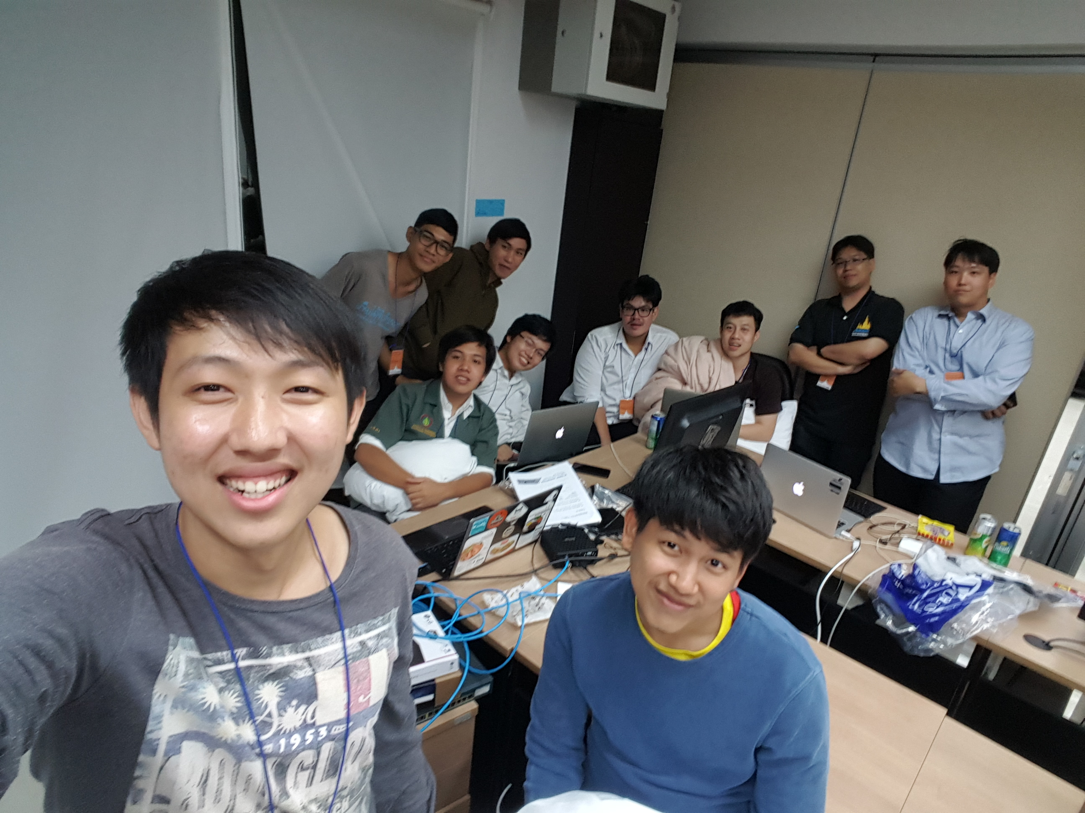
Thank you

