Slide 1
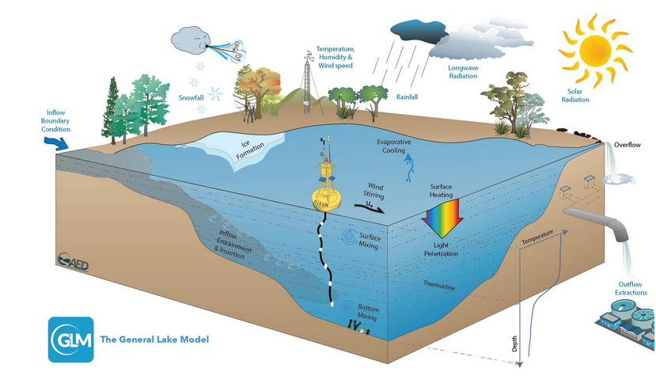
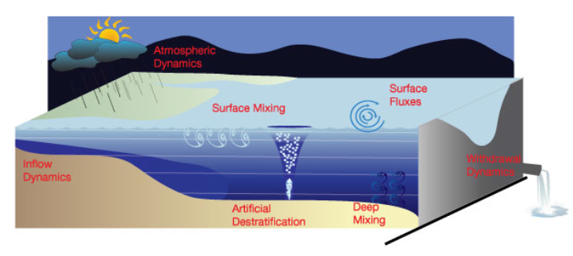
Generic Lake Model (GLM)

Slide 2

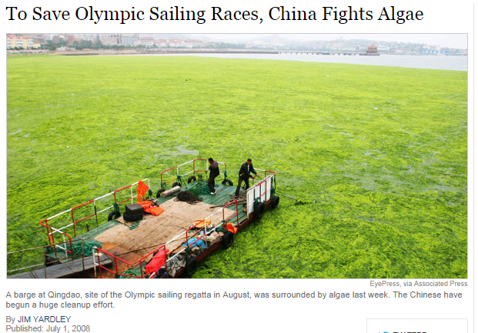

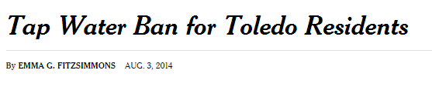
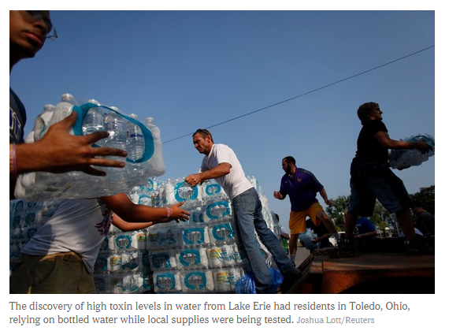
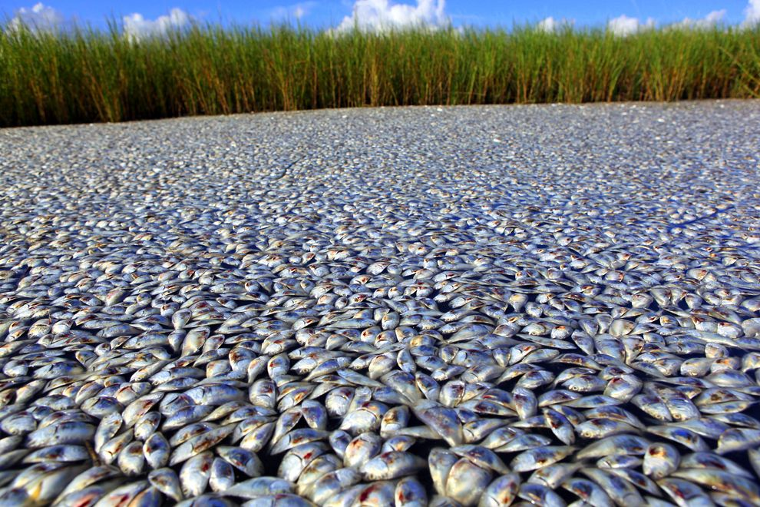
High Profile Water Quality Issues
Notes:
Motivation:
2008: This is a barge physically removing extremely dense algal blooms in Qingdao, China for the 2008 Olympic sailing races
2010: Fishkill in southern Louisiana Gulf due to Mississippi River nutrient loading and potentially lower DO via oil-eating bacteria
2014: Half a million people in Toledo, Ohio area told not to use water due to microcystis from algal bloom in Lake Erie.

Slide 3
Model Summary
Lagrangian layer structure allowing layers to expand, contract, split or merge depending on available energy and required energy to establish/overcome density gradients
Within a layer, water quality properties are homogeneous (more layers during stratified period)
Diffusion between layers below the surface mixed layer
Chemical constituents subject to mixing, diffusion, atmospheric exchange, sediment fluxes, phytoplankton uptake, respiration, mineralization, etc.
Sediment fluxes described by a Monod equation modified by Arrhenius temperature scaling

Slide 4
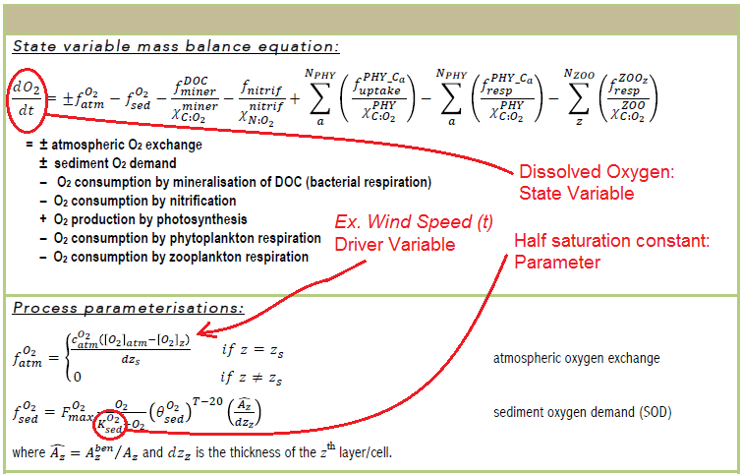
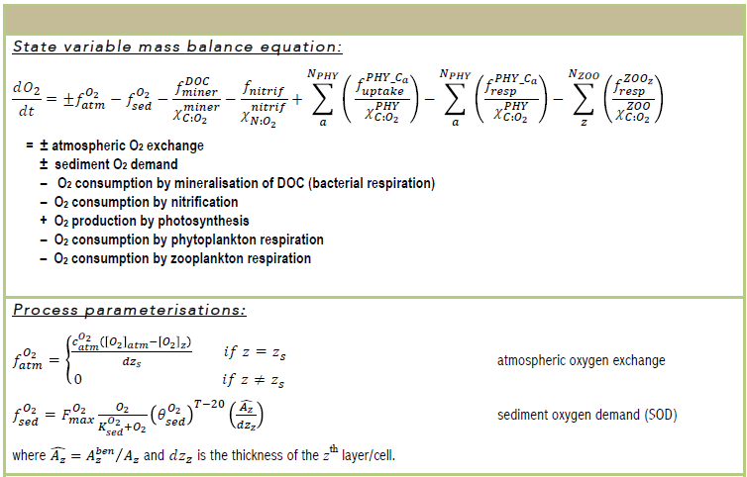
Example Chemical Mass Balance

Slide 5
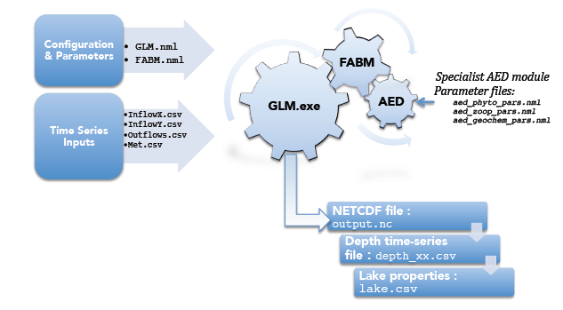
Model Components
GLM: General Lake Model; 1-D lake water balance, energy budget, vertical stratification
FABM: Framework for Aquatic Biogeochemical Models; couples hydrodynamics and biogeochemistry
AED: Aquatic Ecodynamics; set of modules describing chemical and biological processes
Required Files:
Driver Data
inflow file(s)
outflow file(s)
meteorological file
Configuration Files
glm.nml
fabm.nml
aed_phyto_pars.nml (?)
aed_zoop_pars.nml (?)
Application/Executables
Located at ../../bin/glm64/
v1.4.0
bin
sim
sim2
sim1
glm32
glm64
files
files
exe
exe

Slide 6
What you need…
GLM input files and application files
R (& RStudio?)
Package: ncdf4 (http://github.gleon.io/)
Package: rGLM (no longer available online)
Package: glmtools (https://github.com/USGS-R/glmtools)
Package: pragma27 (local from Gabriel)

Slide 7
Reading modeled data from NetCDF
Model outputs data to NetCDF in 4 dimensions: latitude, longitude, depth, and time
Because 1-D model, lat and long are fixed (essentially 2-D output through depth and time)
ncvar_get {ncdf4} extracts a matrix (2D) of state variable values in each layer (up to max layers) and at each time step (interval controlled by nsave in glm.nml)
Using other GLM output data (number of layers [NS] and height top of layer above bottom [z]), the functions of interest (getTempGLMnc, get_temp, get_state_var) convert this information to rounded elevation or depth information

Slide 8
Example
Sample temperature data from ncvar_get:
Layer #\timestep | t1 | t2 | t3 | t4
1 | 5.0 | 5.1 | 5.2 | 5.3
2 | 5.4 | 5.5 | 5.6 | 5.7
3… | 6.0 | 6.1 | 6.2 | 6.3
…71 | 23.2 | 23.3 | 24.1 | 24.2
72… | 24.1 | NA | 24.3 | 24.5
…1000 | NA | NA | NA | NA
Matrix “z” has same dimensions (and same missing value positions), and can be used to convert layer # to depth from lake surface
9.96e+36 value is the missing value

Slide 9
R tools: rGLM [getTempGLMnc]
--Old function for getting temperature data from NetCDF
Usage: getTempGLMnc(GLMnc, lyrDz, ref, z.out)
GLMnc: [NC object] as returned by nc_open()
lyrDz: [numeric value] depth interval
ref: [character string] either “surface” or “bottom”; determines 0 reference (depth or elevation)
z.out: [numeric vector] optional; vector of discrete depths to interpolate (lyrDz not used if z.out is supplied)

Slide 10
R tools: glmtools [get_temp]
-- New function for getting temperature data from NetCDF
Usage: get_temp(file, reference, z.out, t.out)
file: [character string] path to the ‘output.nc’ file
reference: [character string] same as ‘ref’ for getTempGLMnc
z_out: [numeric vector] vector of discrete depths at which data should be interpolated
t_out: [POSIXct vector] optional vector of datetimes for which to return data (if missing, all available time points returned)

Slide 11
R tools: pragma27 [get_state_var]
-- General function to get any state variable data from the NetCDF
Usage: get_state_var(nc_file, var_name, reference, lyrDz, z_out, t_out, precision)
nc_file: [character string] path to ‘output.nc’ file
var_name: [character string] name of state variable in the NetCDF
reference: [character string] same as get_temp
lyrDz: [numeric value] same as getTempGLMnc
z_out: [numeric vector] optional; same as get_temp
t_out: [POSIXct vector] optional; same as get_temp
precision: [character string] optiona; one of “hour” or “day”; not imporant here..

Slide 12
Differences between functions
Whether NC object is saved in R memory (getTempGLMnc) or not (get_temp, get_state_var)
Whether depths must be explicitly specified (get_temp) or inferred from an increment and lake depth (getTempGLMnc, get_state_var)
Whether times can be specified (get_temp, get_state_var) or all available times are automatically extracted (getTempGLMnc)
Important thing is how the NetCDF data (& NC object) are handled, how depths are interpolated, and how data is converted from height above bottom to depth below surface

Slide 13
Compute Times
getTempGLMnc: 5.8 seconds
get_temp: 3.2 seconds
get_state_var: 3.6 seconds
All return the same data:
data.frame with datetime in first column and time series data at discrete depths in the subsequent columns

Slide 14
Challenge
Design a function that minimizes the time to return a data frame of the same format from get_temp or get_state_var
Focus on:
Handling of NC object
Interpolation of data
Switching reference from bottom to surface of lake

Slide 15
3-D lake model diagram: http://aed.see.uwa.edu.au/research/models/GLM/
Lake aerial view: pinnest.net/wordsworth-lake/
Louisiana Fishkill (+ NG logo): http://news.nationalgeographic.com/news/2010/09/100916-fish-kill-louisiana-gulf-oil-spill-dead-zone-science-environment/
Toledo Water: http://www.nytimes.com/2014/08/04/us/toledo-faces-second-day-of-water-ban.html
Qingdao Algae Bloom (+ NY Times logo): http://www.nytimes.com/2008/07/01/world/asia/01algae.html?_r=0
Example chemical mass balance from GLM user manual for v1.3.2 (now see v1.4.0 manual): http://aed.see.uwa.edu.au/research/models/GLM/documentation
Cogs diagram: http://aed.see.uwa.edu.au/research/models/GLM/

