Slide 1

Study in Usefulness of Middleware-Only Provenance
Quan(Gabriel) Zhou, Devarshi Ghoshal, Beth Plale
October 15, 2014

Slide 2
Main Contents
I. Contributions
II. Overview
III. Framework
IV. Completeness of middleware provenance
V. Evaluation
VI. Discussion & Limitation
VII. Conclusion & Future Work

Slide 3
Contributions
A provenance collection extension to WorkQueue that requires no application instrumentation and minimal system intrusion
A technique to correlate provenance events from different layers
An evaluation to show the completeness of middleware layer provenance and usefulness in failure tracing and classification
Notes:
Provenance of the science carried out on high throughput frameworks is as important as is the provenance for any application. The lineage of the data generated by these applications
is important in understanding the quality and reuse of data. However, changing an application to make it provenance aware takes a lot of work.
On the other hand, Middleware abstracts the interaction between the physical and the application layers and handles communication, data movement, and data access for distributed applications.
Capturing provenance at the middleware layer possible enables transparent provenance capture from applications without modifying them and with minimum system intrusions.
In our paper, we make several contributions as below:

Slide 4
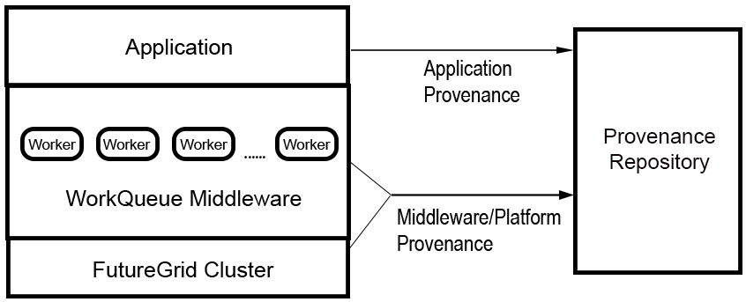
Overview
Notes:
We collect provenance from distributed scientific applications that use WorkQueue as a middleware. The applications are executed on a FutureGrid cluster. We use Karma Provenance tool which is developed by D2I Center, Indiana University as a standalone provenance repository to collect provenance information by mining the logs generated by the WorkQueue middleware and the workflow script.

Slide 5
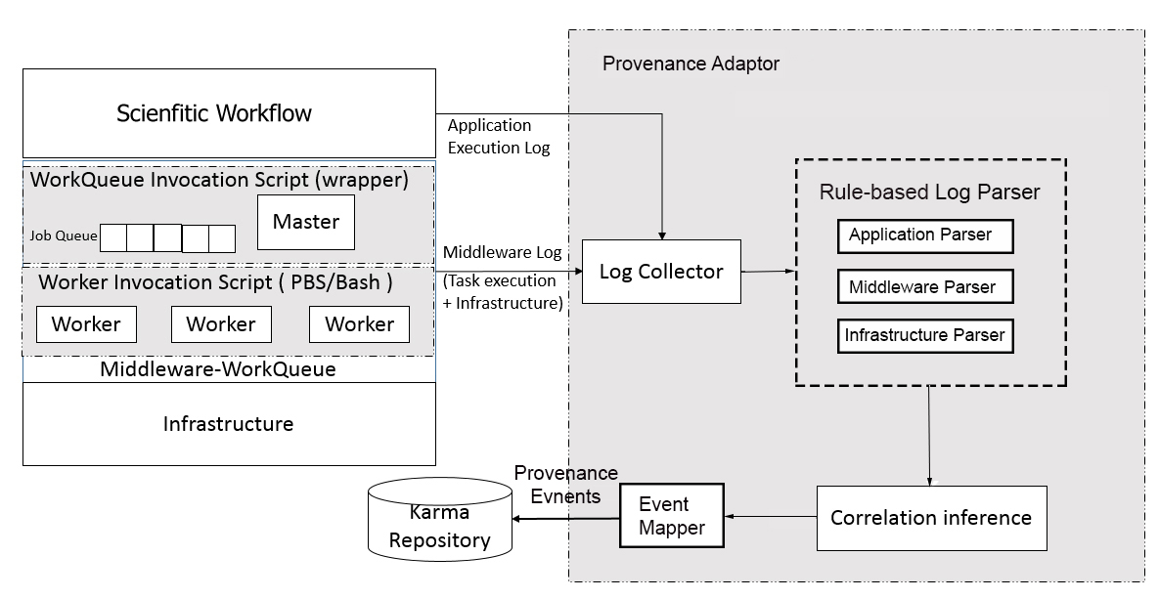
Framework
Notes:
Our approach to provenance capture is to focus on middleware capture, then augment as needed from the application layer. The objective is to minimize the amount of instrumentation needed to capture significant provenance information. We use rule-based log mining to capture provenance from middleware and applications.
We classify the log entries based on our layered model of provenance, and write rules for mining these logs accordingly. Middleware logs describe the middleware and platform information including dynamic workloads, job scheduling, etc. For example, the reporting and accounting files in SGE system for the SLOSH workflow are written to these logs. They also contain information related to the distribution of tasks and data and the mapping between them. Application logs are generated when the application is executed. The application logs generally describe the input data, output data and executable programs or algorithms during execution. Above figure shows the provenance collection framework with two parts: a) provenance-aware middleware; b) provenance adaptor;

Slide 6
Provenance-aware Middleware
A). A provenance-enabled wrapper
Set up master/worker environment
Transparently capture the provenance trace in executing a
distributed application through WorkQueue
Capture information related to failures and data corruption
“What” and “Why” provenance
B). A worker invocation script
Configure workers for executing an application
Provenance captured accounts for task distribution and location of data generated in a distributed environment
“Where” provenance
Notes:
We extend the WorkQueue middleware to make it provenance aware. This is through two additional pieces to existing WorkQueue package as a) a provenance-enabled wrapper; b) a worker invocation script; The wrapper script around the WorkQueue sets up the master/worker environment and configures input, output and log directories. It is responsible for transparently capturing the steps in executing a distributed application through WorkQueue which include task distribution and relationships between data artifacts and the tasks. Additional information related to failures and data corruption is also captured to assess quality of output data.
The worker invocation script is used to configure workers for executing an application. The provenance information captured during worker invocation is part
of the ‘where-provenance’ that accounts for the location of data generated in a distributed environment.

Slide 7
Provenance Adaptor
A). Log Collector
B). Log Parser
C). Correlation Inference Engine
D). Event Mapper
Notes:
The provenance adaptor is composed of 4 components.

Slide 8
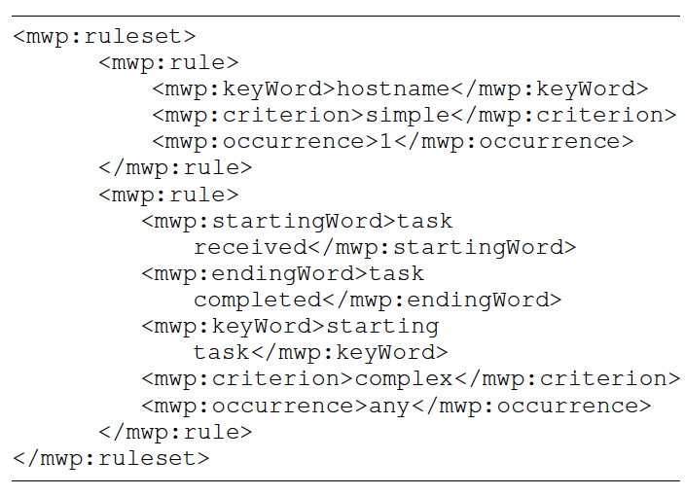
Log Collector & Log Parser
Middleware layer-specific rule set
Application layer-specific rule set
Notes:
The log collector captures raw log data from logs generated by the provenance aware middleware and application layer.
However, capturing provenance from log files presents challenges due to differences in logging mechanisms. We use a rule-based provenance adaptor that mines logs for essential provenance information using a set of rules.
All the rule-set are described in XML. There are two set of rules: a) middleware-specific rules that are generic to provenance events running on the WorkQueue Middleware; b) application-specific rules that are generic to one or more similar kinds of applications. A sample set of middleware-specific provenance identification rule is shown in the slide.
Users define keywords and selection criteria in the rule files to retrieve provenance from log files. The log parser uses the rules to select raw provenance data from logs and builds provenance events by combining a set of related provenance data items. The most common type of provenance event would be an edge in a provenance graph whose vertices are either entities or artifacts or a combination of both. The output of the log parser is a set of individual provenance events

Slide 9
Correlation Inference Engine -- Presumptions
Correlate provenance events from different system layers in order to generate complete provenance graphs
Provenance event tuple presentation:
(I, O, P, T_{s}, T_{e})
Synchronized Clock
Notes:
Collecting provenance from log files in different system layers result in disconnected provenance events. The correlation inference engine uses
Rule inference to match and link such disconnected provenance events. The correlation and linking is of great significance in order to generate a complete provenance graph.
We consider only the set of provenance events that are a tuple as (I,O,P, Ts, Te) consisting of input(I), output(O), and process(P) with start and end timestamps(Ts,Te). Our algorithm assumes a synchronized clock.

Slide 10
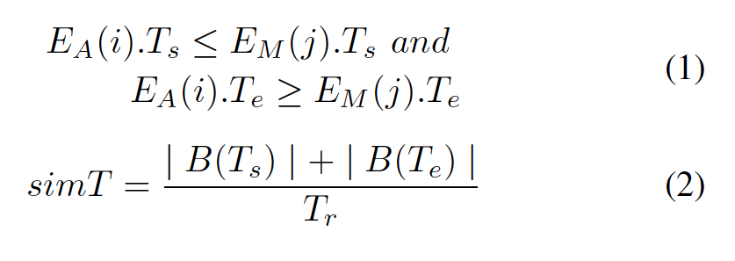

Correlation Inference Engine
Data-flow Correlation: (I, O, P)-Analysis
Timestamp Correlation:
Notes:
Dataflow Correlation: The first step for correlation is using data flow similarity analysis between events. The data-flow similarity is determined on the basis of process P, input I and output O;
Timestamp correlation: However, it is evident that using only dataflow correlation gives rise to duplicate associations between middleware and application layer provenance events. This duplication is because the same task can be reassigned to other workers due to failures which result in multiple correlations. Additionally in distributed environment, one same process can be executed concurrently on multiple nodes with the same input that may generate the same set of outputs. Both these associations can be corrected using timestamp correlation analysis.
Our algorithm assumes a synchronized clock, we select correlated provenance events based on the constraints as two functions on slides.
Equation (1) compares start timestamp and end timestamp to address event reassignment due to failures. From application layer, one subtask is assigned to worker nodes in middleware at the start timestamp Ts and will get end timestamp Te when a successful output is returned from worker nodes. So, the start timestamp of event from application layer should be no later than the start timestamp of the correlated event from middleware layer. Similarly, the end timestamp of event from application layer should be no earlier than the end timestamp of the correlated event from middleware layer.
Equation (2) is to infer correlation among events with same tuple (I,O,P) by locating the event with minimum simT. The simT is calculated as the sum of start time and end time bias divided by the time range of the provenance event from application layer. Since such duplication is not caused by task reassignment due to failures, there should be a one to one mapping between events from different layers. We select the event from middleware layer with the minimum simT to be considered correlated to event from application layer.

Slide 11
Event Mapper
Mapping the raw provenance data to structured provenance events using OPM for provenance representation and exchange
Set to a provenance management service which internally stores the data as relational tuples for future query and analysis
Notes:
Each process is reprensted as entity and involved data items are represented as artifacts with
specific timestamps and annotations. The lineage mapping and linkage between application layer and middleware layer is
presented as edges. We also incorporate agent information for attribution and citation.

Slide 12
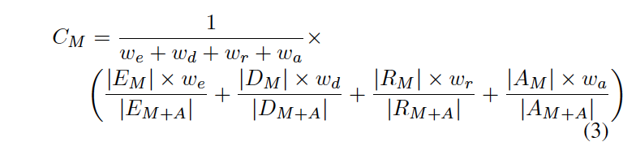
Completeness of Middleware Provenance
Contextual analysis for comparing the completeness of provenance from middleware layer to both middleware and application layer
Equation for completeness index C_{M} of middleware provenance
Entities(E), Artifacts(D), Relationships(R), Annotations(A), Middleware(M) and Application(A) layer, weights(w_{x} )
Notes:
The main idea behind the proposed provenance collection mechanism is to capture as much provenance information as possible through instrumented middleware. Additional provenance can be harvested from the application logs, if available.
We formulate the completeness of middleware provenance by analyzing the entities, artifacts and annotations in provenance events. We use Contextual analysis for comparing the completeness of provenance from middleware layer to both middleware and application layer.

Slide 13
Evaluation
Correlation Inference
Failure tracing
Performance overheads
Completeness evaluation
** All the tests are performed on a set of bare metal nodes on FutureGrid India clusters each of which is an IBM iDataPlex dx 360 M2 node with Intel Xeon X5550 processor @2.66GHz with 2 CPUs and 8 cores/processor. It has 64-bit Red-hat Enterprise Linux server and 24GB DDR3 RAM. Each execution is done on 4 to 32 node clusters with 8 processors per node.We use Karma V3.2.3 with RabbitMQ V3.2.0 for provenance storage and retrieval.

Slide 14
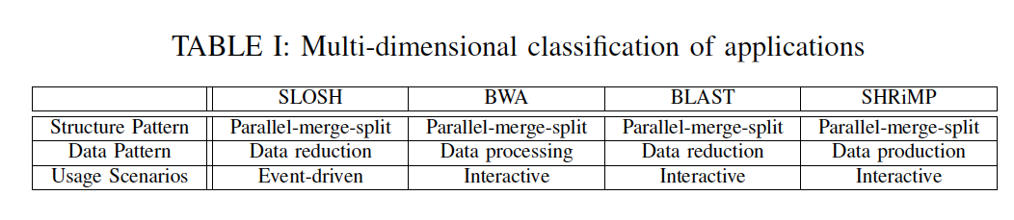
Applications
Atmospheric/oceanographic Workflow: SLOSH application(Sea, Lake, and Overland Surges from Hurricanes)
Bioinformatics workflows: BLAST, BWA and SHRiMP
Notes:
For our evaluation, we select applications from several science domains: the SLOSH application implements an atmospheric/oceanographic model of storm surge. BLAST, BWA and SHRiMP are from bioinformatics.
These applications are mix of data- and compute-intensive applications. They can be described using Ramakrishnan’s dimensions of size, resource usage, structural pattern, data pattern and usage scenarios as the table in this slide.
BLAST and SLOSH are compute-intensive, and BWA and SHRiMP are data-intensive. All of the applications utilize the parallel-merge-split pattern, which split the application into distinct tasks that then have their results combined.
Each of the applications processes gigabytes of input and output data delivered between hundreds of tasks running over a set of distributed nodes.

Slide 15
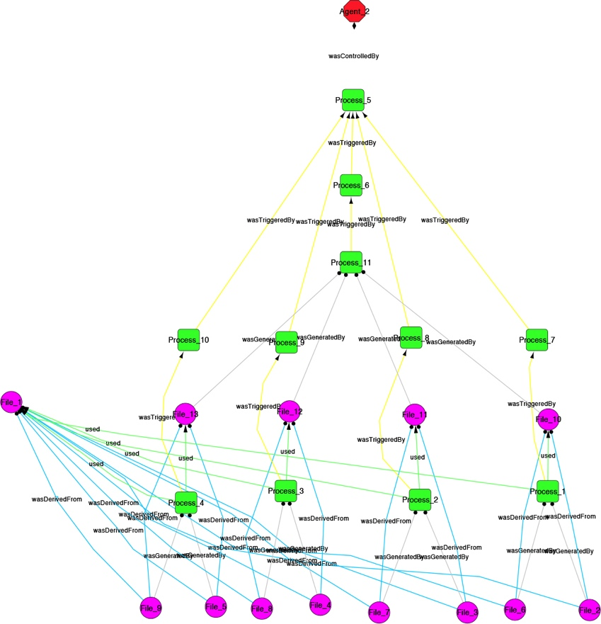
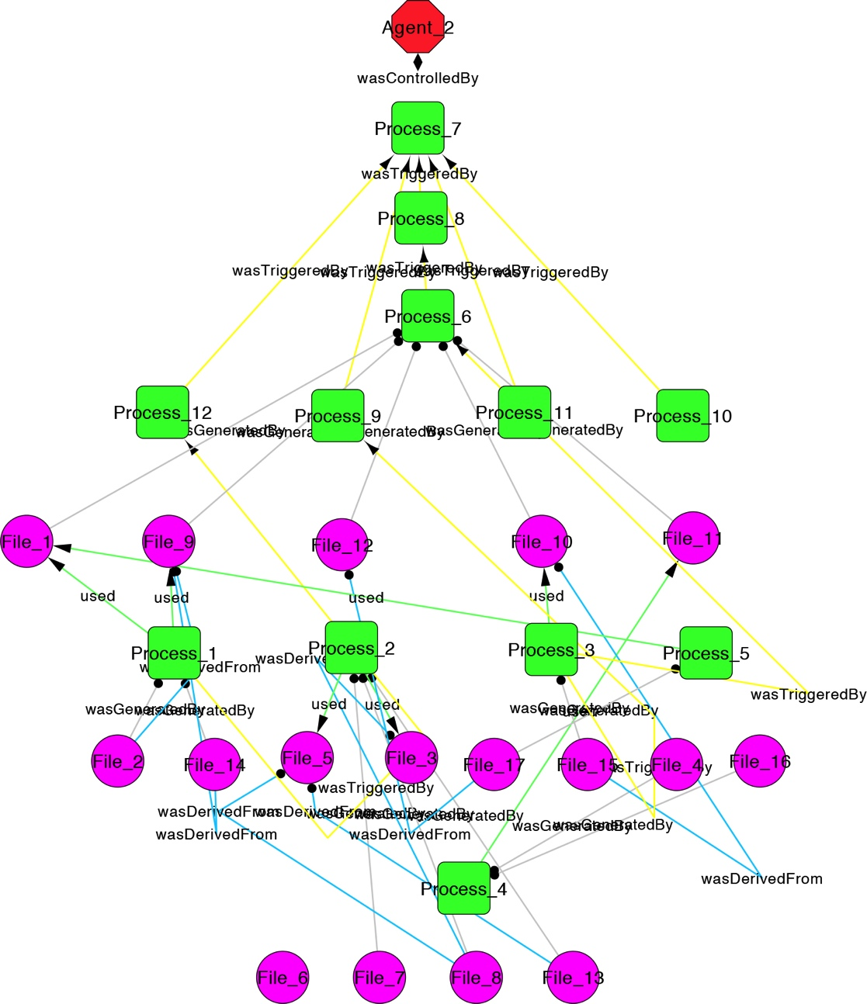
Correlation Inference
Fig. Layered provenance for SLOSH. The graphs show the significance and extent of middleware provenance as opposed to total provenance which is comprised of middleware and application layer provenance.
Notes:
In this first test, we execute SLOSH application and BWA applications, first capturing provenance only at the middleware layers, and second at both middleware and application layers.
Above figure gives a visual depiction of the difference. The key observation here is that middleware provenance is unable to capture provenance of data merge events where data are merged from multiple upstream tasks.
Besides, the comparison demonstrates that the correlation inference is an important step in order to have the complete lineage of the output data.

Slide 16
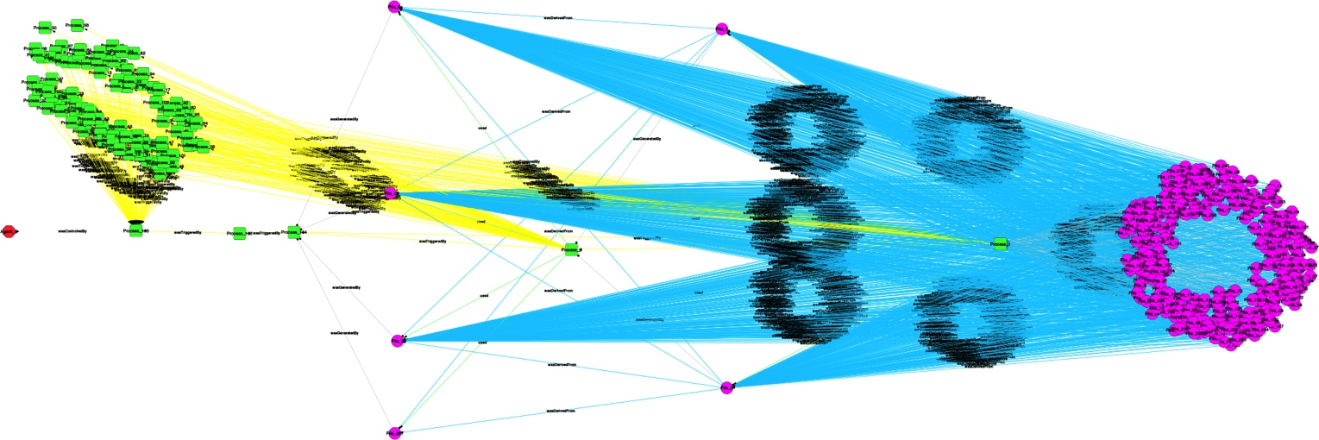
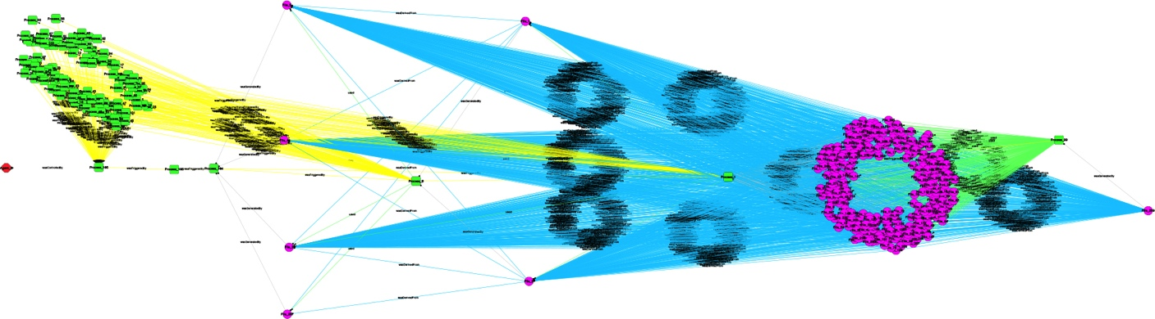
Fig. Layered provenance for BWA. The graphs show the significance and extent of middleware provenance as opposed to total provenance which is comprised of middleware and application layer provenance.

Slide 17
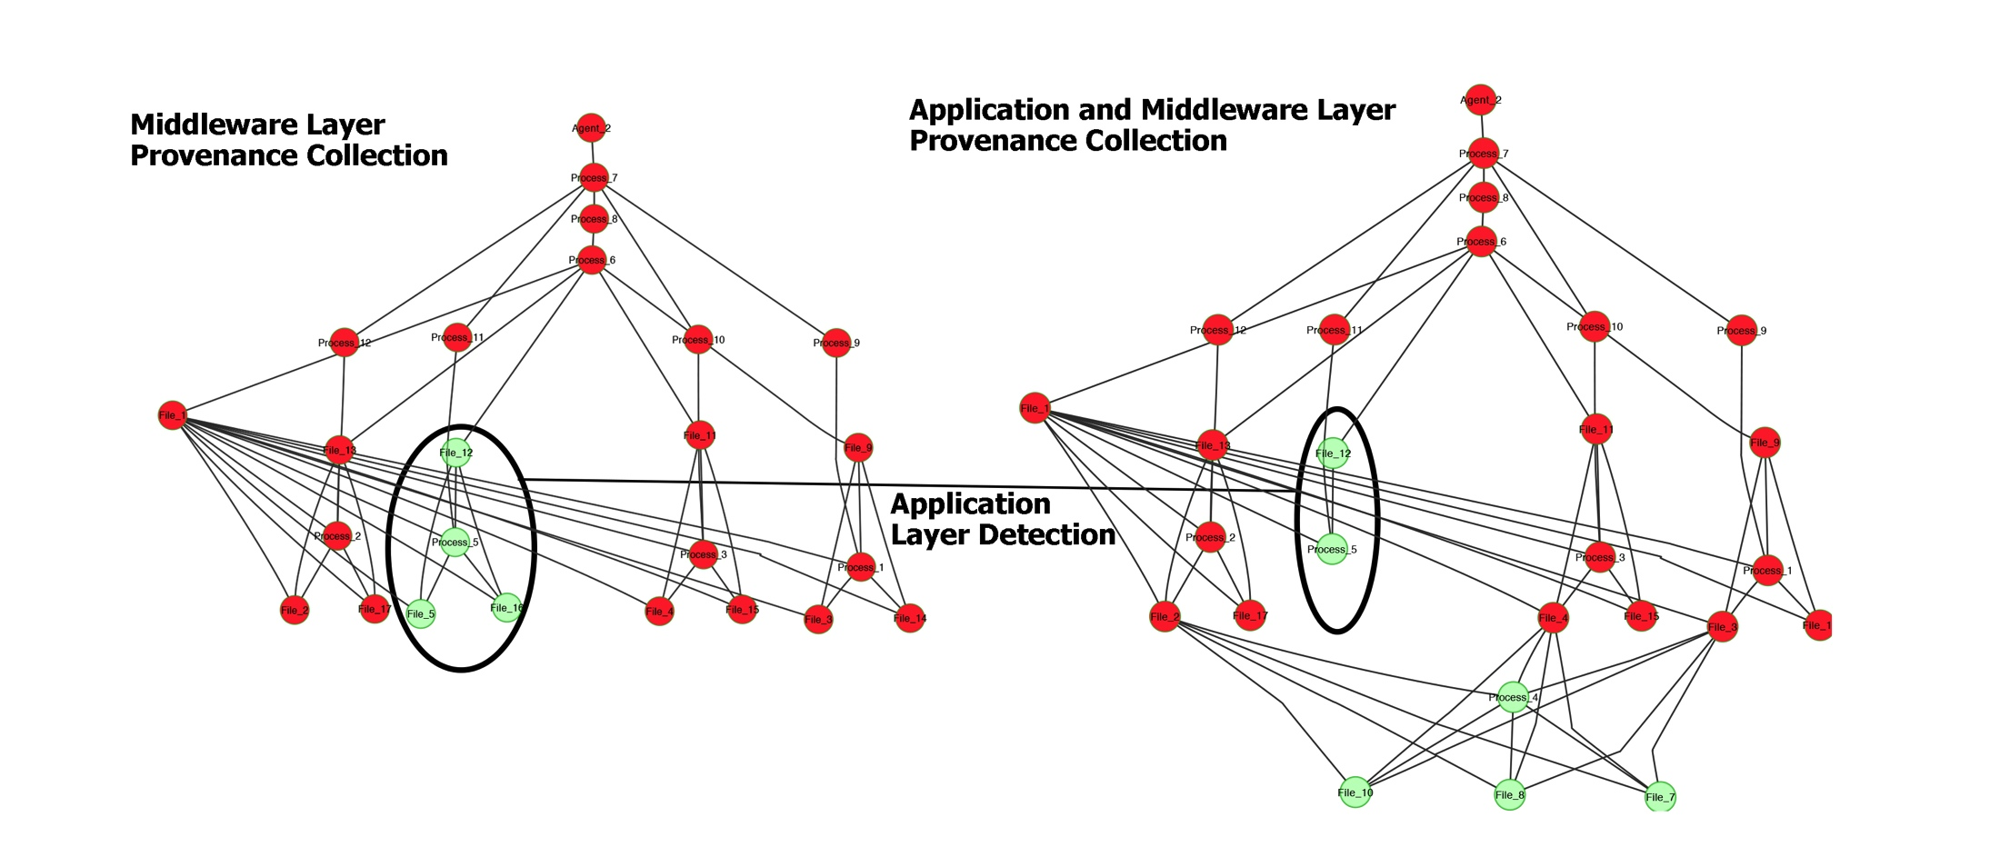
Failure tracing
Fig. Application Failure. Identification of different types of failures using layered provenance capture.
Notes:
The second test we carry out measures failure tracing. We simulate errors and failures over a set of executions of SLOSH workflow. And we trace the reasons of failure by tracking the provenance of each execution.
Through Application layer provenance we can identify application failures like unavailability of files as figure here.

Slide 18
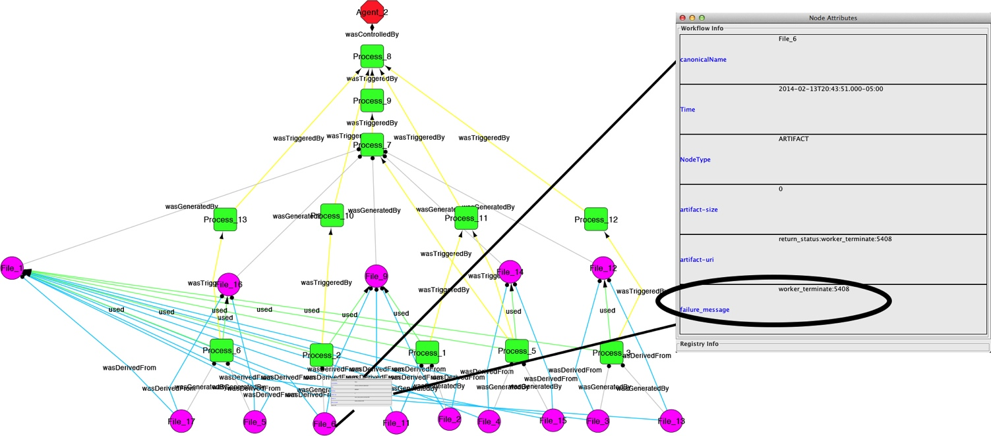
Fig. Middleware Failure. Identification of different types of failures using layered provenance capture.
Notes:
On the other hand, middleware layer provenance captures system and middleware failures such as unreachable hosts as shown in the figure here.

Slide 19
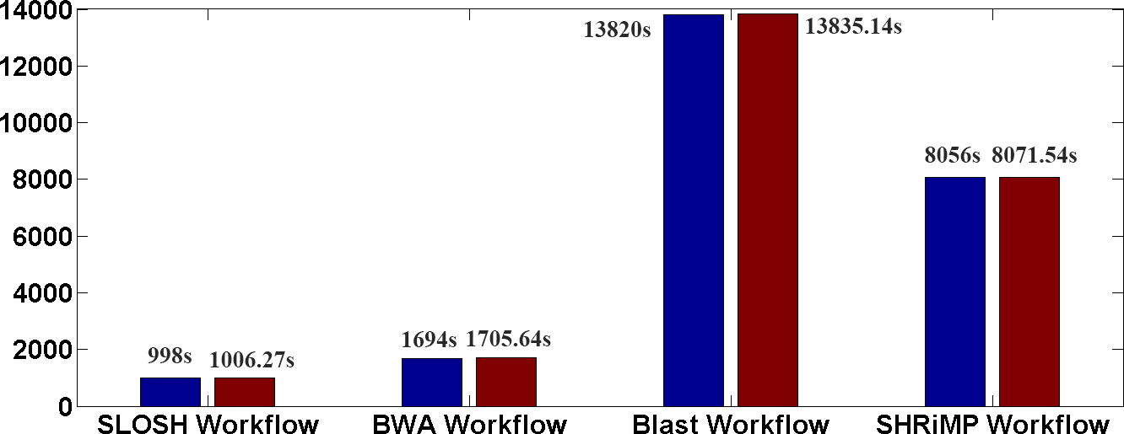
Performance Overheads
Fig. Performance overheads of using provenance-aware Middleware.
The blue bars show execution times for different applications using WorkQueue without using
the provenance-wrapper. The red bars show the results by making WorkQueue provenance-aware by encapsulating it within our provenance collection framework.
Notes:
This third test measures the overhead of provenance capture. From the comparison between red bars and blue bars, we can easily observe that for long running applications, overheads due to the provenance collection framework are minimal due to larger execution time of the applications. This is because the overheads are only due to pre-processing and logging of provenance events during execution which is minimal instrumentation.

Slide 20
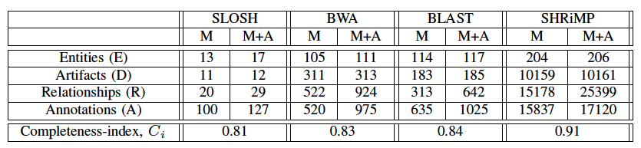
Completeness Evaluation
Table. Completeness of middleware provenance (w_{e} = 1;w_{d} = 1;w_{a} = 0:5;w_{r} = 0:5 )
Notes:
For the final test, we calculate the completeness of middleware provenance using the completeness –index Cm which is discussed earlier. From this result table, we can see middleware layer provenance
Is not 100% complete. The incompleteness of the middleware layer provenance is mainly because of the missing dependencies that are only identified at the application layer. This is because the precise
Relationships between different data artifacts are only known to the application layer and are abstracted from the middleware layer.

Slide 21
Discussion
Middleware provenance is able to capture job distribution and execution plans of a workflow with WorkQueue specification that outlines the steps of workflow execution;
Capturing only from middleware can eliminate certain important elements of provenance; Application layer provenance can be used as enhancement and also to cross-validate the correctness of middleware provenance.

Slide 22
Limitation
Varied and changing log formats
Quality of middleware provenance depends on different applications middleware
Notes:
Our provenance capturing mechanism benefits from provenance-rich logs and general application logs using a rule-based mechanism. Since the log formats for different systems can be varied such as log4j, etc, users need to use different rule sets to capture
provenance from different system logs.
In our evaluation, we show that by adding the provenance aware components to WorkQueue middleware, we can capture almost 80% of the total provenance information. We attributed such high-quality middleware layer provenance to WorkQueue which provides additional specifications that outlines the steps of workflow execution. This enables us to make the middleware provenance-aware without any additional instrumentation. However, other application middleware like GUSH may be lacked such detailed specifications
And hence resulted in relatively lower-quality middleware provenance without additional instrumentation.

Slide 23
Conclusion & Future work
Sources available at:https://github.com/Data-to-Insight-Center/Prov-scaffold
Extend methodology to other application middleware
Refine approach by adding correlation inference rules and user controllers
Notes:
We study middleware-centric provenance capture using several applications running on the WorkQueue Middleware. We measure the completeness of provenance from middleware
and show that it contains sufficient information to understand. the source data and processes involved in generating a data item. This kind of provenance is also useful in identifying
certain failures. While abstracted, middleware provenance is useful overall.
In future work we extend the methodology of provenance capture to other application middleware, comparing and quantifying quality parameters for provenance captured from different application middleware.
In addition, we are also refining our current approach by adding correlation inferencing rules and user controllers to provide more universality and user-configurability.

Slide 24
Acknowledgement
This work is funded by in part by the National Science Foundation under grant OCI-1234983. We thank Douglas Thain of University of Notre Dame, Craig Mattocks of the National Hurricane Center, and Abhirup Chakraborty of Indiana University for help and discussions.

Slide 25
Contact Information
Quan (Gabriel) Zhou: quzhou@indiana.edu
Devarshi Ghoshal: dghoshal@indiana.edu
Beth Plale: plale@indiana.edu

Slide 26
Questions?

Slide 27
Thanks!

