Slide 1




Evaluation of MPTCP on PRAGMA-ENT
Chawanat Nakasan, Kohei Ichikawa, Luca Clementi, Philip Papadopoulos
Demonstration, 2014/10/17 @ PRAGMA27, Indiana University Bloomington, IN
Notes:
This work represents my internship in collaboration with UCSD.

Slide 2
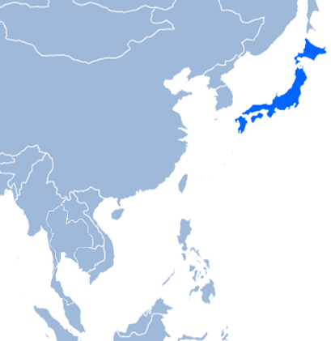
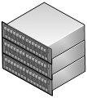
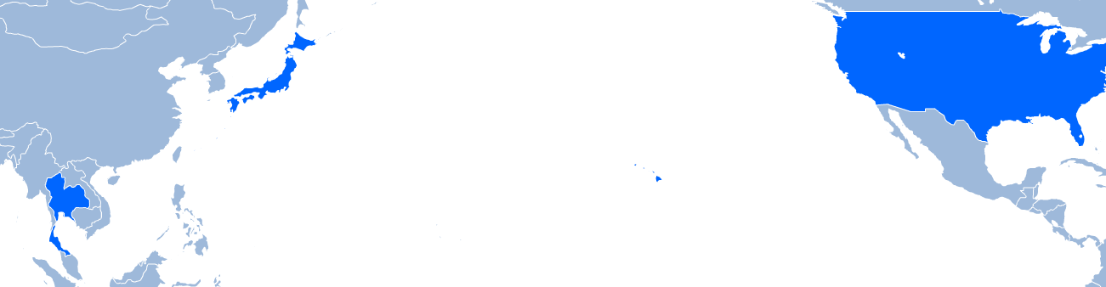

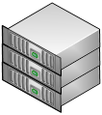











What is PRAGMA-ENT?
From the Lightning Talk
Single Overlay Network
Notes:
PRAGMA-ENT is an OpenFlow network created by collaborative efforts of PRAGMA members. The WAN is joined together using GRE, VLAN, and other technologies.

Slide 3

What is MPTCP?
From the Lightning Talk
TCP flows are aggregated and handled as a single link
Application
Application
MPTCP
MPTCP
TCP
TCP
TCP
TCP
IP
IP
IP
IP
ETH
ETH
ETH
ETH
Line
Line
Line
Line
Packet
Packet
Packet
Packet
Packet
Packet
Packet
Local System
Packet
Packet
Packet
Remote System
Notes:
MPTCP, Multipath TCP, is an extension to TCP that comes in a form of OS kernel. This kernel automatically forks multiple TCP subflows whenever a socket is created by an application. Congestion, buffers, and other parameters are also considered.

Slide 4
Why MPTCP?
Then I have to manage both sockets manually. Put 100 bytes in sock1, another 100 bytes in sock2 …
Manage sockets from apps
sock1 = socket.new()
sock2 = socket.new()
Application
“MPTCP”
TCP
IP
IP
ETH
ETH
The WAN environment is unfortunately not equal-cost.
Packet may arrive out-of-order and prompt TCP to retransmit.
Equal-Cost Multipath (ECMP)
Packet 1 => route 1 Packet 2 => route 2 etc.
Line
Line
Notes:
MPTCP is a new approach to multipathing. Multipathing can already be done using application-level sockets, or by using network-or-lower layer techniques like ECMP. While those are useful, they lack some perspective that makes MPTCP unique and compatible with our mission: Flow control for unequal links in the WAN, and full compatibility with other components.

Slide 5





Then why PRAGMA-ENT?
Because it’s Big: WANs work differently from LANs
Because it’s SDN: Easy to try out routing mechanisms & protocols
Single Overlay Network
Notes:
The PRAGMA-ENT is a WAN that spans multiple countries, and provide a perfect environment if we were to test something meant for WAN use. Additionally, being an SDN, PRAGMA-ENT is completely hackable, so any protocols, routing mechanisms, or variants of those, can be easily tested.

Slide 6

Conventional routing may behave less than optimally with MPTCP
Congestion
(assuming we use “minimum hops” routing and don’t use “exact same” route twice)
Notes:
For example, if we have a limit of two paths from one site to another and we choose lowest-hop routing, this is what would happen in this graph. As you can see, there is a congestion which reduces efficiency.

Slide 7
This is a solution. But how can we make this automatic?
We’ll find out later.
Notes:
Instead, we could compromise on the latency and have the second route use an entirely disjoint path so that each path can use maximum bandwidth instead.

Slide 8
Basics of MPTCP Kernel
Software & Components
Open vSwitch
iperf
MPTCP utils
MPTCP components managed by staff at UCLouvain
(multipath-tcp.org)
MPTCP Kernel (v0.89.2, based on Mainline 3.14.19) + Modules
Network Interface
Hardware Devices
Parts related to experiment
Other parts
Notes:
Next, we will talk about the basics of MPTCP. The MPTCP Kernel is, of course, a complete kernel based on *the* Linux kernel. It’s not a module so you cannot just compile them and slap on the mainline kernel. On top, the authors have additional utilities that further extend the customizability and lets you test, mod, play, or hack MPTCP further.

Slide 9
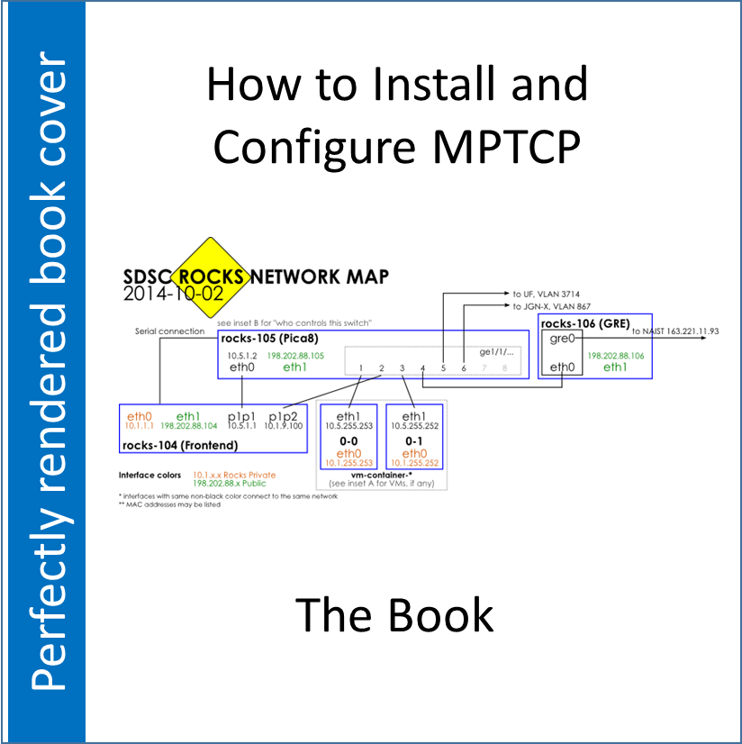

What must be done to set up MPTCP?
Compile Kernel
Set up routing tables
Must use multiple routing tables
Install additional
Specialized version of net-tools, tcpdump, etc. allow you to play with more options
Enjoy!
Do I look like a world-renowned book author now?
Seriously, the book is worthless. Get it here ➔➔➔
http://goo.gl/PpPqBb
Notes:
In order to facilitate compilation of MPTCP for Rocks cluster machines, or any other CentOS, I have compiled a small guide. It is (at time of writing) currently being edited by referred experts. Sharing is unlimited so please do.

Slide 10
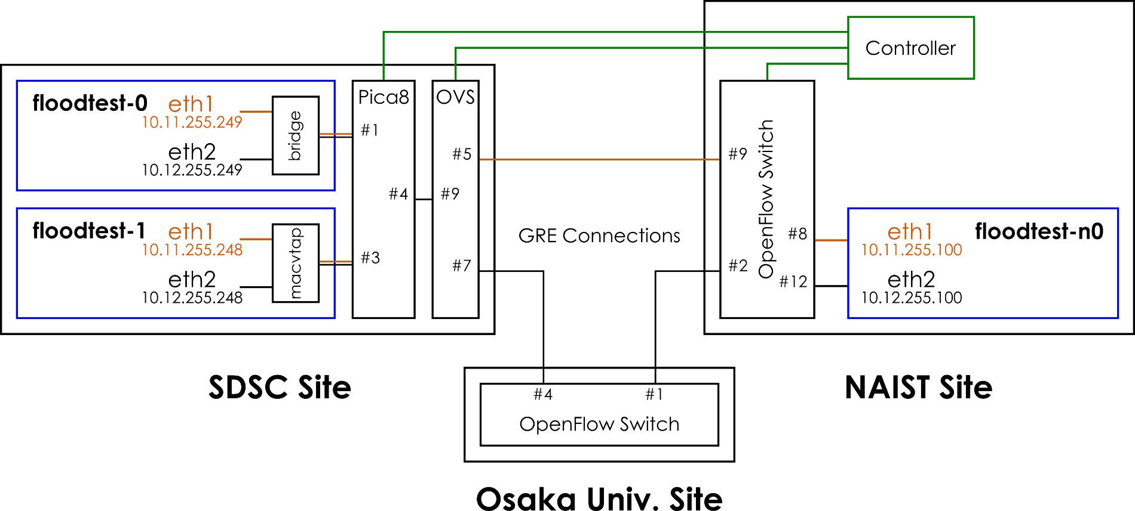
Where to configure everything
Add flow rules
(I’m using Floodlight for this one)
Install MPTCP & Routing Tables
GRE Connections from
PRAGMA-ENT project
Notes:
This is how I construct the test environment.

Slide 11
Live Demo
Rules:
Please tell me if I’m too fast.
Murphy’s Law may be in effect. I’m actually sharing the network with the previous and the next guys.

Slide 12
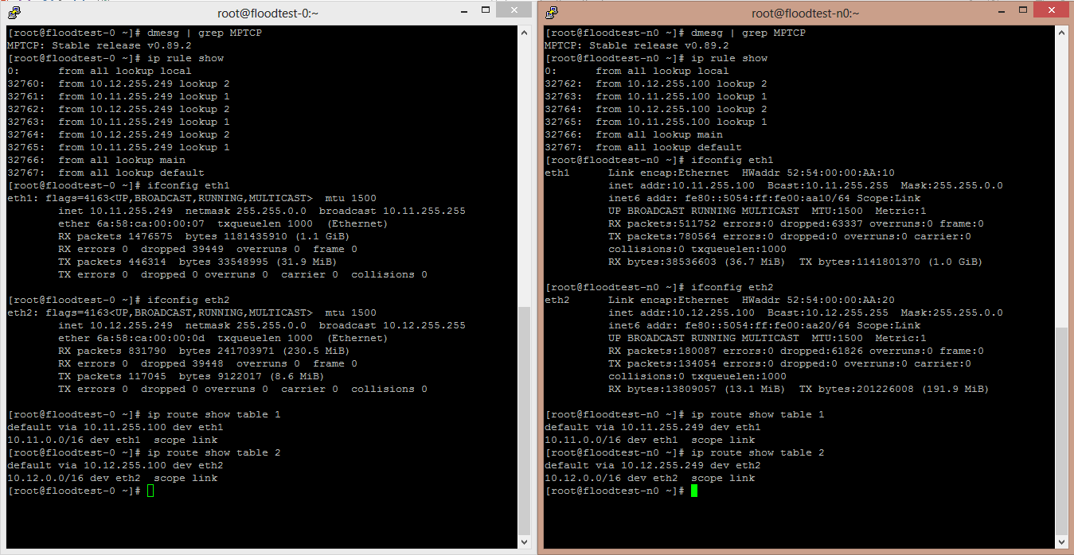
Verifying settings
dmesg | MPTCP; ip rule show; ip route show table 1
Notes:
Some ways to verify that it’s indeed working.

