Slide 1
Resources Working Group Report
PRAGMA 27

Slide 2
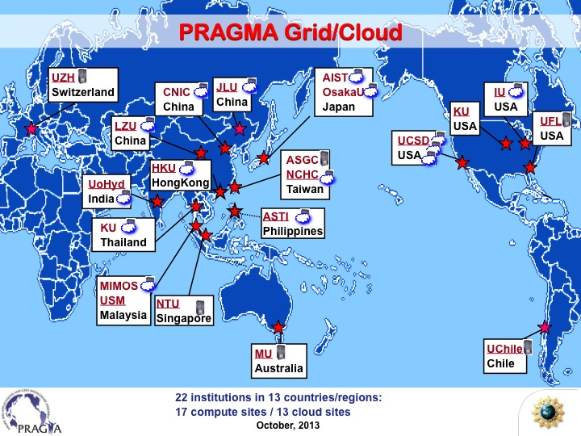
This Map is out of date
As a group we have effectively stopped using Globus
A number of sites have changed personnel
We have been effectively working on component technologies.
Time for the next step

Slide 3
Rebooting the Persistent PRAGMA Testbed
PRAGMA-wide persistent testbed resources
Various technologies are now “good” enough that we can profitably revisit.
PRAGMA Boot, Cloud Controller, Overlay Networks
Discussion was about
What, How, Who
Two types of natural testbed resources
Pure VM and Virtual Cluster Hosting.
VM and Virtual Cluster Hosting w/ programmable networking.
Need to be able to integrate data resources (particularly important in Biodiversity expedition)

Slide 4
Areas of Discussions
What cloud deployment technologies are people using today?
Rocks (UCSD), OpenStack, OpenNebula (NCHC),CloudStack (AIST, UFL, KU (thai),
How should we handle accounts?
something simple. Recognize that we don’t need to scale to 1000s of users.
Central place for usernames, contacts, public ssh keys?
Eduroam? Leveraging FutureGrid? OpenID? (weicheng to investigate)
Centralized SSH pubkey list via private GitHub Repository (Via an academic)
Access? How do we determine who/when a remote user can spin up a virtual cluster for an experiment.
Can we steal from HPC schedulers? What about Condor Scheduler?
Components from INCA that can be used to detect collisions.
Central Place for Reservations/Availability? ORCA from GENI/Planetlab?
Leases? Shava + Jose to investigate
Record keeping/performance
Tracking.
perfSONAR --- mesh config (John Hicks to assist in PRAGMA mesh config).

Slide 5
What’s an endpoint look like?
a Node to start/stop VMs/VC’s
N nodes to host VMs (N >= 4)
Support KVM.
perfSONAR host in the Rack (perhaps a VM on the head/submit node? – Public IP)
Probably need 8 available Public IP addresses
v6 addressing (unlimited!)
Sites:
UCSD, UF, NAIST, Internet2, CNIC?, Osaka, NCHC, IU (when Staffing issues are sorted)
UCSD (Luca, Phil, Nadya) to coordinate
---

Slide 6
Goals by Next PRAGMA
Resources Defined/Deployed
PRAGMA_BOOT at all sites
VM Images stored in Amazon S3 (Possibly Available through CloudFront
GitHub (Private) of users + ssh public keys
perfSONAR PRAGMA Mesh Deployed at all sites
Simple (one email?) request for resource allocation at sites.

Slide 7
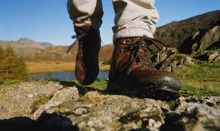
Lifemapper + ENT + Specialized Data (Overnight Hike)
Overall Goal: Run Lifemapper Cluster on PRAGMA ENT w/access to private satellite data
Data in Florida (Data is NOT on ENT Resources, but close to Florida Resources)
Have many of the component technologies but, the integration will drive activity and uncover specific issues
Need to extend the ENT openflow overlay to the data server
IPOP integration? To be worked out
ENT needs to have slicing so that we can have a (Semi) stable experiment env.
Some work to be done in Lifemapper itself to integrate the new Satellite Data
Demonstrated capability by Pragma 28 (2)
Sciene output: run/insight gained by using the data (Reed)
Technology Demo, all the pieces needed to make this work (the rest of us)
People
ENT: Kohei, Mauricio, Pong? Chawa? (for controller expertise)
IPOP: Renato
Cluster deployment: Aimee and Nadya
domain science: Reed

Slide 8
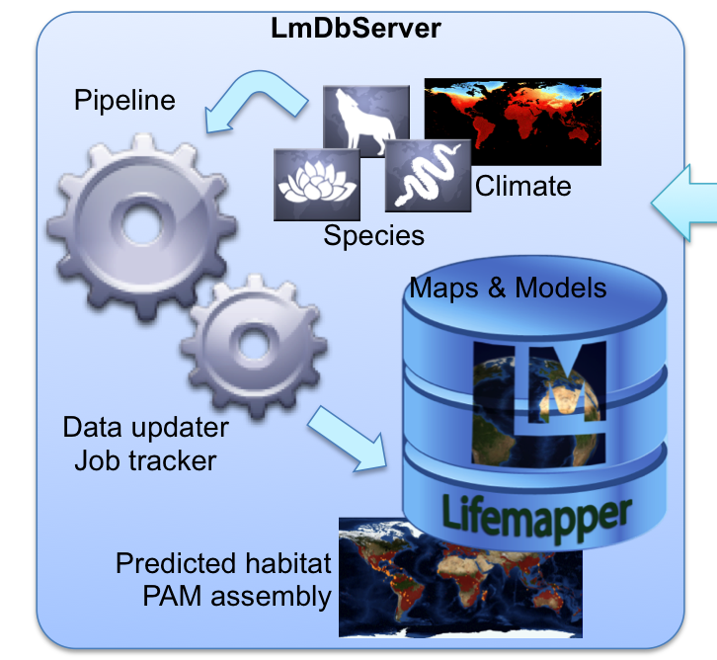


Lifemapper virtual compute clusters
Data resources
UAV multispectral imagery
Specimen data
Big, non-portable
plot data
Restricted, licensed
Specimen data
Commercial Multispectral imagery
Open, attributed
Trait, plot data
IPOP ?
Hardware, Middleware, and Networking
NAIST
Osaka U.
AIST
UTM
UQueen
UCSD
UF
NICT - RISE
Fla. Lambda Rail
Internet 2
PRAGMA-ENT
Pacific Wave

Slide 9
Discussion about Resources WG and Other working groups
Possible (Probable) resources WG ½ day meeting before usual 2-day meeting
For at least one working group session during meeting, Resources will NOT meet
members of resources will participate directly in other working groups
E.g Telescience/Geosciences
Biosciences
Cyber-learning
Goal: learn more of what others in PRAGMA need/desire from resources.

