Slide 1
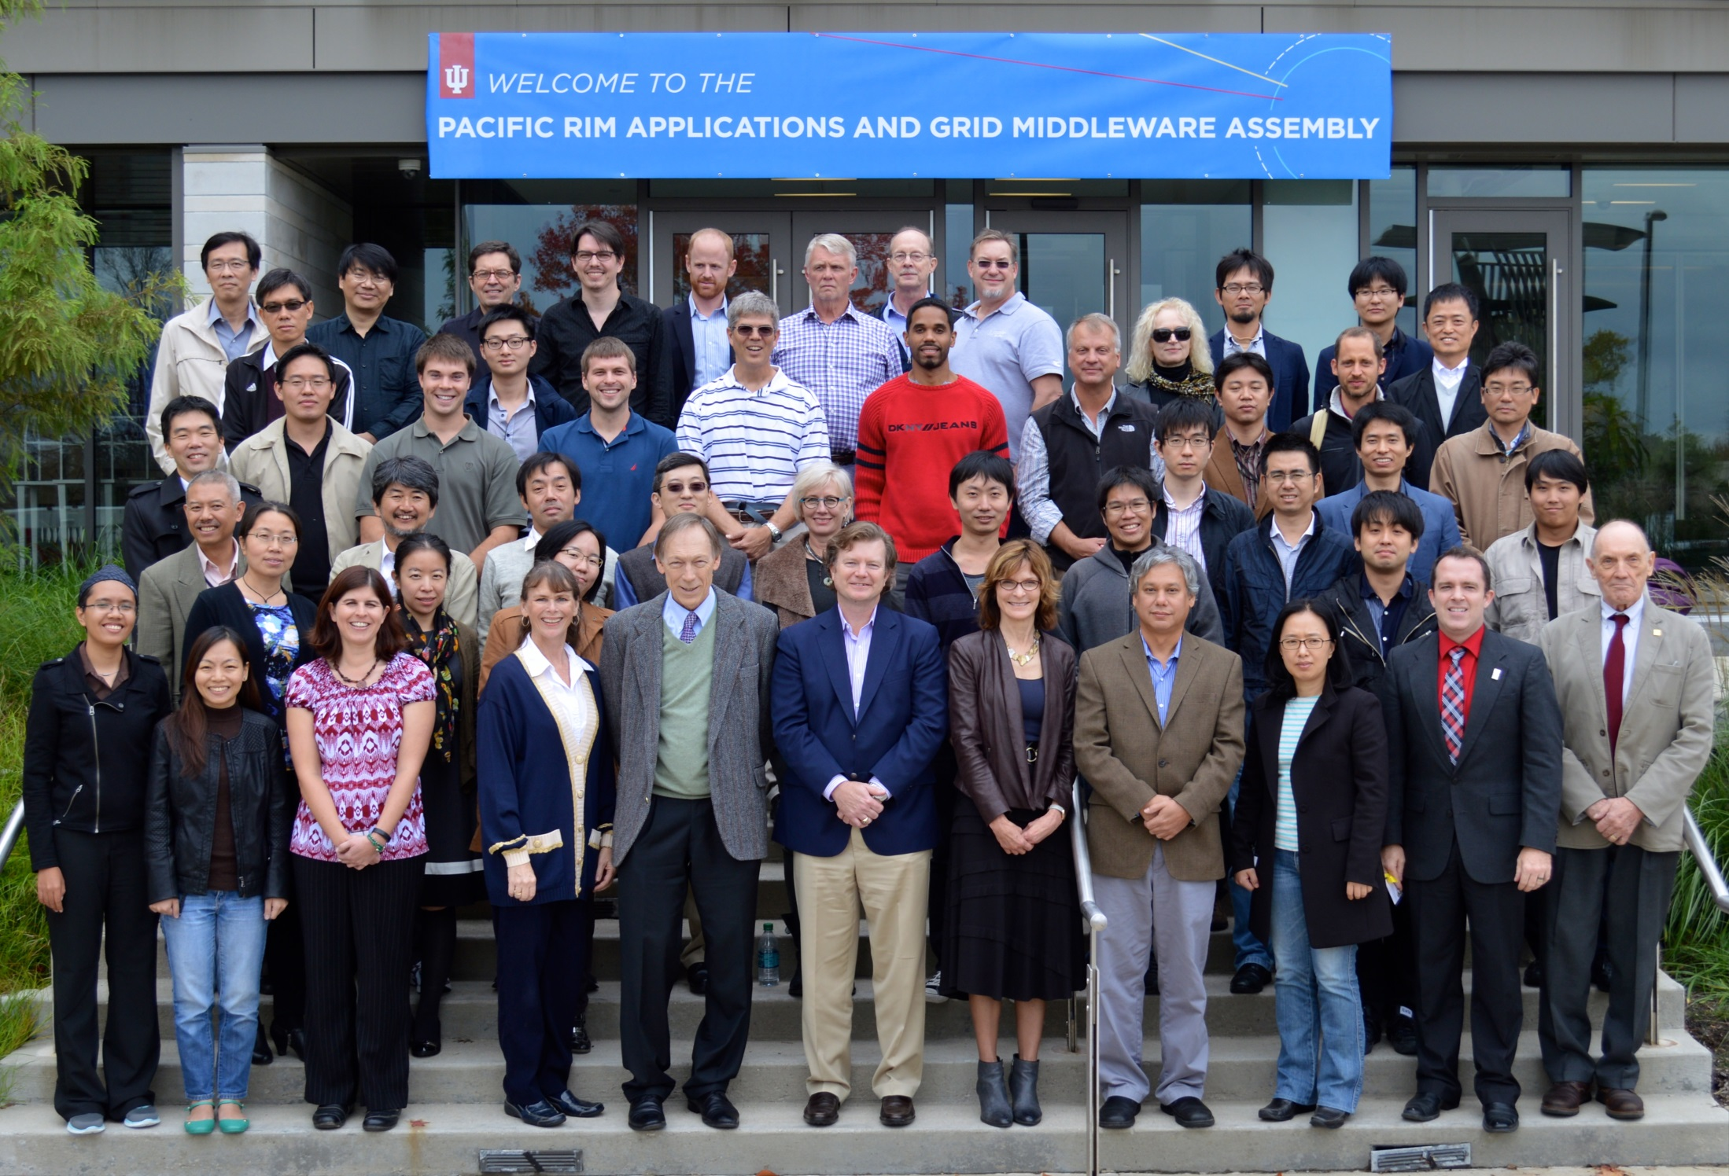

Slide 2
Slides to Nadya Williams
nadya@sdsc.edu

Slide 3
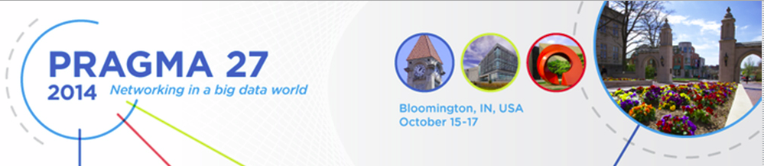
Steering Committee Report
PRAGMA 27
Bloomington Indiana
2014.10.17

Slide 4


New Members Applications Approved
Nara Institute of Science and Technology (NAIST)
Institute for Computational Science and Technology (ICST)

Slide 5
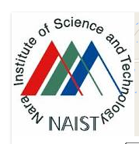
PRAGMA 28 in NARA
PRAGMA 28 Proposal
NAIST, April 8 – 10, 2015

Slide 6
Changes to Operational Principles and Practices
Representation of PRAGMA Students on Steering Committee
Terms to be while serving as lead of PRAGMA Students
Designation of Former Members as Ex-Officio
None voting, valued for their expertise and experience

Slide 7
Rotation of Steering Committee Members
Agreement that a system needs to be implemented, to balance desire for
New members
Institutional commitments
Key components (proposed)
Terms with process of renewal or rotation
Process for nomination, solicitation, and selection
Representative of diversity of members, institutions, expertise, geography, gender, …
Retain trusted relationship of committee, and PRAGMA

Slide 8
Other Topics
Workshops Structures
Balancing plenary talks, working group time, cross-working group discussions, demos and posters.
Issue: Often hard to start new working groups with concurrent sessions
One suggestion arose
Publications from PRAGMA Workshops
Interest by certain portion of PRAGMA membership

Slide 9
New Member of Steering Committee
Hosting workshop is a strategic activity
Beth Plale

Slide 10

Thanks to the Organizers and Sponsors
Beth Plale
Robert Ping
Quan Gabriel Zhou
Many others
US National Science
Foundation
Thank you and your organizations and sponsors

Slide 11
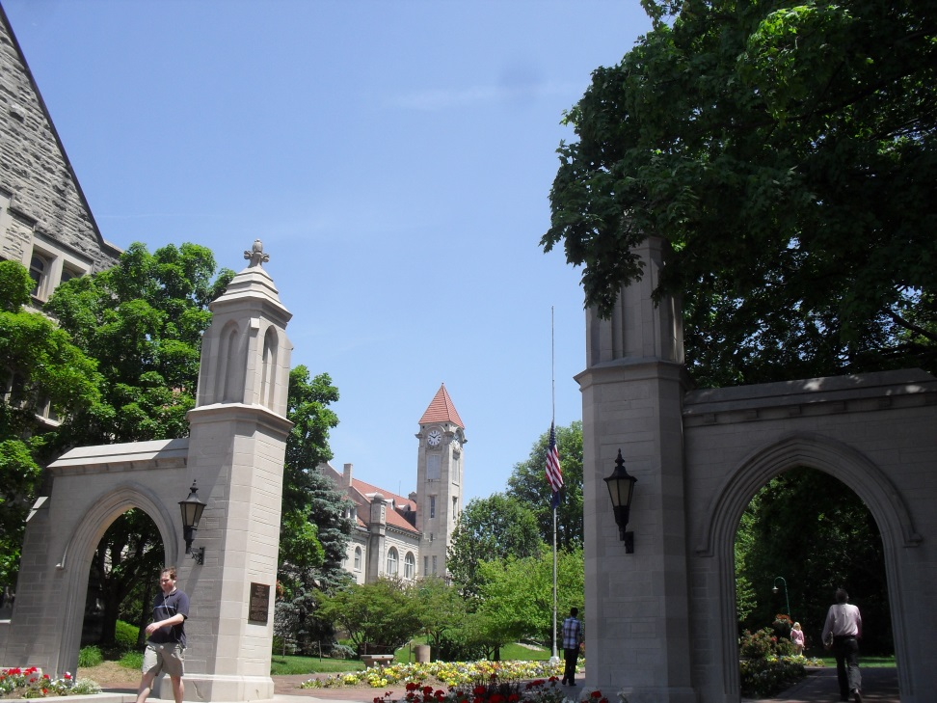

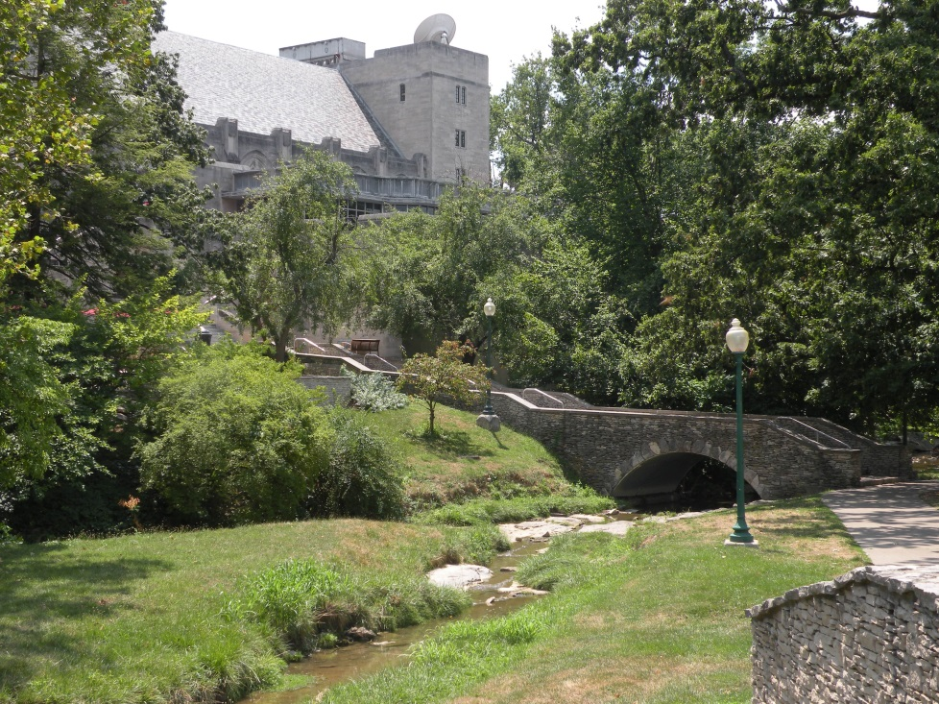
Enjoy the Beautiful Campus
PRAGMA 27 Indiana University

