Slide 1




Evaluation of MPTCP on PRAGMA-ENT
Chawanat Nakasan, Kohei Ichikawa, Luca Clementi, Philip Papadopoulos
Lightning Talk, 2014/10/15 @ PRAGMA27, Indiana University Bloomington, IN

Slide 2
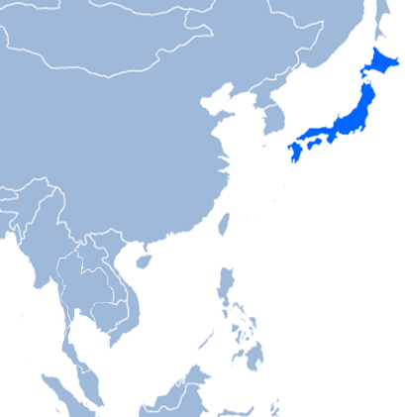
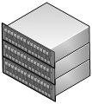
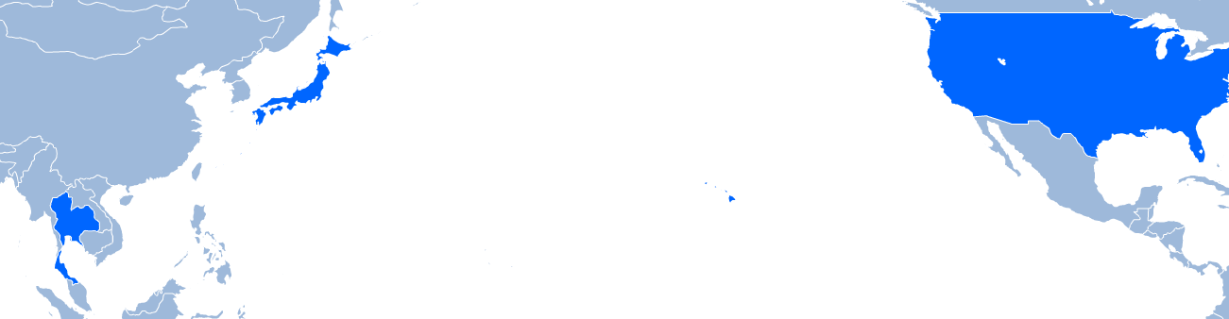

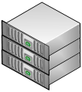











What is PRAGMA-ENT?
Single Overlay Network
Notes:
The ENT in PRAGMA-ENT stands for Experimental Network Testbed. It’s a collaboration between many organizations to create an SDN overlay network spanning multiple domains and sites. It is a very true-to-the-books infrastructure network. The sites are connected together using L3 GRE and L2 VLANs.

Slide 3

What is MPTCP?
TCP flows are aggregated and handled as a single link
Application
Application
MPTCP
MPTCP
TCP
TCP
TCP
TCP
IP
IP
IP
IP
ETH
ETH
ETH
ETH
Line
Line
Line
Line
Packet
Packet
Packet
Packet
Packet
Packet
Packet
Local System
Packet
Packet
Packet
Remote System
Notes:
Multipath TCP, or MPTCP, is an extension to the TCP protocol. Being a transport-layer modification, it has the advantage of compatibility as it allows multiple routes to be used at the same time without modifying an application (as in application-layer protocols like GridFTP) or configuring the network (as in network-layer techniques like ECMP). Essentially, with MPTCP, application can open just one socket and multiple routes will be used simultaneously.

Slide 4
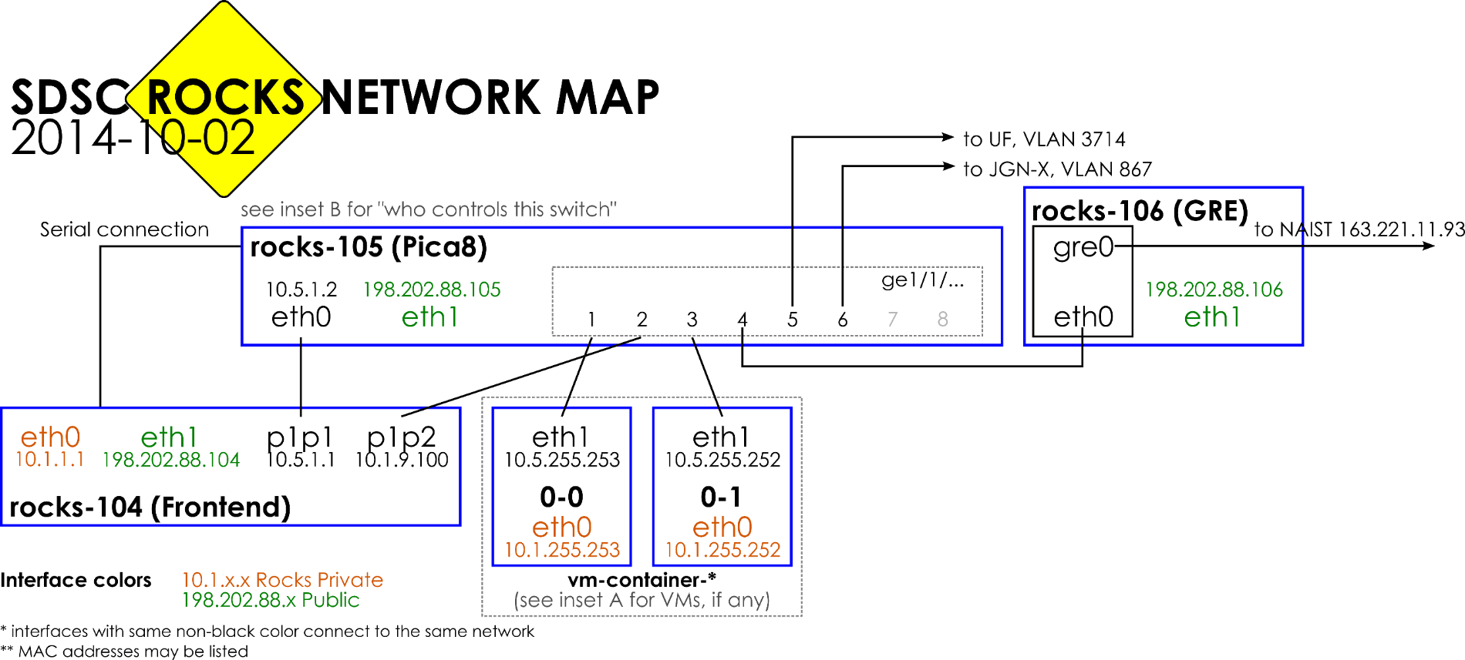
SDSC (UCSD) updates for PRAGMA-ENT
Interconnected using OVS
vm-container-0-1 now uses macvtap
Notes:
During my internship at UCSD, we worked with the San Diego Supercomputing Center Rocks Cluster network. There were some slight changes and I redocumented the network into a map. This red ring here shows us where SDSC is connected to the rest of PRAGMA-ENT. Both rocks-105 and rocks-106 use Open vSwitch, so all traffic in and out of SDSC can be regulated using OpenFlow. Additionally, after user request, Luca had set up vm-container-0-1 for macvtap, allowing the physical interface to be connected directly to the virtual machines, without OS-level bridging. This allows tighter integration between the VMs and the main network, but it will cut off communication between the VM and the host. Therefore, we are still quite open about whether or not to recommend everyone to try it ☺
If you are a current PRAGMA-ENT developer, you can download this in SVG or PNG from our Gdrive.

Slide 5
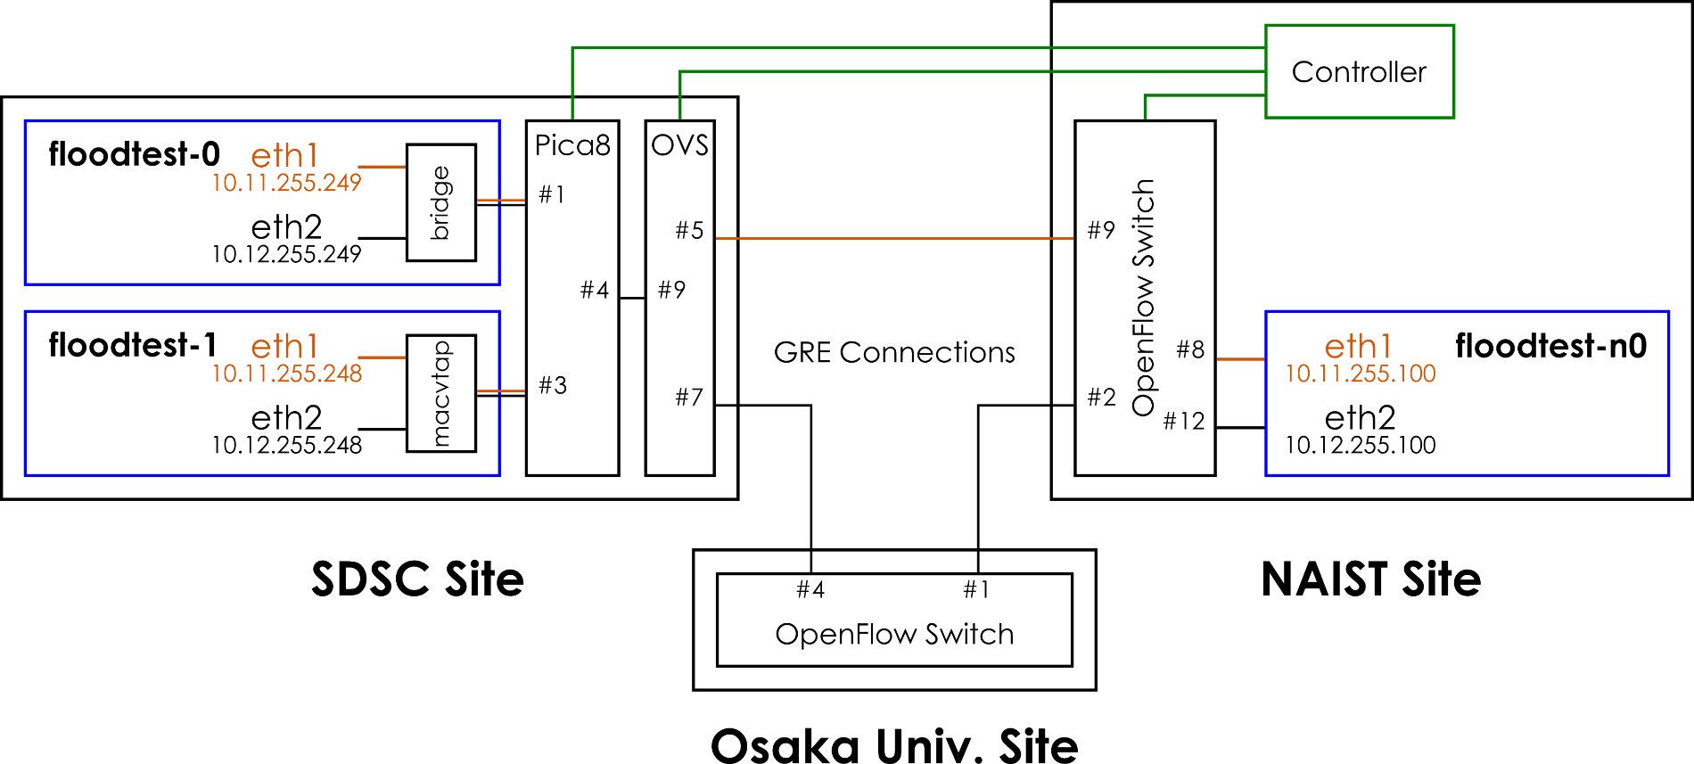
MPTCP implementation on PRAGMA-ENT
Add flow rules
(I’m using Floodlight for this one)
Install MPTCP & Routing Tables
GRE Connections from
PRAGMA-ENT project
Notes:
So we have compiled MPTCP kernels for SDSC and NAIST sites. The Controller will create two routes between SDSC and NAIST, one of them through direct GRE link and another through Osaka University. By the nature of MPTCP, we expect that it will work as soon as we set up routing and MPTCP on each host node. This is an ongoing work nearing its conclusion and we expect to get results real soon.

Slide 6



What will this mean?
User Application
=> Functionality
MPTCP
=> Utilization
Overlay Network
=> Connectivity
Single Overlay Network + Full Path Utilization
Notes:
PRAGMA-ENT allows research projects to be done on top of the unified overlay network while OpenFlow controllers can specify the behavior of PRAGMA-ENT. We already have promising applications and good networks. We are confident that MPTCP will be an important key to maximize path utilization in the overlay networks, and will continue to perform more extensive tests and integration in the future.

