Slide 1
Lake Expedition: Response of Anoxia in Lake Mendota to seasonally and diurnally asymmetric air temperature changes
Craig Snortheim¹, Paul C. Hanson², Trina McMahon¹, Jordan S. Read³, Luke Winslow², Cayelan C. Carey⁴, Renato Figueiredo⁵, Louise C. Bruce⁶
¹ Department of Civil and Environmental Engineering, University of Wisconsin-Madison, 1415 Engineering Drive, Madison, WI 53706
² Center for Limnology, University of Wisconsin- Madison, 680 North Park Street, Madison, WI 53706
³ Center for Integrated Data Analytics, United States Geological Survey, 8505 Research Way, Middleton, WI 53562
⁴ Department of Biological Sciences, Virginia Tech, 1405 Perry Street, Blacksburg, VA 24061
⁵ Department of Electrical and Computer Engineering, University of Florida, 968 Center Drive, Gainesville, FL 32611-6200
⁶ School of Earth & Environment, University of Western Australia, 35 Stirling Highway, Crawley, WA 6009, Australia
Notes:
This project is part of the GLEON-PRAGMA Lake Expedition. We investigated the response of anoxia (or lake of dissolved oxygen) to changes in climate. We specifically looked at how the time of day or season of year of air temperature changes effected changes in anoxia in Lake Mendota, using a 1-D water quality model. I’ll first talk about the lake science and preliminary results, and then move into how modeling projects like this can greatly benefit from computing resources like the iPOP overlay network and HTCondor.

Slide 2
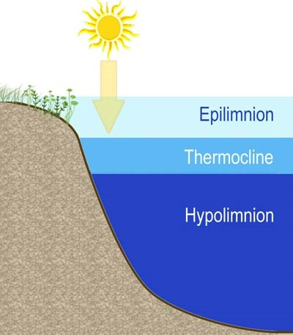
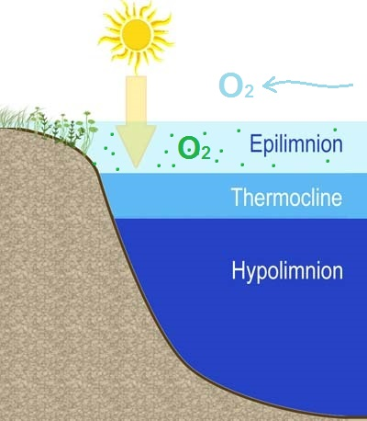



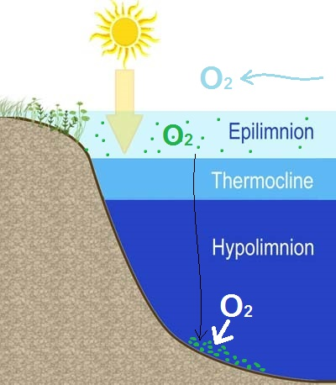

Lake Stratification and Anoxia
Notes:
Lakes are heated from the surface
Warmer, lower density water develops at surface in spring/summer a temperature/density gradient develops (i.e. lake stratification)
This physically separates deep waters from the oxygen sources in the surface layers – photosynthesis and atmosphere
When organic matter is decomposed in the deep waters, oxygen is consumed and the isolated bottom waters become anoxic
This is important because anoxia deteriorates ecosystem health by enhancing internal nutrient loading, releasing toxic metals from sediments, limiting fish habitat and potentially altering food web structure
Given this, strength of stratification and organic matter input to deep waters affects the intensity of anoxia
Both of these could be altered by climate change, however the effects are likely to change depending on the time of day or season of year that the air temperature changes occur because different lake processes occur at different times of day and different times of year.
We investigated these potential changes using a relatively new, open source, 1-D hydrodynamic-biogeochemical model GLM-FABM-AED developed at the University of Western- Australia…..

Slide 3
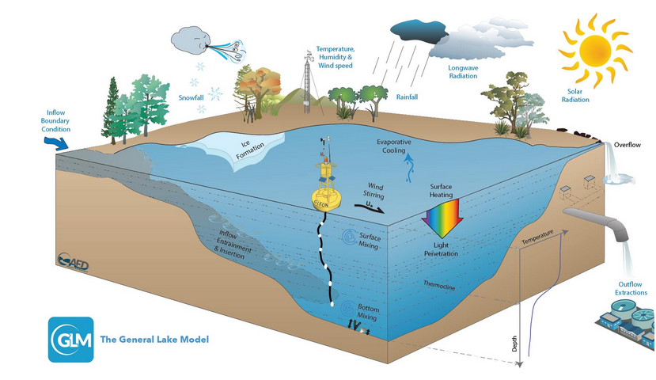
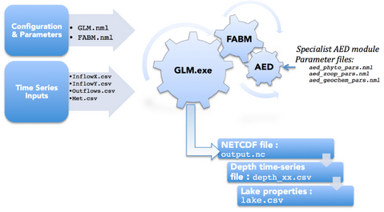
GLM-FABM-AED

Slide 4
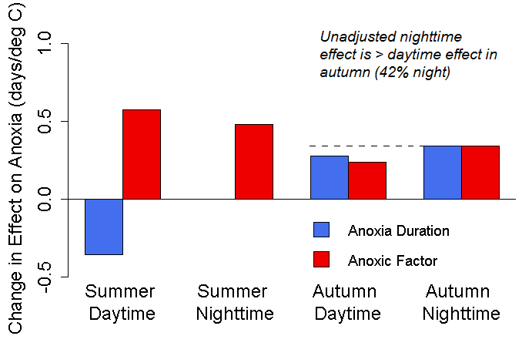
**Nighttime effects (days/deg C) are about 2x daytime effects when accounting for time of exposure
Notes:
We are finding that

Slide 5

Versatility of R
Pre-processing:
changing parameters in configuration files
changing driver data (scenario)
creating directories and copying simulation files
Simulation Execution:
system call to run simulation
parallel computing interface
non-linear, multi-dimensional optimization functions
Post-processing:
reading data from NetCDF file
statistical comparison to field data
summarizing results or calculating metrics
visualization of modeled data

Slide 6
Parameter Optimization Workflow
Original Parameters File
New Parameters File
NetCDF File (~290 MB)
Modeled & Observed Data (~ 1-2 MB)
Objective Function Value (single FP number, 48 bytes)
Optimization wrapper provides new parameter values based on previous runs--- difficult to run in distributed environment
System call to run sim
Extract data from NetCDF
Execute statistical comparison
Optimization Wrapper (Nelder-Mead method)

Slide 7
Climate Change Scenario Workflow
Original Meteorological Data File
Altered Meteorological Data File (+ air temperature increment)
NetCDF File (~290 MB)
Modeled Temperature, Oxygen and Phytoplankton Data (~5MB)
Anoxia Measure
(48 bytes per FPN)
Each simulation is independent and can be run in parallel or distributed computing environment
System call to run sim
Extract data from NetCDF
Post-
processing
Store results to data frame for writing to CSV file at end

Slide 8
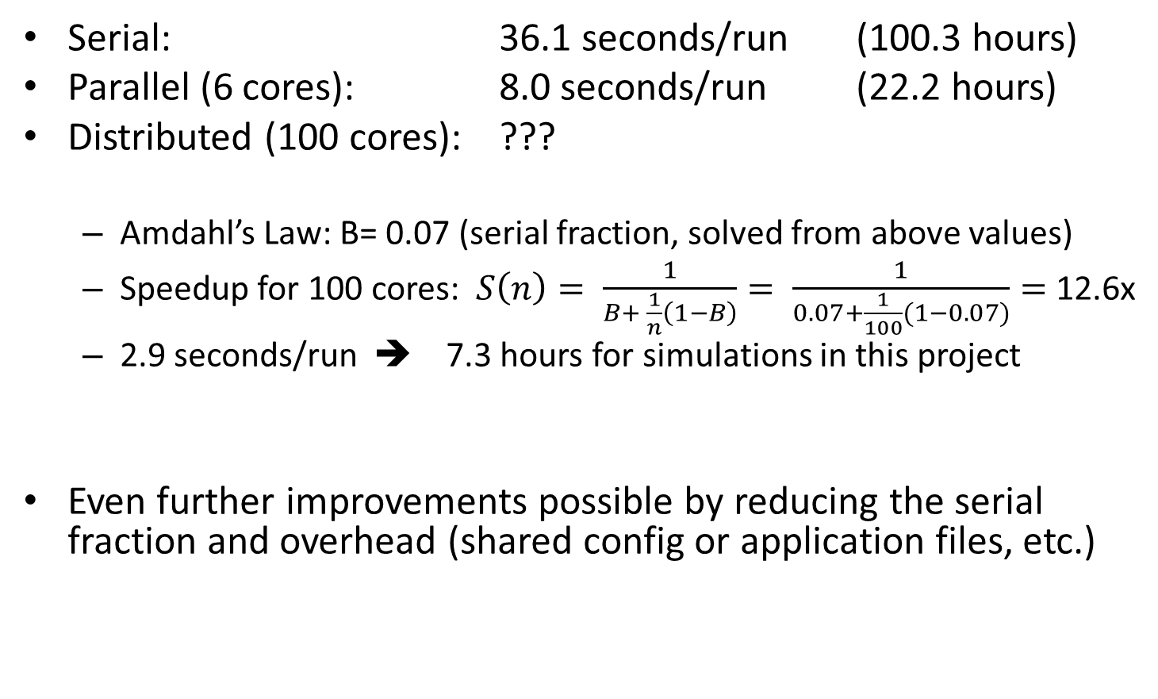
Compute Times
Serial: 36.1 seconds/run (100.3 hours)
Parallel (6 cores): 8.0 seconds/run (22.2 hours)
Distributed (100 cores): ???
Amdahl’s Law: B= 0.07 (serial fraction, solved from above values)
Speedup for 100 cores: $S\left(n\right)= \frac{1}{B+ \frac{1}{n}\left(1−B\right)}= \frac{1}{0.07+\frac{1}{100}(1−0.07)}=$ 12.6x
2.9 seconds/run ➔ 7.3 hours for simulations in this project
Even further improvements possible by reducing the serial fraction and overhead (shared config or application files, etc.)

Slide 9
References
Lake Stratification w/ sun: http://pelicanlakemn.org/Education/Lake_Learning/spring_turnover_in_our_lakes.htm
Louisiana Fishkill (+ NG logo): http://news.nationalgeographic.com/news/2010/09/100916-fish-kill-louisiana-gulf-oil-spill-dead-zone-science-environment/
Toledo Water: http://www.nytimes.com/2014/08/04/us/toledo-faces-second-day-of-water-ban.html
Qingdao Algae Bloom (+ NY Times logo): http://www.nytimes.com/2008/07/01/world/asia/01algae.html?_r=0
GLM Model diagrams (2):
http://aed.see.uwa.edu.au/research/models/GLM/
R logo: http://www.r-project.org/
Amdahl’s Law: http://en.wikipedia.org/wiki/Amdahl%27s_law

