Slide 1
Expedition Programming Challenge CASE III
Yu Luo
MS. Computer Science
Indiana University

Slide 2
Background
-DO datasets:
dissolved oxygen data collected by a sensor in reservoir- this sensor is deployed for month-long intervals and collects data every 15 minutes at 1m depth.
-FCR datasets:
5 temperature files collected by thermistors deployed at five depths (depth in the file name). These sensors were deployed in June 2013 and removed in March 2014, and collect data every five minutes.

Slide 3
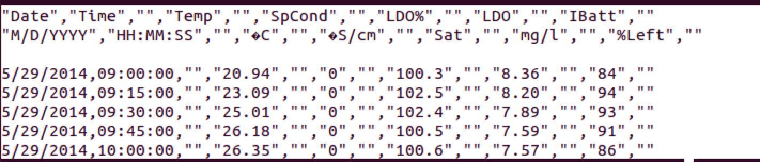
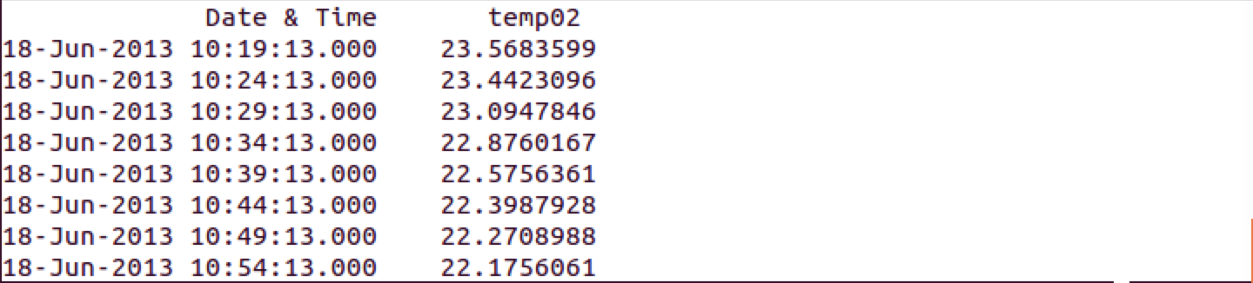
Raw Data (retrieved from data stream simulator)
DO Dataset sample
FCR Dataset sample

Slide 4
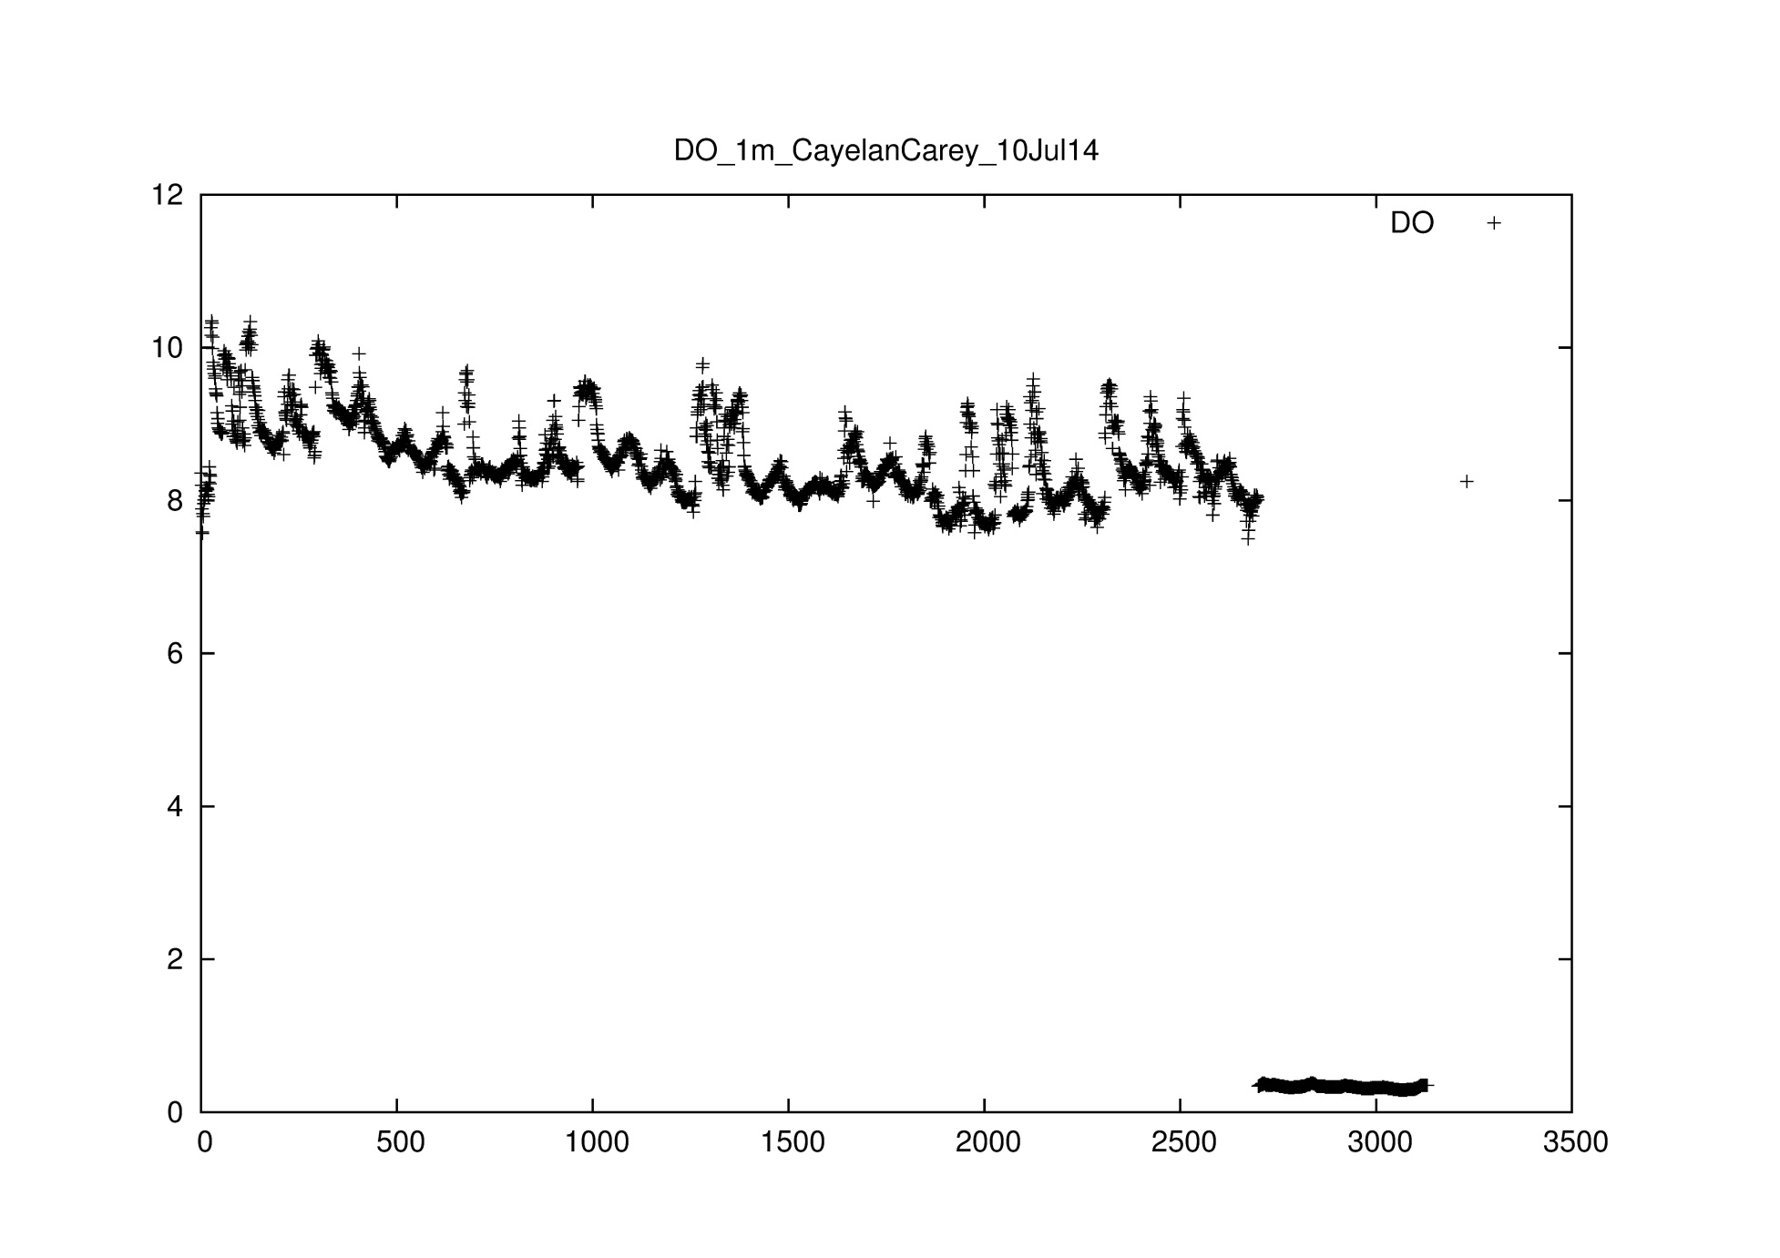
Raw data visualization

Slide 5
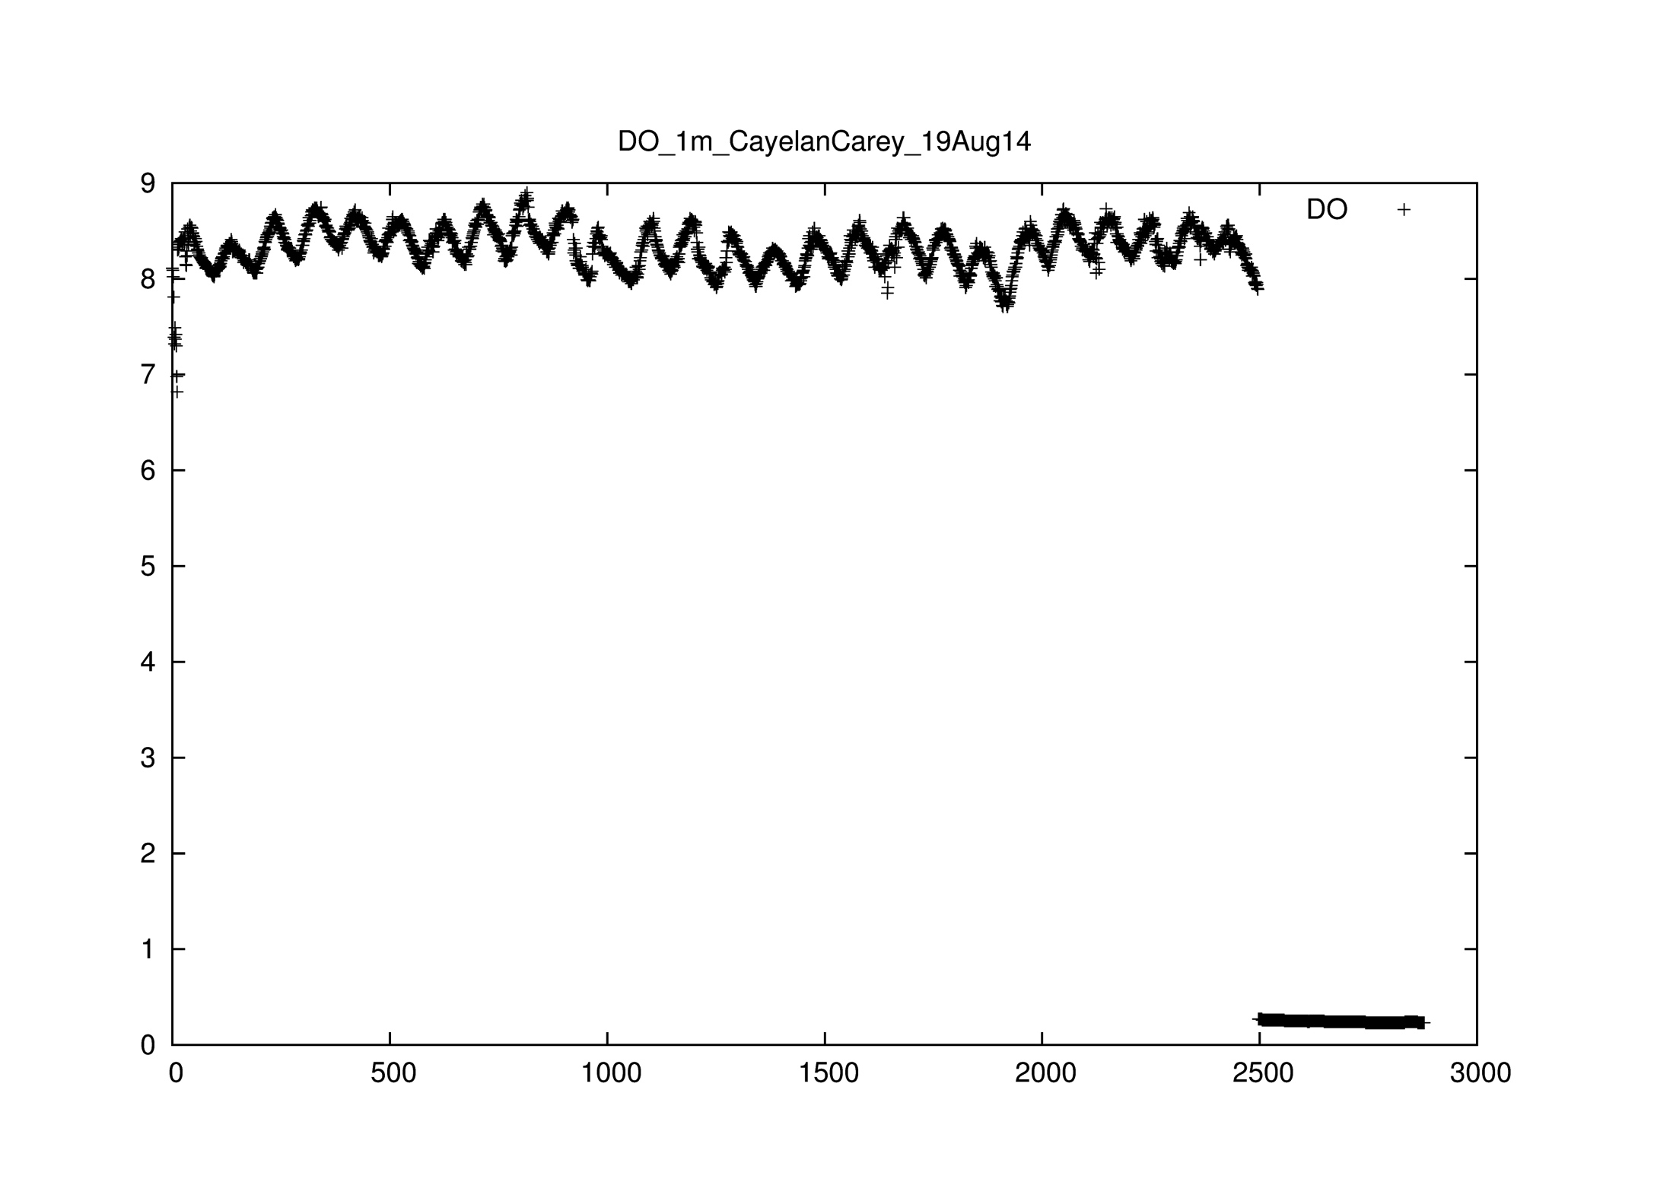
More Raw Data Visualization

Slide 6
Discussion
Data Issues:
1. Outliers
2. Low Battery Screening
3. Drift
Solution:
Data Cleaning.
Final Result:
Product two different .txt files
- .txt files that removes the outliers and sensor drift
- .txt files that leaves the raw data but adds flags

Slide 7
Data Cleaning Workflow
Raw Data
Flag the Outlier message(append a flag)
Tuple = “”, “”, “”, “”, “outlier”
Process 1
Flagged Data
2. Flag the Battery error message(append a flag)
Tuple = “”, “”, “”, “”, “nobattery”
Process 2
Final Data
3. Flag the Drift message(append a flag)
Tuple = “”, “”, “”, “”, “drift”

Slide 8

Outliers
What is outliers?
e.g., LDO > 15 mg/L or a negative number
LDO 1m depth

Slide 9
Outlier Filter
Read the raw data file line by line
(delete the header lines and description lines)
2. For each line, check the attributes
if “LDO” > 15 or “LDO” < 0,
append flag “outlier” at the end of line;
3. Save all lines to new .text file

Slide 10

Low Battery Screening
After reading the data file, we draw a scatter plot whose x-axis is time and its y-axis is Temp or LDO.
From the above graphic, we could find that the some points are plotted at low degree.
Battery Dies:
In DO data sets, we could find battery information. When “IBatt” is 0, it means sensor is out of power.
In FCR data sets, when the Temp is null. It means the sensor is out of power.

Slide 11
Battery Filter
Read the raw data file line by line
(delete the header lines and distribution lines)
2. For each line, check the attributes
if “LDO” > 15 or “LDO” < 0,
append flag “outlier” at the end of line;
if “IBatt” is 0,
append flag “nobattery” at the end of line;
if “Temp” is null,
append flag “nobattery” at the end of line;
3. Save all lines to new .text file

Slide 12
Before Outlier Filter and Battery Filter

Slide 13
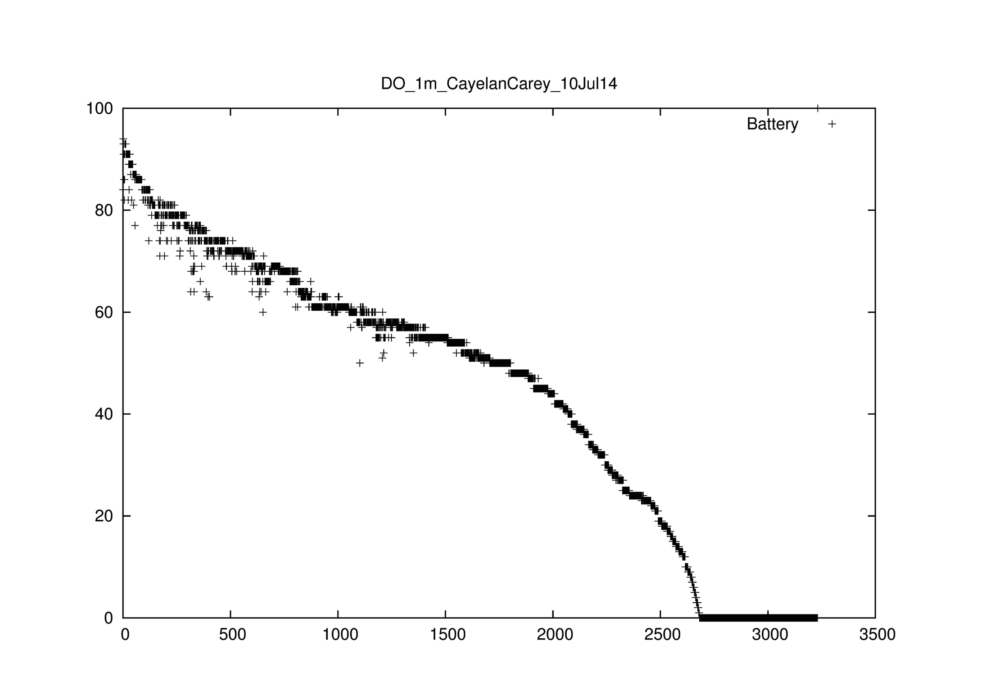
Before Outlier Filter and Battery Filter

Slide 14
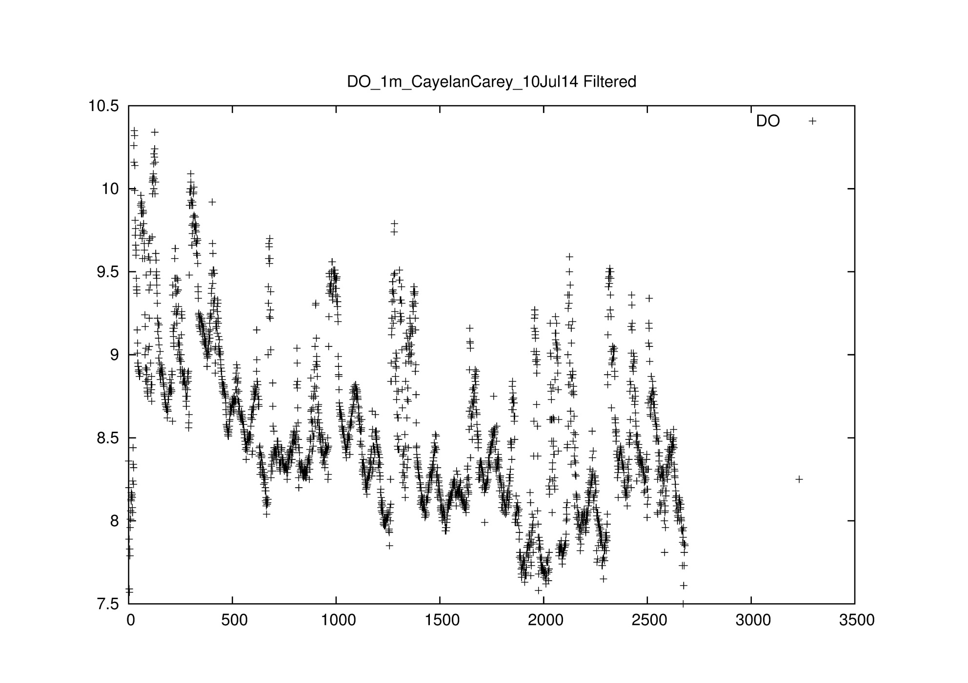
After Outlier Filter and Battery Filter

Slide 15
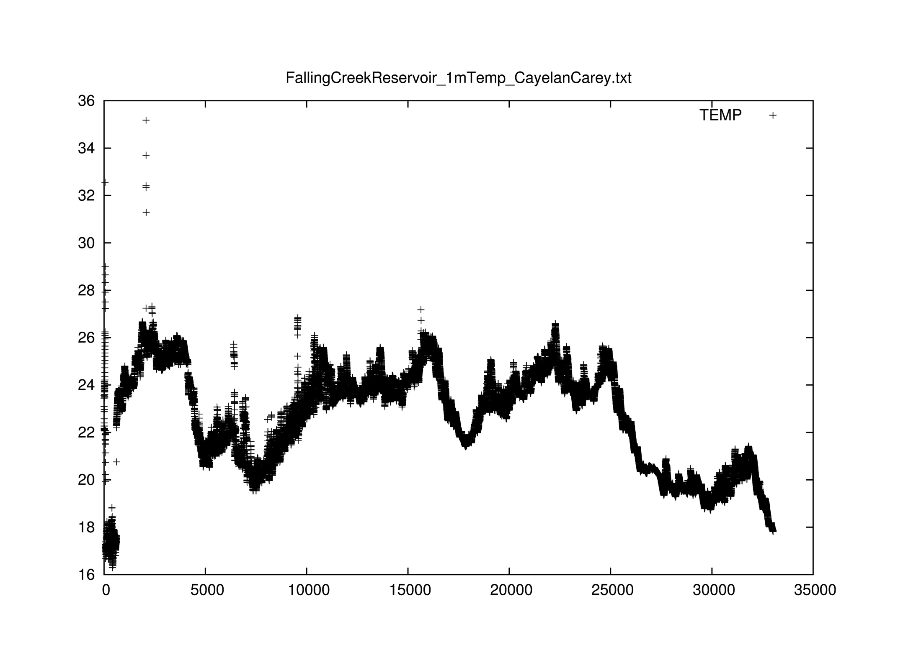
After Outlier Filter and Battery Filter

Slide 16
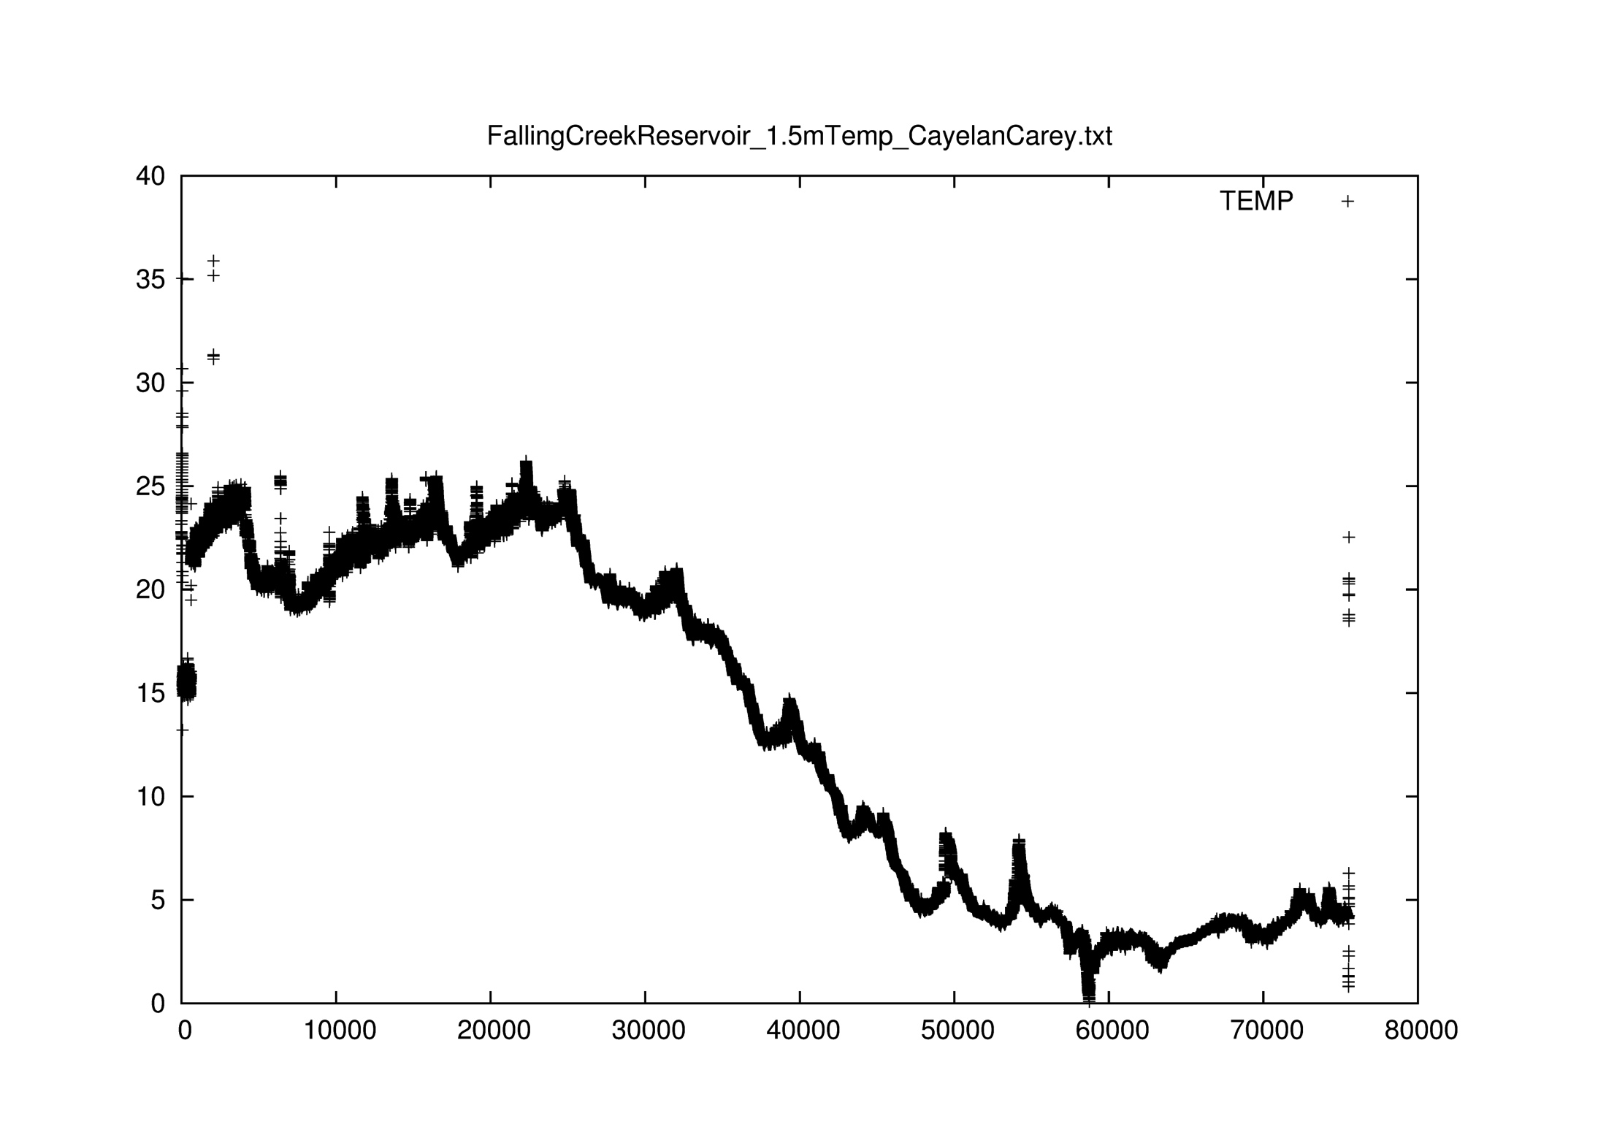
After Outlier Filter and Battery Filter

Slide 17
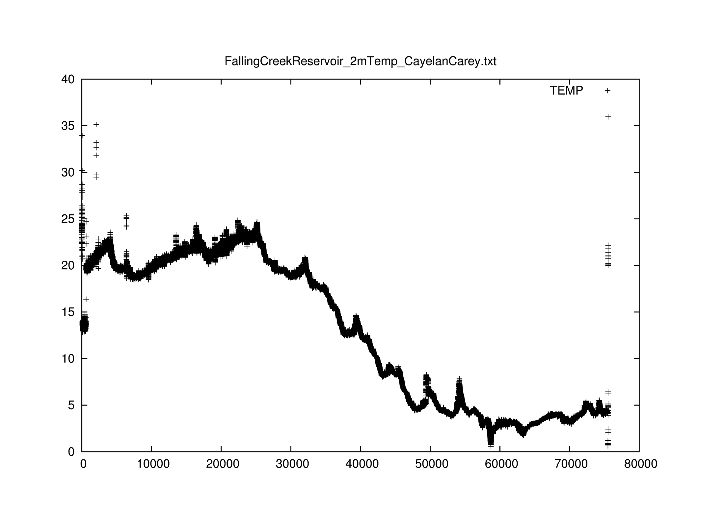
After Outlier Filter and Battery Filter

Slide 18
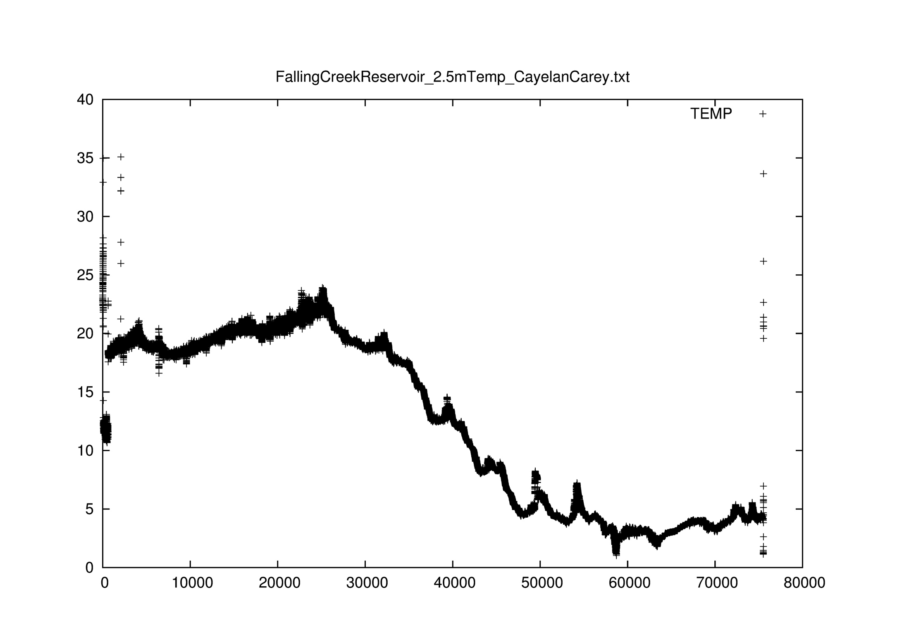
After Outlier Filter and Battery Filter

Slide 19
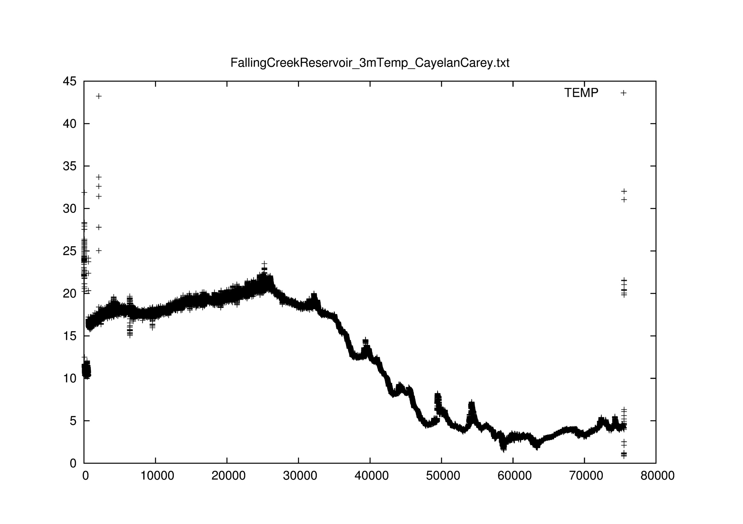
After Outlier Filter and Battery Filter

Slide 21
Drift Filter(1)
Whatever Temp and LDO, they increase and decrease by a constant slope.
When there are drifts on the sensor, the slope will change.
e.g.,
for LDO, we calculate slopes between different points.(x1 is before x2)
Slope of x1= (x2.ldo –x1.ldo)/15
Flag and remove the x2 whose slope is larger than a limited slope (n).
Flag and remove the x1 whose slope is smaller than a limited slope (–n).
-> we reduce the range of points which are affected by drifts. (not efficient)
point
n=3
slope

Slide 22
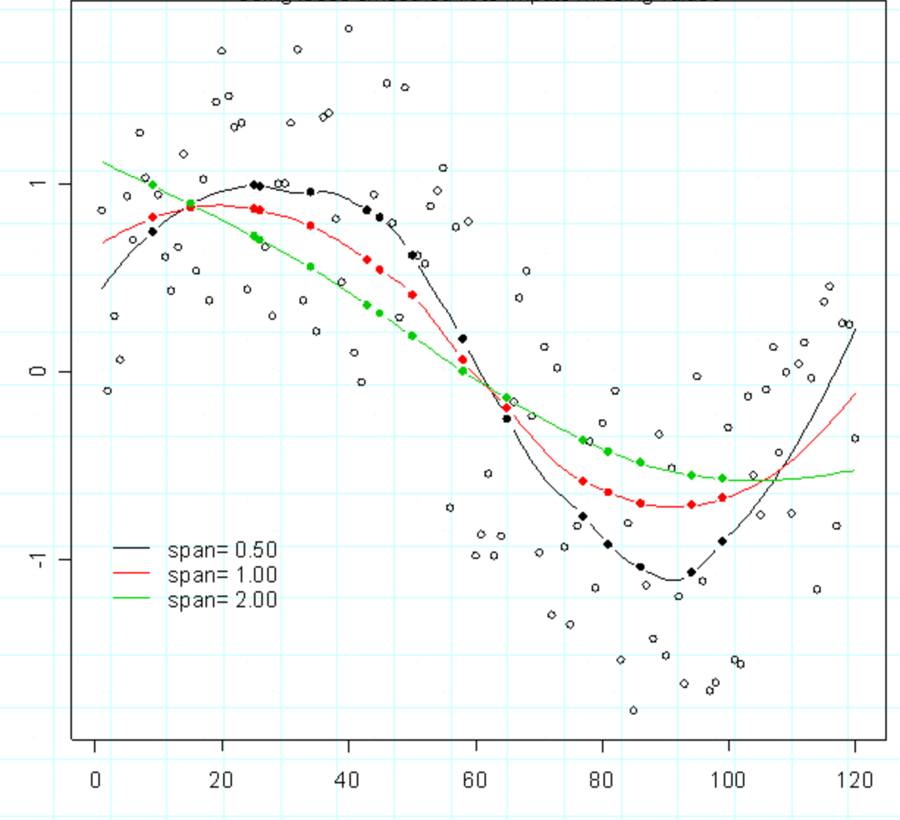
Loess Curve
If Span is lower, we get more curved line.
Then Loess Curve will be more accurate

Slide 23
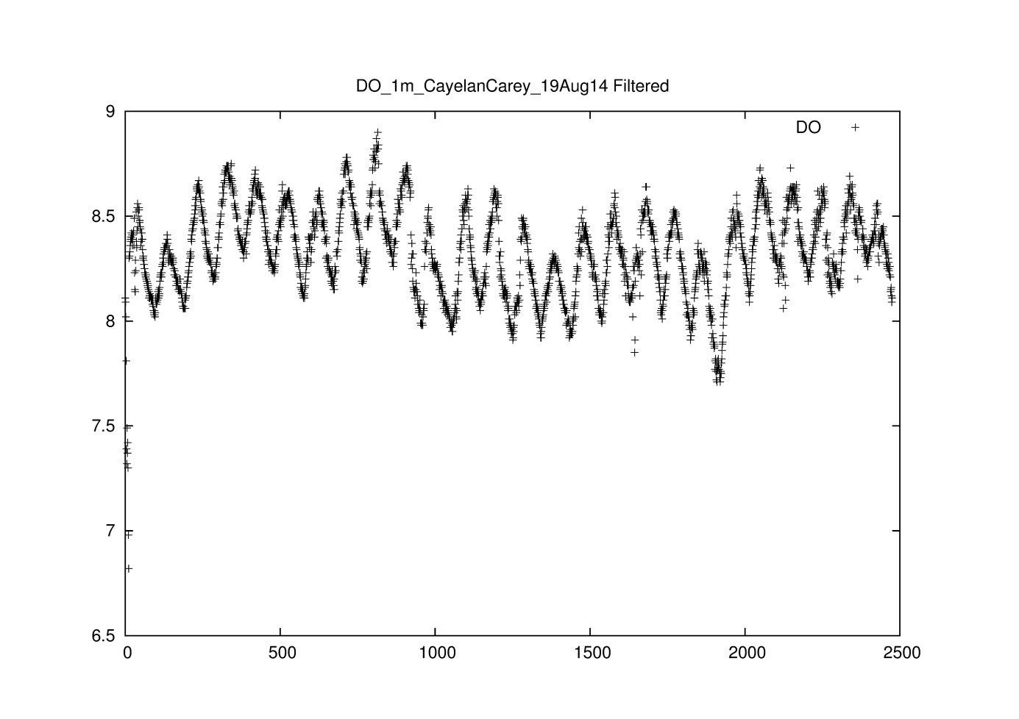
Drift Filter(2)
The scatter plot shows Temp and LDO are affected by time and each of them has a high correlation with it.
The Loess Curve is a good trend curve to describe the data changes with time passing.
-> The point which is further from Loess Curve is more likely to be the Drift point.
There is a online sample of Loess Curve on Java. It could help me make a efficient algorithm as Drift Filter.
But that’s the future work.

Slide 24
Data Cleaning Workflow (cont’d)
Raw Data
Process 1
Flagged Data
1. Leave the data with all flags
Restore data to a new .txt file
Process 2
2. Remove the tuples which contain flags “outlier”
and “drift”
Restore accessed data to a new .txt file
2 Final Datasets

Slide 25
Conclusion and Future Work
Retrieve raw data
Visualization raw data
Data cleaning
Outlier
Out of battery
Drift (ongoing work)
Visualization on cleaned data
Loess Curve(Local Regression)
QC/QA

Slide 26
Thank you!

