Slide 1
Quality Assurance & Quality Control of Lake Sensor Data
Tony Liu & Ian Wang

Slide 2
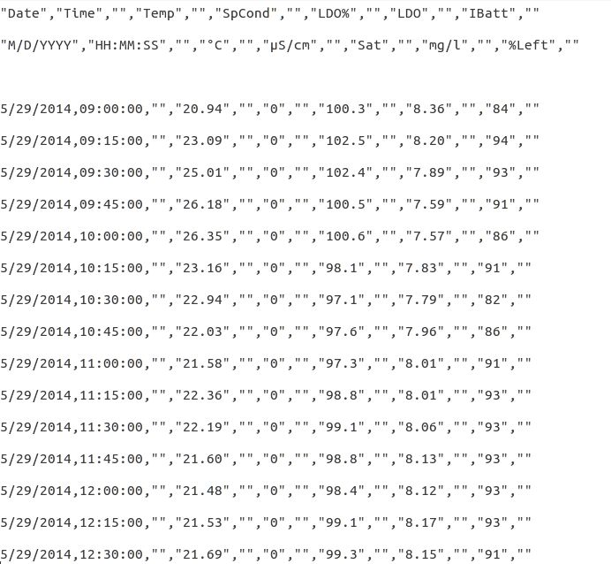
Original Data

Slide 3
“Obvious” Data Cleaning
Temperature range [-50,100]
Conductivity abnormal 0
Dissolved oxygen percentage range (0,∞]
Battery percentage range (0,100]

Slide 4
QA Standard
Temperature variance ± 1
Conductivity fluctuation ± 20%
If <10 then define fluc as ± 50%
Dissolved oxygen percentage fluc ± 20%
If <10% then define fluc as ± 50%
Dissolved oxygen value fluc ± 20%
If <10 then define fluc as ± 50%
Battery percentage fluctuation ± 5

Slide 5
QA Standard
Temperature variance ± 1
Conductivity fluctuation ± 20%
If <10 then define fluc as ± 50%
Dissolved oxygen percentage fluc ± 20%
If <10% then define fluc as ± 50%
Dissolved oxygen value fluc ± 20%
If <10 then define fluc as ± 50%
Battery percentage fluctuation ± 5
If stays the same for 3 samples, flag them!

Slide 6
Example of Temperature Data

Slide 7
Example of Temperature Data

Slide 8
Example of Temperature Data

Slide 9
Example of Battery Data

Slide 10
Example of Battery Data

Slide 11
Example of Battery Data

Slide 12
Effect of Different Variance
± 1 VS ± 0.5

Slide 13
Generalization
Each data point
Null
Too high, too low

Slide 14
Generalization
Each data point
Null
Too high, too low
Relation between different data points
Absolute variance too large
Fluctuation too large
Stays the same over certain period

Slide 15
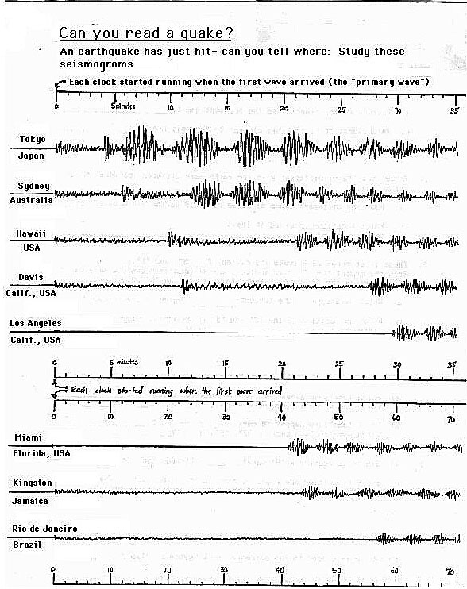
More Challenging!
http://cse.ssl.berkeley.edu/img/earthquakes/seismogram000.jpeg

Slide 16
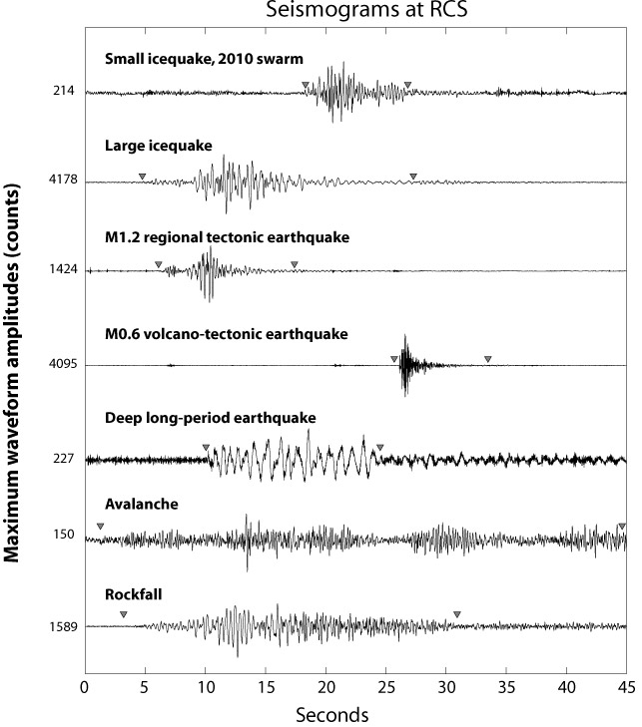
And more…
http://pnsn.org/blog/2012/01/06/repeating-earthquakes-on-mount-rainier-are-glaciers-the-culprit

Slide 17
Thanks!
Questions?

