Slide 1




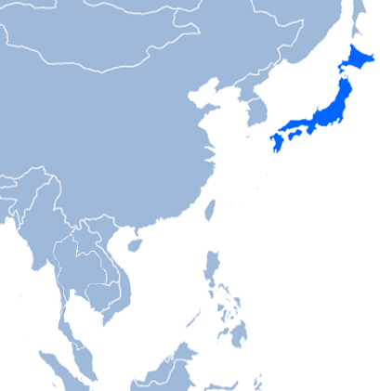
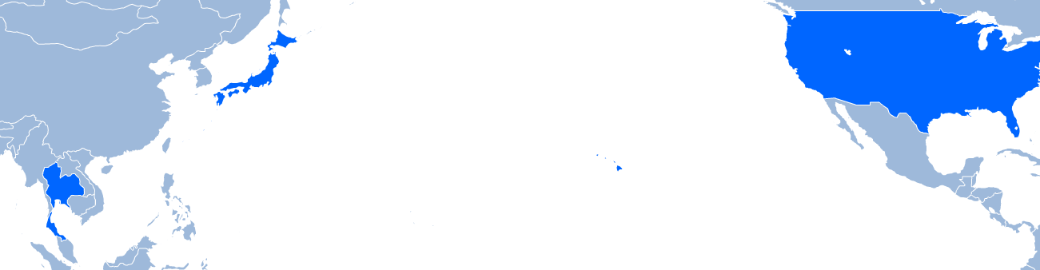
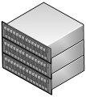

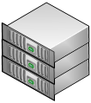











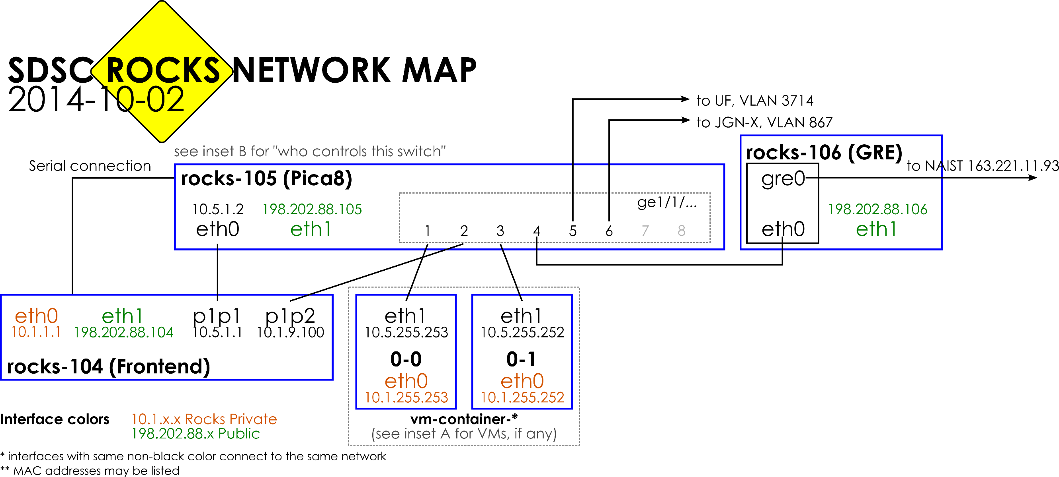
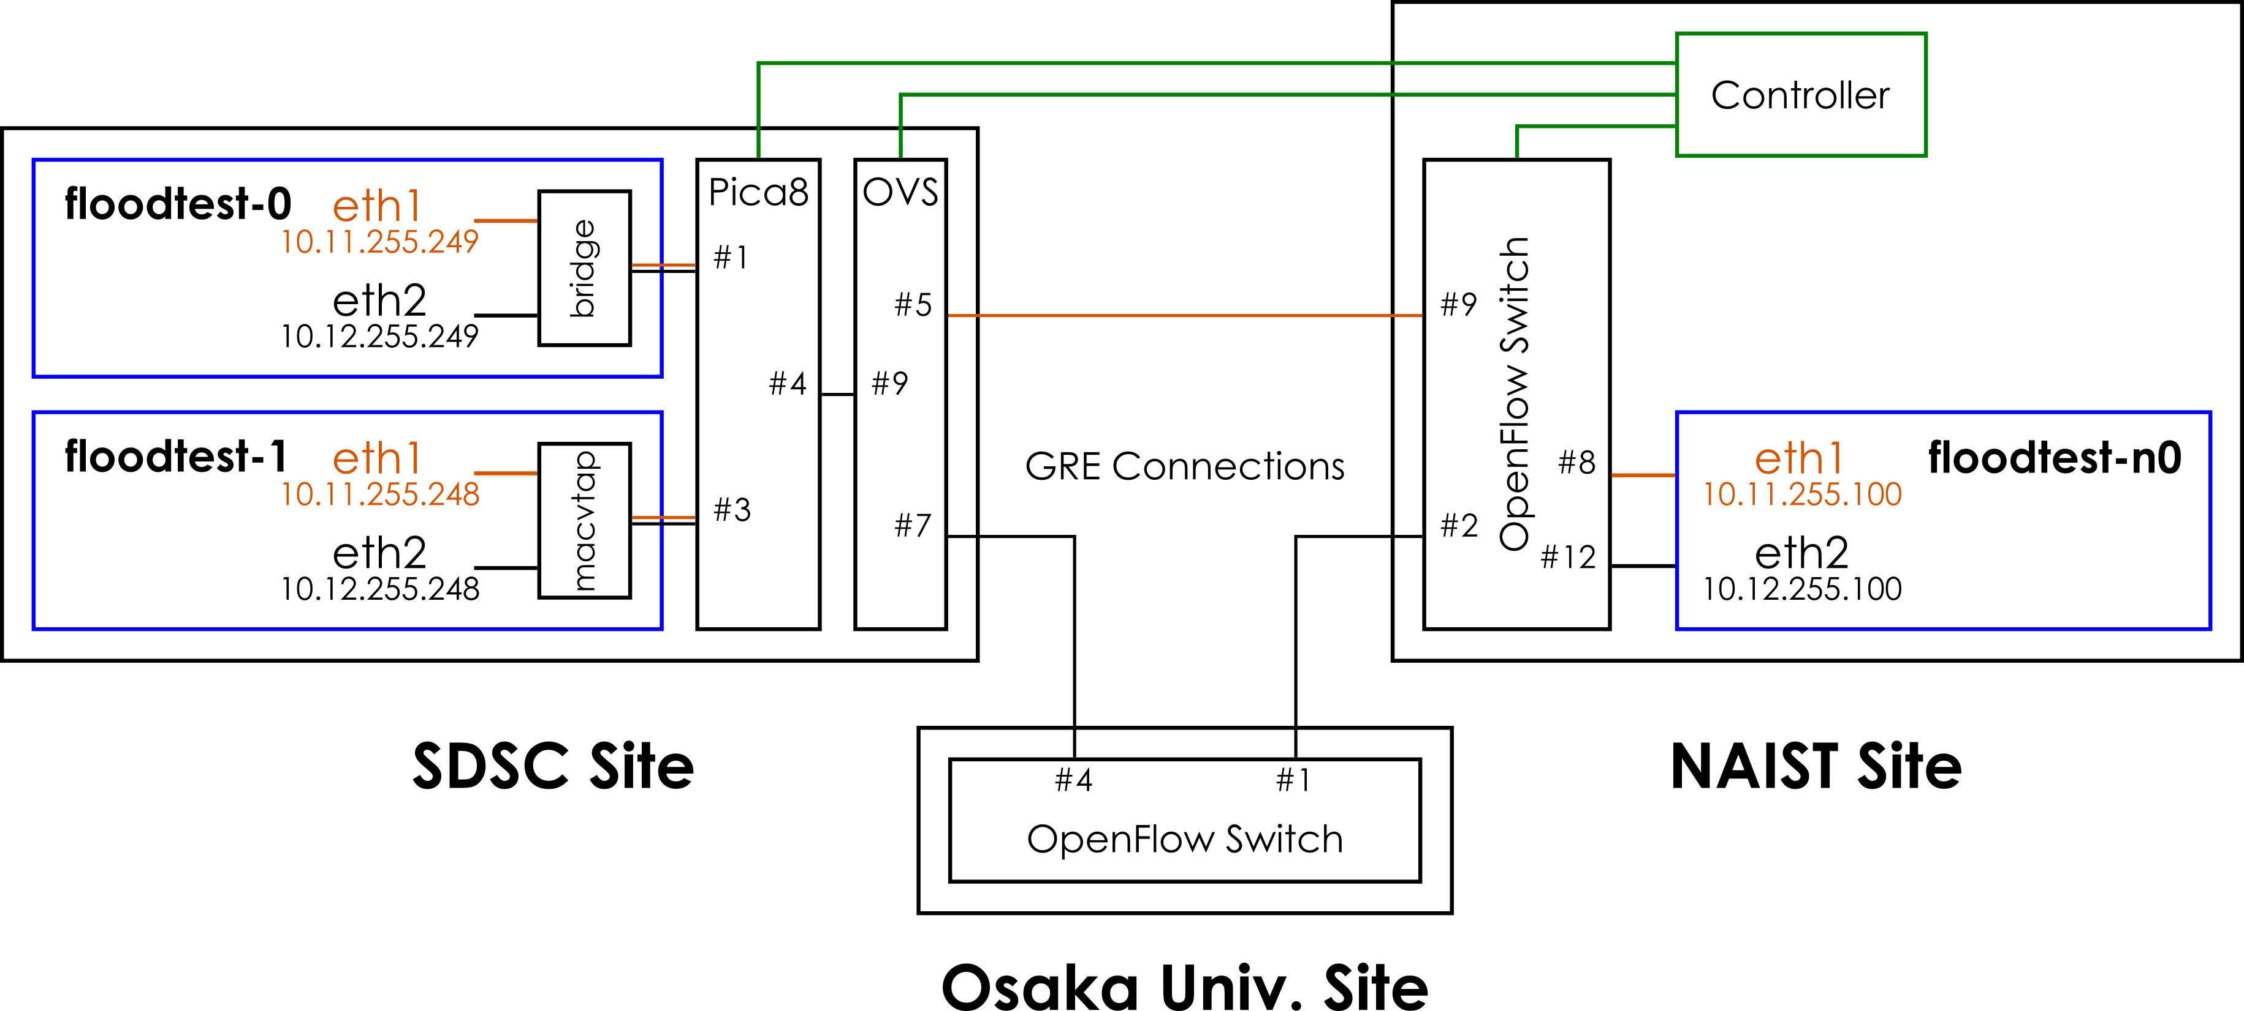

Evaluation of MPTCP on PRAGMA-ENT
Laboratory for
Software
Design & Analysis
Introduction
Chawanat Nakasan, Kohei Ichikawa, Luca Clementi, Philip Papadopoulos
Modern networked systems, such as data centers, cloud computing, or distributed storage systems, are adopting multi-homed, multi-site configuration. These concepts allow systems to have multiple routes to the Internet and span across the globe.
To aid in researching and developing such systems, the PRAGMA-ENT network was created to facilitate high-performance computing research across the wide-area network. This testbed is an excellent opportunity to deploy a test on Multipath TCP (MPTCP) in a real-world wide-area network.
Network 1
Network 2
Image of a multi-homed multi-site network
PRAGMA-ENT
Current Status of Testbed at SDSC
We have thoroughly updated the documentation of the testbed infrastructure at SDSC, as well as confirmed connections to NAIST, Osaka-U, UF, and JGN-X.
One Rocks VM container was modified to use macvtap instead of brctl bridges. Despite some limitations, we believe that using macvtap should provide more direct connection between the virtual machines in PRAGMA-ENT and offer more options to suit varying requirements.
Current version of the network map at SDSC
MPTCP Testbed on PRAGMA-ENT
The MPTCP testbed was created over the PRAGMA-ENT network by placing a number of MPTCP-capable virtual machines on NAIST and SDSC sites. All of these machines have at least two interfaces connected to PRAGMA-ENT.
With the MPTCP kernel, communication was tested and we could confirm that MPTCP is functioning both in the same site and multi-site.
Currently, we use Floodlight controller’s static flow entry API to insert the rules. In the future, we will create a controller that separates MPTCP traffic into multiple routes. To do this, the controller should detect MPTCP subflows and split them accordingly.
MPTCP Testbed Setup on PRAGMA-ENT

