Slide 1

Application to Membership in PRAGMA by Pervasive Technology Institute and Data To Insight Center Indiana University Bloomington, Indiana USA
Professor Beth Plale

Slide 2
Pervasive Technology Institute (PTI) and Data To Insight Center
PTI at Indiana University pairs fundamental academic research with university high performance computing (petascale) and large scale network management (including Transpac). Plale, PTI Managing Director
Data To Insight Center (Plale, Director), a research center in PTI. $1.2M year budget, PhD students, staff, postdocs. Connections to IU library.
Research: policy and technical advancements for scientific data sharing, metadata and provenance capture, data analysis at scale (mapReduce, cloud computing), data repositories, and workflow systems.

Slide 3
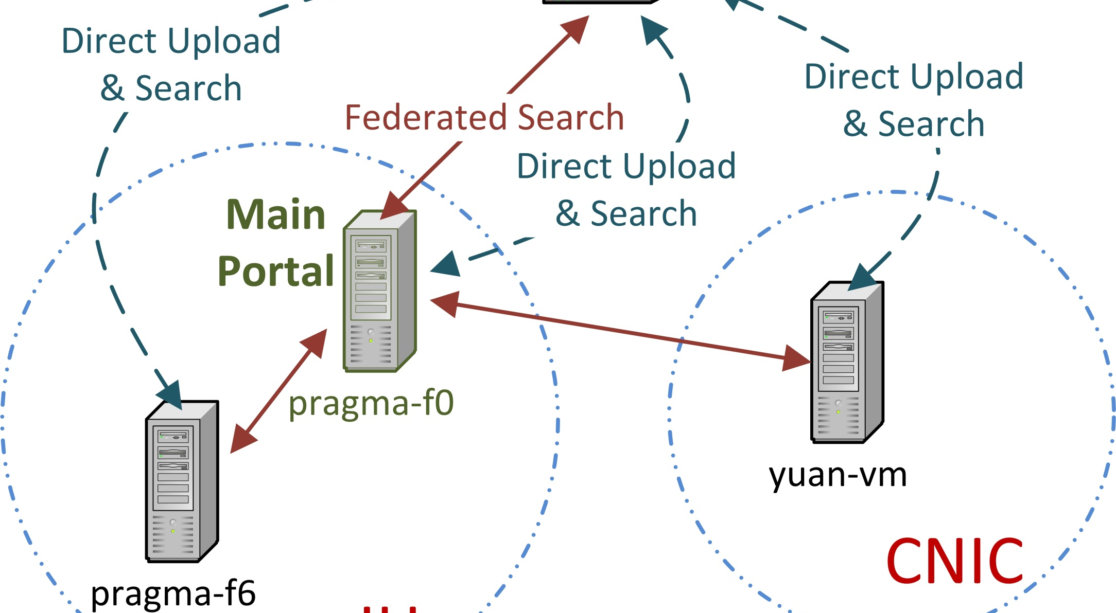
History with PRAGMA
Key role first demo of biodiversity interoperability in PRAGMA, demo PRAGMA 23
Additional participation
Invited talk and poster PRAGMA 19 Changchun, China
Poster PRAGMA 20 Hong Kong
Talk in biodiversity workshop PRAGMA 22 Melbourne, AU, and poster and demo
Demo and poster, student leadership in student poster session, PRAGMA 23 Seoul, South Korea
Student leadership PRAGMA 24

Slide 4
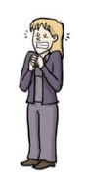
IU ongoing contribution to PRAGMA
Lakes thrust and biodiversity thrust involvement:
issues of data provenance and attribution in long-lived trusted PRAGMA cloud
Networking optimization
Develop PRAGMA student group:
Yuan, Meilan, and Uma have done great job with startup
Align student research with PRAGMA practice and experience
Student opportunities and funding
Notes:
Meilan Jinag, Konkuk University

Slide 5
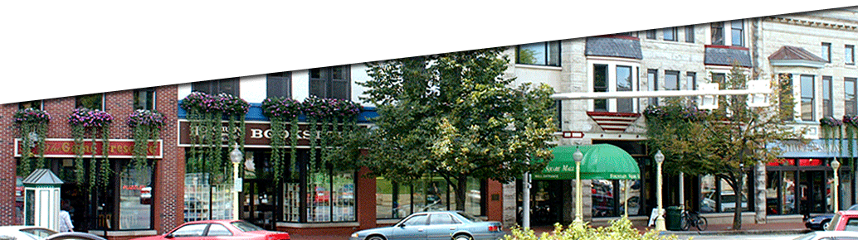
Finally …
We are interested in hosting an upcoming PRAGMA workshop in beautiful Bloomington, Indiana. Ideally in October when deciduous trees are in full color.

