Slide 1


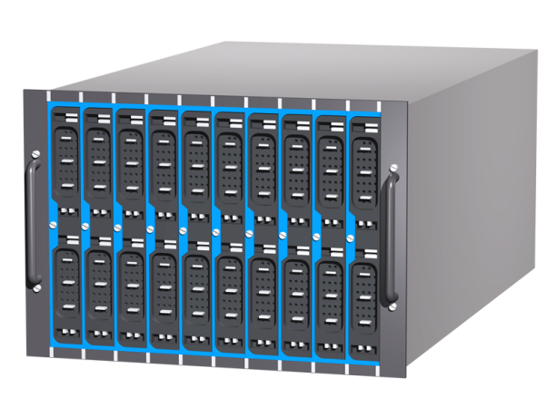
High Throughput, Low Latency and Reliable Remote File Access
Hiroki Ohtsuji and Osamu Tatebe
University of Tsukuba, JST/CREST
Background
Remote File Access with RDMA
Architecture
Client
Server
Remote File Access
Client
Infiniband
Server
Storage System
(e.g. Distributed File System)
Memory
RDMA
Memory
40-100Gbps
5-10μs
100PB-1EB(2016)
Application
Storage
Exascale storage systems require the high bandwidth, low latency and reliable remote file access method.
・Latency and Bandwidth
Ethernet is a common network to connect storage nodes and client nodes. However, latency of Ethernet is at least a couple of hundreds microsecond. This is caused by the overhead of many hardware layers and the software stack. In order to accelerate the performance of applications, this should be eliminated and we need other sophisticated mechanisms to transfer the data. InfiniBand is one of the most suitable components to achieve this goal.
・Reliability
In terms of reliability, this poster describes how to securely store and access the data.
This poster mentions these three topics:
Remote File Access with RDMA
Reduce the overhead of network communication with the CPU bypass architecture.
Node-level redundancy
Replication is a famous method to prepare for failures. Redundant data can save amount of disk space, while replication takes space more than twice as large as size of the original data.
Congestion avoidance
Redundant data provides more options to choose storage nodes. Some of combinations of storage nodes can avoid the network congestion.
IOPS evaluation of stride access
Infiniband QDR
RDMA reduces the network latency and enhances the IOPS .
Node-level Redundancy
Congestion Avoidance
File1 d₀ d₁ p₀
File2 d₀ d₁ p₀
SCSI / SATA
0
1
2
3
Network of storage node #1 will be congested if all clients access the files concurrently.
This congestion is avoided by the proposed method, which uses the redundant data to disperse the traffic.
Network
Storage nodes
Clients
Local RAID
Network-based
0
1
2
3
Data layout
XOR throughput (CPU)
Performance Evaluation
Data
28%
improvement
Infiniband FDR
15% improvement
Congestion avoided
w/o congestion
w/ congestion
Stripe #1
Stripe #2
Redundant data
Rebuild the striped data
復号あり
If stripe #1 is failed, the original data can be calculated from the data of stripe #2 and the redundant data.
The XOR throughput ranks with throughput of InfiniBand FDR.
復号あり
# of client
w/ decode

