Slide 1
PRAGMA Students Update
Yuan Luo and Meilan Jiang
on behalf of the PRAGMA Students Steering Committee
The PRAGMA24 Workshop, Bangkok, Thailand, March 21st, 2013

Slide 2
Introduction to PRAGMA Students
Background
PRAGMA22 launched a discussion of how to engage graduate students more actively in PRAGMA. Since PRAGMA22, students have been engaged with these discussions and have assumed leadership of the PRAGMA student activity.
Why PRAGMA Students Activities?
Tremendous potential to give students interdisciplinary science and computer science experience coupled with leadership growth opportunities that they may not get within their PhD studies in their university – Prof. Beth Plale, IU

Slide 3
Goals of PRAGMA Students
Have students research tied to activities in PRAGMA
Expose students to network science, in particular to develop skills in interdisciplinary research, peer mentoring, leadership responsibilities and multicultural competence.

Slide 4
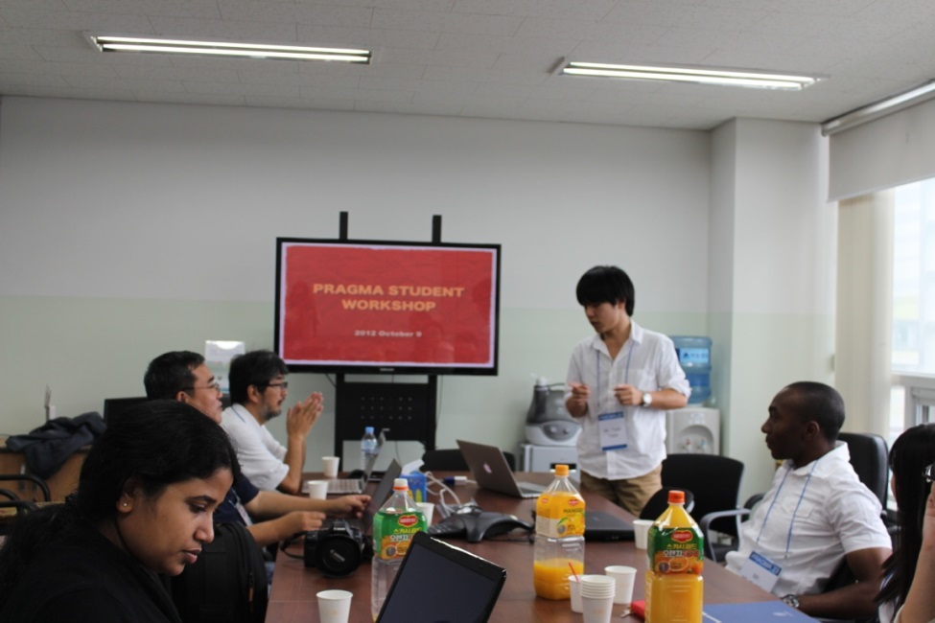
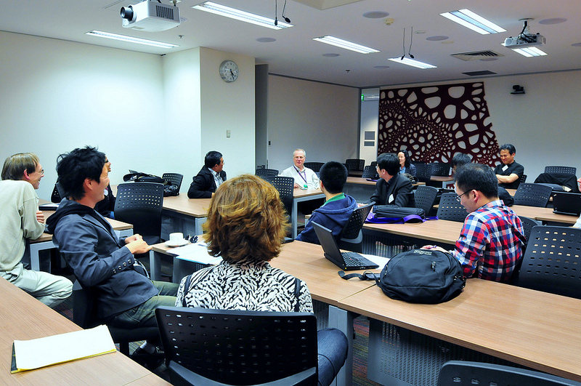
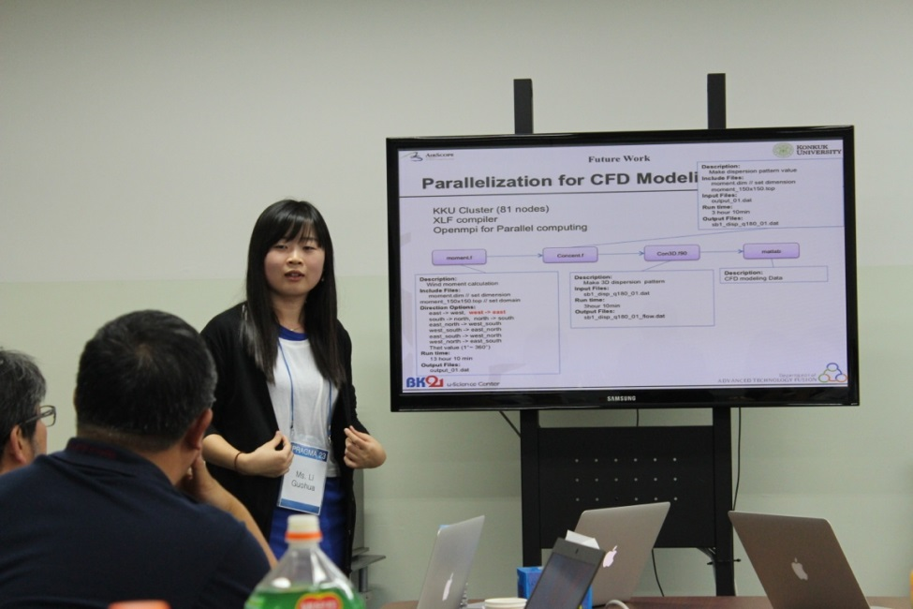
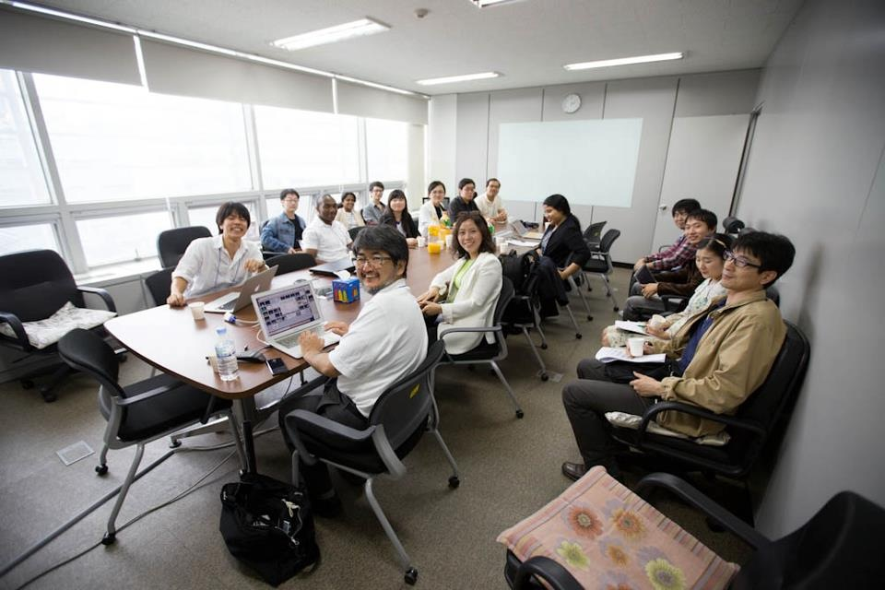
Students Activities in PRAGMA22 and PRAGMA23

Slide 5
Accomplishments to Date: Leadership and Peer Mentoring/Networking
Network of Students
Biweekly Skype meeting led by students steering committee to discuss students activities.
Distributed Seminar
Around 60 participants attended Phil’s talk (first seminar)
Poster Session
17 posters in PRAGMA 23
26 posters in PRAGMA24
Student Workshops
5 invited talks and 1 students presentations in PRAMGA 23
8 students presentations and a panel discussion in PRAGMA24

Slide 6
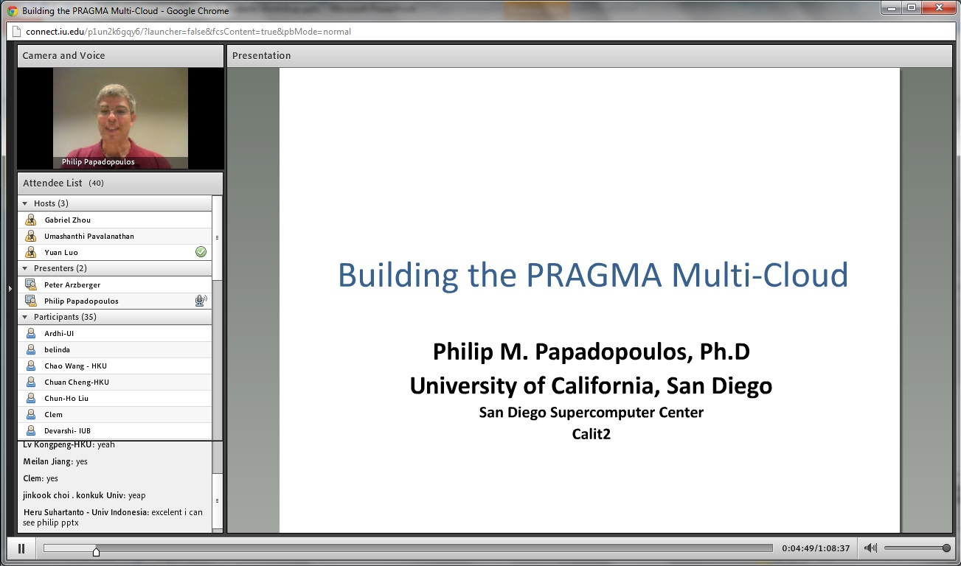
PRAGMA Students Online Seminars
First Seminar:
Building the PRAGMA Multi-Cloud, by Dr. Philip Papadopoulos, UCSD
http://connect.iu.edu/p1un2k6gqy6/
Second Seminar (mid April to early May 2013):
By Dr. Jose Fortes, UF, Topic TBD
http://connect.iu.edu/pragmastudents

Slide 7
Revisit the 2nd PRAGMA Students Workshop
Time | Title | Name | Institute/Company
3:30pm-3:35pm | Welcome to PRAGMA Students | Yuan Luo, and Meilan Jiang | PRAGMA Students
3:35pm-4:25pm | High Throughput, Low Latency and Reliable Remote File Access | Hiroki Ohtsuji | University of Tsukuba
 | CARE Resource Broker (CRB) | Thamarai Selvi Somasundaram | Anna University
 | Biodiversity Capacity Building in Malaysia using Information Technology | Nurul Shakina Mohd Talkah | Universiti Teknologi Malaysia
 | IPOP: Self-configuring IP-over-P2P Overlay-based Virtual Private Networking | Pierre St Juste | University of Florida
4:25pm-5:00pm | Panel discussion | All faculty and students
5:00pm-5:05pm | Break (extending panel discussion if necessary)
5:05pm-5:55pm | Performance evaluation of a nested virtualization based on KVM | Praween Amontamavut | Takushoku University & AIST
 | Instrumenting Thailand’s Coastline: Cyber-Infrastructure for Environmental and Disaster Monitoring | Michael Nekrasov | UC Santa Barbara
 | Cloud Computing Model and Prototype Implementation of Molecular Dynamics Simulations using Amber and Gromacs | Rezi Riadhi Syahdi | Faculty of Computer Science, University of Indonesia
 | An Implementation of a Virtual Cluster on a Cloud | Pongsakorn U-chupala | Kasetsart University
5:55pm-6:00pm | Close comments

Slide 8
Panel Discussion on the 2nd PRAGMA Students Workshop
Aligning graduate student research with practical experiments in PRAGMA.
Improving the open environment for discussing research and research related issues.
Notes:
Start early in research career (Beth Plale)
Understand and Use Current Structures
Identify What Is Missing/ Who needs to be engaged
Do you feel you can talk with anyone?
Have you introduced yourself to anyone?
Have you asked a question of other participants?

Slide 9
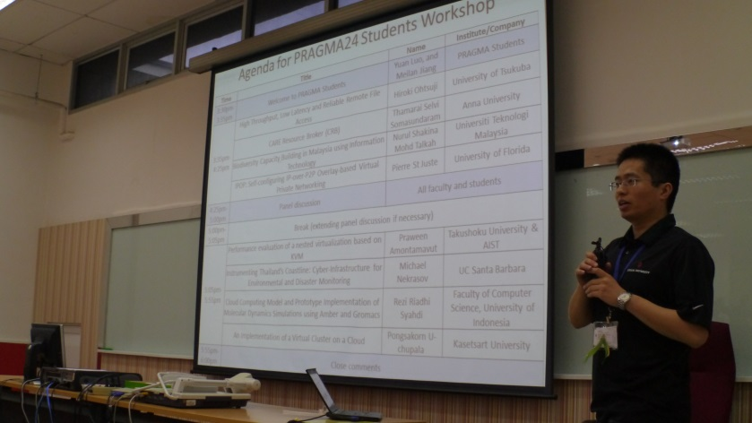
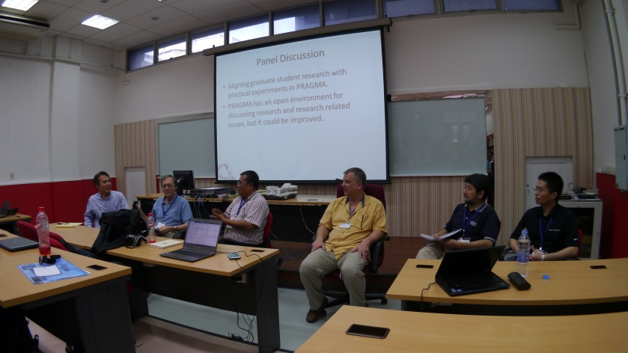
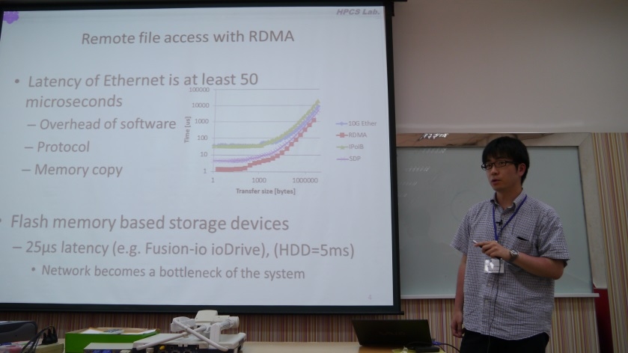
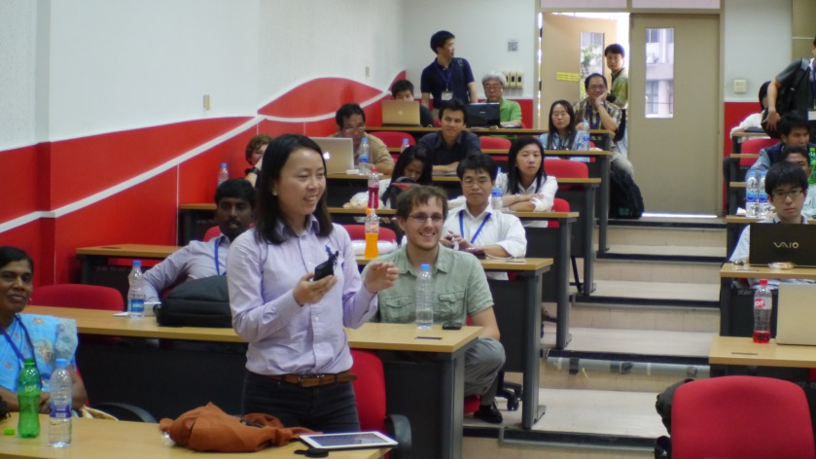
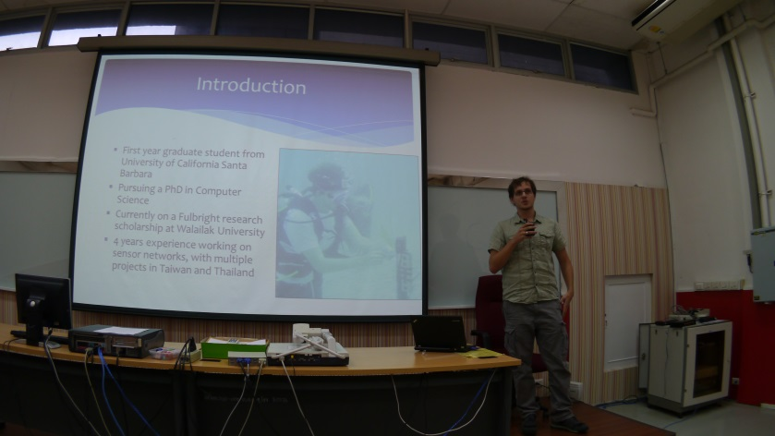
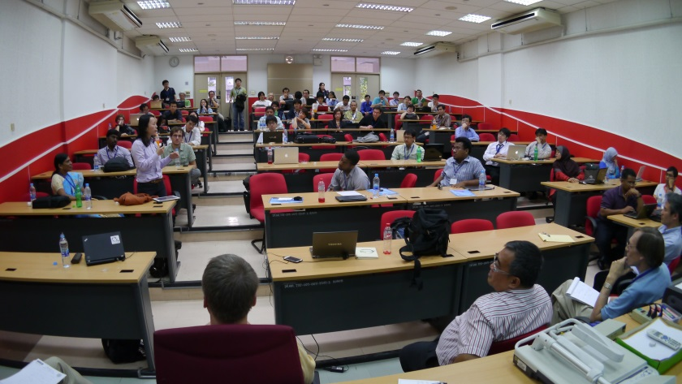
The 2nd PRAGMA Students Workshop

Slide 10
Accepted Posters for PRAGMA24
Institute/Company | Title
Konkuk University | AirCleaner: Seoul Metro Integrated Management System for Intelligent & Energy-efficient Air Quality Monitoring & Control
Walailak University | Coral Sensor Network at Racha Island, Thailand
COE for Ecoinformatics, NECTEC-WU | Comparison of Cloud Appearance between Forest Types at Khao Nan, Thailand Using CloudSat Quicklook Images
Walailak University | Applying a landscape mosaics technique to detect tropical cyclone impacts on coral reef community
Kasetsart University | Big VM: Design and Implementation of a Very-Large-Memory Virtual Machine
University of Tsukuba | High Throughput, Low Latency and Reliable Remote File Access
Institute of Information Technology, Vietnam Academy of Science and Technology | A GRID AND CLOUD-BASED DATABASE OF PRE-COMPUTED SCENARIOS OF TSUNAMIS IN MANILA TRENCH
COE for Ecoinformatics, NECTEC-WU | Seed Production, Seed Predation and Germination of Parah trees at Khao Nan National Park
National Center for High-performance Computing | Big Data Applications in Disaster Management Information Platform
Anna University | CARE Resource Broker (CRB)
Konkuk University | Experiments with Emulab Testbed
Walailak University | Dashboard Decision Support System for Community Well-Being Assessment System in Thailand
Walailak University | Ecological Observatory System at Racha Yai Island, Phuket, Thailand
Universiti Teknologi Malaysia | Biodiversity Capacity Building in Malaysia using Information Technology
UC San Diego | Place-Sticker Mobile Tour: Implementation of a Novel Location-Based Technology
University of Florida - ACIS | IPOP: Self-configuring IP-over-P2P Overlay-based Virtual Private Networking
University of Indonesia | Virtual screening of Indonesian herbal database as HIV-1 protease inhibitor
AIST | Asia GEO Grid Initiative
Civil Engineering of Hong Kong University | Impacts of urban land use change and aerosol increase on frontal rainfall near to coastal regions: a case study of a rainstorm over Pearl River Delta in South China
Universiti Teknologi Malaysia | UltraMJ: Identification and characterization of metal hyperaccumulators for phytoremediation from ultramafic flora in Johor Botanical Garden (Malaysia)
Kasetsart University | Development of a Software Tool for PRAGMA VM Migration on OpenStack Cloud
Takushoku University & AIST | Performance evaluation of a nested virtualization based on KVM
UC Santa Barbara | Instrumenting Thailand’s Coastline: Cyber-Infrastructure for Environmental and Disaster Monitoring
Faculty of Computer Science, University of Indonesia | Cloud Computing Model and Prototype Implementation of Molecular Dynamics Simulations using Amber and Gromacs
Kasetsart University | An Implementation of a Virtual Cluster on a Cloud
AIST | Preliminary Evaluation of Disaster Recovery based on Interconnect-transparent VM Migration

Slide 11
To discuss:
Can we enhance and expand the leadership opportunities?
Are there ways to improve student networking and peer mentoring?

Slide 12
Join PRAGMA Students
To subscribe, email to
pragma-student-list+subscribe@googlegroups.com (discussion)
pragma-students-announcements+subscribe@googlegroups.com (public announcements)
Facebook group:
https://www.facebook.com/groups/432548480124371
Official Website:
Coming soon …

Slide 13
Acknowledgement
PRAGMA Steering Committee
PRAGMA24 Organizing Committee
All faculty and student participants
PRAGMA Students mentors:
Peter Arzberger, Beth Plale, Karpjoo Jeong, Shinji Shimojo, Putchong Uthayopas

Slide 14
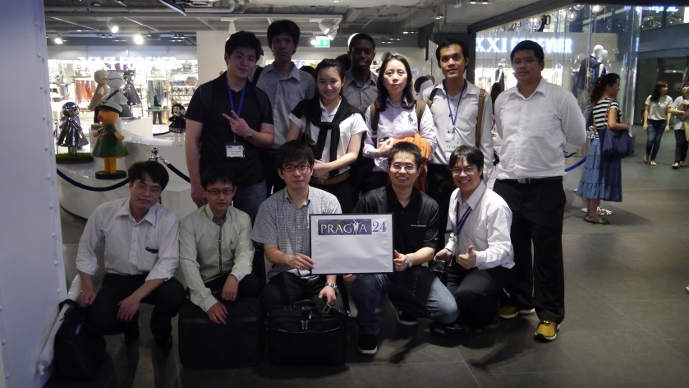
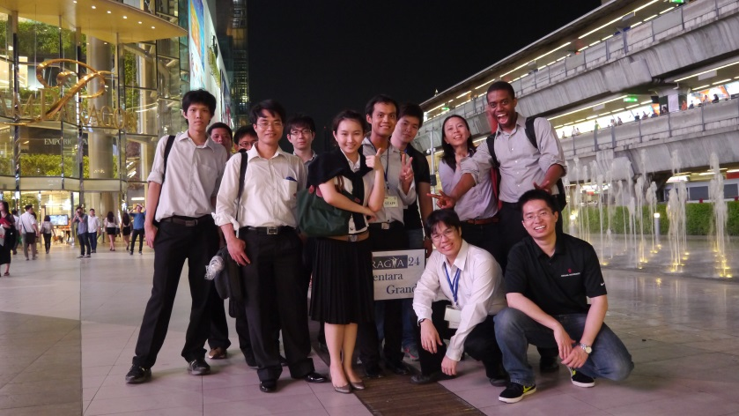
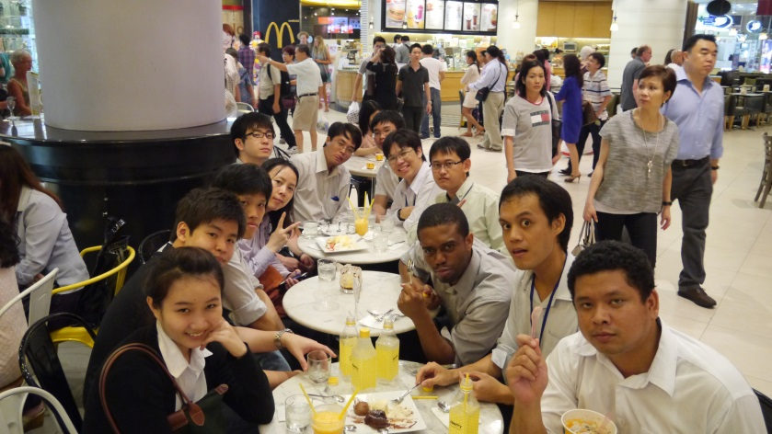
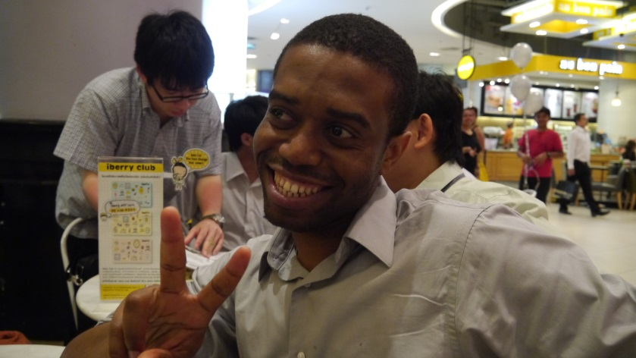
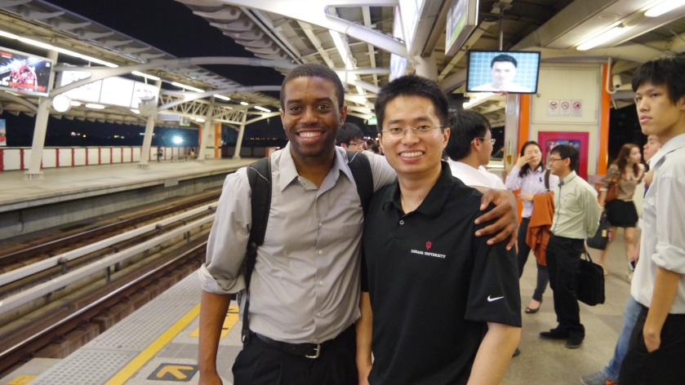
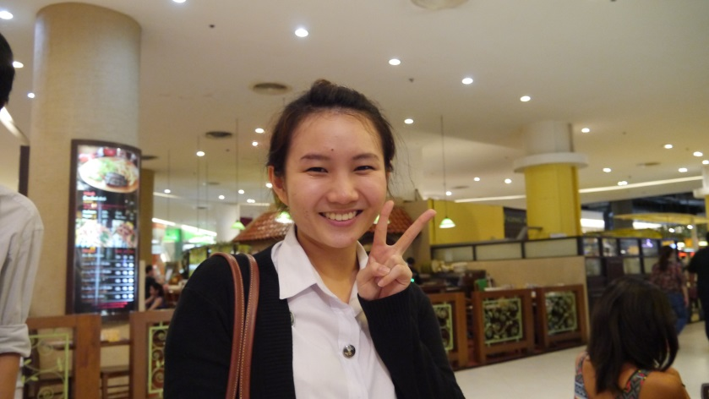
Social Activities (Lost in Thailand)

Slide 15
