Slide 1
Biosciences Working Group Update
Wilfred W. Li, Ph.D., UCSD, USA
Habibah Wahab, Ph.D., USM, Malaysia
Seok Jong Yu, Ph.D., KISTI, Korea
Hosted by Kasetsart University
Bangkok, Thailand March 20-22, 2012

Slide 2
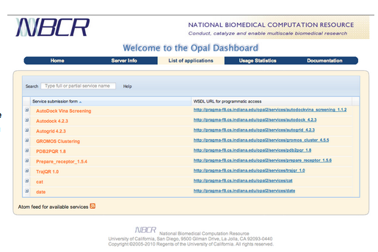
Rocks BioApp
Originated as a toolkit to deploy scientific application as web services using the SOAP protocol
  Developed by S. Krishnan
Released as Opal toolkit
Now available as Rocks 5 VM
Applications:
  AutoDock
  AutoDock Vina
  PDB2PQR
  MEME
  …
Contact: Nadya Williams
Related Projects:
Opal OP
  Developed by K. Ichikawa
Contact: Jason Haga, Susumu Date
http://goc.pragma-grid.net/wiki/index.php/Using_Bioapp

Slide 3
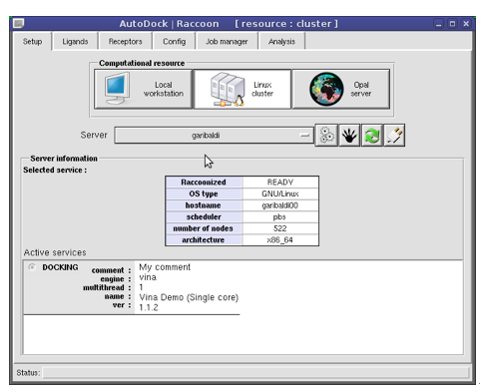
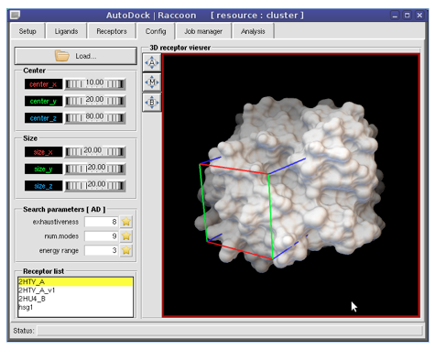
NBCR CADD Expedition
http://mgltools.scripps.edu

Slide 4
Other Bio-related VM
NAMD, Species Simulation – Rocks 6, Bio1
  Contact: Zhang Yang, Lanzhou University (LZU)
Fmotif - Ezilla
  Contact: Weicheng Huang – NCHC/NARL
Lifemapper Project – VC
  Contact: Aimee Stewart – Kansas U.
Galaxy VM—workflow for NGS
  Contact: Seok Jung Yu – KISTI
Source: PRAGMA GOC

Slide 5
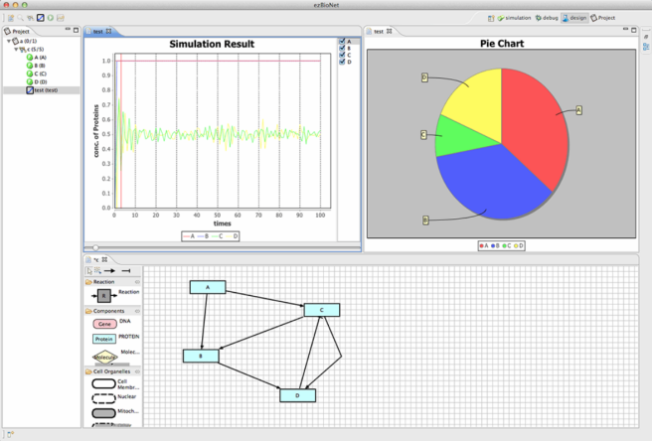
Recent Developments - KISTI
KISTI – Dr. Seok Jong Yu
  insilicoCell system
    Implements the VCellSim (a simulation system) for biological reaction on the KISTI cluster.
    Making a client software (ezBioNet) for modeling tool for biological reactions.
    OPAL was setup and enhanced the job monitoring module.

Slide 6
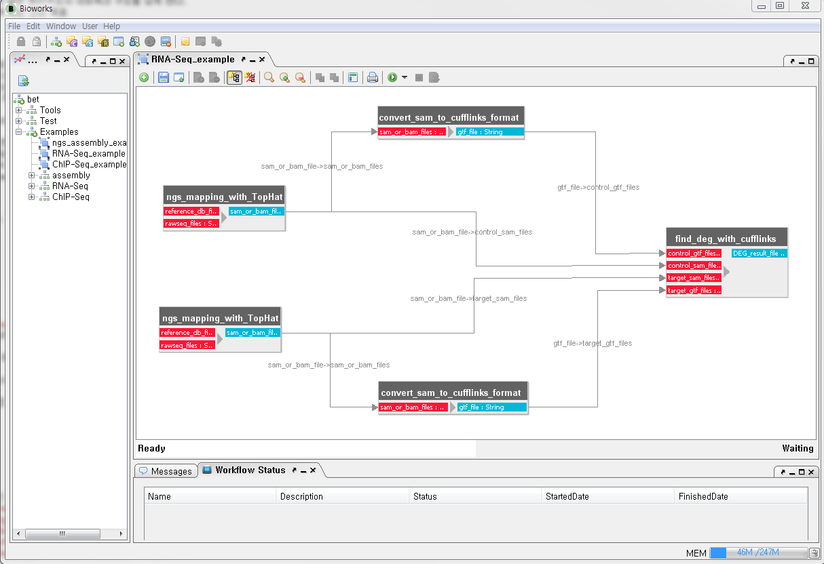
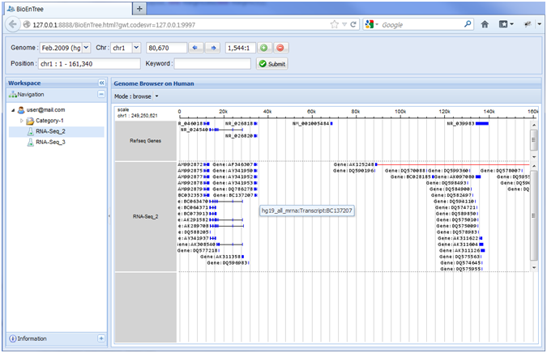
  Bioworks for NGS analysis
    Developing a workflow system for NGS analysis process
    Currently, have made a workflow for RNA-seq analysis.
Bioworks
Genome map Viewer

Slide 7
  Bio-Cloud service using Galaxy on PRAGMA Cloud
    Creating a virtual image for NGS analysis on Galaxy system.

Slide 8
University of Indonesia Bio-WG
Member :
  Prof. Heru Suhartanto, Ph.D (High Performance and Numerical Computing)
  Dr. Arry Yanuar (Pharmaceutical Chemistry)
  Alhadi Bustamam, Ph.D. (GPU Computing)
  Dr. Abdul Mun'im (Phytochemistry)
Student:
  Rezi Riadhi Syahdi, MSc.

Slide 9
University of Indonesia Bio-WG
On progress Research Activities
  High performance computing Simulation process as part of infectious disease drug discovery based on Indonesian grown medical plants,
  Virtual Screening and invitro activity of Compounds from Medicinal Plants Database in Indonesia for targeting HIV-1 and Malaria.

Slide 10
University of Indonesia Bio-WG
Publication
  Hayun; Hudiyono, S. , Hanafi, M., and Yanuar, A., Synthesis and COX-2 Inhibitory Activity of 4-[(E)-2-(4-Oxo-3-phenyl-3, 4-dihydroquinazolin-2-yl) ethenyl] benzene-1-sulfonamide and Its Analogs, Pharmaceuticals 2012, 5(12) 1282-1290; doi:10.3390/ph5121282
  Syahdi, RR., Mun’im, A., Suhartanto, H., Yanuar, A. Virtual Screening of Indonesian Herbal Database as HIV-1 Reverse Transcriptase Inhibitor, Bioinformation 2012, 8(24) 1201-1210,

Slide 11
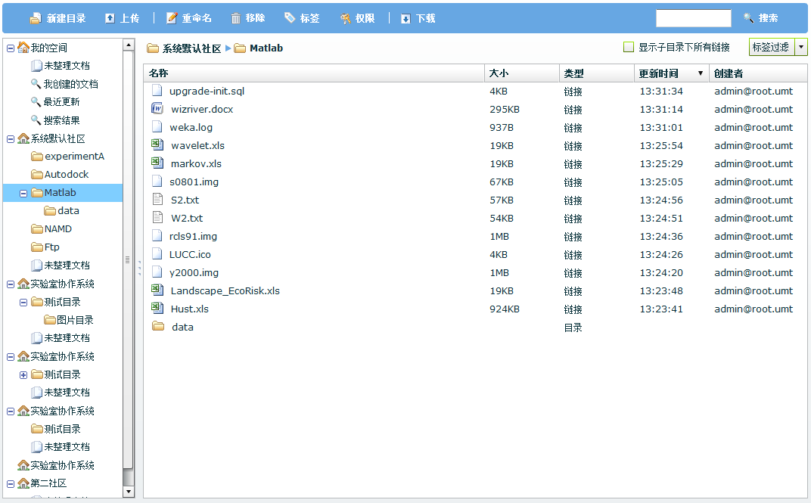
CNIC – Duckling Collaboration Library
CLB - Collaboration Library
  A component of Duckling, an open-source toolkit developed by the CNIC, Chinese Academy of Sciences (CAS)
  Used by all Duckling applications as the Data Repository
Duckling Portal
Duckling Application
Integration Framework
Document
Collaboration
Tool (DCT)
Collaboration
Library (CLB)
Application Plug-ins
Application Plug-ins
Application
Plug-ins
User
Management
Tool (UMT)
Virtual
Organization
Tool (VMT)
Resource
Resource

Slide 12
Key Features
Cloud-based Data Repository
  Means offering a robust and scalable data cloud service. Researchers do not need to worry about where the data is stored or whether it is backed up or not.
Ease of Access
  Stands for the data accessibility from most experimental environments. Scientists can access the data from their desktop, servers and mobile devices on demand.
Data Life Cycle Management
  Indicates that the cloud repository can be used to store and track all processes and data generated by experiments, especially for workflow-based jobs, by the means of data versioning, which is crucial for experimental data collaboration.

Slide 13
Use Case Scenario
CADD Client
User
Workstation
Laptop
Dashboard
@ Opal Services
Data Replication
(Web -based or PC Client)
PDB
MD Simulation
@ NAMD Cluster
C
L
B
+
Data Mapping
Receptor Conformation
@ Opal Service
Data Mapping
ZINC
Virtual Screening
@ AutoDock Cluster
(WebDAV Protocol)

Slide 14
Breakout Sessions
Presentations
  Kevin Dong, Cloud Environment for biomedical case studies, Duckling collaboration library
  Seok Jong Yu, Bio-Cloud services
Training
  NBCR Summer Institute 2013, Aug 5-9, 2013
Workshop, Conferences
  PRAGMA 25, 10/16-18/2013
  IEEE e-Science 2013, 10/23-25/2013

Slide 15
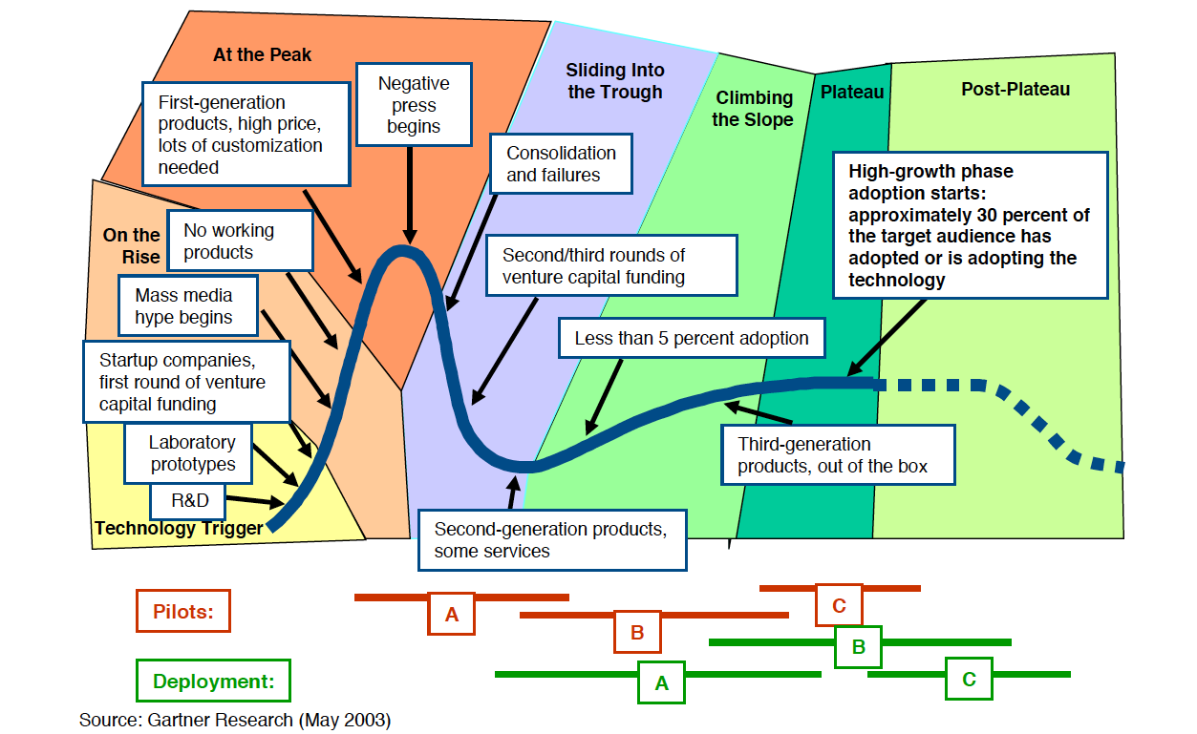

Slide 16
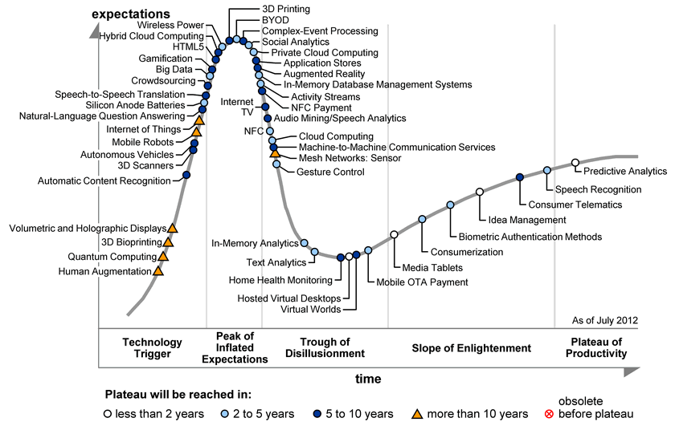

Slide 17
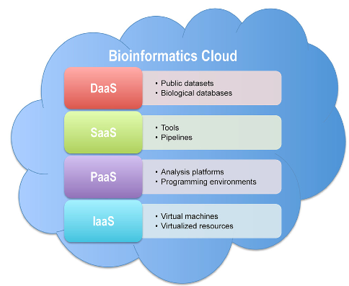
Cloud computing for Biosciences
Dai et al. Biology Direct 2012, 7:43

