Slide 1
Working Group Report Resources Working Group
Cindy Zheng (SDSC)
Yoshio Tanaka (AIST)
Phil Papadopoulos (SDSC)

Slide 2
Agenda of breakouts
Thursday 15:00-16:30
Discussion: VC sharing
Demo by AIST
Discussion for improvements and next steps
Friday 11:30-13:00
Talk
Research activities at Anna University (Prof. S.Thamarai Selvi)
Discussion: Identify issues and people who will be working on
Friday 14:40-16:00
Demos
IPOP: Self-configuring IP-over-P2P Overlay-based Virtual Private Networking (Pierre St Juste)
Network throughput-aware routing for Pragma Cloud (Kohei Ichikawa, et.al.)

Slide 3
Summary of VC Sharing Discussion
Demonstrated booting VC images on two cloud hosting environments.
Rocks/KVM by SDSC
OpenNebula/KVM by AIST
Next steps
Review the design of the scripts and re-implement by python.
Do this in San Diego in July (SDSC, AIST, NCHC).
Detailed schedule TBD.
Anybody interested in is welcome to join.
SDN integration with VC (NAIST/Osaka)

Slide 4
Summary of the 2nd day Discussion
Scenario: Three different labs want to share computing and data
What are the resources (data, computing)
How do they author their software structure (VM/VC) to do what they need (e.g. LifeMapper Compute Nodes)
How do they provide network privacy
How do they control their distributed infrastructure

Slide 5
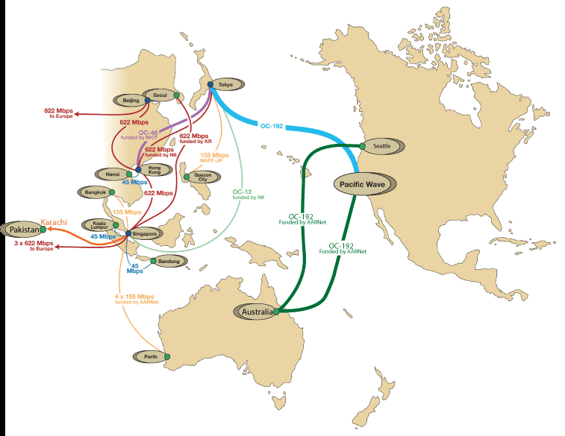
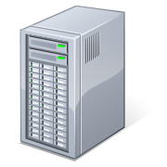

User-Controlled Trust Envelope
Application VM
Overlay Network
Data Server
Other Networks

Slide 6
Let's Talk ….
Issue/Area | Who? | Initial Ideas/Plans
Resource Broker Identify Resources Resource Registry | Thamarai (Anna U)
Identify Management (Incommon/CILogin, GoogleID? OpenID | Yoshio, Aimee, Weicheng
Controlling Infrastructure | Phil, Nadya, Mauricio
Monitoring of Infrastructure Global view | – Not yet
Integrated Definition/Construction | Phil, Mauricio, Nadya
Reliability – of data Distribution Failure of remote VM/VC
What happens if an outsourced service goes away (eg. googleID)

Slide 7
Issue/ | Who | Ideas/Plans
What ARE we doing about data? What level do we want to address | Reed,Yoshio, Aimee, Nadya
Integrating public, semi-private, private data resources | Reed,Yoshio, Aimee, Nadya
What Data/Software does PRAGMA “Publish” ? And How | Everyone
Is there Temporary Data Storage at Remote Resource Providers? | Rajeev – Identification of Replica selection strategies (existing SW/research)
Scaling Limits (practical) of PRAGMA cloud? What are steps to simplify expansion?
Integrate Data Provenance into PRAGMA resources. How to utilize the Provenance info | Indiana Lab
Hierarchical Map Reduce | Yuan

