Slide 1
Resources Working Group Update
Cindy Zheng (SDSC)
Yoshio Tanaka (AIST)
Phil Papadopoulos (SDSC)

Slide 2

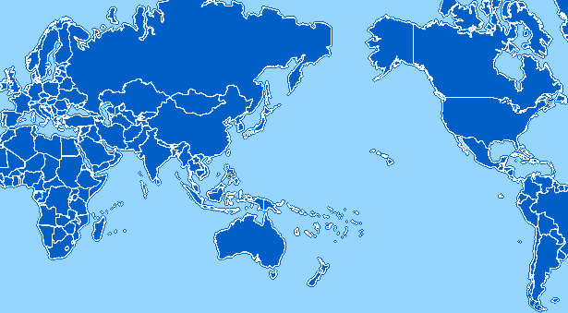
PRAGMA Grid/Cloud
UZH
Switzerland
UZH
Switzerland
CNIC
China
JLU
China
AIST
OsakaU
UTsukuba
Japan
IndianaU
USA
LZU
China
LZU
China
UCSD
USA
HKU
HongKong
ASGC
NCHC
Taiwan
UoHyd
India
KU
USA
UFL
USA
KU
Thailand
ASTI
Philippines
More sites involved in Cloud work
Kansas University
Nanyang Technological University
University of Florida
Universiti Teknologi Malaysia
MIMOS
UTM
Malaysia
NTU
Singapore
MU
Australia
BESTGrid
New Zealand
UChile
Chile
23 institutions in 14 countries/regions, 18 compute sites, 13 Cloud sites
March 4, 2013

Slide 3
SDN Work
Extend Vine experiments
+ UCSD, Indiana, KUK, any other volunteers (KUT?), UTM?
Lead by UFL
Extended to UCSD and IU. Konkuk and UTM will join soon.
Successful VM live migration between UCSD and UFL
Successful Condor VC deployed in ViNe subnets (demo)
Extend Openflow experiments
+ KUT, KUK
Lead by OsakaU
Extended to NTU, KU-Thailand, NAIST, LZU (demo @ resources breakout)
UCSD is getting ready to test OpenFlow hardware switch

Slide 4
VC Sharing Work
Lead by UCSD, AIST and NCHC
F2F meeting at SC12 and finalize
Done http://goc.pragma-grid.net/wiki/index.php/SC12_meeting
Format of the configuration description
Done. See http://goc.pragma-grid.net/wiki/index.php/Vc-interface
Develop scripts
AIST implementation (demo @ resource breakout)
UCSD implementation (demo)
http://goc.pragma-grid.net/wiki/index.php/Rocks_VC_experiment_1

Slide 5
Building CI For Scientists
Meetings
SC12 meeting
December meeting
http://goc.pragma-grid.net/wiki/index.php/CIBD_meeting_notes
3 Tracks
Virtualize Lifemapper service (KU, UCSD)
KU and UCSD successfully build a VC and run lifemapper jobs (demo)
ViNe (UFL, UCSD, IU)
Successfully setup connection between UFL, IU, UCSD
VM auto-migration test between UFL and UCSD successful
Successfully deployed condor cluster and run condor jobs among UFL and UCSD
Data service publication (UFL, UTM)
Successfully setup UTM Geoportal at http://mapping.fbb.utm.my:8080/pragma_geoportal/catalog/main/home.page and currently hosts eight different types of GIS data for Sabah.

Slide 6
Agenda of breakouts
Thursday 15:00-16:30
VC sharing
Demo by AIST
Discussion for improvements and next steps
Friday 11:00-12:30
CI for Scientists
Review progress and status
Discussion for the next steps
Friday 14:30-16:00
Demos (20min each)
IPOP: Self-configuring IP-over-P2P Overlay-based Virtual Private Networking (Pierre St Juste)
Network throughput-aware routing for Pragma Cloud (Kohei Ichikawa, et.al.)
Time available for more demos. (new demo or detailed demo)
AOB

