Slide 1
Building The PRAGMA International Cloud 2011-
Cindy Zheng
For
Resources Working Group

Slide 2
TOC
Why Grid to Cloud
Heterogeneous Cloud needs and solutions
Distributed/Common file system
Overall strategies
Key technologies
VM/VC sharing
SDN
Building infrastructure for scientists
Lifemapper

Slide 3
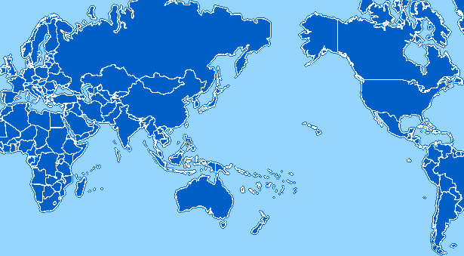
PRAGMA Grid 2004-2010
UZH
Switzerland
UZH
Switzerland
CNIC
China
JLU
China
AIST
OsakaU
UTsukuba
Japan
KISTI
KMU
Korea
LZU
China
SDSC
USA
LZU
China
ASGC
NCHC
Taiwan
UPRM
Puerto Rico
HKU
HongKong
UoHyd
India
CICESE
UNAM
Mexico
ASTI
Philippines
NECTEC
KU
Thailand
CeNAT-ITCR
Costa Rica
HCMUT
HUT
IOIT-Hanoi
IOIT-HCM
Vietnam
MIMOS
USM
Malaysia
UValle
Columbia
IHPC/NGO
NTU
Singapore
MU
Australia
BESTGrid
New Zealand
UChile
Chile
28 institutions in 17 countries/regions, 22 compute sites (+ 7 site in preparation)

Slide 4
Shifting Focus to Cloud http://goc.pragma-grid.net
Basic goals unchanged
Distributed resources
Data collection/storage, expertise, computing, …
Needs of sharing and collaborations
Try to make easier for scientists to collaborate and use distributed resources
Grid is still hard to use
Main difficulty: provide software environments for users
Cloud can be easier to use
VM allow customize/maintain user environment
But needs work
How can users deploy VMs/VCs easily in a heterogeneous global cloud

Slide 5

PRAGMA Grid/Cloud
UZH
Switzerland
UZH
Switzerland
CNIC
China
JLU
China
AIST
OsakaU
UTsukuba
Japan
IndianaU
USA
LZU
China
LZU
China
UCSD
USA
HKU
HongKong
ASGC
NCHC
Taiwan
UoHyd
India
KU
USA
UFL
USA
KU
Thailand
ASTI
Philippines
MIMOS
UTM
Malaysia
NTU
Singapore
MU
Australia
BESTGrid
New Zealand
UChile
Chile
23 institutions in 14 countries/regions, 18 compute sites, 13 Cloud sites
March 4, 2013

Slide 6
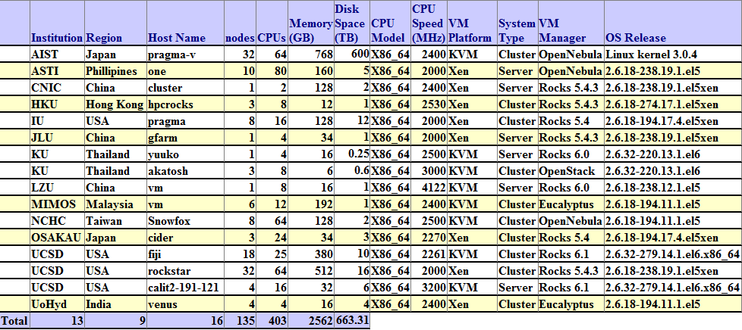
PRAGMA Cloud Resources

Slide 7













PRAGMA Heterogeneous Cloud
OpenNebula
KVM
Rocks
Xen
Rocks
KVM
OpenNebula
KVM
Rocks
Xen
Share VM and VC
Rocks
Xen
OpenNebula
Xen
vmdb.txt
Able to deploy to heterogenous cloud sites
AIST Geogrid + Bloss
NCHC FMotif
LZU Bio1
AIST Nyouga
UCSD BioApp5
Need a common file system
Rocks
Xen
Rocks
Xen
AIST QuickQuake
Gfarm
Rocks
Xen
Rocks
KVM
OpenStack
KVM
Rocks
KVM
Eucalyptus
xen

Slide 8
Gfarm http://goc.pragma-grid.net/wiki/index.php/Gfarm
Open source
Distributed file system
Developer – University of Tsukuba
Used by PRAGMA Grid and some regional networks
GSI authentication
Meta-servers
File servers
Clients

Slide 9

PRAGMA Cloud Storage – Gfarm
http://goc.pragma-grid.net/wiki/index.php/Gfarm
metaserver
File server
Client
Gfarm
Notes:
Start 2011 – Gfarm for VM image depository and sharing – heterogeneous platforms – allow user create VMs at any platform and deploy to all - to make Cloud easy to use – application driven - manual – automate – common interface – VM – VC – on Rocks, Gfarm roll, vm-deploy scripts

Slide 10
Overall Strategy
Goals
Easy to use
Distributed computing
Distributed services
Use distributed data
Secure
Private network span globally
Technologies
Virtualization
Sharing VM/VC images among heterogeneous clouds
Moving big data is slow
Running application where the data is
SDN
Secure envelopes for projects
How
Pilot team leads experiments
Build infrastructure for scientists
Work with science team – first Biodiversity

Slide 11
VM/VC Sharing Experiments
Methedology
Pilot team (UCSD, AIST, NCHC)
Extended testing team (All PRAGMA Cloud sites)
Experiments
Manually create VMs - pilot
Manually deploy VMs - pilot
Between KVM and Xen
Automate VM deployment – pilot then PRAGMA Cloud
Manually create VCs - pilot
Manually deploy VCs - pilot
Automate VC deployment – pilot then PRAGMA Cloud sites
Results
Pilot team designed VM/VC sharing scheme and interface standards
Pilot team developed software and share with all sites
Successfully auto-deploy VM/VC among many PRAGMA Cloud sites

Slide 12
Define Roles and Processes
VM/VC authors
Create VM/VC with applications
If a VM/VC includes any network-sensitive service/application and needs adjustments when the VM/VC is deployed in a new network environment, the VM/VC author should provide script /root/VMreconfig or /root/VCreconfig to reconfigure the VM and VC
Deposit VM/VC images into Gfarm
Provide information about the VM/VC
VM/VC users
Request resources for VM/VC deployment
Deploy VM/VC use scripts provided by resources providers
Run /root/VMreconfig or /root/VCreconfig if provided
Manage the VM/VC and run applications
Resources providers
Provide resources and access to users
Provide easy means for users to deploy and manage VM/VCs

Slide 13
Implement Easy VM/VC deployment
Automate deployment
Implementation per virtual environment
Virtualization engine (KVM, Xen, …)
Virtualization manager (Rocks, OpenNebula, …)
Share among sites with the same virtual environment
Standard interface
Transparency for users
Enable easy implementation among different virtual environment

Slide 14
Design Interface Standards
VM/VC image depository
VM/VC datebase
VC deployment input xml file
VC deployment output xml file
VM/VC deployment script command-line

Slide 15
VM/VC Images Depository Standards
VM/VC images Gfarm depository directory structure
/vm-images/
vmdb.txt
vcdb.txt
<author institution>/
VM images
VC directory
Frontend image, compute node image, xml file
Example
$ gfls /vm-images/SDSC/calit2-119-222
-rw-r--r-- 1 zhengc gfarmadm 10293547538 Jan 24 10:12 calit2-119-222.img.gz
-rw-r--r-- 1 zhengc gfarmadm 1148 Feb 21 13:35 calit2-119-222.xml
-rw-r--r-- 1 zhengc gfarmadm 1693669044 Jan 24 10:20 hosted-vm-0-0-1.img.gz

Slide 16
VM/VC Database Standards
VM database
$ gfexport /vm-images/vmdb.txt
lzu-bio1,kvm-xen,LZU/lzu-bio1.img.gz,418f8b472dc7578bbfd661a71c712591
bioapp5,xen-kvm,SDSC/bioapp5.img.gz,fd555578ddd725c07d3ee378452d8147
fmotif,kvm-xen,NCHC/fmotif.hda.gz,06fff5f211750a38fd0883e8c97102ff
geobloss,kvm-xen,AIST/geobloss.hda.gz,fcf9b1e45098f2e8053afc1e0e15b6a5
nyouga,xen-kvm,AIST/nyouga.img.gz,e4342a37740b9998c781fe2210fa8989
quiquake,xen-kvm,AIST/quiquake.img.gz,db64fc7fcaced46ef3b7baf7e3441418
worker,xen-kvm,AIST/worker_qq.img.gz,83113dddf665e86368a15d0682a3a532
VM-name boot-order image path checksum
VC database
$ gfexport /vm-images/vcdb.txt
calit2-119-222,SDSC/calit2-119-222/calit2-119-222.xml
VC-name XML file path
All VC files are in the same directory – images, xml, checksum

Slide 17
VC Deployment Input http://goc.pragma-grid.net/wiki/index.php/Vc-in.xml
VC-in.xml template
Cluster topology
KVM or Xen
Architecture, HVM?
Memory size, number of CPUs
Network interface name, type
How to boot
…

Slide 18
VC Deployment Output http://goc.pragma-grid.net/wiki/index.php/Vc-out.xml
VC-out.xml template
Cluster topology
KVM or Xen
Architecture, HVM?
Number of compute nodes
Each compute node
name, MAC address, IP address
…

Slide 19
VC Deployment Command-line Interface http://goc.pragma-grid.net/wiki/index.php/Vc-interface
$ pragma_boot vc-name [number of compute nodes] [local VC image depository path]
"pragma_boot" is the script name, should be run in a normal user account
"vc-name" is the name of the VC to be deployed. It's a required argument and should match the first field of an entry in vcdb.txt
"number of compute node" is an optional argument. Default is 1.
"local VC image depository path" is an optional argument. Default is standard gfarm path.
Hide heterogeneity from users
Needs minimum one implementation per virtual environment (virtualization engine, virtualization manager)

Slide 20
The Process
Gfarm
vcdb.txt
F
F
C
C
vmdb.txt
xml
Users
Pragma_boot vcxyz 8
Authors
Hosting server frontend
vm-container-1-0
C
vm-container-1-0
vm-container-1-0
vm-container-1-0
vm-container-0-0
Pragma
_boot
vm-container-0-0
vm-container-0-0
vm-container-0-0
Resources Providers

Slide 21
Automated VM/VC Deployment Solutions
VM Deployment Script
Rocks/Xen (UCSD), installed and ran on 7 sites
http://goc.pragma-grid.net/wiki/index.php/Vm-deploy-multi
OpenNebula/KVM (AIST)
http://goc.pragma-grid.net/wiki/index.php/Auto-deploy_with_KVM/OpenNebula
VC Deployment Script – demo tomorrow
Rocks/KVM (UCSD)
http://goc.pragma-grid.net/wiki/index.php/Auto-deploy_VC_on_Rocks
OpenNebula/KVM (AIST)
Next phase
Expand usage to more Rocks/KVM-Xen and OpenNebula/KVM sites
More implementation in other virtual environment

Slide 22
Network Overlay Experiment http://goc.pragma-grid.net/wiki/index.php/Network_Overlay
OpenFlow
ViNe

Slide 23
Openflow network environment
Virtual network slice A
VM
VM
VM
VM
VM
VM
VM
VM
Virtual network slice B
VM
VM
VM
VM
Lead by OsakaU, Pilot + AIST + UCSD
Motivation
Eliminate reconfigure network
Better access control
VM
GRE
VM
AIST
Open vSwitch
VM
VM
Openflow Controller Trema (Sliceable routing switch)
Open vSwitch
Open vSwitch
VM
GRE
VM
Open vSwitch
VM
GRE
GRE
GRE
UCSD
Open vSwitch
VM
VM
Open vSwitch
Open vSwitch
VM
GRE
VM
Osaka Univ.
Open vSwitch
Open vSwitch
VM

Slide 24
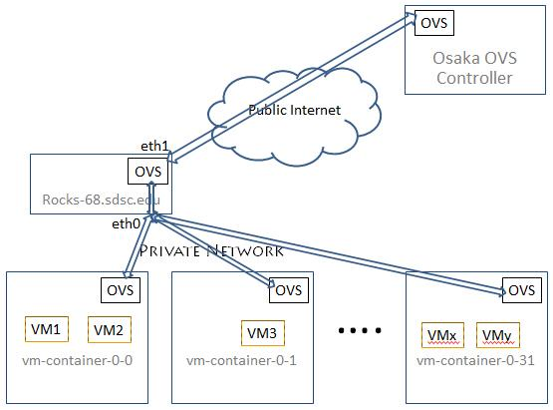
Site Setup Example For Software OpenFlow http://goc.pragma-grid.net/wiki/index.php/Network_overlay_setup_at_UCSD

Slide 25
OpenFlow Experiments In PRAGMA Cloud
First experiment by pilot team (OsakaU, AIST, UCSD)
Successfully setup a OpenFlow subnet
Easy deployment of Geogrid VMs as condor workers
Successfully ran Geogrid applications
OpenFlow activities fourishing in PRAGMA Cloud
OsakaU leads expansion and further research on performance (demo)
UCSD getting ready to test hardware OpenFlow (OpenFlow switch) functionalities and performance
NTU, KU-Thailand setup OpenVswitch at their sites and connecting to PRAGMA Cloud OpenFlow network
LZU built a Openflow switch test environment use NetFPGA at their site

Slide 26
Another Network Overlay – ViNe Experiment http://goc.pragma-grid.net/pragma-doc/pragma23/posters/vine-Maur%c3%adcioTsugawa.pdf
Lead by UFL
First experiment, +AIST
Setup ViNe subnet
Successfully tested VM live migration
Second experiment, +UCSD+IU
Setup ViNe subnets
http://goc.pragma-grid.net/wiki/index.php/UCSD_implementation
http://goc.pragma-grid.net/wiki/index.php/IU_implementation
Successfully tested VM live migration
Successfully deploy VC and run condor job (demo)
http://goc.pragma-grid.net/wiki/index.php/Condor-ViNe_test

Slide 27
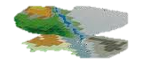

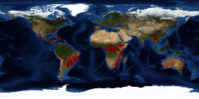

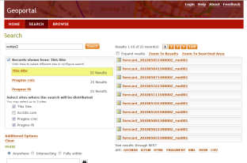
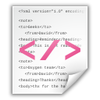


Building Infrastructure For Scientists http://goc.pragma-grid.net/wiki/index.php/Building_CI_For_Scientists First case - Lifemapper
Mount Kinabalu specimen
data storage
(3)
Predicted Habitat
(1)
(2)
LifeMapper WebService at
UKansas
(4)
(5)
GeoPortal at UTM
Metadata
A script queries GeoPortal instance at UTM (Malaysia )to retrieve raster data
Retrieves raster data from stored dataset
Submit dataset to LifeMapper as occurrences/experiments
Prepare occurrence dataset
Post occurrence set
Post experiment
LifeMapper outputs prediction result as metadata (EML)
Catalogs LifeMapper predicted output metadata in GeoPortal at IU (US)
GeoPortal at IU
PRAGMA node
Source: Uma Pavalanthan
Notes:
What is Geo Portal? http://www.esri.com/software/arcgis/geoportal/index.html
ESRI GeoPortal is an open source metadata server that enables discovery and use of geospatial resources.
GeoPortal enables organizations to manage and publish metadata about their geospatial resources and let their users to discover and connect to those resources
What is LifeMapper? http://lifemapper.org/
At its core, LifeMapper consists of two main components:
First, An archive of species occurrence data, current and predicted climate and environmental data, and modeled habitat maps created from them
And second, a set of tools, published as webservices, for researchers to use with LifeMapper’s data, or their own, to study biodiversity of single or multiple species
What is metadata?
Refer next slide
About this experiment:
Metadata describing Mount Kinabalu raster data will be catalogued in a Geo Portal at Universiti Teknologi Malaysia (UTM)
A script running from an Indiana University(IU) PRAGMA node will query this catalog and retrieve specimen data
Specimen data will be passed to LifeMapper webservice running at University of Kansas
LifeMapper will output predicted habited and metadata describing it
The script will catalog this metadata in a GeoPortal instance running at IU, so that users can search the catalog and retrieve the predicted habited via LifeMapper

Slide 28
Infrastructure for Lifemapper
Needs
Private network among biodiversity sites
UFL, KU, IU (USA), UTM (Malaysia)
Distribute data services
Currently only KU, UTM
Distribute computing
Currently only KU
Solutions
Overlay network
Setup and tested ViNe subnet among UFL, IU and UCSD
Nest step, add other sites into the subnet
Virtualize Lifemapper components
First – virtualize Lifemapper compute component

Slide 29
Build a Virtual Cluster for Lifemapper http://goc.pragma-grid.net/wiki/index.php/Lifemapper_VC
Team: Kansas University (KU), UCSD
KU: modulate compute component
UCSD: build VC, install software
Team: Testing
Successfully run lifemapper jobs on VC (demo)
Next step: deploy the VC to other sites, use automated VC deployment solutions

Slide 30
Welcome Everyone To Get Involved

