Slide 1
Lightning Talk
Vasuwat Tan-anannuwat
Wisarut Khumngoen
Wanida Putthividhya, Ph.D

Slide 2
Motivation

Slide 3
Motivation
Nobody can conjectured the natural disaster. Whether it be earthquake, Flood, Tsunami, Hurricane, or other disasters.
In these disaster situations, availability of network bandwidth to access important data, transmit crucial information as needed is very necessary.

Slide 4
Infrastructure

Slide 5
Infrastructure
Software- defined networks (SDN) are known as a novel infrastructure for controlling and managing network resources from a programmable centralized controller.
OpenFlow protocol: the communication protocol between switches and SDN controller.

Slide 6
“FGBAM”
The prototype of Fine-Grained Bandwidth-Allocating Middleware in software-defined networks
Notes:
Therefore, we design our project call“The prototype of Fine grained Bandwidth- Allocating middleware in software-defined network” or FGBAM in short

Slide 7
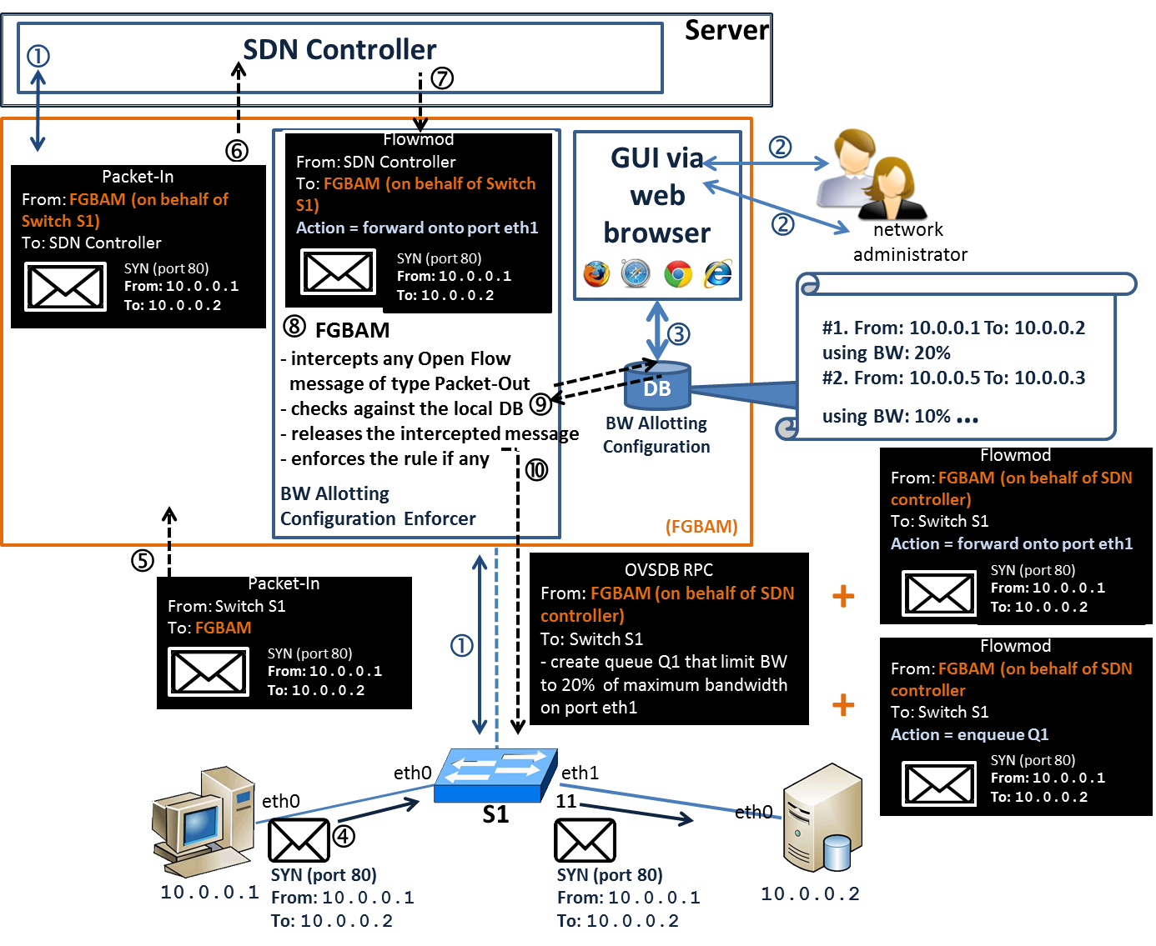
System Architecture
Notes:
Here is the system architecture showing how FGBAM works together with SDN controller and switches in SDN.
Basically, FGBAM works as a proxy between switches and SDN controller.
But, I think it might be too detail for this session.
We can discuss more about this during the poster session.

Slide 8
Advantages

Slide 9
Advantages
Fine-grained bandwidth allocation: FGBAM can divide communication bandwidth of a single port among many data flows.
Transparent : no changes in implementation of SDN controllers and configuration of network devices are required.
Universal : Can work with SDN controllers of many kinds and any network topology.

Slide 10
Current Results

Slide 11
Current results
We have tested FGBAM in simulated environments.
Our results showed that we can actually do fine-grained communication bandwidth allocation in SDN.

Slide 12
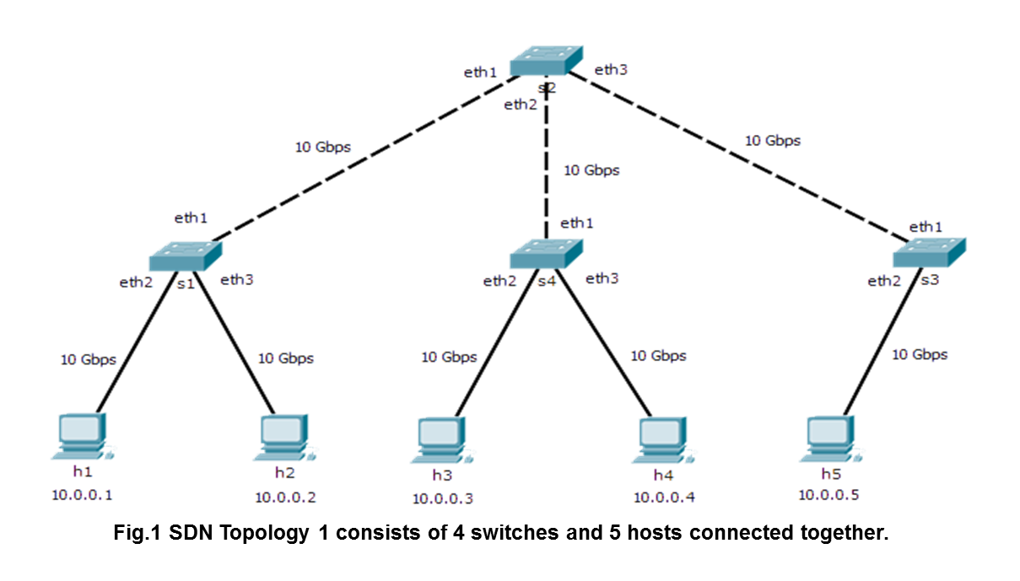
Current results : Topology
Simulated environments using
Mininet and virtual machines
Notes:
This is one topology which we have tested our FGBAM on.
The topology was built using Mininet.

Slide 13
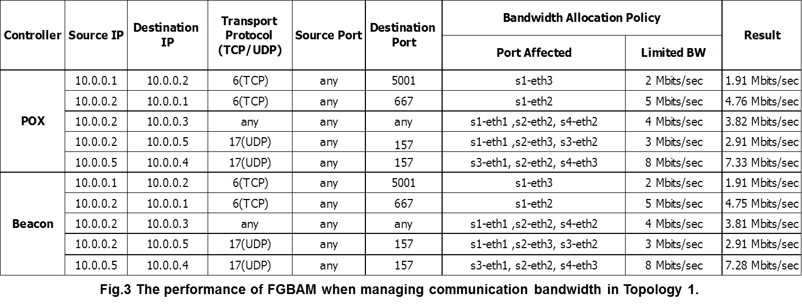
Current results
Notes:
If you have a question you can discuss more about this during the poster session.

Slide 14
“Thank you”

