Slide 1
VmigSim: Simulation study of time-limited VM migration scheduling in WANs
Notes:
Greeting
Introducing self
Tell that you are going to talk about this topic

Slide 2
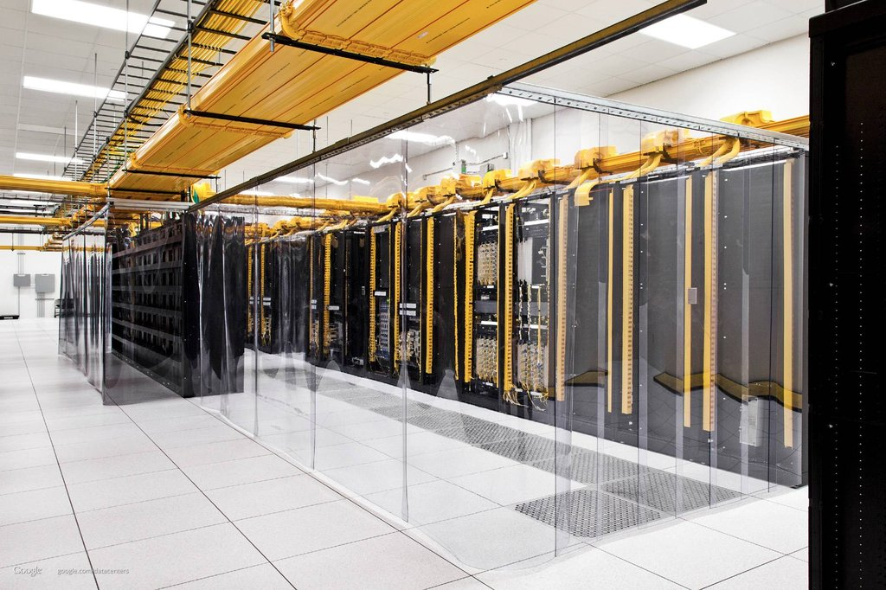

Why does a migration?
More and More VMs.
Migration keeps services running.
Image credit: http://background-kid.com/data-center-wallpaper.html
Notes:
- The favoring of using virtual machines (VMs) instead of physical machines (PMs) is increasing so fast.
- Migration helps keeping services on VM out from permanently down or losing data inside VMs.

Slide 3
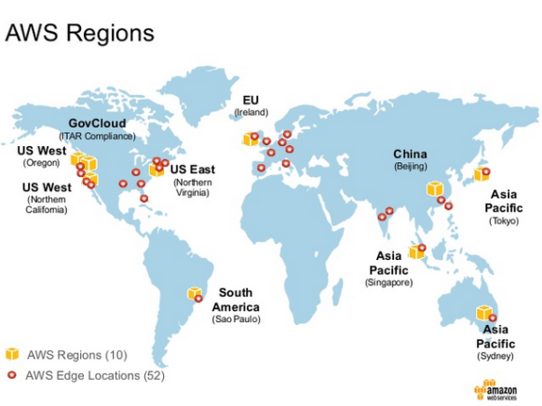
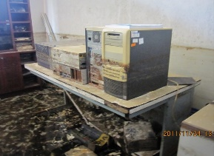
Why must a migration be efficient?
Datacenters are mostly connected by WAN.
WAN is usually unstable.
Time limitation involved.
Image credit: http://www.slideshare.net/insideHPC/update-on-hpc-use-on-aws
Notes:
(Optional) Current method of inter-datacenter migration we have is physical moving.
(Optional) While VM migration mechanisms is designed for LAN
(Optional) Now we want to use those mechanisms on WAN.
To enable an inter-datacenter VM migration, we have to do it over WAN.
Which is usually unstable and hard to predict its throughput, so you cannot tell your users (customers) how long will your systems exactly go offline.
Moreover, in some circumstances, such as disasters like flood or unscheduled site maintenances, there is time limitation involved.
So the efficient inter-datacenter migration is very important.

Slide 4
What do we exactly do?
Study factors affecting the VM migration time.
Study various migration mechanisms and scheduling policies.
Design and develop efficient migration management mechanism.
Notes:
- To put it simply, to develop the efficient migration method.

Slide 5
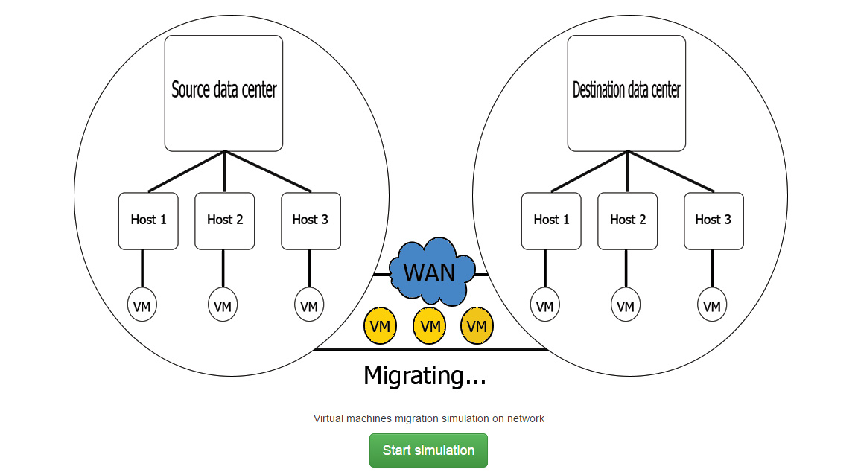
VmigSim
Cross-datacenter VM migration Simulation.
Notes:
Because studying on real environment has so many factors that hard to control, such as network throughput.
So we decided to design and develop the simulator, called VmigSim.
It supports cross-datacenter VM migration simulations (with dynamic network bandwidth generator).

Slide 6
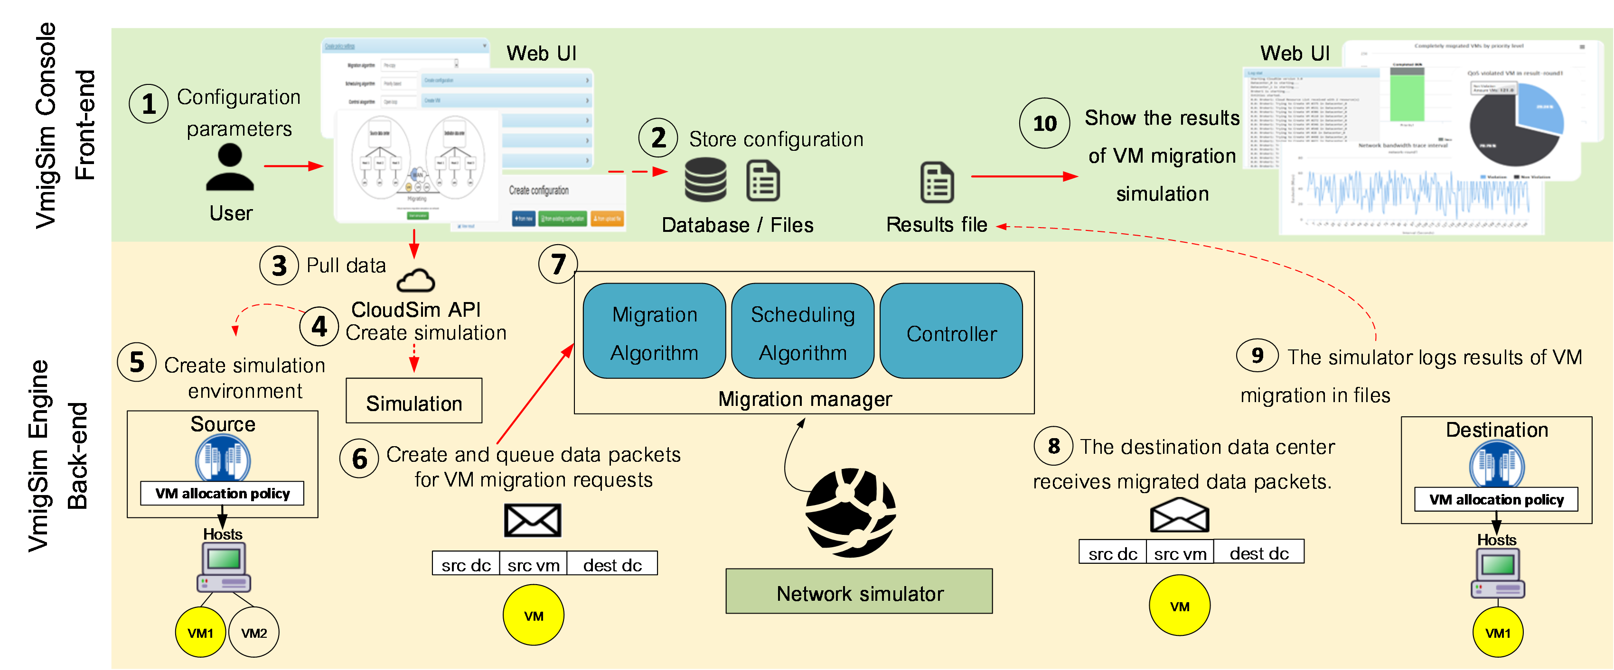
VmigSim
Extends CloudSim.
Notes:
Extends from CloudSim, which is the well-known cloud system simulation framework.
We extends it by implementing some modules responsible for migration management and scheduling

Slide 7
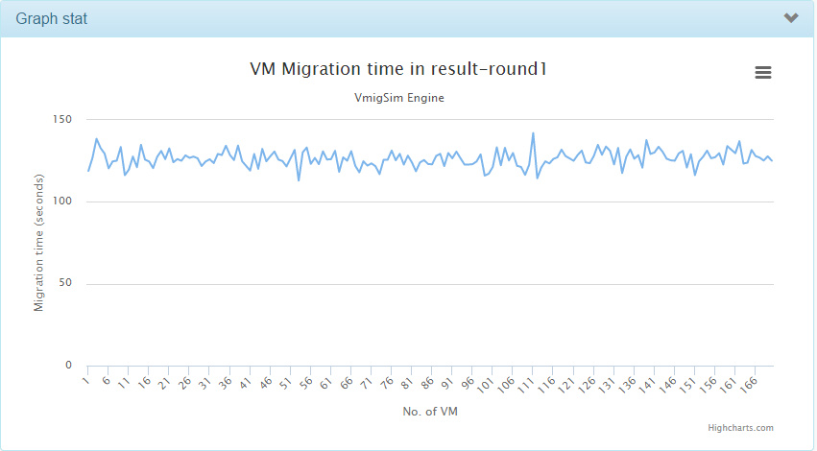
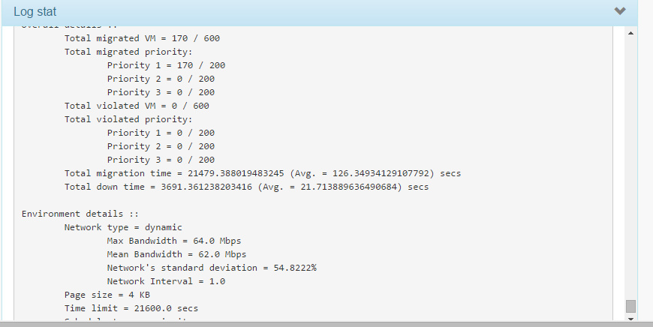
VmigSim
Web-based graphical interface.
Text result
Graph result
Notes:
And for the ease of using and analyzing results, we also develop a web-based user interface
Which displays the results in forms of both text, and graph.

Slide 8
Our conclusions
VmigSim considers the dynamic bandwidth, while CloudSim does not.
Notes:
- VmigSim considers the dynamic bandwidth and also enables inter-datacenter migrations, which don’t existed in CloudSim.

Slide 9
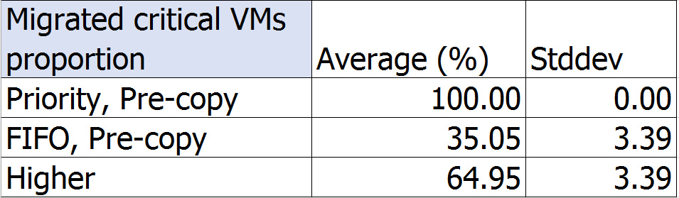
Our conclusions
The priority-based scheduling improves the number of critical VMs successfully migrated.
Notes:
- The priority-based scheduling increases the number of critical VMs that are successfully migrated for about 60% comparing with non-priority considered.

Slide 10
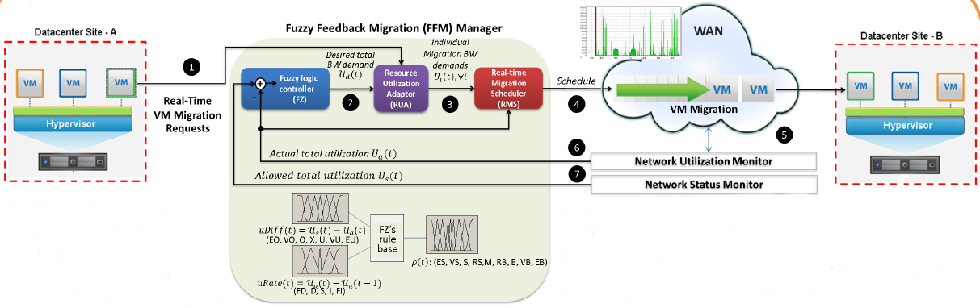
Ongoing & future work
Close-loop looks promising.
Notes:
- Our current migration controller doesn’t seem good for network that is heavily dynamic. So we started looking for something to improve the controller.
We found that closed-loop control system looks promising, and we are looking into it.
(Optional) Since it could potentially allow the migration to adapt to WAN, which is unstable.

Slide 11
Thank you
Notes:
If you have any questions, please catch me at the poster.

Slide 12
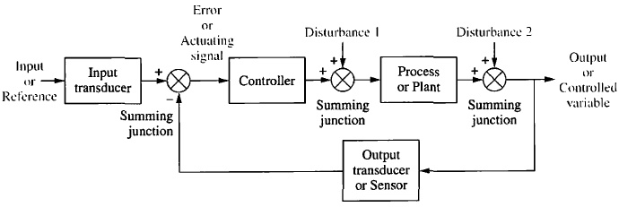
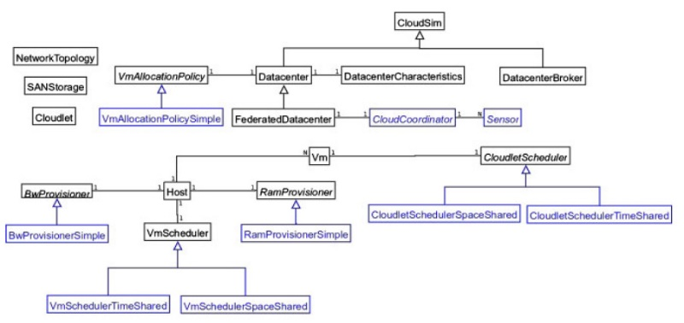
Image credit: Nise, N.S., Control Systems Engineering. 2011: p. 2-30.
CloudSim’s structure

