Slide 1


Invitation to Beijing PRAGMA25
Kai Nan, Kevin Dong, Peter Zhao
Computer Network Information Center (CNIC),
Chinese Academy of Sciences (CAS)
Notes:
It’s my honor and pleasure to have the invitation presentation here to invite all of our friends to attend PRAGMA25 workshop, the next workshop which will be held in BEIJING.

Slide 2
PRAGMA25 Fall 2013 BEIJING, CHINA
October 16-18, 2013
Computer Network Information Center(CNIC) Chinese Academy of Sciences
A leading institute for next-generation internet research and applications in China, providing networking, supercomputing, and data information services for Chinese Academy of Sciences
Notes:
a leading institution for next-generation Internet research and applications in China, which also provides networking, supercomputing and information services for Chinese Academy of Sciences (CAS)
In the last ten years, CNIC got actively involved in PRAGMA activities by participation in workshops, contributing resources, hosting student and researcher exchanges.

Slide 3
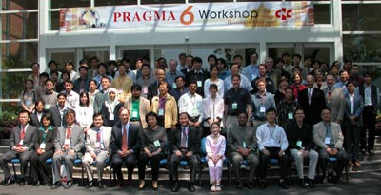


Look back to PRAGMA6 (2004@BEIJING)
Notes:
Let’s look back to 2004, as a founding member of PRAGMA, CNIC have honored to have the PRAGMA6 workshop at Beijing. We have good memories. At this moment,

Slide 4
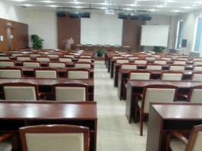
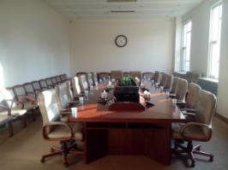
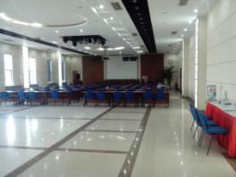
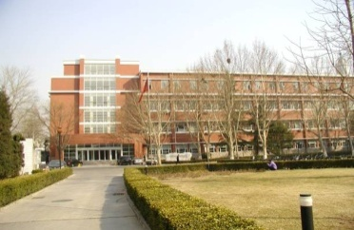
Venue@CNIC
Hall 505 & 507
Room 508/504/107
VTC Room 510
Multimedia Room 514

Slide 5
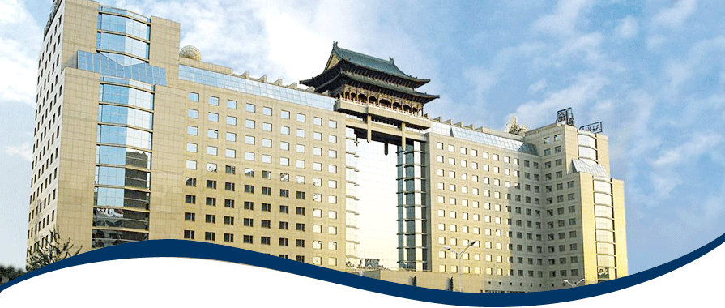
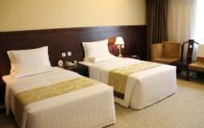
Accommodation
The Beijing Jade palace Hotel (5 mins walk to CNIC)
Hotels near IEEE 2013 e-Science conference (10 mins Taxi to CNIC)
InterContinental Beijing Beichen
China National Convention Center Grand Hotel
Beijing Continental Grand Hotel
Notes:
We will make

Slide 6
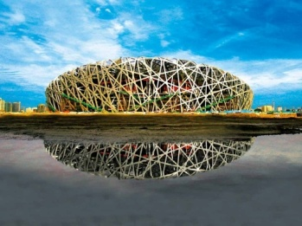

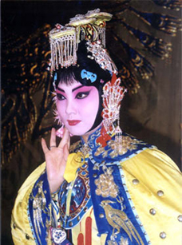
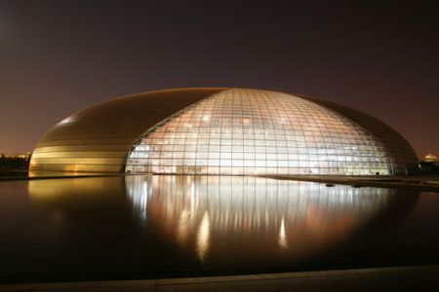
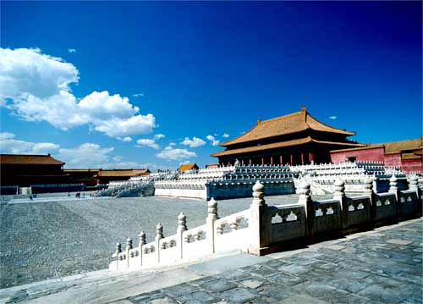


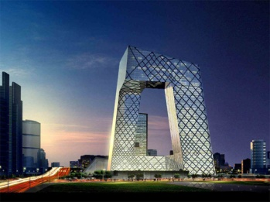
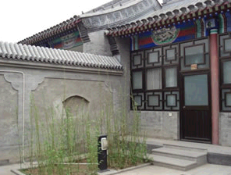
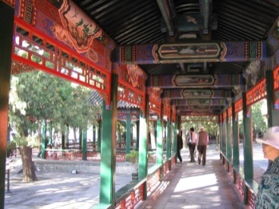
Beijing Scenery – OCTOBER is the BEST
Notes:
I believe all of our friends, old and newer also can find some valuable in fantastic Beijing.

Slide 7
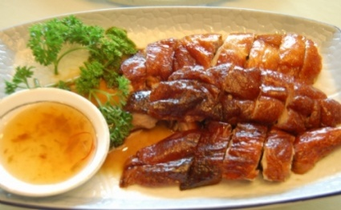


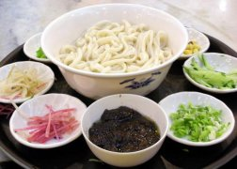

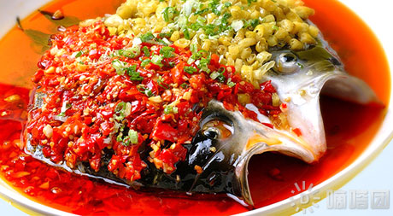
Beijing - Food
All traditional food and dishes around China
Spicy, Hot spot, …
Beer/“Yellow” wine
&Chinese alcohol
Foreign food
Korean, Japanese, Western food…

Slide 8
IEEE 2013 e-Science conference
will be held in 22~25, 2013, in Beijing
http://escience2013.csp.escience.cn/
China National Convention Center
<10km to CNIC

Slide 9
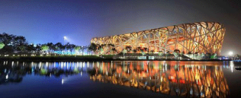
ONE MORE BEIJING!
欢迎您到北京
Notes:
I think lots of people have heard of Beijing’s fog. I think this autumn will be fantastic and away from fog because we have PRAGMA25…

