Slide 1

Trends and Direction of a National Research and Education Infrastructure
Assoc. Prof.Kamjorn Tatiyakavee, MD.
Deputy Secretary-General Office of the Higher Education Commission

Slide 2
Agenda
Introduction to UniNet
From UniNet to NEdNet
Education Information Service
Research and Education Activities
Self learning Centre and Sharing Educational Resources

Slide 3
Introduction
UniNet is the largest internet provider for Thai educational institute.
Established in 1996 as a part of Ministry of University
Now is under Ministry of Education
UniNet provides hi-speed internet links to universities, educational institutes
For advanced research
Education and learning
Notes:
UniNet was founded in the year 1996 with the purpose follow as Government policy on that time for link together and develop the teaching and learning of universities and the regional campuses throughout the country and to serve and linkage for the academic and research projects conducted among institutions in foreign countries. This is achieved with the implementation of information technology within a network infrastructure and the optimization of shared network resources. Uninet resembles the central operation unit that is responsible for developing the information technology for Advance research and education and Learning

Slide 4
Vision and Mission
NEdNet
To develop a Infrastructure and high-speed network for REN
To employ information technology for learning resource development
To created and support a research and education working group
To develop the human resources
Basic Education
Vocational
Higher Education
UniNet
Notes:
UniNet vision and mission want to push the policy for development Information and Communication Technology in Education provides a comprehensive education system with the following:
1. To develop a Infrastructure and high-speed network for Research and Education Network
2. To employ information technology for learning resource development
3. To created and support a research and education working group
4. To develop the human resources

Slide 5
Member of UniNet/NEdNet (2009-2014)
Members | Number of Member
Universities/Institutes | 194
Vocational Education | 415
Educational Service Area | 185
Basic Education (schools) | 9,749
Municipality Public Library | 151
Research and other Education | 51
Total | 10,745
Millions of users!
Notes:
Currently UniNet has the members more than 10,000 institutes including universities/vacationals/schools and other education offices around the country and more than millions of users.

Slide 6
From UniNet to NEdNet (National Education Network)
The Previous Education Networks
MOE Net (Primary, Secondary Schools)
VEC Net (Vocational Network)
UniNet (University Network)
“Thailand Government approved Stimulus Package total Budget 6,000 M Baht or 170 M US$ to Integrate all Education Network to National Education Network (NEdNet)”
Notes:
Currently, UniNet has been determined project from Thai Government (Bureau of the Budget), The project Stimulus Package with support all infrastructure and connection link to Education at all level in Thailand for research and Education Network via Fiber optic only, The project run between year 2010 to 2014 and approved budget around 170 Million US$ to Integrate all Education Network to National Education Network

Slide 7
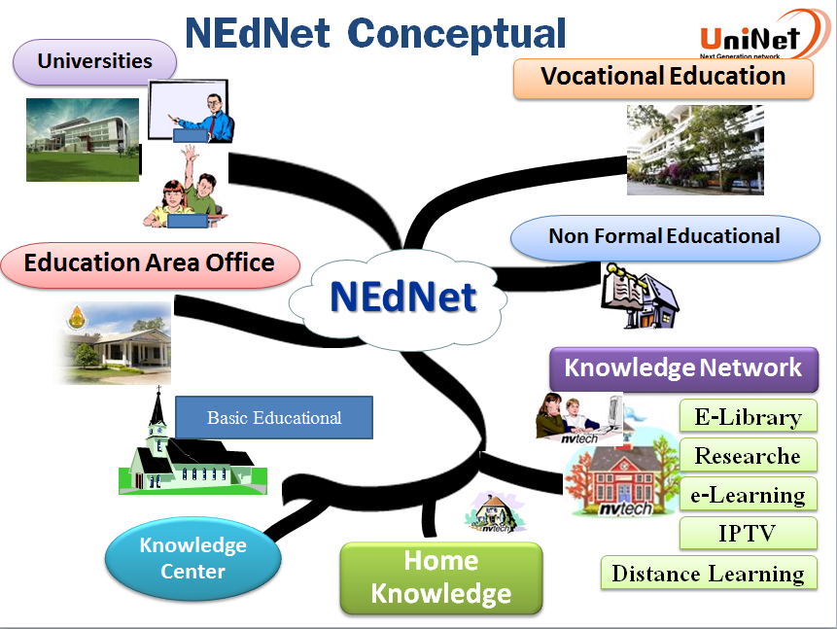
Notes:
The Government policy for link together and develop the teaching and learning of universities and the regional campuses throughout the country and to serve and linkage for the academic and research projects conducted among institutions in foreign countries. This is achieved with the implementation of information technology within a network infrastructure and the optimization of shared network resources such as Distance Learning with Tele conference technology, e-Library and e-Learning etc..

Slide 8
UniNet functions
There core function of UniNet
Infrastructure provider
Services hosting
Activities leader

Slide 9
Infrastructure Goal 2010-2014
Fiber Optic to accommodate the core network (Backbone) that can support bandwidth 50 Gbps (total 87 Node)
University connected (Dark Fiber) with bandwidth 1 Gbps-N x 1 Gbps.
Vocational institutions bandwidth 100-1,000 Mbps.
School bandwidth 10-100 Mbps.
Research network at least 10 Gbps.
Phase1 (2010-2012)
293 Universities (1 Gbps).
415 Vocational Education (100 - 1,000 Mbps)
2,749 schools (10 - 100 Mbps)
Phase2 (2013-2014)
7,000 schools (10 - 100 Mbps)
Building a content infrastructure that stimulate learning and research in Thailand
Notes:
Scope of operations plan year 2010 to 2014.
create and develop Fiber Optic to accommodate the core network backbone speed 50 Gbps distribute more than 87 Node that serves as the nation's international linkage to foreign educational and research networks. The linkage of nationwide Thai education to foreign education Network. Linked network institutions/agencies for education. At least the following.
293 Universities (1,000 Mbps each of the N x 1,000 Mbps).
415 Vocational Education (100 - 1,000 Mbps)
9,749 schools (10 - 100 Mbps). (7,000 schools will be implemented success in the year 2014)

Slide 10
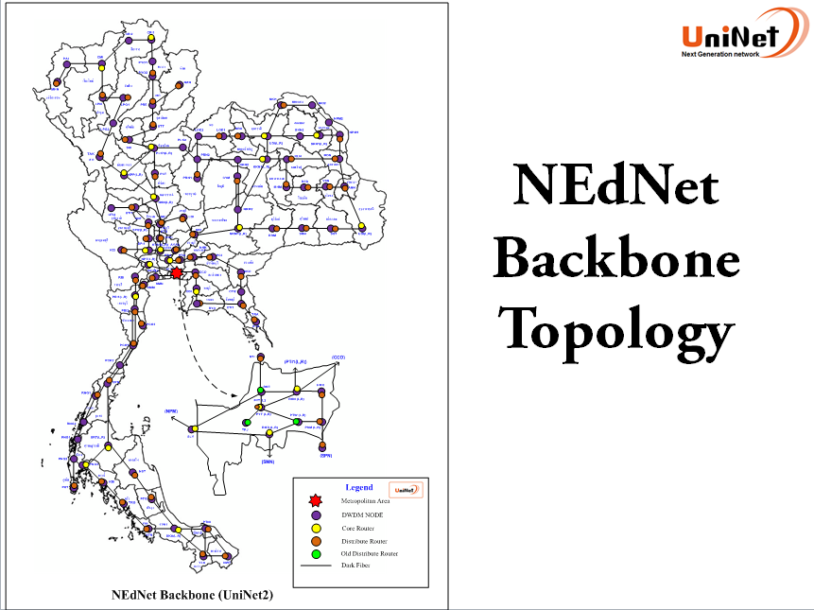

“All POP IPv6 Ready”
Notes:
In the year 1996 UniNet has provide internet speed 2 Mbps via Leaded Line connection to the currently UniNet has establish reach in 16th Year with has developed a core network bandwidth more than 50 Gbps link 87 node region and implemented IPv6 ready.
The network fiber optic link cover 50,000 KM from core network link node region and distributed.

Slide 11








Research & Education Collaborations
TEIN4
JGN
Seminar
Research
Conference
THAILAND
UniNet
Thaisarn
Notes:
The picture show structure network connection of UniNet with ThaiREN
ThaiREN network has expanded the original circuits from Thailand connect into TEIN4 network via Singapore Node the Bandwidth is155 Mbps and will upgrade to 622 Mbps. There is a direct link from Singapore node APAN-JP network in Japan with the bandwidth 622 Mbps
And also connect into Internet2 network Bandwidth of 155 Mbps.

Slide 12
Education Information Services
National Education Information Services (NEIS) using Service Oriented Architecture (SOA) infrastructure which provide information for management and executives in three levels.
National level using TH e-GIF (Thailand e-Government Interoperability Framework)
Local level (province)
School level
Notes:
National Education Information Services (NEIS) is a information infrastructure, which provide information for management and executives in three levels. The first level is national level, which establishes a comprehensive e-government project using TH e-Gif (Thailand e-Government Interoperability Framework) to enhance efficiency and quality of general services such as procurement, service delivery, monitoring and evaluation and etc. The second is local level, which share data and information among education administration organizations and other government departments. The last is school level, which handle education administration in a more efficient, convenient, and innovative way.

Slide 13
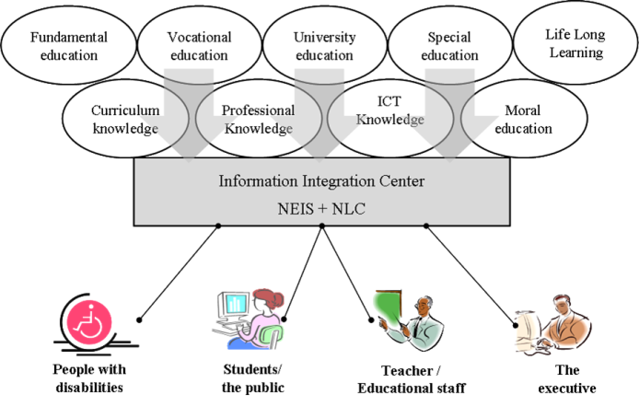
Information Integrated center with combine education information services and learning services
Notes:
NEdNet applied this concept to integrate education related services from each education level and also used with learning services to be the Information Integration Center for all education stakeholders such as teachers, students, and executives. National Learning Center (NLC) is the center for integrated contents in all level of educations.

Slide 14




2012 1 Million Tablets
2013 3 Million Tablets
Target 10 Million Tablets

Slide 15
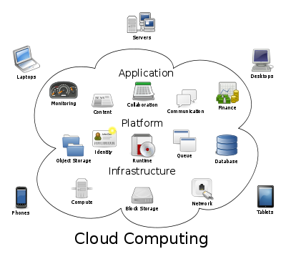
Learning Cloud Service
Vision
Driving research and education using cloud, internet, and mobile computing technology
Leverage the emerging cloud computing technology to provide a
Rich educational content environment
Internet services, Computing service
Mobile learning support
Storage service
Notes:
Also, the network service provider, as already mentioned. Creating a system for data management between education institutions. The office of Higher Education Commission Ministry of Education aware of and support the development the project U-Cloud for Education and advanced research services.

Slide 16
Learning Cloud Service Model
Notes:
Learning Cloud Service Model include tool and information for formal/in-formal/non-formal Education.

Slide 17
Learning Cloud Services
Personal website: link to teachers and students websites.
Interactive application and game
Picture and video sharing
Wiki, Blog
e-book and e-learning
Peer-to-peer sharing application
Collaborative tools such as e-mail, messaging
Distance learning through Video Streaming services

Slide 18
UniNet Services
Currently, UniNet provides self learning centre and sharing educational resources
Thai Library Integrated System: ThaiLIS
Thai Cyber University: TCU
Thai Teacher TV

Slide 19
“Make a collaboration with University Libraries in Thailand and support and service academic content”
Thai Library Integrated System: ThaiLIS

Slide 20
1.Union Catalog
Bibliographic data of university libraries in Thailand 3.4 M Bibliographic records located at 24 University libraries
Operated the MARC Standardization
Distributes Web based Union Catalog and service for Inter Library Loan (ILL)

Slide 21
2. Thai Digital collection Fulltext Service
Fulltext collection more than 300,000 fulltext files located by 140 University libraries in Thailand
Operated the Metadata Duplin core Standardization
Distributes Web based Thai Digital collection and allow network-user to access full-text immediately

Slide 22
Type of Digital collection: Fulltext Service
Integrated search of digitized as:
Theses & Dissertations
Research
Journal Articles
Rare book
E-books
Proceeding

Slide 23

3. Foreign Research Database: Project Reference Database
Supporting international research Database
Subscription to 78 members of university
SpringerLink Journal
ProQuest ABI/INFORM
ScienceDirect
IEEE/IEL
American Chemical Society
Computer Applied Science
Complete
ProQuest Dissertation
Academic Search Premier
Education Research Complete
Emerald Management
ACM
Digital Library

Slide 24
Thai Cyber University: TCU
The TCU has developed its own LMS and developed it to be the sharable LMS which is open source software. The system includes:
Content management system, student management system, and production tools.
Several support and service systems such as web board, chat room, collaborative group system.
Support English version that we could provide to the world.
Students can choose many open courseware offering in the TCU-LMS. At present there are about 616 courses available in the TCU-LMS

Slide 25
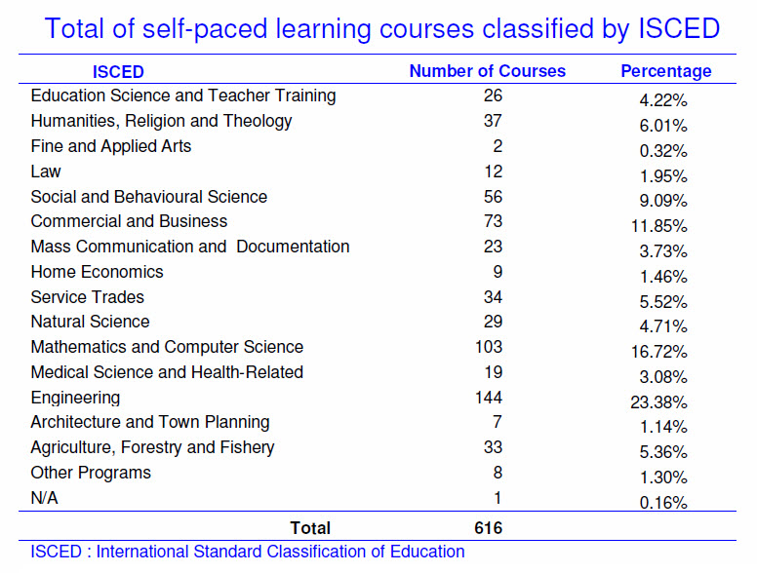
Notes:
TCU has launched in January 2005 with 161 courses in service. All are self-paced learning courses which everyone can access with free of charge via registering as TCU member. At present, February 2013, TCU has 735 courses in service with 616 self-paced learning courses.

Slide 26
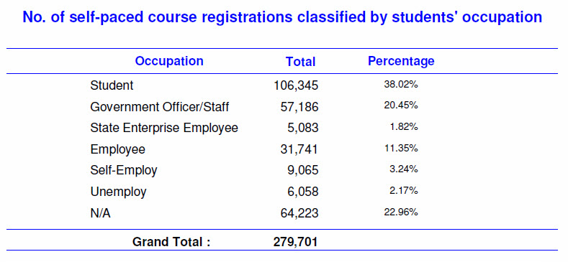
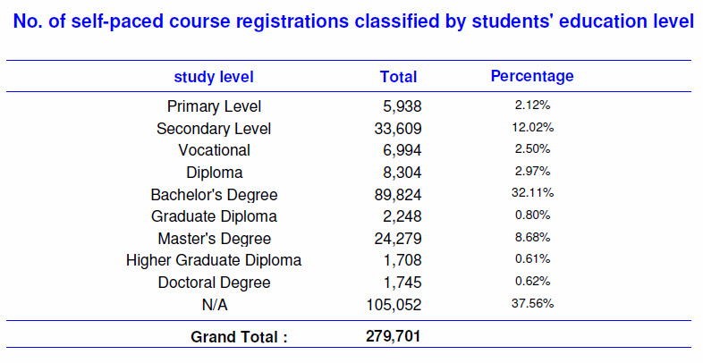
Notes:
Most of TCU members that access self-paced learning courses are student (38%) and government officer/staff (20%).
The study level mostly are Bachelor’s degree (32%) and Secondary level (12%).

Slide 27
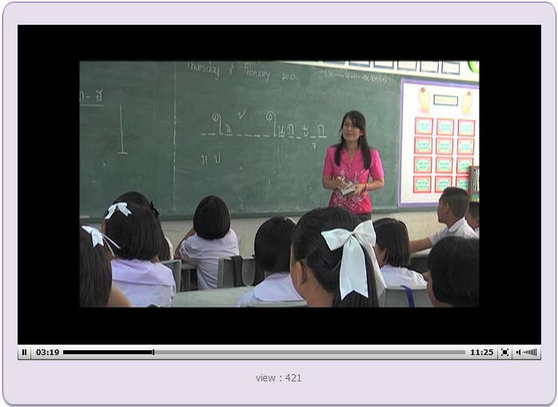
Thai Teacher TV
Sharing best practice
to see good practice
24 Hours a day on IPTV and Digital Television Channel (CAT chanel, TRUE) and internet Channel on http://iptv.uni.net.th
Over 3,600 Programmes online for Broadcast Streaming on IPTV (15 Minute format for each program)
High Quality Video

Slide 28
Research Working Groups
IPv6
Multicast Technology
Grid
Security
Network Monitoring
Open Source
E-Learning and Multimedia
GIS
Web cache
Distance Learning
Telemedicine
E-Culture

Slide 29
Future Direction
Expanding Internet for Research and Education
Reach ability
Performance, Speed, Reliability
Expanding Content and Service using Cloud Computing
Building Stronger Community of
Education
University Researchers
Stimulate research and education
Rich content and services environment
Real experimental test bed using UniNet

Slide 30
Thank You

