Slide 1
High Throughput, Low latency and Reliable Remote File Access
Hiroki Ohtsuji and Osamu Tatebe
University of Tsukuba, Japan
/ JST CREST

Slide 2
Motivation and Background
Data-intensive computing is a one of the most important issue in many areas
Storage systems for Exa-byte (10¹⁸)
Need a fast and reliable remote file access system

Slide 3
Motivation and Background(cont’d)
Data sharing
Distributed file system
Clients access the data via Network
Bottlenecks
Wide-area network
Long latency
Storage cluster
Overhead of network
Fault tolerance
Suggestion: Congestion avoidance
Client
Meta data server
Storage node

Slide 4
Remote file access with RDMA
Latency of Ethernet is at least 50 microseconds
Overhead of software
Protocol
Memory copy
Flash memory based storage devices
25μs latency (e.g. Fusion-io ioDrive), (HDD=5ms)
Network becomes a bottleneck of the system

Slide 5
Usage of Infiniband
IP over IB
Use the IP Protocol stack of operating systems
Pros
Can use as a network adapter
Cons
Inefficient
SDP (Socket Direct Protocol)
Pros
Easy to use
Specify the LD_PRELOAD
Cons
Performance
RDMA (Verbs API)
Pros
Low-latency
Cons
No compatibility with socket APIs
Performance
Implementation cost
better
better

Slide 6
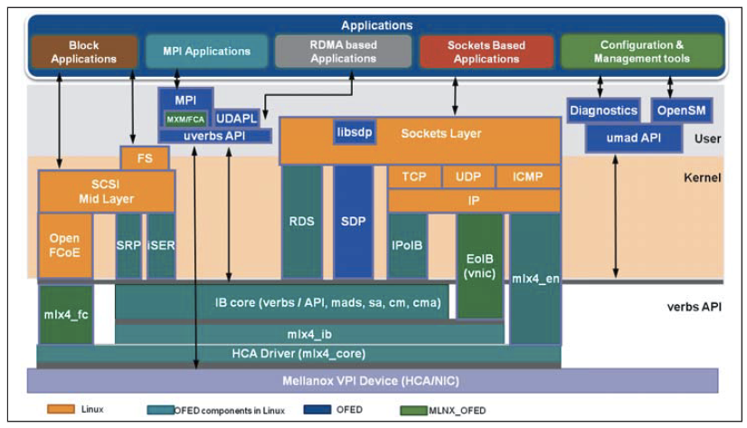
Structure of OFED
OFED：Drive and libraries for Infiniband
Verbs API
SDP
IPoIB
From ©Mellanox document
Notes:
なぜVerbs APIを使うと早いか
通るレイヤーが少ない
IPoIBはカーネルのTCP/IPも通る．
一方，SDPは再送制御などをInfinibandのハードウェア（HCA）に任せるので，その分
オーバーヘッドが減る．だが，依然としてソケットレイヤーを通る．
VerbsAPIを使うと，TCPなどの制御やソケットレイヤーを通らずに，ダイレクトに通信が行なえるため
圧倒的な低レイテンシを実現できる．

Slide 7
Remote file access with RDMA
Infiniband FDR (54.3Gbps)
Storage: Fusion-io ioDrive
Architecture
Client
Server
CPU bypass
Client
Infiniband
Server
RC
RDMA
Memory
Memory
Storage
Application
Low overhead remote file access with Verbs API

Slide 8
Preliminary Evaluation: Throughput
A client accesses the file on the file server via Infiniband w/ Verbs API
Sequential
(Verbs API)

Slide 9
Preliminary Evaluation of IOPS
Stride access from 2KB-64KB (seek 1MB)
(Verbs API)
Stride = 1MB

Slide 10
Congestion avoidance by using redundant data
Concentration of access
There are hotspots (files) on the storage node
Redundant data
Fault tolerance
Can be use to avoid congestion

Slide 11
Redundant data
Basic structure
File1 d₀ d₁ p₀
File1 d₀ d₁ p₀
0
1
2
0
1
2
d₁ xor p₀ = d₀

Slide 12
RAID: connected with SCSI / SATA
→connected with network
SCSI / SATA
Network
Notes:
今話した内容はRAIDにも共通しているが，異なるのは

Slide 13
Performance deterioration
File1 d₀ d₁ p₀
File1 d₀ d₁ p₀
File2 d₀ d₁ p₀
File2 p₀ d₀ d₁
0
1
2
3
0
1
2
3
Storage nodes
Storage nodes
Clients
Clients
0
1
2
3
0
1
2
3

Slide 14
Performance deterioration(cont’d)
No congestion
w/ congestion
Clients
RAM Disk，16GB，Sequential

Slide 15
Congestion avoidance
File1 d₀ d₁ p₀
File2 d₀ d₁ p₀
0
1
2
3
Storage nodes
Clients
0
1
2
3

Slide 16
Performance evaluation
Compare the cases
+28%
+15%
Congestion avoided
No congestion
w/ congestion
Rebuild the striped data
Clients
復号あり
復号あり
w/ decode

Slide 17
Related work
Stephen C. Simms et al, Wide Area Filesystem Performance using Lustre on the TeraGrid, 2007.
Wu, J., Wyckoff, P. and Panda, D.: PVFS over InfiniBand: Design and Performance Evaluation
Erasure Coding in Windows Azure Storage, USENIX ATC ‘12
Shorten the latency by using redundant data
HDFS RAID

Slide 18
Conclusion and Future work
Remote file access with Infiniband RDMA
Congestion avoidance
Future work
How to detect the congestion
Writing of data(in progress)
w/o performance degradation
0
1
2
3
Storage nodes
Client

