Slide 1
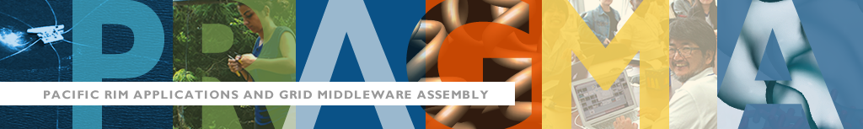

Multi-tenancy in PRAGMA-ENT using AutoVFlow
Hiroaki Yamanaka (NICT, Japan)
Kohei Ichikawa (NAIST, Japan)
Maurício Tsugawa (UF, USA)
2015 April 8
Pre-workshop in PRAGMA 28
Notes:
Today, I would like to demonstration the multi-tenancy mechanism in PRAGMA-ENT.

Slide 2












Acknowledgement
Co-developers of AutoVFlow
Eiji Kawai
Shuji Ishii
Shinji Shimojo
Backbone network providers
Participants of PRAGMA-ENT
Notes:
First of all, I gratefully acknowledge these co-developers of AutoVFlow, Backbone network providers of PRAGMA-ENT, and participants of PRAGMA-ENT.

Slide 3
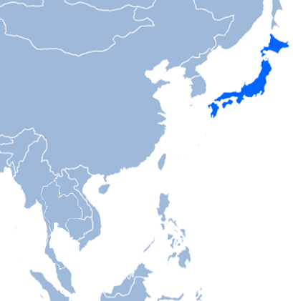
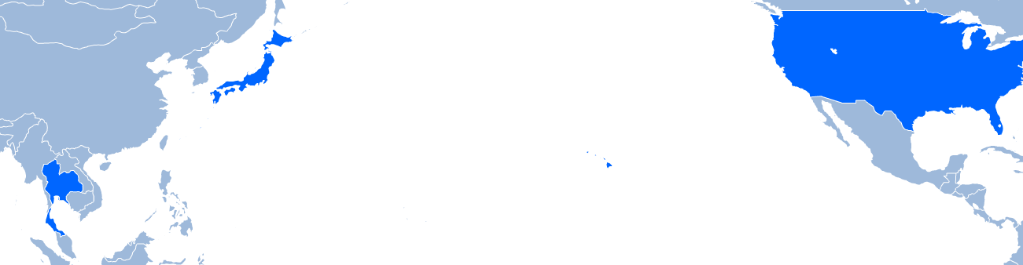
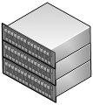
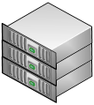


PRAGMA-ENT (Experimental Network Testbed)
Conceived in October 2013
Goals
Build a testbed to explore for use by PRAGMA researchers
Facilitate collaborations as demonstrated by use of testbed in papers and presentations
Notes:
PRAGMA-ENT is an Experimental Network Testbed for PRAGMA researchers. Participants of Pragma-ENT provide computer resources to Pragma researchers through the networks.
The goal of PRAGMA-ENT is to build a testbed to explore for use by PRAGMA researchers and to facilitate collaborations of Pragma researchers.

Slide 4
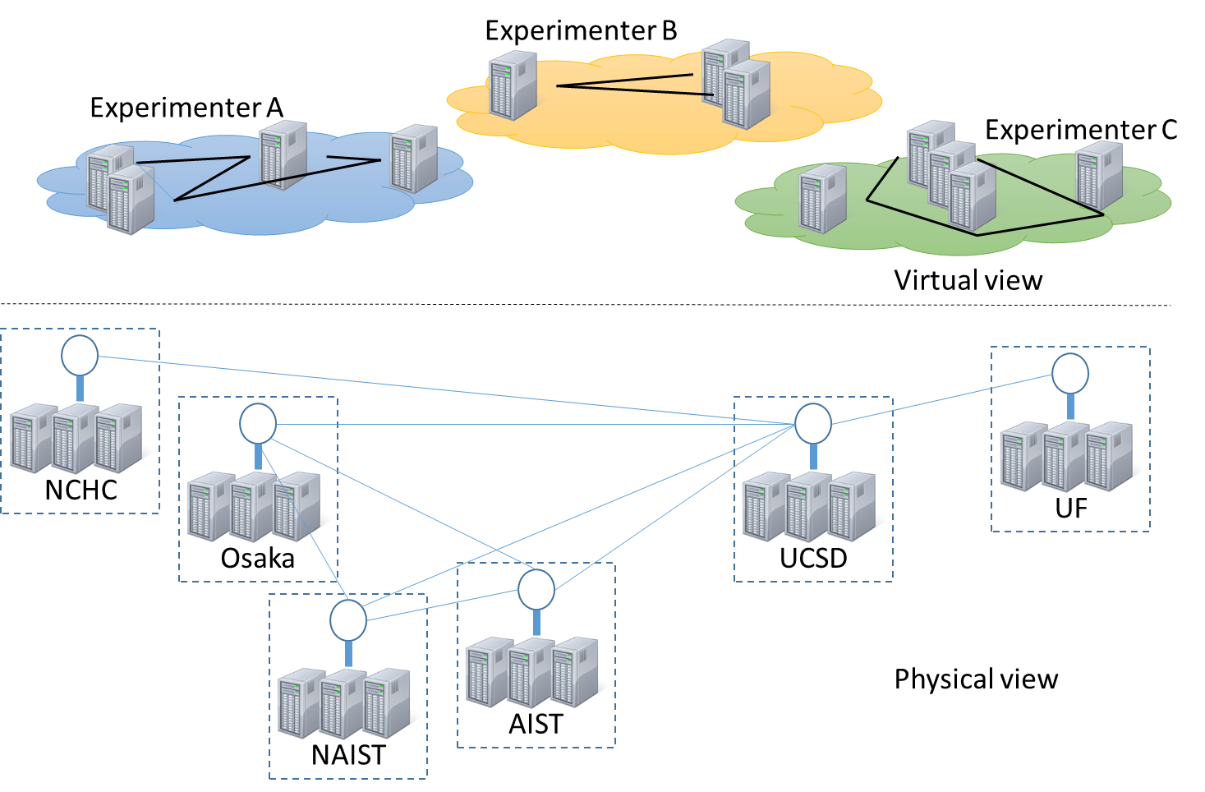
What PRAGMA-ENT provides
Multi-site virtual clusters to experimenters
Virtual machines
Software Defined Networking (SDN)-enabled network which you can control as you like using OpenFlow
Notes:
PragmaENT will provide the virtual environment of clusters and OpenFlow networks to the experimenters.
In the physical view, clusters of multiple sites of Pragma researchers are connected through the network. These physical resources are virtualized for every experimenters. In the virtual view, there is an exclusive multi-site clusters and OpenFlow-enabled networks.

Slide 5
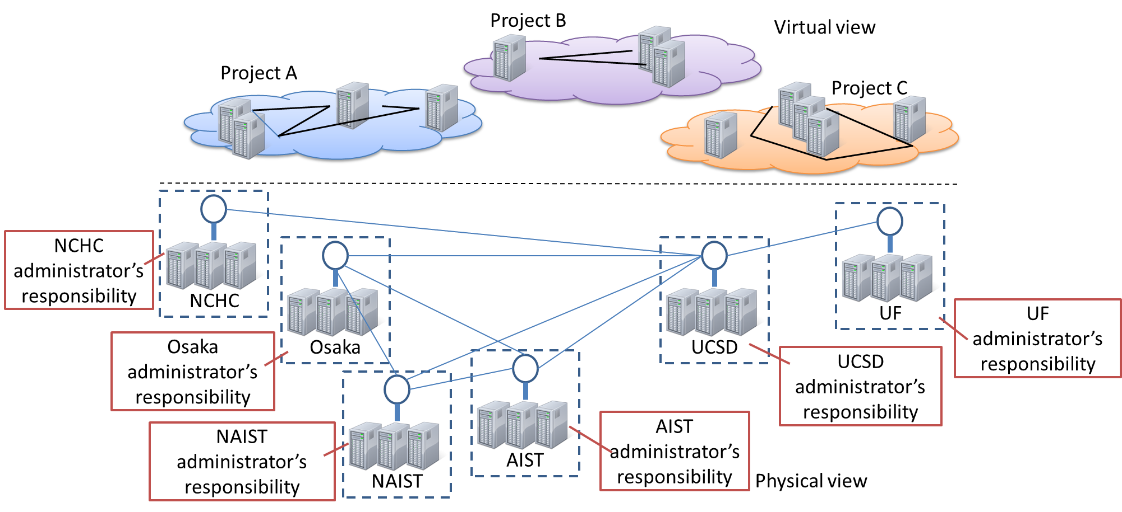
Distributed ENT Management
No super-administrator
How to federate multi-domain networks
Notes:
One feature of PRAGMA-ENT is a distributed resource management. Site administrators are responsible for their own compute clusters and OpenFlow switches. There is no super-administrator who manages all resources. The distributed management encourages site administrators to provide resources with minimum costs. The question is how to federate multi-domain networks.

Slide 6
PRAGMA-ENT L2 backbone
VLAN 866
VLAN 867
1404
866
1405
867
1086
1087
2039
3714
1404
3799
1405
How to realize network virtualization without many VLAN configurations
Notes:
This is the PRAGMA-ENT L2 backbone. These sites are connected by L2 network providers, TWAREN, RISE, JGN-X, PACIFIC WAVE, Internet2, and Florida Lambda Rail with VLAN configurations.
Basically, the L2 network providers provides layer 2 links by allocating the VLAN IDs. VLAN allocation is a popular way to provide virtual links. However, in the experience, VLAN allocation requires extensive human resources and the ticket resolution time.
So the question, here, is how to realize network virtualization without many VLAN configurations.

Slide 7

FlowSpace Firewall
VLAN-based OpenFlow network virtualization
VLAN configurations per tenant in L2 backbone networks are required.
Virtual OpenFlow network1
Virtual OpenFlow network2
Tenant controller 1
Tenant controller 2
Add or strip VLAN tag to data packets at ingress or egress ports
ADVisor proxy
Add or strip the VLAN tags to the matching rules
Physical OpenFlow network
Notes:
Within existing OpenFlow network virtualization techniques, FlowSpace firewall is an open source software. Howerver, because FlowSpace Firewall is a VLAN-based virtualization method, VLAN configuration for each virtual OpenFlow network is necessary. So, it is not suitable for network virtualization in PRAGMA-ENT.

Slide 8
FlowVisor
Flow space (header address) division-based OpenFlow network virtualization
No VLAN configurations for each tenant
Necessary to intermediate of the flow space division when tenants want to use same header address (e.g., dst TCP 80)
Virtual OpenFlow network1
Virtual OpenFlow network2
Tenant controller 1
Tenant controller 2
Flow space cannot be shared by distinct tenants.
FlowVisor proxy
Access control of flow space
Physical OpenFlow network
Notes:
Another technique, FlowVisor, is a virtualization method based on the flow space division. Because the flow space can be divided by any header fields. So VLAN configuration for each tenant is not necessary. The problem is that intermediation of the flow space division is necessary when tenants want to use same header address, for example destionation TCP port number 80.

Slide 9


OpenVirteX
OpenFlow network virtualization with flow space virtualization
Enabling to use overlapped header values in all virtual OpenFlow networks
No need of mediation for the flow space division among tenants
Virtual OpenFlow network 1
Flows of overlapped header value
Virtual OpenFlow network 2
Translating data packet headers at ingress and egress ports
Translating OpenFlow protocol messages
OpenVirteX proxy
Transparently divide the flow space for the tenants
Physical OpenFlow network
Notes:
OpenVirteX enables the flow space virtualization. So different tenants can use the overlapped header address.
A single proxy between controllers of the tenants and the substrate OpenFlow network, translate OpenFlow protocol messages and data packet headers from end-hosts at ingress and esgress switch ports. For translation, the proxy manages the header address mapping table for virtual and physical OpenFlow networks. Transparently, the flow space is divided for the tenants in the substrate network for the isolation.
Tenants do not need to agree the flow space division. So tenant can join every time without mediation.

Slide 10
Virtualization over Multi-domain Networks
The single proxy architecture
Most of the existing techniques
The single proxy has huge responsibility for all virtual networks
When the proxy is failure, it affects all virtual networks.
Virtual
OpenFlow networks
Virtual OpenFlow network α
Virtual OpenFlow netowrk β
The proxy
Substrate
OpenFlow networks
Administrator A
Administrator B
Administrator C
Notes:
The problem is that the single proxy architecture has a single point of failure because the single proxy manages the header translation for all switches and virtual OpenFlow networks. When the single proxy crashes, it affects whole the virtual OpenFlow networks.

Slide 11
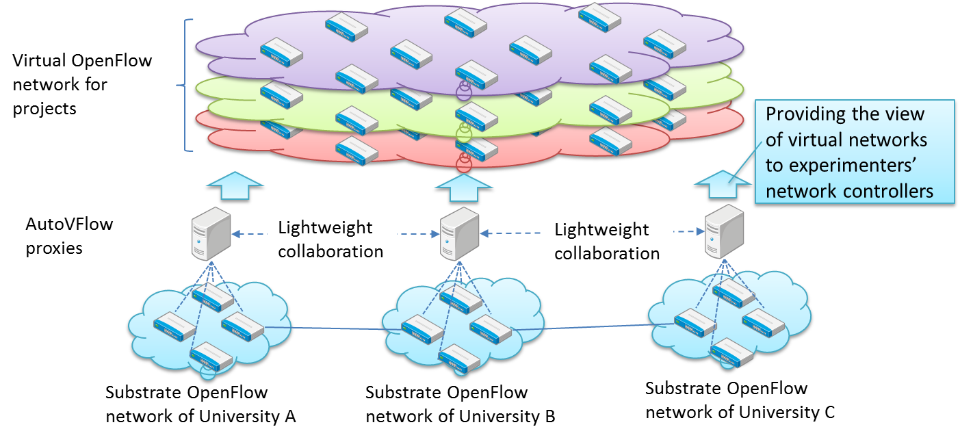
AutoVFlow Approach
AutoVFlow: Autonomous Virtualization of OpenFlow networks
Features:
Flow space virtualization
Autonomous federation of multi-domain physical OpenFlow networks
Information exchange between domains for header address virtualization
Notes:
Our approach is using AutoVFlow. AutoVFlow autonomously federates and virtualizes multi-domain physical OpenFlow networks.
Each proxy autonomously manages the translation of header addresses in the physical and the virtual OpenFlow networks. So, the proxies may translate virtual header addresses to different physical addresses. However, the OpenFlow controller of the virtual OpenFlow network does not need to care about the difference because the proxies transparently modify the physical header address of data packets to be understood by the peer proxy.

Slide 12
Demonstration 1
Virtualization over multi-domain physical OpenFlow networks
Virtual OpenFlow network A
Virtual OpenFlow network B
End-host A1
End-host A2
End-host B1
End-host B2
End-host A1
End-host A2
End-host B1
NAIST domain
End-host B2
UF domain
UCSD domain
Notes:
Settings
(Figure of network topology)
3 different domain infrastructures
2 virtual OpenFlow networks over the infrastructures
Demonstration
Hosts in the virtual OpenFlow networks communicate using the same addresses concurrently.
However, the traffic does not interfere each other.

Slide 13
Demonstration 2
Autonomous federation of multi-domain physical OpenFlow networks
Virtual OpenFlow network A
Virtual OpenFlow network B
End-host A1
End-host A2
End-host B1
End-host B2
End-host A1
End-host A2
End-host B1
NAIST domain
End-host B2
UF domain
UCSD domain
Notes:
Setting
(Figure of network topology)
3 multi-domain infrastructures
Two virtual OpenFlow networks over the infrastructrues
Demonstration
Crash one of AutoVFlow proxies
Virtual OpenFlow switches provided by the crashed AutoVFlow disappears
The communication still survives using the remaining virtual OpenFlow switches.

Slide 14
Conclusion
OpenFlow network virtualization in PRAGMA-ENT
No VLAN configurations per tenant
No super administrator for all resources
AutoVFlow is suitable for PRAGMA-ENT.
Autonomous federation and virtualization of multi-domain physical OpenFlow networks
Demonstration
Virtual OpenFlow networks over multi-domain physical OpenFlow networks
Autonomy of virtualization

