Slide 1
OpenID Introduction
2015.04.08
Hui-Shan Chen
PerComp Team

Slide 2
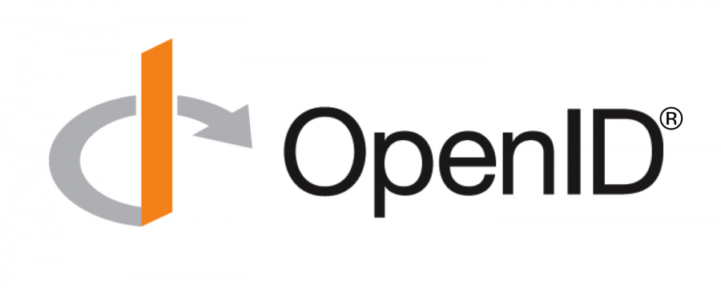
What is OpenID?
Open Standard
Single Sign-On (SSO)
Support multiple Websites
  use your existing account
  no more registering different accounts
  User-centric identity
    identification, authentication, trust, authorization services
Notes:
We all know OpenID is an open standard and decentralized protocol.
It provides a single sign-on solution.
So you can sign in to multiple web sites with your existing account, and no more registering different accounts.
OpenID service is user-centric identity management.
It can deal with these services to reduce users’ efforts and save users’ time.

Slide 3
Why should we use OpenID?
Faster/Easier
  simplify signing in
Convenience
  just needing one account/password
Uniqueness
  OpenID URI is a unique identifier
Security
  only give your password to an OpenID provider
Notes:
OpenID is a way of identifying yourself no matter which web sites you want to sign in.
This means web sites can take advantage of OpenID and won't bother you for the same user information over and over again.
So you just need one account and password.
Once you establish your identity and use the unique OpenID, when someone sees your OpenID on the Internet, they'll know it's you.
And for security, you only need to give your password to an OpenID Provider, and no other web sites can see your password.

Slide 4
What can OpenID do for us?
Three roles of OpenID service
  End user, OpenID Provider (OP), and Relying Party (RP)
OP can provide delegating authentication mechanism
  without keeping password in RP
RP can get user data from OP based on the agreement of users
OP can manage and keep track of login data
Notes:
There are three main roles in OpenID service, including end users, OpenID provider, and relying party.
OP can provide delegating authentication mechanism.
You don't worry about insecure web sites compromising your identity because RP gets user data from OP based on users’ agreement.
And OP can manage and keep track of login data for later lookup by end users.

Slide 5


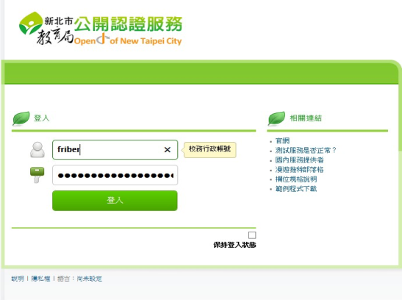









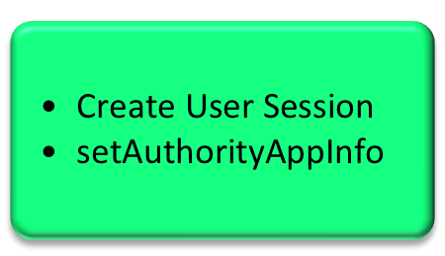

Ezilla Architecture
Open ID Auth. Module
Sunstone
Server
SOAP Web Service
OpenID Auth. Plugin
Regular
Auth. Plugin
Data Transfer
SSO
Token
File Services
OpenNebula Core Auth.
User Profile
Storage Devices
Import into
One DataBase
Notes:
As long as the Ezilla server receives the login request form end users, the Sunstone server will judge the request belongs to regular auth. or OpenID auth. ?
If the request belongs to OpenID auth., the Sunstone server would activate the OpenID Auth. Module. This module is implemented by NCHC PerComp team.
At first, Ezilla will check the openID account via SOAP Web service. If the OpenID is valid, the legal token will be generated. Then the user profile will be redirected from OpenID provider to Ezilla server.
After that, the procedure will continue to integrate with OpenNebula core Auth., and the user profile will be imported into “One” Database.

Slide 6









How does OpenID work on the server side?
2. Login Redirect to OP
5. Redirect with Signed Data
and Exchange User Information
1. Login Request to RP
3. OP Login Dialog
6. Access Permission on RP
4. OP Authentication
Notes:
In this figure, we can see the three main roles of OpenID service.
When end users want to use Ezilla private Cloud service, and choose OpenID authentication to login.
Ezilla is a RP, so Ezilla needs to redirect the login request to the selected OP.
Then OP provides the login dialog for end users to apply the legal access control.
After successful authentication, OP redirects the signed user data back to RP, and exchanges user information with RP.
Finally, after getting the access permission on RP, end users can logint to Ezilla web site and use Ezilla private Cloud service.

Slide 7





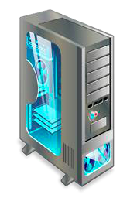




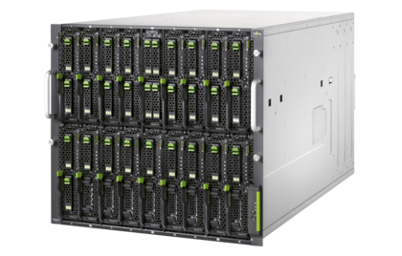

How does user use OpenID?
Web Service
Token
Ezilla SSO
Google
New Taipei City
NCHC
KVM
Distribution
File System
Notes:
Ezilla can support Google OpenID service for most Internet users; and New Taipei City OpenID service for education purpose; and NCHC IAM OpenID service for research domain.
So users can use their own OpenID to login to Ezilla web site.
As long as the OpenID account is valid, the web services will generate the legal token for end users.
And then, the Ezilla server will get the user profile and setup the user quota according to the user profile.
Finally, end users can use Ezilla private Cloud service to create virtual machines quickly.

Slide 8
Thank You For Listening!
Notes:
DEMO:
This is Ezilla private Cloud Service Website, and there are two types of login authentication to verify user identity. The first type is regular local authentication of OpenNebula Sunstone. The second type is the main point today – OpenID authentication.
End users can choose one OpenID server for login authentication. Now I take Google(NTPC) OpenID for example, so Google(NTPC) provides the login dialog. (End users just need to key in account/password and authorize the access for the user profile.) After successful authentication by Google(NTPC), end users can log in to Ezilla website with the identity of Google(NTPC) account.
Then end users can create virtual machines quickly. Because they just need to key in VM’s name and set VM’s password, and then select a template to create a virtual machine.
Finally, as long as the status of the VM becomes running, end users can open a VM console. After the VM boot completely, they can login to the VM and use the VM.

