Slide 1
A Database Approach to NAEMP in Korea
NAEMP
National Aquatic Ecological Monitoring Program
MEILAN JIANG
meelankang@gmail.com
Department of Advanced Technology Fusion
Konkuk University

Slide 2
Goal
Assess the health condition of rivers and streams in Korea
Notes:
Monitor and evaluate the ecosystem health of Korean rivers and streams

Slide 3
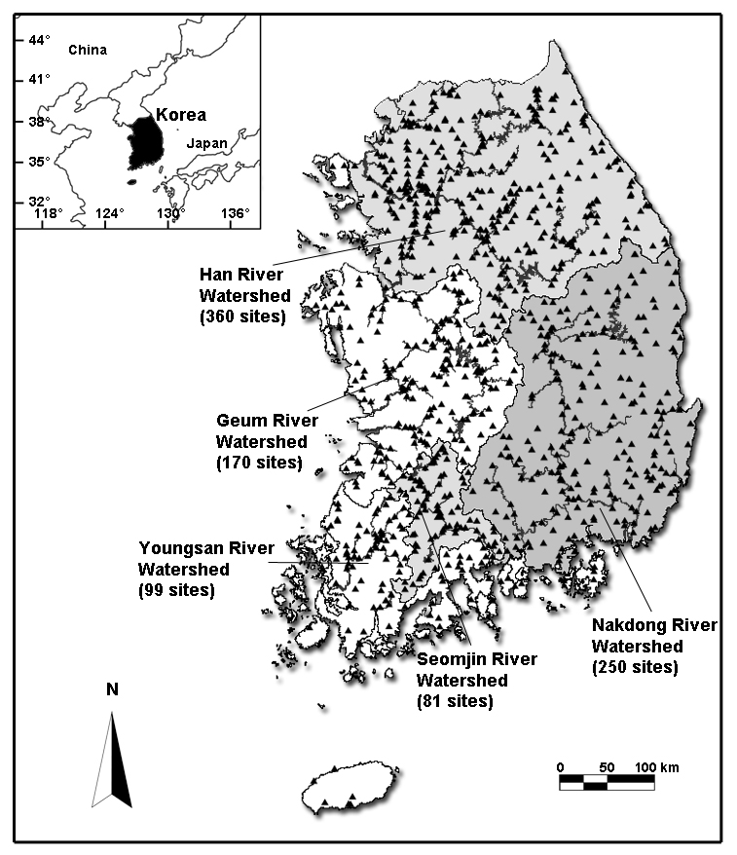
Establish Monitoring Network
Five major rivers
Han
Geum
Nakdong
Youngsan and Seomjin
Total 960 Sites
Notes:
The Youngsan and Seomjin rivers are usually treated as one river system (Youngasn–Seomjin River) because their watersheds are closely located.
Independent tributaries of major rivers
Small streams encompass the entire country
Every 5 or 10 km was segmented in each river/stream
5711 potential monitoring sites was compiled

Slide 4
Develop Criteria
Choose monitoring parameters
Design evaluating equations and metrix
Physico-chemical parameters
BOD, pH, DO, SS, COD, T-N, T-P
Biological parameters
Benthic diatoms, Macro invertebrates, Fish
Habitat quality
channel development, lateral and longitudinal connectivity, substrate condition, riparian land use
Simple hydraulic parameters
Water velocity, width, and depth
Notes:
The Youngsan and Seomjin rivers are usually treated as one river system (Youngasn–Seomjin River) because their watersheds are closely located.
Independent tributaries of major rivers
Small streams encompass the entire country
Every 5 or 10 km was segmented in each river/stream
5711 potential monitoring sites was compiled

Slide 5
Conduct monitoring
Twice every year
From 2007 to 2014

Slide 6
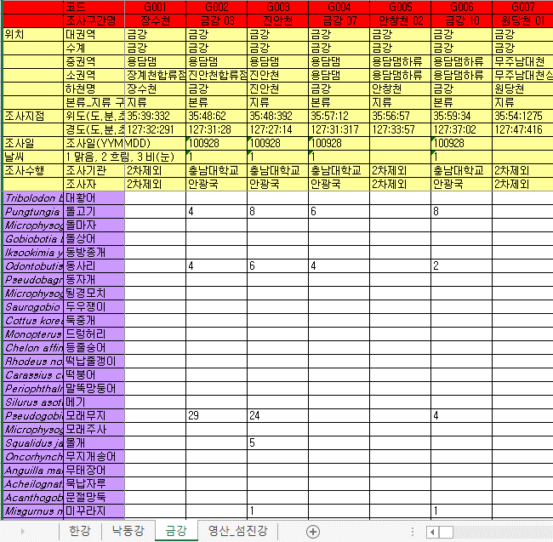
What’s the Problem?
Managed in the easiest way
only for the Assessment
Data

Slide 7
Challenging Issues
Data Searching
Hard to know and locate what kind of data is stored in files
Data Reorganization
New analyses or reports require a substantial amount of reorganization to structure files
Data Conservation
Some data that are not included in file structure are likely to be lost and never recovered in the future

Slide 8
Database Approach!
Design a Data Model
Develop Database
Support Data Access

Slide 9
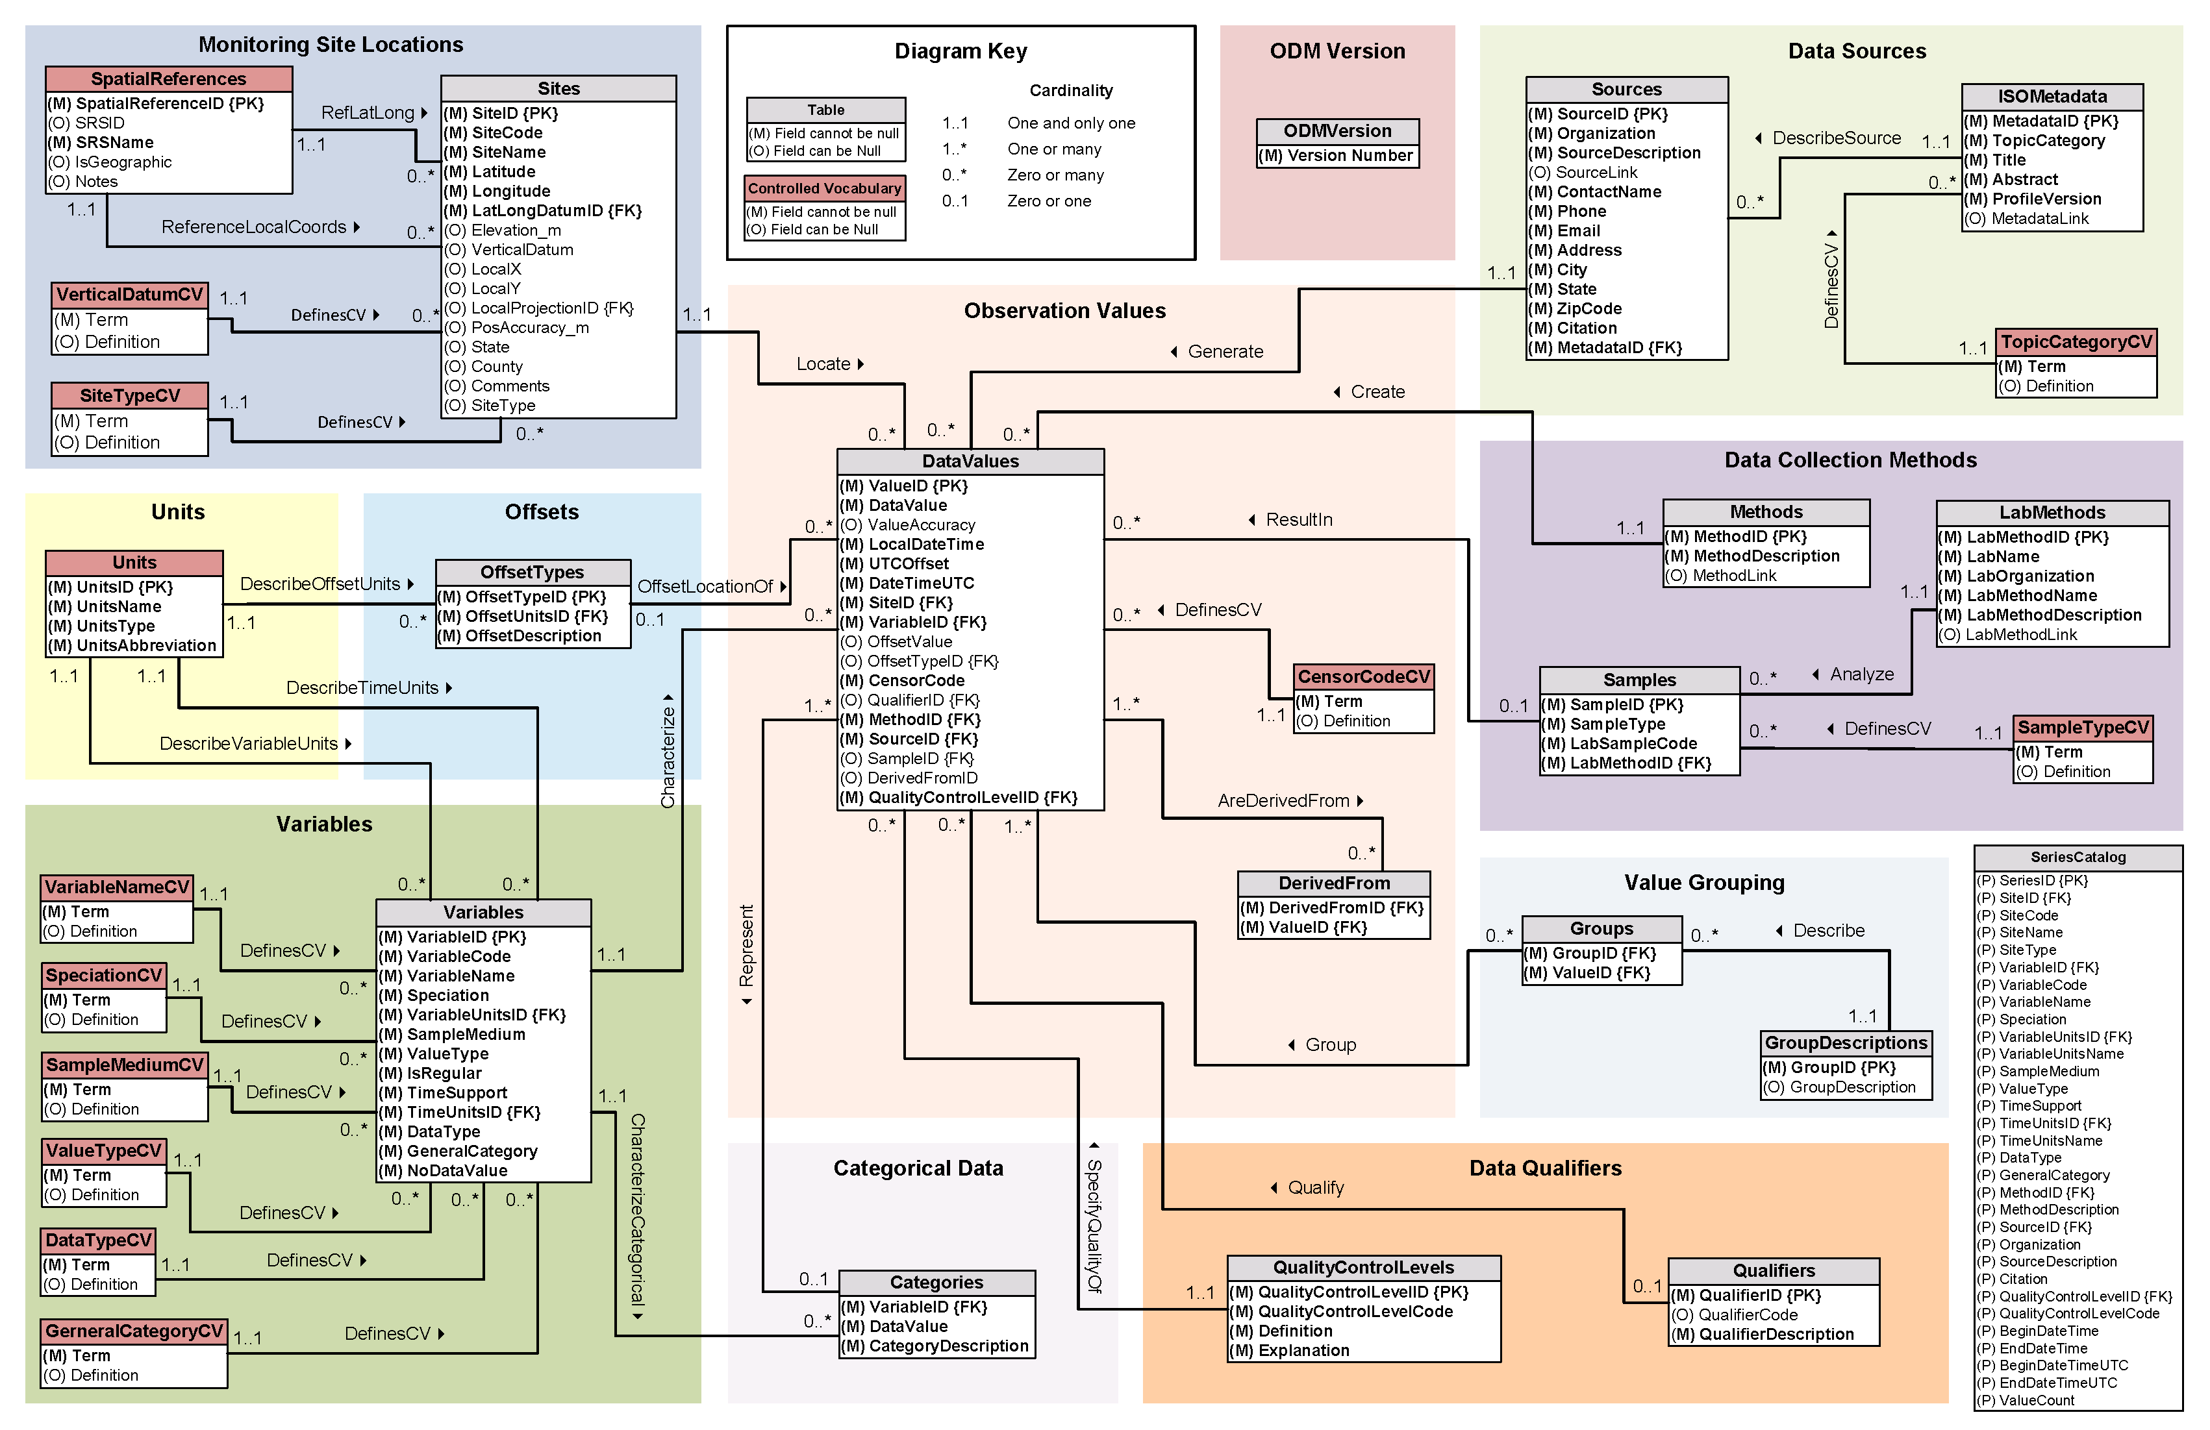
Related Work?
CUAHSI
Consortium of Universities for
the Advancement of Hydrologic Science, Inc
www.cuahsi.org
Observation Data Model
Hydrological Observations

Slide 10
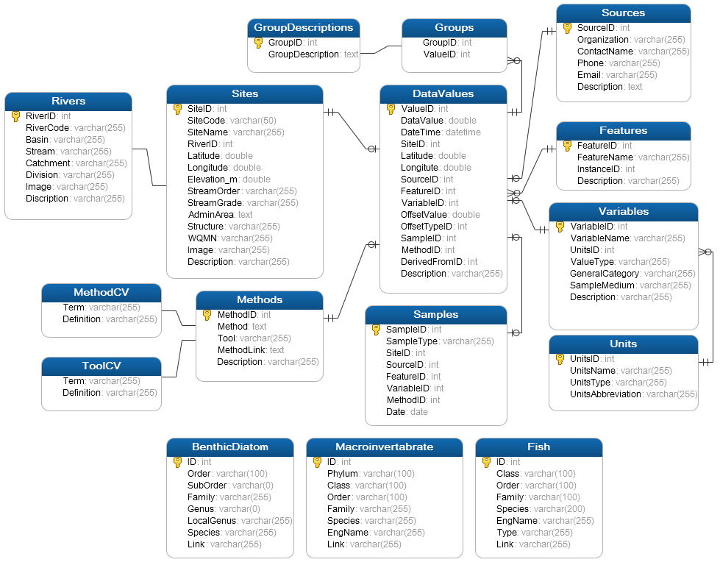
What more is there?
Taxonomic information for Biological Observation

Slide 11
Data Access
Query: Space, Time, Variables and Taxonomy
“When”
Time, T
t
Taxonomy
s
v_{i}
“Where”
Space, S
“What”
Variables, V

Slide 12
Data Management System
Current
Analysis
Future
Analysis
#4
Future
Analysis
Current
Analysis
#N
#2
Future
Analysis
#1
#3
… …
NAEMP Data Management System
Inter-Observation Relationship Layer
Monitoring Data Query System

Slide 13
Summary
Brief introduction to NAEMP in Korea
Challenging issues in data management
Largely raised from spreadsheet file based management for specific analysis ad report
The Database Approach
Adding the support for monitoring data based on the CUAHSI ODM
Supporting Data Access by Query System
Notes:
Current State of NAEMP Data Management: Spreadsheet files designed for specific analyses and reports

Slide 14
Thank you ☺

