Slide 1
Netspec: Software-Defined Network Behavior Test Tool
Kazuki Hara*, Yasuhiro Watashiba*, Kohei Ichikawa*
*Nara Institute of Science and Technology
Notes:
Thank you very much.
Hello, everyone.
My name is Kazuki Hara.
I am a master student at Nara Institute of Science and Technology.
Today, I’d like to present you our research, Netspec: (一息止める) A Software-Defined Network Behavior Test Tool.

Slide 2
Outline
Software-Defined Network (SDN)
Problem
Existing Integrated Test Tools
Idea of Software-Defined Network Behavior Test Tool (Netspec)
Conclusions
Future Work
Notes:
At the beginning, I’d like to show you the outline my presentation.
Firstly, I will briefly talk about the summary for Software-Defined Network;
secondly, I will present Problem and Existing Integrated Test Tools;
Last, I will introduce the idea of our tool, Netspec.

Slide 3

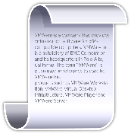

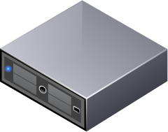
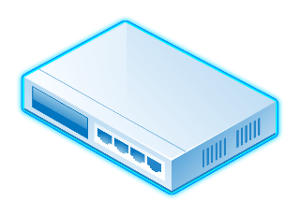

Software-Defined Network (SDN)
Developers’
Program
Developer
SDN is controlled by a centralized programmable controller
Controller
Control channel
Host
Host
Switch
Notes:
SDNではcentralized programmable controllerを使ってネットワークを制御する
First of all, I would like to talk about Software-Defined Network Architecture, shortened as SDN.
It is an important point that SDN is controlled by a centralized programmable controller.
コントローラとネットワークは制御用チャネルを通して制御情報をやり取りする
And Control Message could be communicated between controller and network through control channel.
これにより，Developerはプログラムによりフローの流れを操作できる
So developers could control the flow by programs.

Slide 4
Problem
Developer
？
Developers’
Program
Controller
After flow rules have been installed into switches through SDN controller……
Control channel
Host
It is difficult for developers and network administrators to check if the packets are processed correctly within SDN
Packet
Host
Switch
Notes:
一方で，SDNは次のような問題があります．
However, There is a problem in SDN.
Developers’ programsがネットワークにcontrol ruleを書き込んだ後に，開発者はパケット正しく処理をされた確認することは難しい．
After flow rules have been installed into switches through SDN control channel,
It is difficult for developers and network administrators to check if the packets are processed correctly within SDN.

Slide 5


Existing Integrated Test Tools
Test framework and Test domain-specific language (DSL)
Checks if developers’ programs run correctly
Test programs are written in DSL
Checks if servers had been set up required components as developers’ expectations
This research is inspired by these two existing integrated test tools.
Notes:
For addressing this problem, we are proposing an integrated test tool for SDN focusing on the behaviors of the network.
And our work is inspired by two existing integrated test tools, rspec and serverspec.
RspecはRubyで書かれたプログラムに対して，正しい振る舞いをするかDSLで記述されたプログラムを用いてテストできるツールである．
Rspec is a program behavior test framework and Test domain-specific language (DSL).
It allows Developers to check if developers’ programs run correctly with test programs written in DSL.
また，Serverspecはサーバに対して正しい構成をしているかrspecに近いDSLを用いてテストできるツールである．
On the other hand, Serverspec checks if servers had been set up according to developers’ expectations.

Slide 6

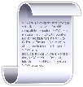
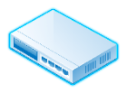
Idea of Software-Defined Network Behavior Test Tool (Netspec)
SDN Controller
Netspec consists of Proxy and Test Engine
Test Engine provides SDN Test DSL, like rspec
Proxy inspects OpenFlow Control Messages
NetSpec
Proxy
Testcode (like rspec)
JSON
TestEngine
Host A
Switches
Host B
Notes:
私たちは，このツールをSDN Behavior Test Tool略してNetspecという名前で開発している．
As our concept is based on these test tools, we name our test tool for SDN as Software-Defined Network Behavior Test Tool, shortened as netspec.
Netspecは，ProxyとTest Engineの２コンポーネントで構成される．
Netspec consists of Proxy and Test Engine.
ProxyはOpenFlow channelに対してテスト用のコントロールメッセージとinjectして，SDN ControllerとSwitchesのやり取りをinspectsする．
Proxy injects testing control message into control channels for inspecting the communication between SDN Controller and Switches.
Test Engineはrspecに似たSDN Test DSLを提供する．
Test Engine provides SDN Test DSL, which is similar to rspec.
Test EngineはDSLを用いて記述されたテストを元にしてProxyと情報やり取りしながらSDNの振る舞いを確認する．
Based on the described test written in DSL, Test Engine could verify the behavior of SDN while taking information from Proxy.

Slide 7
Conclusions & Future works
Problem
It is difficult for developers and network administrators to check if the packets are processed correctly within SDN
Approach
SDN Behavior Test
Use proxy between a SDN controller and SDN switches
Enable to write SDN behaviors in Test DSL (like rspec)
Implement Netspec (Proxy and Test Engine)
Define typical SDN behaviors test patterns
Notes:
今後，私たちは特徴的なSDNのテストパターンを策定してNetspecのProxyとTest Engineの実装を進める．
As for our future work, we will define the testing patterns of typical SDN behaviors.
Then based on the results, we will continue our implementation on Netspec, including the Proxy and the Test Engine.
Thank you for listening

