Slide 1
Extending the capability of TOUGHREACT simulator using parallel computing
Application to environmental problems

Slide 2
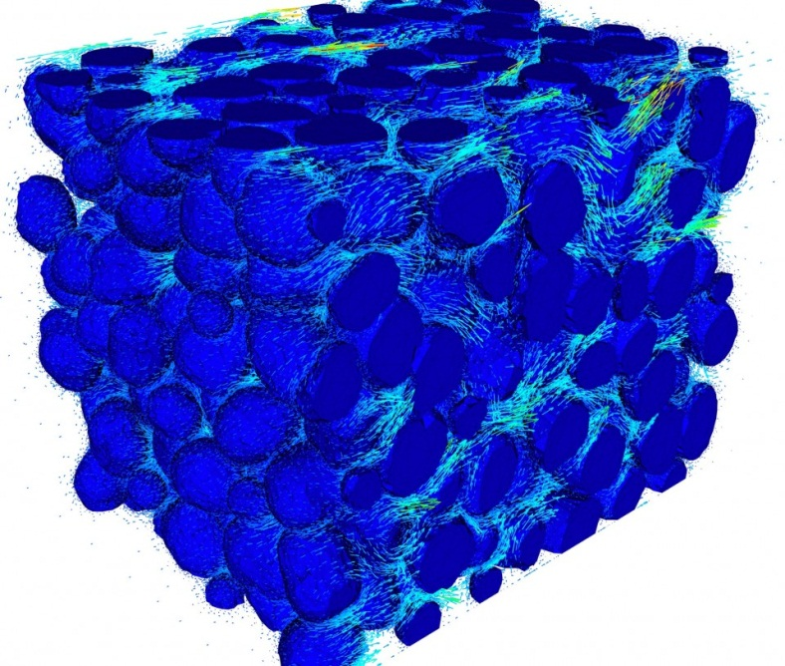
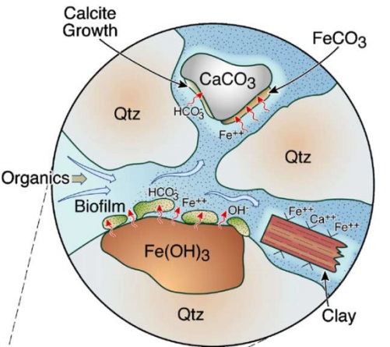

What is TOUGHREACT ?
Coupled Process in porous media simulator,
developed in Lawrence Berkley Lab.
Multi-phase flow
+
Solute transport
+
Geochemical reaction

Slide 3
Motivation of the work
Lab code constraints:
Developed for testing the model
Running on workstation or laptop
Numerical model can not scaling ( 8000 discrete grids limited)
Engineering requirements:
Carrying the simulation of site-scale model involved complex processes
Improve the speed in numerical solving .

Slide 4
Method
Redevelop the software package using parallel computing schema.
Domain Decomposition.
Communication between divided subdomains(MPI)

Slide 5
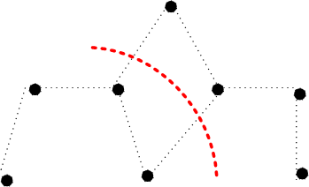
Domain Partition
ELEME A11 1 10.2000E+000.4000E+00 0.1000E+000.5000E+00-.5000E+00 A11 2 10.2000E+000.4000E+00 0.3000E+000.5000E+00-.5000E+00 A11 3 10.2000E+000.4000E+00 0.5000E+000.5000E+00-.5000E+00 A11 4 10.2000E+000.4000E+00 0.7000E+000.5000E+00-.5000E+00 CONNE A11 1A11 2 10.1000E+000.1000E+000.1000E+01 A11 2A11 3 10.1000E+000.1000E+000.1000E+01 A11 3A11 4 10.1000E+000.1000E+000.1000E+01
Multi-level Graph Partition:
Metis

Slide 6
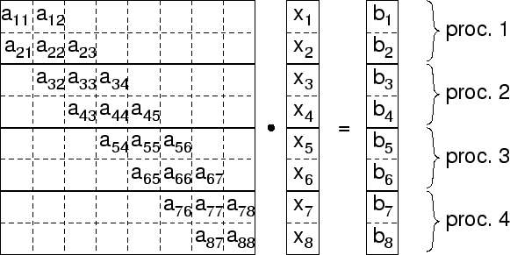
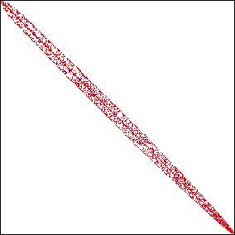
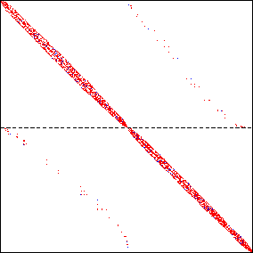

Parallel Linear Solver
Large Sparse Linear System iterative solving
Aztec

Slide 7
Module organization
Public Module
IO
Flow
Simulation procedure
Transport
Geochemical
EOS-MODULE
Domain Decomposition
Subdomain Communication
Index Transform-ation
State
Update
Parallel Matrices Assemble
Parallel Linear solving

Slide 8
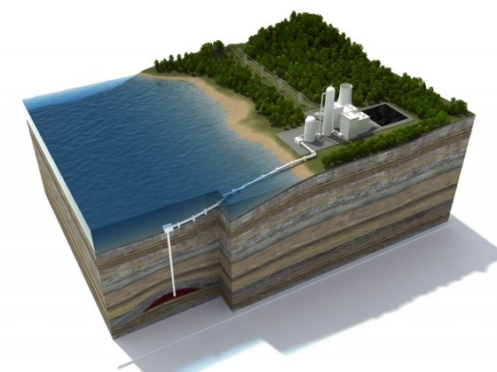
Application: Carbon dioxide sequestration

Slide 9
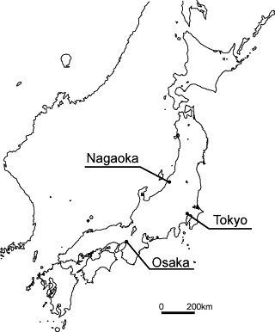
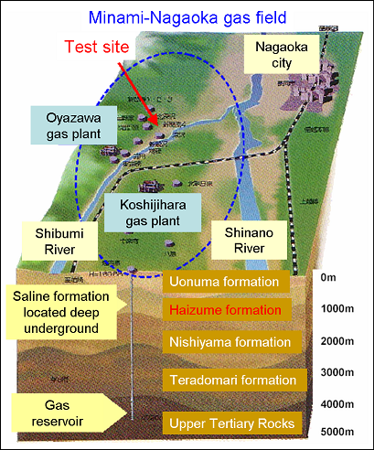

Slide 10
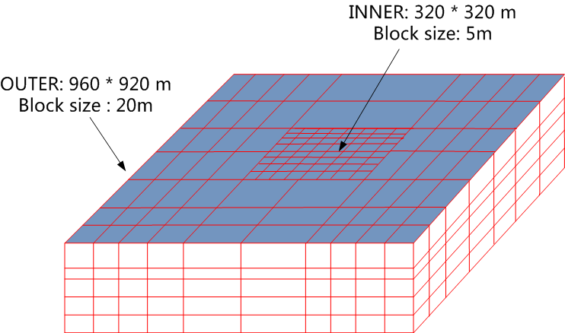
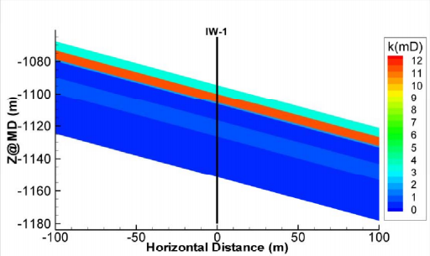
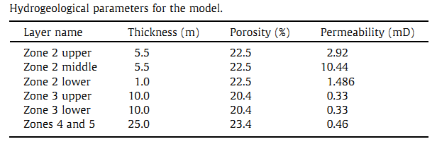
Fine grid model:
Total : 37824 grids

Slide 11
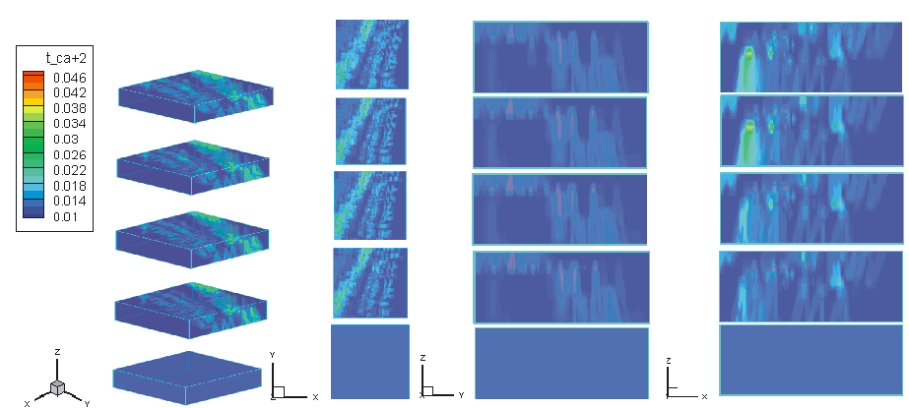
Mid-term behavior prediction
Serial computing
Parallel Computing

Slide 12
Runtime Statistics

Slide 13
What we’ve gained from work
A new software package running on parallel computing facility ( Cluster …)
Speed up ( 20 X – 40 X in test case )
Simulation model scaling up ( 100,000 grids have been tested)

Slide 14
Thanks for your attention !

