Slide 1
Experience and Expertise of Designing SDN MPI_Bcast
Khureltulga Dashdavaa, Susumu Date, Hiroaki Yamanaka, Eiji Kawai, Yasuhiro Watashiba, Kohei Ichikawa,
Hirotake Abe, Shinji Shimojo
1
Notes:
hello everyone. thank you for coming to my presentation. my name is hureltulga. i am student at osaka university in japan. today, i am going to present about architecture of a high speed mpi_bcast leveraging software defined network. this presentation takes about 18 minutes followed by 10 minutes q&a. if you have any question please ask after my presentation.

Slide 2
Outline
Background and Problem
Software-Defined Network
Research goal
Proposed method: SDN_MPI_Bcast
Evaluation
Conclusion
2
Notes:
Today’s presentation divides into 5 parts roughly. in the beginning, i am going to talk about background of message passing interface, or mpi, and network related problem of mpi in parallel computing. then, i am going to introduce briefly software defined network, a new network technology concept. because we are using this new network technology in our research. then, i am going to explain our research goal and our proposed method. then, i am going to show experiment environment and experiment result. at the end, i am going to conclude the presentation. so, let me start the presentation.

Slide 3
Background and Problem
MPI is playing great role in parallel programming.
However, MPI implementation is not optimized for common network hardware, such as Gigabit Ethernet.
Example: MPI_Bcast (basic collective communication)
Main reason is that network has “static” resource, and cannot be controlled “dynamically”.
Network
N
N
N
N
N
Collective communication uses multiple unicast-based communication.
P0
P2
P3
P1
N : Computing node
P0, P1, P2, P3 : Running process
3
Notes:
Recently, mpi or message passing interface is playing great role in parallel computing programming. However, mpi implementations not optimized on common network hardware such as gigabit Ethernet interconnection. Let me explain this through this example. In picture, process0 wants to broadcast data to other processes like this. In this case, p0 sends data one by one using unicast communication like this. However, if process number is many, this communication could be very inefficient communication. The main reason of this implementation is that traditional network has static resource, and cannot be controlled dynamically, which means during the calculation.
our first motivation of the research is MPI collective communications which is communication method for transferring data between multiple processes. general MPI implementations such as OpenMPI considers that network resource is static and cannot be dynamically controlled. This means, it is not possible to control network resources during the calculations. as the result, inefficient communication takes place on real computing environment especially in collective communications. lets take an example that there is cluster consists from 5 computing nodes like this picture. and mpi program with 4 processes is running on this cluster. process 0 wants to send data to all other processes. in this case, mpi program uses mpi_bcast which is one of the basic collective communication.
as the scale of cluster becomes larger, the time spend on collective communication of mpi is becoming problem in parallel computing. one of the main reason of this problem is that, usually, collective communications implemented over combinations of multiple use of unicast communication. lets take an example that this process 0 wants to send data to process 2, 3, and 1. for this purpose, instead of sending data to multiple processes at the same time, process 0 sends data one by one using unicast communication like this in one of the simple method. this overhead of collective communication highly affect the execution time of mpi program which uses collective communication many times because mpi collective communication uses multiple unicast communications. before explaining our research goal, let me introduce new network technology called software-defined network briefly because we are using this network technology in our research.
環境を想定している

Slide 4
Emergence of Software-Defined Network
Software-Defined Network (SDN) :
a new concept of network technology
Traditional Network
Controller part
(how to deal with packets)
Controller part
(how to deal with packets)
Switch
1
2
1
1
Switch
Switch
2
3
4
5
6
2
3
4
5
6
4
Notes:
our second motivation is emergence of software defined network. software defined network is a new concept of network technology. in traditional network technology, each network devices such as switches has controller part that decides how to deal with incoming packets. in other words, each network device has own brain part in itself.
originally, sdn is
the main difference of sdn from traditional network is that sdn has individual network controller which means it separated from network devices. this network controller responsible for controlling network packets. this network controller sends rules how to deal with the network packets to switches in order to control network packets. then switches deal with network packets according to those rules.
one of the important feature of sdn is that this controller is directly programmable.
with those features and functions, sdn has some advantages which traditional network technology does not have.
first, it is possible to control whole network from one place because network controller is centralized to one logical place.
second, this network controller can control network packets dynamically which means even during the calculation. this ability is almost impossible in traditional network.
third, because it is programmable, we can develop our own network controller which can control whole network.
in this research, we are applying this new network technology to mpi.
originally

Slide 5
Emergence of Software-Defined Network
Software-Defined Network (SDN) :
a new concept of network technology
In SDN, controller parts decoupled from devices (switches) and centralized to one place.
Software-Defined Network
Input Packet
In : 2
Out : 1, 4, 6
Network Controller
Example:
SDN Switch
Controls out going port or ports of incoming packet on switches.
1
2
1
1
SDN Switch
SDN Switch
2
3
4
5
6
2
3
4
5
6
Network controller can control network “dynamically”.
5
Notes:
on the other hand, in software defined network, or sdn, those brain parts for network devices are decoupled from network devices and centralized to the one place called network controller. originally sdn developed to simplify the controlling network for network administrators by this architecture. through a centralized network controller manner, controlling network is becomes very easy. plus, this network controller is directly programmable. network controller can control network in very detailed level. for example, network controller even can control outgoing ports of incoming packets on the switches. in order to control network packets, network controller simply sends rule how to deal with packets to switch. in this case, incoming packets through port number 2 are going out to port number 1, 4, and 6. this sending rules is possible also during the calculations which brings that network controller can control network dynamically.
the main difference of sdn from traditional network is that sdn has individual network controller which means it separated from network devices. this network controller responsible for controlling network packets. this network controller sends rules how to deal with the network packets to switches in order to control network packets. then switches deal with network packets according to those rules.
one of the important feature of sdn is that this controller is directly programmable.
with those features and functions, sdn has some advantages which traditional network technology does not have.
first, it is possible to control whole network from one place because network controller is centralized to one logical place.
second, this network controller can control network packets dynamically which means even during the calculation. this ability is almost impossible in traditional network.
third, because it is programmable, we can develop our own network controller which can control whole network.
in this research, we are applying this new network technology to mpi.
originally

Slide 6
Research goal
Integrate “dynamic” controller ability of SDN into MPI in order to overturn the assumption that network is “static” resource.
Network Controller
SDN Switch
1
2
Reduce execution time of MPI_Bcast using SDN.
1
1
SDN Switch
SDN Switch
2
3
4
5
6
2
3
4
5
6
N
N
N
N
N
N
N
N
N
N
SDN MPI
6
Notes:
so, our research goal is to integrate this dynamic controller ability of software defined network into MPI in order to overturn the assumption that network resource is static. at the current stage of our research, we aims to reduce execution time of mpi_bcast which is simple mpi collective communication leveraging software defined network.
so, our ultimate research goal is to optimize collective communications of mpi in parallel computing leveraging software-defined network. at this stage of our research now, we are aiming to reduce the execution time of broadcast communication of mpi, or MPI_Bcast, by introducing software-defined network technology.
mpi_bcast is one of the basic collective communication in mpi. mpi_bcast is well suited collective communication method for one process sends data to all other process.
now, i am going to explain how we applied software-defined network to mpi.

Slide 7
Proposed Method: SDN_MPI_Bcast
An SDN feature that Network controller can choose outgoing ports of incoming packet on switches is adapted to MPI_Bcast as a duplication action.
Network controller
In ：1
Out：2
1
SDN Switch
2
3
4
5
6
SDN Switch
In ：1
Out：2, 4
In ：2
Out：1, 4
1
2
1
1
SDN Switch
SDN Switch
A process sends data only once for broadcasting data in our method
2
3
4
5
6
2
3
4
5
6
N
N
N
N
N
N
N
N
N
N
P0
P2
P3
P1
Data
Data
Data
Data
Data
Data
Data
7
Notes:
we adapted the feature of sdn that network controller can choose outgoing port or ports of incoming packets on switches as a duplication action of broadcasting data into mpi_bcast. but, first lets see how traditional mpi_bcast works in simple case. this p0 is trying to broadcast data to others which are p1, p2, and p3. for this purpose, p0 sends data like this, one by one using one-to-one communication in one of the simple case. instead of sending data to multiple processes at the same time.
for applying sdn feature into our research, first our network controller program sets up rules that duplicates packets into switches. after installation of rules, it is ready to broadcast data. in our method, all the this p0 need to do is send data only once in order to broadcast data. then those switches are duplicates data and broadcast data will be delivered to p1, p2, and p3 correctly.
in conclusion, it is possible that a process sends data only once in order to broadcast data by using our proposed method.

Slide 8
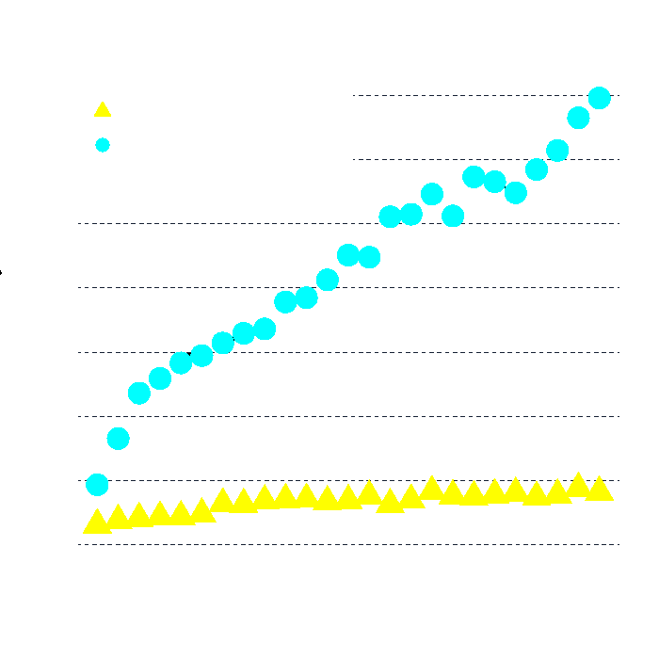

Experiment Result
Execution time of SDN_MPI_Bcast and MPI_Bcast.
Execution time on initialization.
Install Duplication Rules.
Change process numbers
Data size：15.6 KiB (constant)
Change process number
8
Notes:
Those graphs are some of our prototyped experiments of sdn mpi bcast. Left graph shows execution time of broadcasting data while changing broadcasting process number. From this graph, our proposed method is faster than traditional method as number of process increases. And, also we interested in how much time spending on network controller installing duplication rules to switches. We measured this execution time while changing processes number same as before. And, it’s spending time is still in millisecond order, we can deal with this result, because it happens at the beginning only once.

Slide 9
Conclusion
Introduced architecture of MPI_Bcast Leveraged Software-Defined Network.
Our experiment result confirmed that SDN_MPI_Bcast is feasible.
Future Works
Stability and reliability of prototype implementation.
Aim to SDN MPI.
9
Notes:
Let me conclude the presentation.

