Slide 1
Cyber-Learning WG Update
October 17, 2013
Ruth J Lee (KISTI),
Hsi-ching Lin (NCHC),
Putchong Uthayopas (KU)
25@Beijing, China

Slide 2
Review of Last PRAGMA 24 Meeting
Proposed Cyber-Learning WG as a new one
Introduction Meeting for Cyber-Learning WG
  Cyber-Learning : An open, web & simulation based education & research environment for computational science & engineering
  Participants: 13 people from 9 institutes, 7 Countries
  6 presentations related to the topics of e-/cyber-learning
    Introduction on Development of EDISON (Ruth Lee, KISTI)
    How to use EDISON system (Joon Lee, KISTI)
    Architecture of Thai University Cloud (Putchong Uthayopas, KU)
    Education Platform based on NCHC Co-Life (Hsi-Ching Lin, NCHC)
    Supports and Cooperation in Bio (Kitty, National Supercomputing Center in Tianjin)
    E-learning status in the univ. of HK (Wing-Keung Kwan, Univ. of HK)
  Discussions: Share information and situations of each institutes/countries on e-/cyber-learning
Co-chairs : Ruth Lee (KISTI), Hsi-ching Lin (NCHC), Putchong Uthayopas (KU)

Slide 3
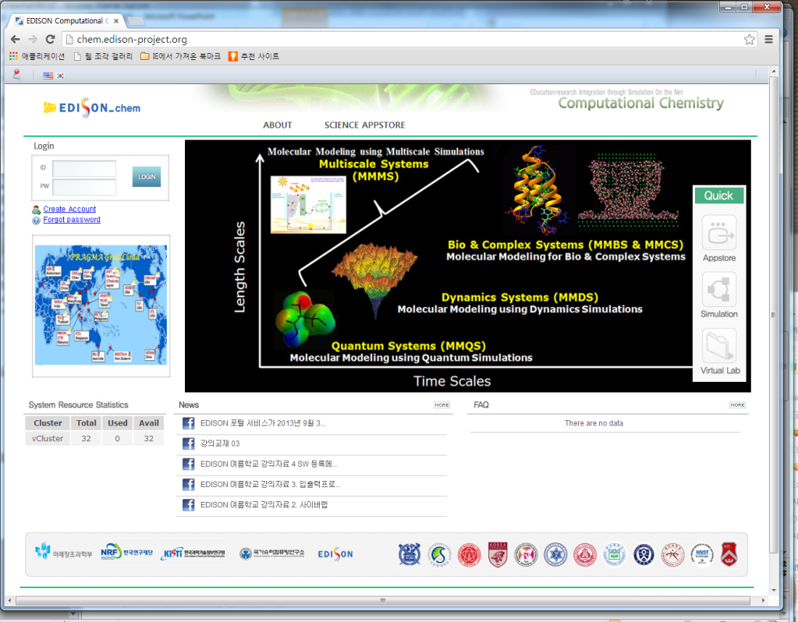
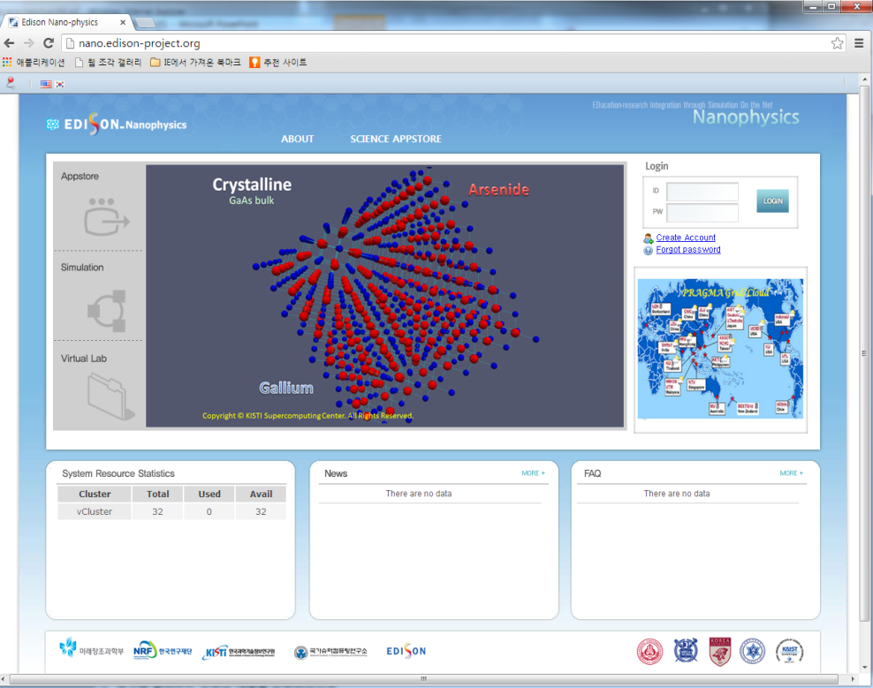
After PRAGMA 24 (I)
2 EDISON Web Portals for PRAGMA Users
(Currently Beta Version available)
EDISON Web Portal for
Computational Chemistry
(http://chem.edison-project.org)
EDISON Web Portal for
Nano Physics
(http://nano.edison-project.org)

Slide 4
After PRAGMA 24 (II)
Funding for KISTI-NCHC International
Collaborations on Cyber-Learning
  Duration: 01/08/2013~31/07/2015 (2 Years)
  Budget: 50M KRW/Year
  Funding Agency: KRCF (Korea Research Council of Fundamental science and technology)
  Project Name: Construction and Collaboration of Simulation based Cyber-Learning between Korea and Taiwan

Slide 5
After PRAGMA 24 (III)
Possible future collaboration items with other WGs
  Resource WG: Collaboration in supporting physical/virtual computing resources and utilizing of middleware technology -> eventually provide the PRAGMA resources for the Cyber-Learning service
  Tele-science WG: Collaboration in supporting/developing remote visualization systems or SWs for results of computing(or data) intensive simulation -> eventually utilize the outcome for the post-processing on CL
  Bio WG: Collaboration on researches of computational bio-science (including the development of simulation SWs) -> eventually utilize the outcome for bio educations on CL
Future Plans for WG activities
  Promote Cyber-Learning WG to activate and let more core members join
  Clarify the objectives and deliverables achieved by 2015 with core members
  Introduce EDISON system (one of Cyber-Learning systems developed by KISTI) to students and researchers in Taiwan by collaborating with NCHC
  Find out a way how to collaborate with other WGs
  Find out any possible collaboration items for Cyber-Learning such as platform, simulation SWs, digital contents, and so on

Slide 6
Cyber-Learning WG Plan @PRAGMA 25
Breakout Session I : 14:40~16:30, Oct. 17(Thur), 2013 (Room 504)
Presentations & Demos :
  Introduction of EDISON Web Portal for Nano Physics (Dr. Hoon Ryu, KISTI)
  Introduction of EDISON Web Portal for Computational Chemistry (Dr. Joon Lee, KISTI)
  Knowbita: Massive Online Open Course Infrastructure for Computing Education (Prof. Uthayopas, Putchong, KU)
  Introduction to e-learning for EM Education in Taiwan (Dr. His-Ching Lin, NCHC)
  Open for any speakers….
Breakout Session II: 10:40~12:00, Oct. 18(Fri), 2013 (Room 504)
Discussions :
  Building a forum that exchange ideas, status, and best practice at a regular basis
  Sharing technologies/solutions developed by WG members
  Looking for collaborative opportunities among WG members
  Holding Cyber-Learning Workshop or EDISON Tutorials at PRAGMA 26
  Collecting ideas to make others join and actively work, etc.
Breakout Session III : 14:00~15:30, Oct. 18(Fri), 2013 (Room 514)
Joint Session with Resource-Data WG & Bio WG
Cyber-Learning related Poster Presentation : 16:30~17:30 Oct. 17, 2013
  Come and ask your questions on EDISON Web Portal: CFD, Nano-Physics, Computational Chemistry

Slide 7
Thank You!!!

