Slide 1
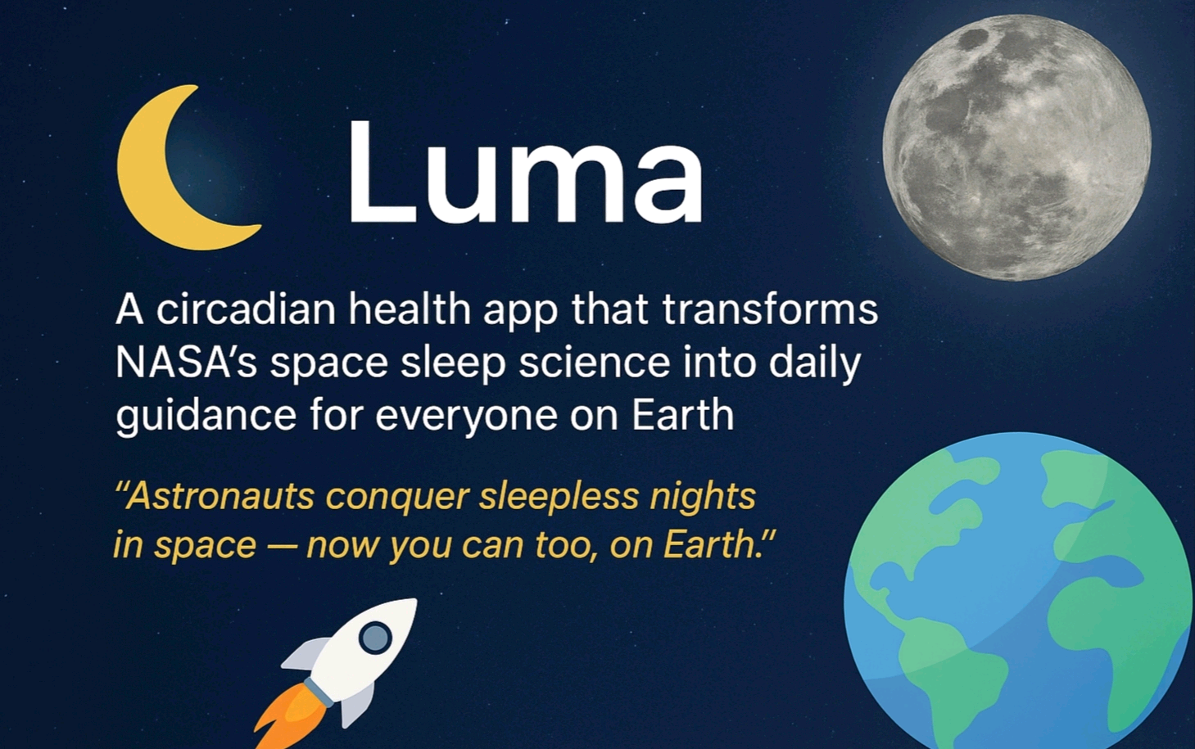
🌙 Luma — Vision
🚀 A circadian health app bringing NASA’s space sleep science to everyday life. ✨ “Astronauts conquer sleepless nights in orbit — now you can too.”

Slide 2
💤 The Problem
🌍 60% of people suffer poor sleep and fatigue. 🕒 Misaligned circadian rhythms cause stress and health issues. 🚀 Astronauts face 16 sunsets/day, extreme disruption. ❌ NASA science exists but isn’t public-ready.

Slide 3
🌙 The Solution
🌙 Luma makes NASA science actionable. - Personalized sleep coaching with solar & lunar data. - Smart nudges: sunlight, meals, meditation. - Adaptive feedback: energy & rest reports. - NASA rewards: unlock space & Earth knowledge.

Slide 4
📱 App Workflow
1️⃣ Enter location, sleep & wake times. 2️⃣ NASA solar & moon data personalize guidance. 3️⃣ Offline alarms with NASA space sounds. 4️⃣ Morning check-ins for quick feedback. 5️⃣ Push nudges: sunlight, meals, meditation. 6️⃣ Circadian reports with insights. 7️⃣ NASA rewards for building habits.

Slide 5
⭐ Key Features
✨ Offline Smart Alarms with NASA sounds. ✨ Light nudges synced to location. ✨ Interactive morning check-ins. ✨ Personalized circadian reports. ✨ NASA rewards system for healthy routines. ✨ Meditation & lifestyle prompts. ✨ Adaptive AI suggestions for better sleep.

Slide 6
🛰️ Tech & Data
🌞 NASA POWER API → daylight cycles. 🌙 JPL Horizons → moon phases. 🔊 NASA Sound Library → alarms. 🌐 NASA Open Data → rewards. Stack: - Frontend: Flutter/React Native - Backend: Firebase + offline DB - AI: adaptive lifestyle recommendations.

Slide 7
🌍 Impact & Future
🌍 Better global sleep, focus, and wellness. 🚀 NASA legacy — astronaut science for all. 🎮 Gamified NASA rewards make learning fun. Future: - Wearable integrations. - Global circadian health maps. - Community ‘Sleep like an astronaut’ challenges.

