Slide 1
IBM University Engagement Project Submission

Slide 2

Project Tile – GrantGenie-AI: Agentic AI-Based Startup Grant Recommendation and Proposal Generation System
Domain of Project – Entrepreneurship and Startup Ecosystem
Student Name | Recent Passport Photo | Email ID | Mobile number [WhatsApp]
Samudrala Venkata Naga Lakshmi Chandra Pragna |  | praghna1005@gmail.com | 7569311984

Slide 3
Problem Statement -
Problem Statement : GrantGenie-AI
The Challenge
Startups often face difficulties in finding suitable grants, understanding complex eligibility requirements, and preparing effective funding proposals. Existing approaches require manual research and lack personalized funding guidance.
The Objective
Build an Agentic AI-powered Grant Recommendation and Proposal Generation System that:
Grant Recommendation – Suggest suitable funding opportunities based on startup profile, domain, and requirements.

Slide 4
Eligibility Verification – Analyze grant criteria and identify eligibility status and missing requirements.
AI Proposal Generation – Generate customized funding proposals for grant applications.
Multi-Agent System –
Startup Profile Agent
Grant Recommendation Agent
Eligibility Verification Agent
Proposal Generation Agent
Interactive Dashboard – Visualize startup insights, grant matches, eligibility scores, and proposals.

Slide 5
Proposed Solution -
GrantGenie-AI is an Agentic AI-powered platform that automates the startup funding discovery and application preparation process.
The solution uses multiple AI agents powered by IBM watsonx.ai to:
Analyze Startup Profile – Extract domain, technology, stage, and funding requirements from user input.
Recommend Suitable Grants – Identify and rank funding opportunities based on startup characteristics.
Verify Eligibility – Evaluate grant requirements and highlight matched and missing criteria.
Generate Funding Proposals – Create customized, structured proposals for grant applications.
Provide Interactive Dashboard – Display grant recommendations, eligibility scores, and AI-generated proposals in a user-friendly interface.

Slide 6
Technology Used
IBM watsonx.ai – For foundation model access, AI inference, natural language understanding, reasoning, and generating personalized funding insights.
Meta Llama Model – For understanding startup information, grant analysis, reasoning, and AI-powered proposal generation.
IBM Cloud – Provides a secure and scalable infrastructure for deploying and managing the Agentic AI application.
IBM Cloud Object Storage – Used for secure storage and management of startup documents and project resources.
RAG (Retrieval Augmented Generation) – Enables retrieval of relevant grant information before generating responses, improving accuracy and reliability.

Slide 7
FastAPI – Backend framework for building APIs and managing the multi-agent workflow.
React.js + Vite – Used to develop an interactive dashboard for displaying startup profiles, grant recommendations, eligibility analysis, and proposals.
Multi-Agent Architecture – Enables collaboration between specialized agents for profile extraction, grant recommendation, eligibility verification, and proposal generation.

Slide 8
Role of Agentic AI in the solution
Autonomous Decision Making – AI agents analyze startup information and make intelligent funding recommendations.
Multi-Agent Collaboration – Specialized agents work together for profile extraction, grant recommendation, eligibility verification, and proposal generation.
Automated Reasoning – Agents evaluate grant requirements and identify suitable opportunities.
Personalized Assistance – Generates customized funding proposals based on startup needs.
End-to-End Workflow Automation – Reduces manual effort by automating the complete grant application preparation process.

Slide 9
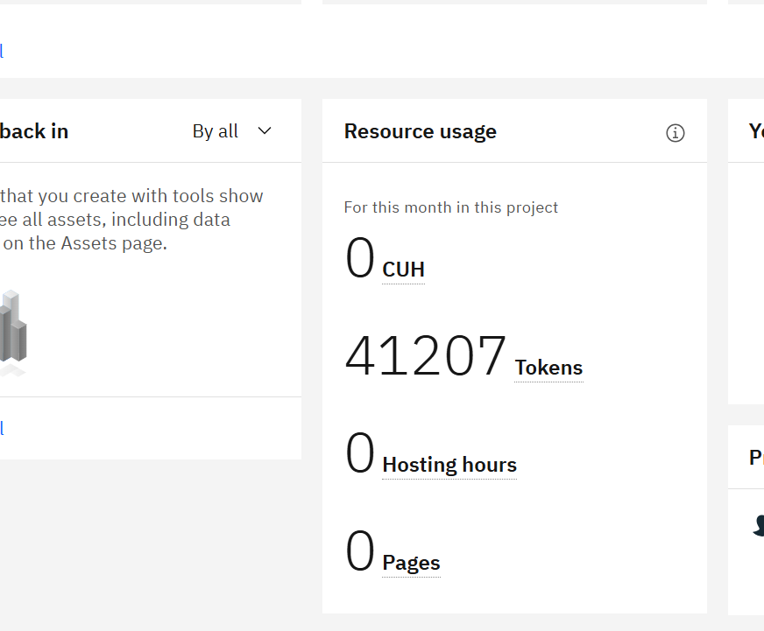
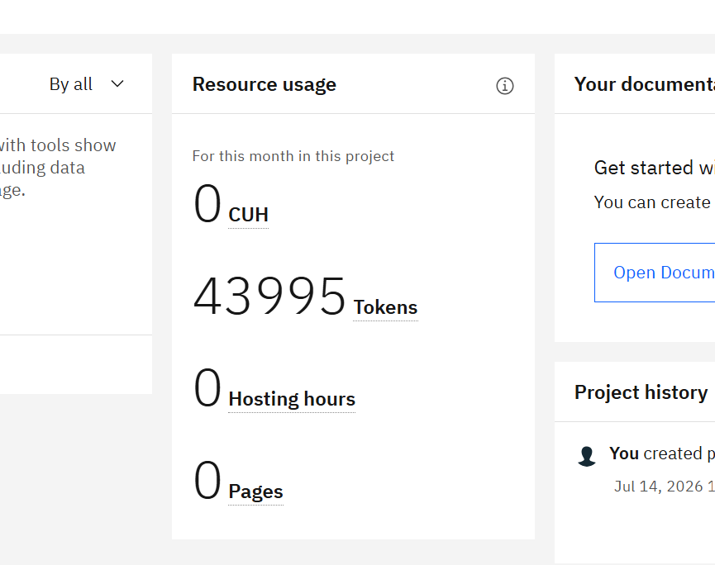
Token Usage
Before prompt
After prompt
·
·
·

Slide 10
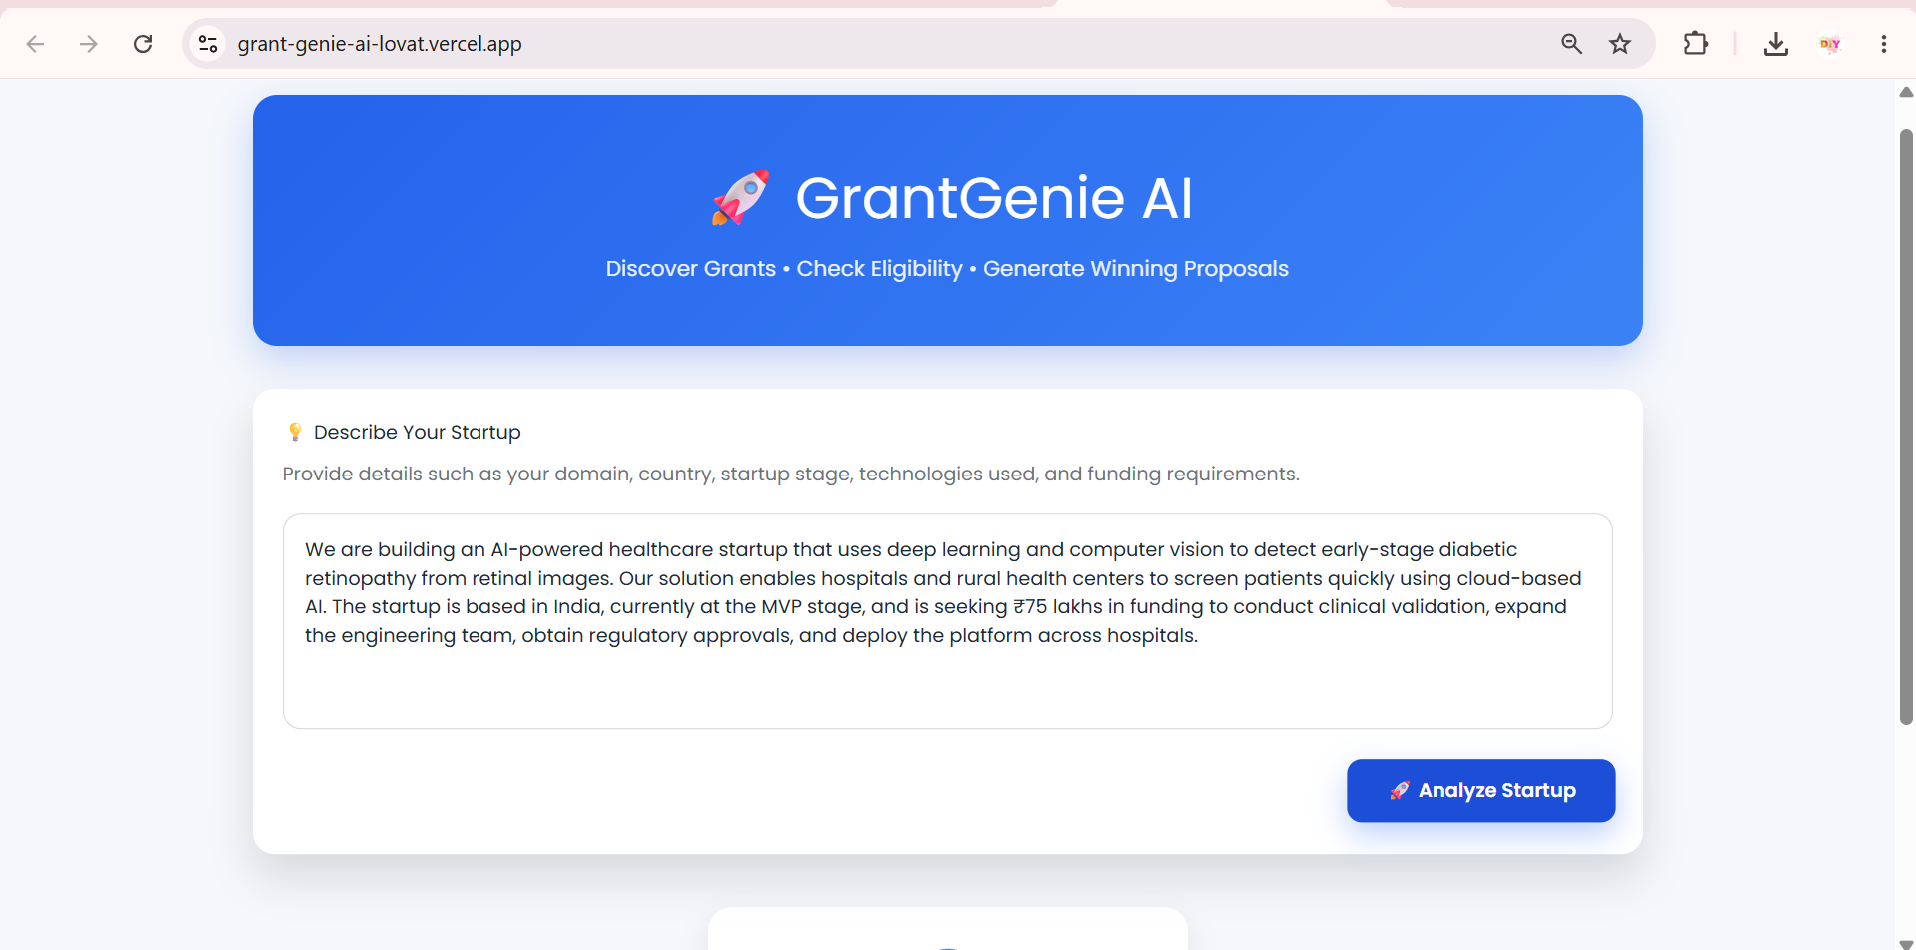
Demo
User input

Slide 11
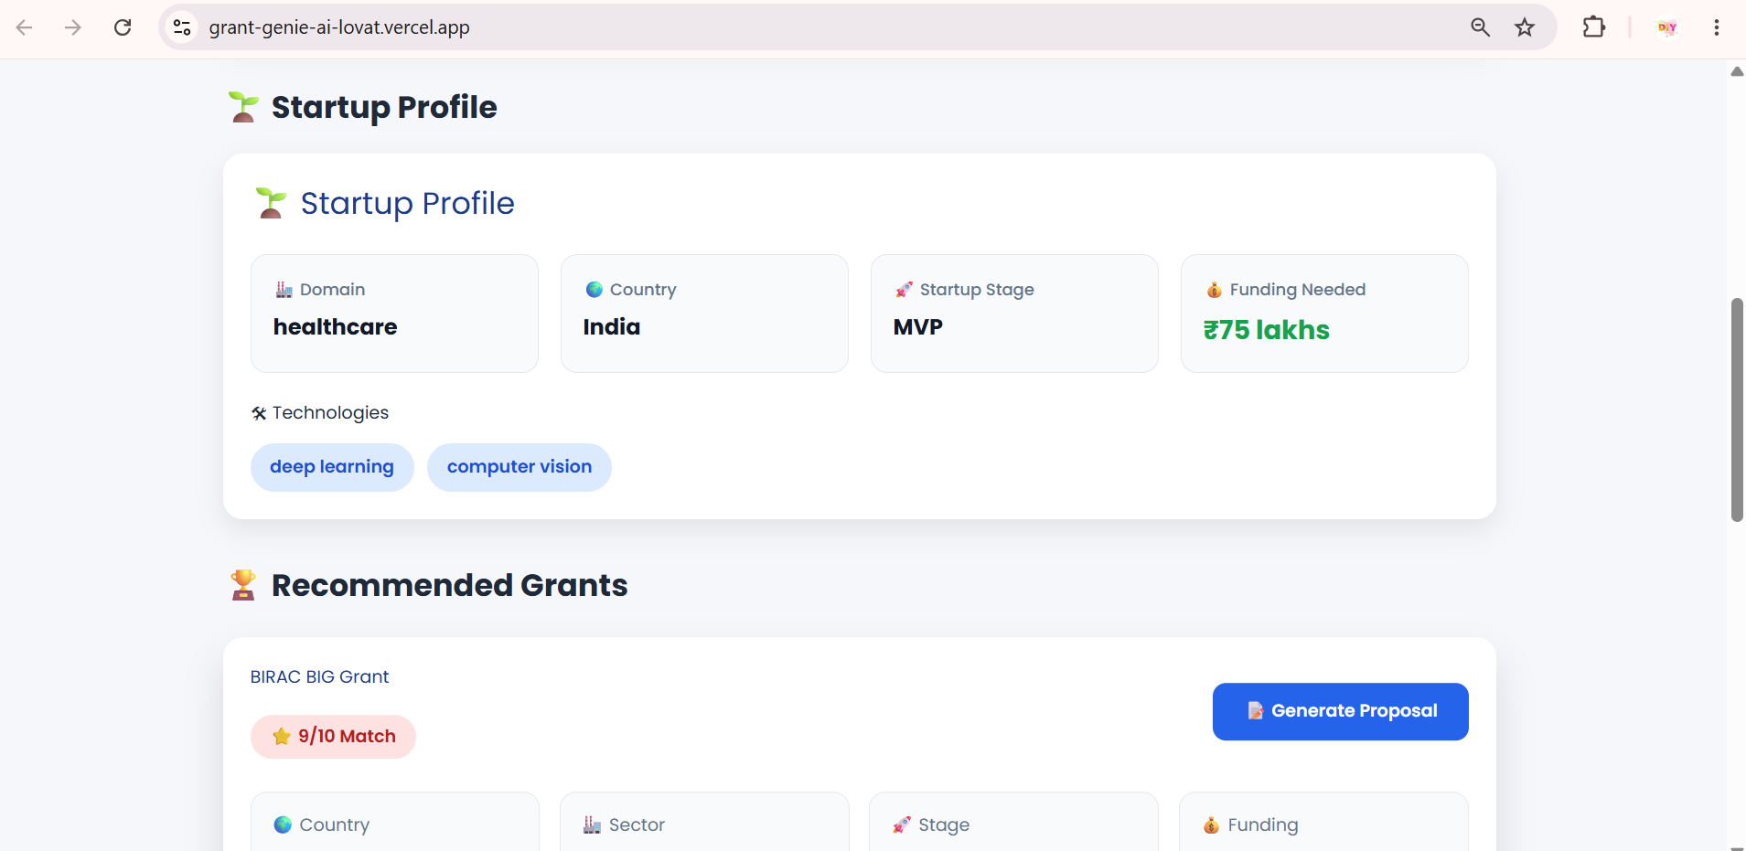
Startup Agent

Slide 12
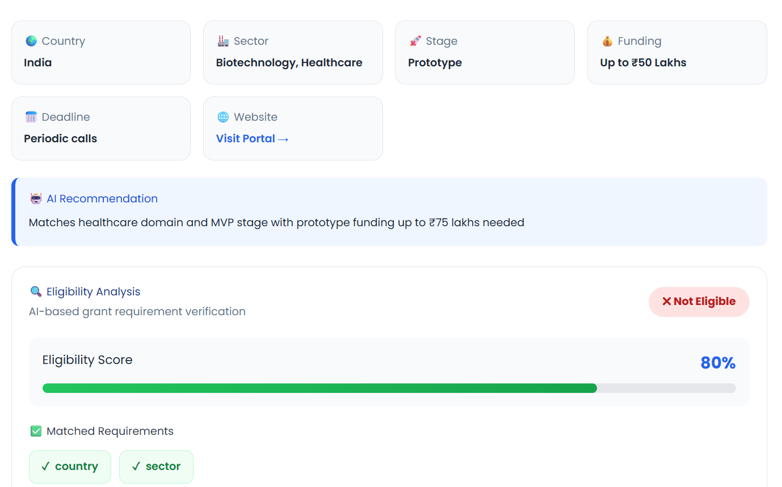
Grant recommendation

Slide 13
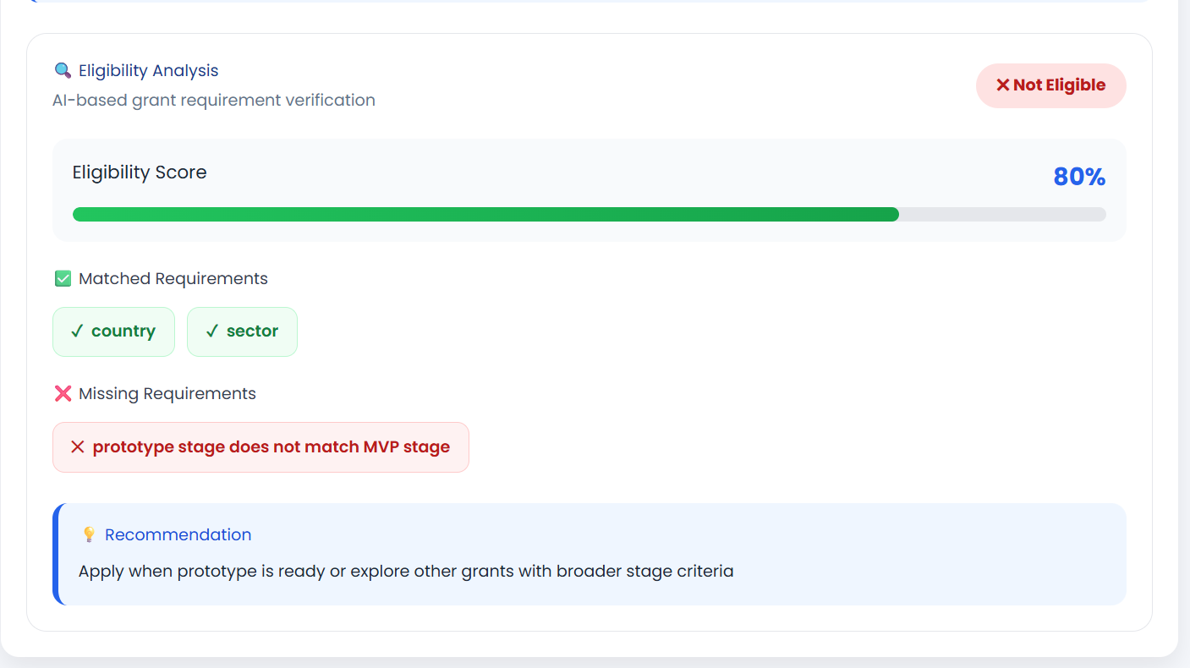
Eligibility check

Slide 14
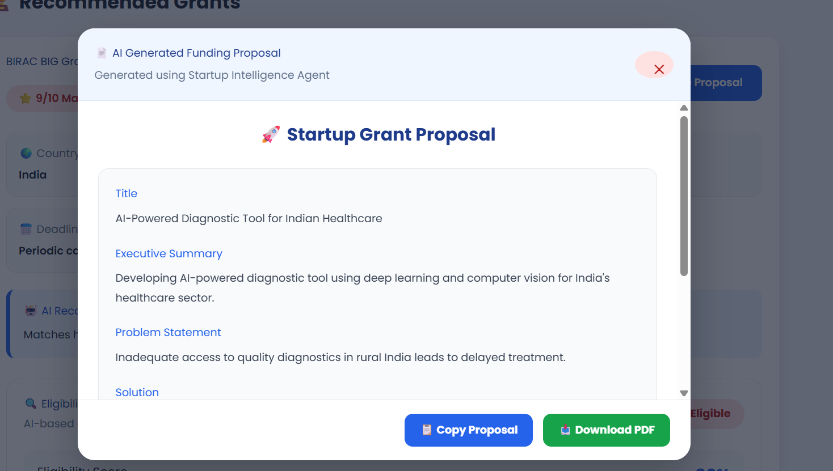
Proposal Agent

Slide 15
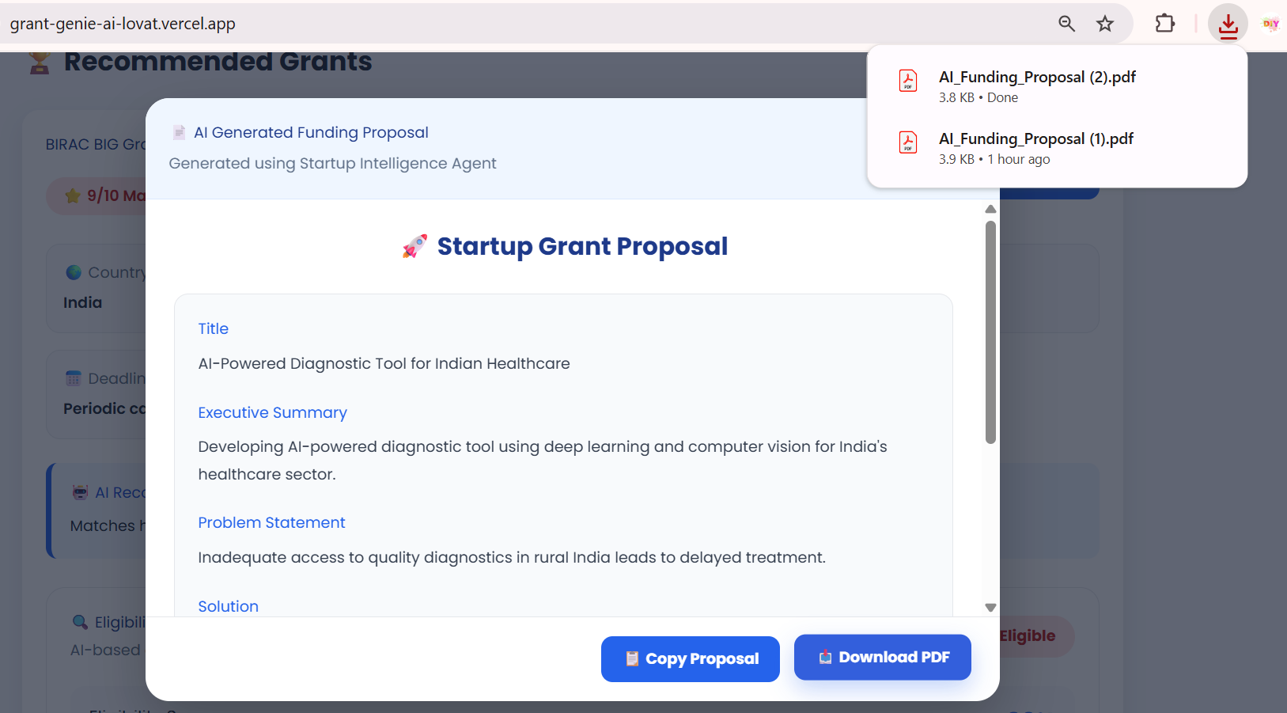
Proposal download

Slide 16
Novelty and Uniqueness
Agentic AI Workflow – Multiple AI agents collaborate for profile analysis, grant matching, eligibility checking, and proposal generation.
End-to-End Funding Assistant – Automates the complete grant discovery and application preparation process.
Intelligent Grant Matching – Recommends grants based on startup domain, stage, technology, and funding needs.
AI-Based Eligibility Analysis – Identifies eligibility status, missing requirements, and improvement suggestions.
IBM watsonx.ai Integration – Uses enterprise-grade foundation models for intelligent decision support.

Slide 17
Git Hub Link
https://github.com/pragna100510/GrantGenie-AI
Deployment Links
Frontend Application: https://grant-genie-ai-lovat.vercel.app
Backend API: https://grantgenie-ai-backend.onrender.com
API Documentation: https://grantgenie-ai-backend.onrender.com/docs
·
·
·

Slide 18
Future Scope
Autonomous Grant Discovery Agent Automatically discover and update new funding opportunities.
AI-Powered Document Intelligence Analyze startup documents and verify eligibility requirements.
Advanced Multi-Agent Workflow Add specialized agents for market research, financial planning, and compliance verification.
Automated Application Assistance Generate application forms, pitch documents, and supporting materials.
Scalable IBM Cloud Integration Expand deployment using IBM Code Engine, Cloud Object Storage, and watsonx.ai.

Slide 19
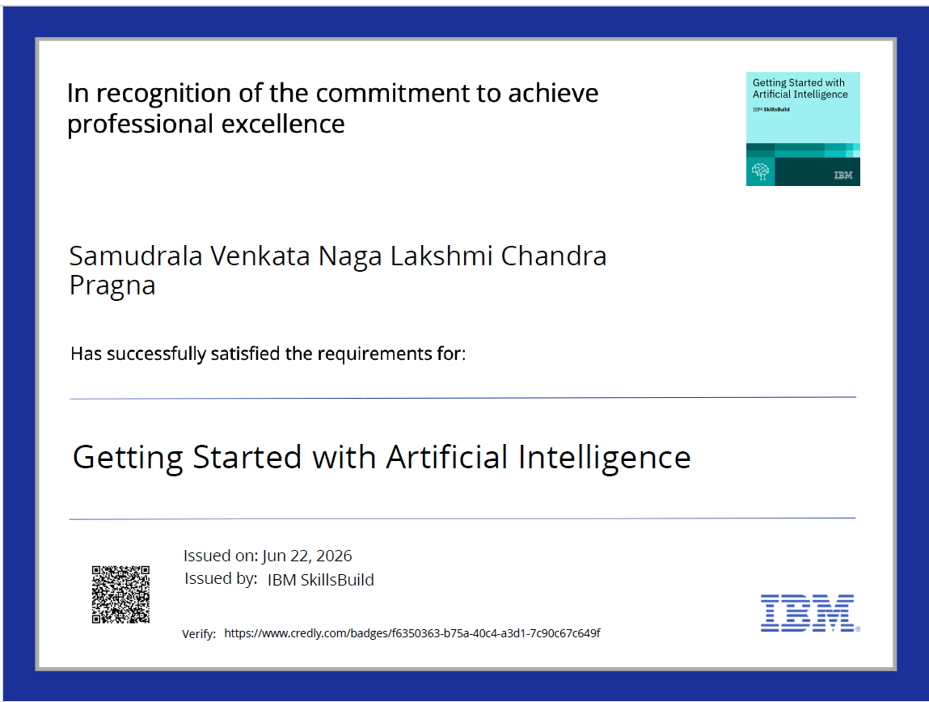
Certificates Earned:
Credly certificate

Slide 20
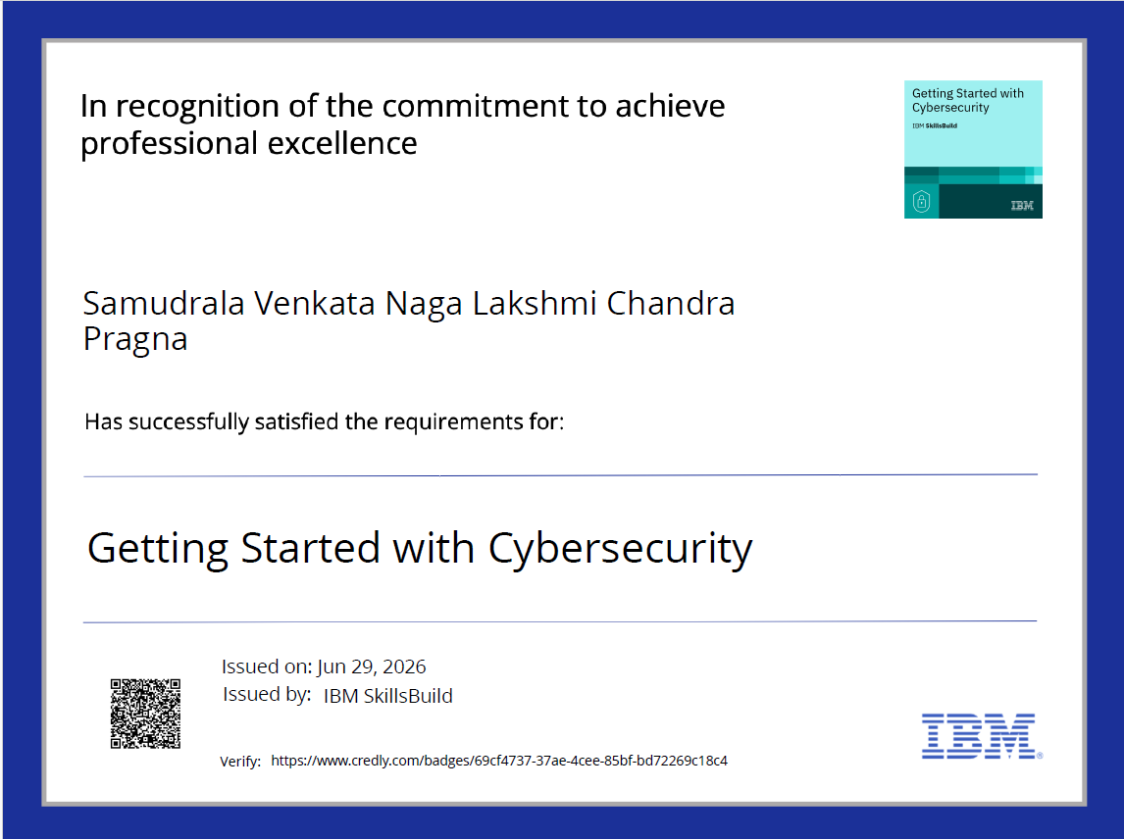

Slide 21
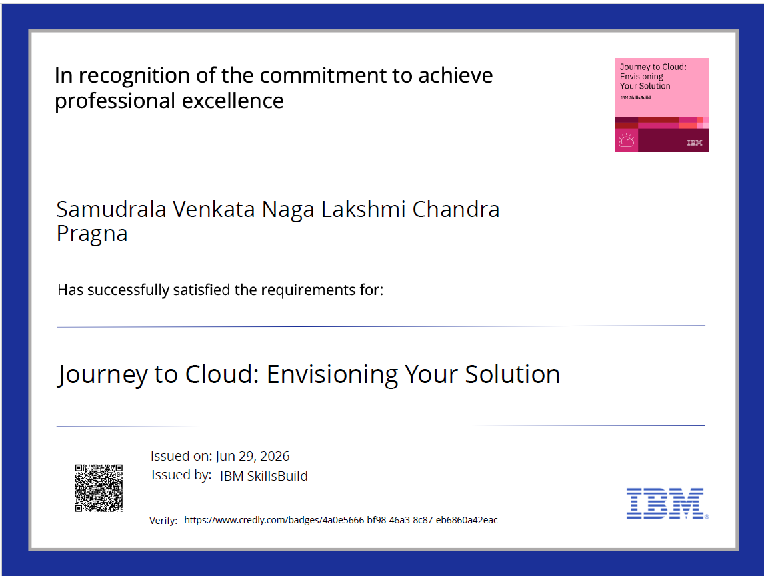

Slide 22
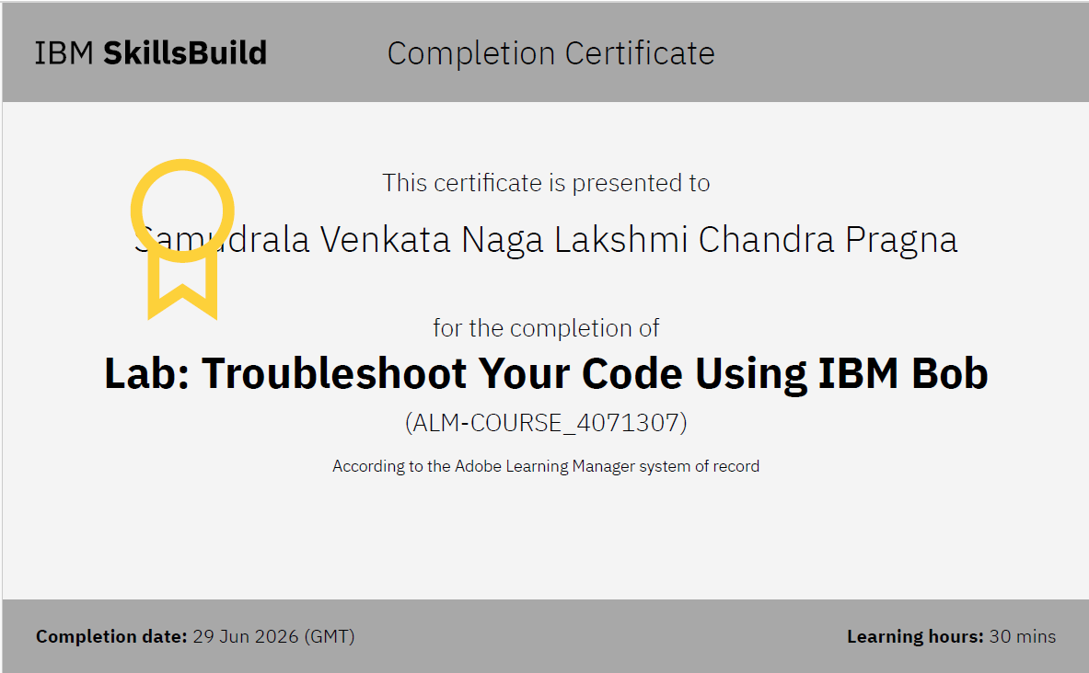
Certificates Earned:​
IBM BOB Certificate

Slide 23


