Slide 1




Project Title -Seasonal Agriculture Performance Analysis
Student Name – Pragnan Kiran Kadiyam
College Name – Saveetha Institute of Medical and Technical Science
AICTE STU ID : STU68459f96b68e41749393302

Slide 2

PROBLEM STATEMENT
(Agricultural activities are influenced by seasonal variations in environmental conditions, farming practices, resource availability and market conditions. As a result, agricultural performance may differ from one season to another. However, raw agricultural data does not clearly explain how agricultural performance changes across seasons or what patterns can be observed in different seasonal conditions. The problem is to analyze the given agricultural dataset and investigate seasonal differences in agricultural performance by identifying meaningful patterns, trends, relationships and variations within the available data.

Slide 3


Project Description
Seasonal Agriculture Performance Analysis is a data analytics project that analyzes agricultural data across Kharif, Rabi and Zaid seasons. The project examines agricultural yield, production, environmental conditions, farming inputs, water usage, irrigation methods and economic performance. Data cleaning, exploratory data analysis, statistical analysis and visualization techniques are used to identify meaningful seasonal, crop and regional patterns. The findings are used to provide data-driven recommendations for better agricultural planning and resource management.

Slide 4



WHO ARE THE END USERS?
Farmers
Agricultural planners
Government agriculture departments
Agricultural researchers
Irrigation and resource management teams
Agribusiness organizations

Slide 5
Technology Used
  Programming Language :Python
  Libraries : Pandas , NumPy , Matplotlib , Seaborn
  Tools : Jupyter Notebook / Google Colab , GitHub
  Techniques : Data Cleaning , EDA , IQR Outlier Detection , Correlation Analysis , Data Visualization

Slide 6
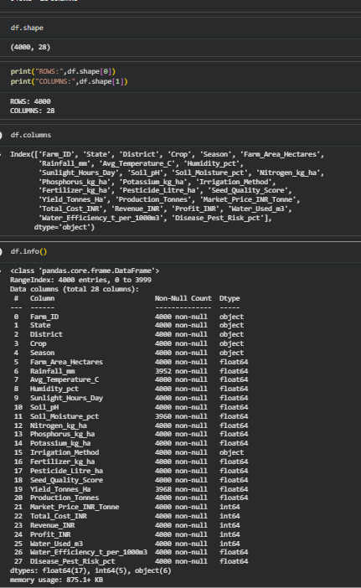
RESULTS
Dataset Overview :
• 4,000 Records
• 28 Variables
• 17 Float
• 5 Integer
• 6 Categorical
Data Quality :
• 314 Missing values
• 0 Duplicates Records
Preprocessing :
• Median imputation
• IQR outliers

Slide 7
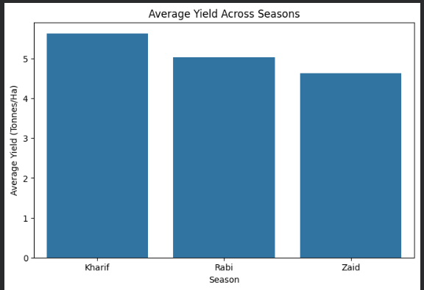
RESULTS
Kharif: 5.64 Tonnes/Ha
Rabi: 5.08 Tonnes/Ha
Zaid: 4.67 Tonnes/Ha
Key Finding:
Kharif recorded the highest average yield,
followed by Rabi and Zaid.
This indicates that agricultural yield varies across seasons.
Seasonal Yield Comparison

Slide 8
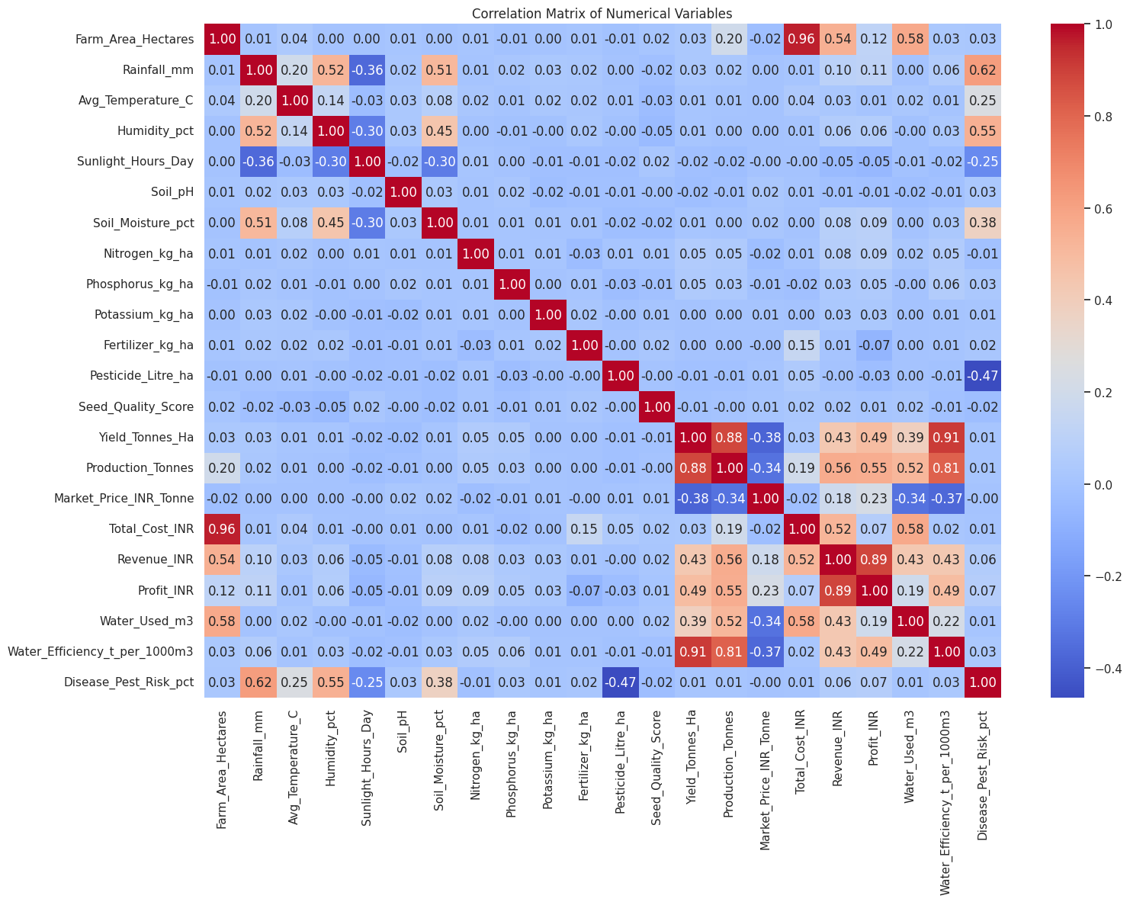
RESULTS
Environmental Factors vs Yield
Rainfall vs Yield: 0.03
Temperature vs Yield: 0.01
Humidity vs Yield: 0.01
Sunlight vs Yield: -0.02
Key Finding:
Individual environmental factors
showed very weak linear
correlations with yield.
Therefore, seasonal yield
difference cannot be explained
by a singleenvironmental
factor alone.

Slide 9
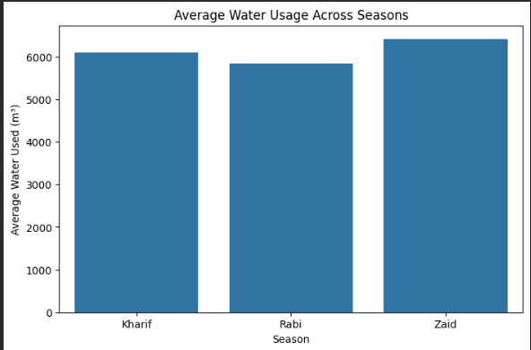
RESULTS
Kharif: 6,102 m³
Rabi: 5,847 m³
Zaid: 6,420 m³
Key Finding:
Zaid recorded the highest average water usage.

Slide 10
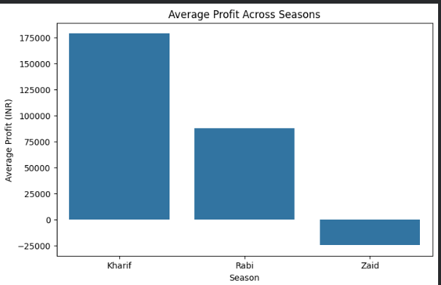
RESULTS
Kharif: ₹1.79 Lakh
Rabi: ₹0.88 Lakh
Zaid: -₹0.25 Lakh
Key Finding:
Kharif recorded the highest average profit,
while Zaid recorded negative average profit.

Slide 11
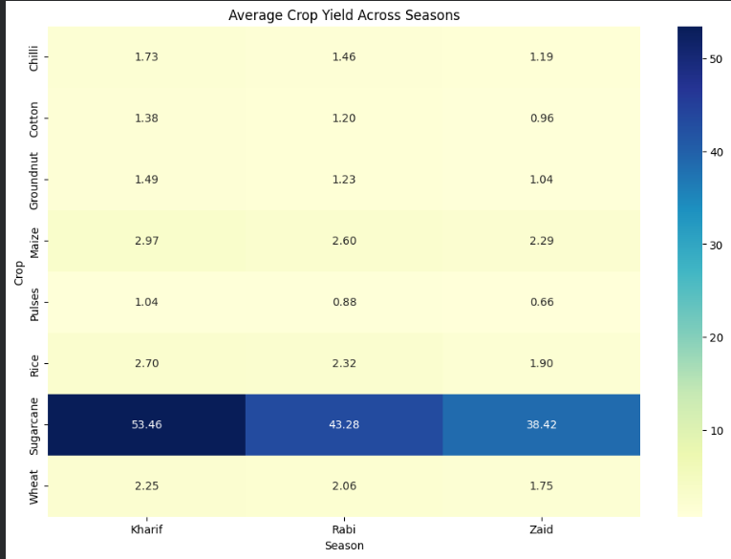
RESULTS
Key Finding:
Crop performance varies across seasons.
Therefore, crop selection should consider
seasonal conditions.

Slide 12
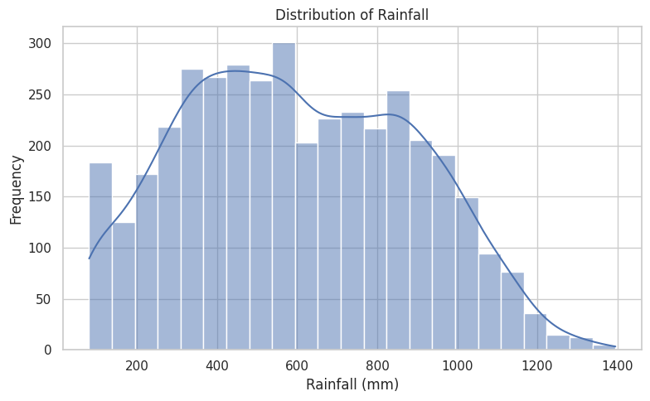
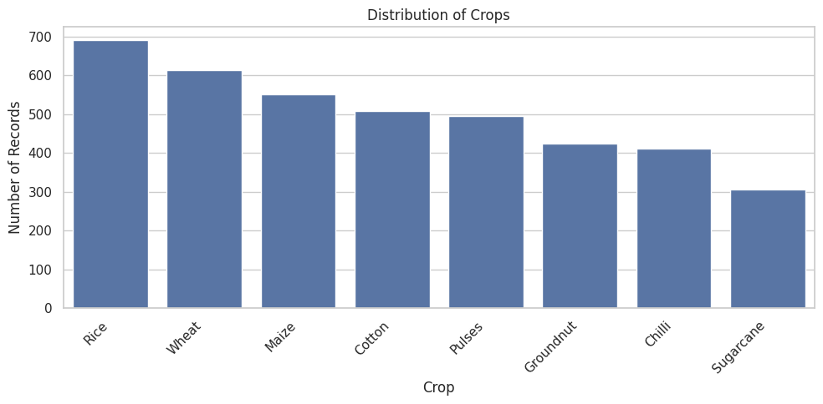
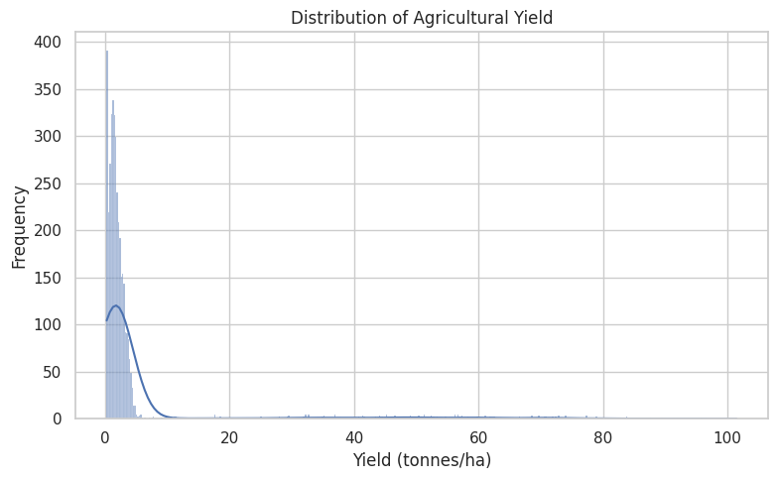
Types of Distribution

Slide 13
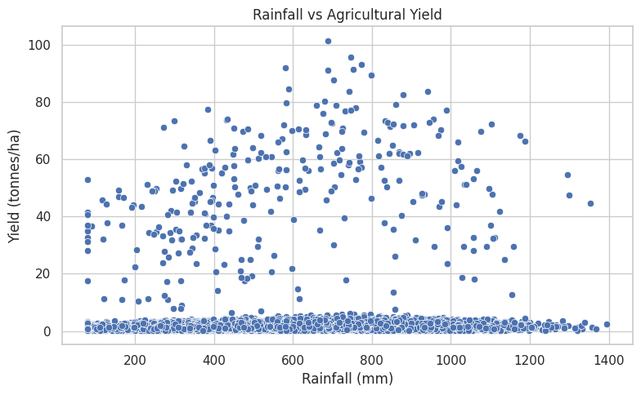
Pie – Chart on Yield
Rainfall vs Agricultural Yield:
This scatter plot shows the relationship between rainfall and agricultural yield. There is a positive relationship to some extent, as yield generally increases with rainfall, but the points are widely scattered. This indicates that rainfall affects yield, but other factors also play an important role.

Slide 14
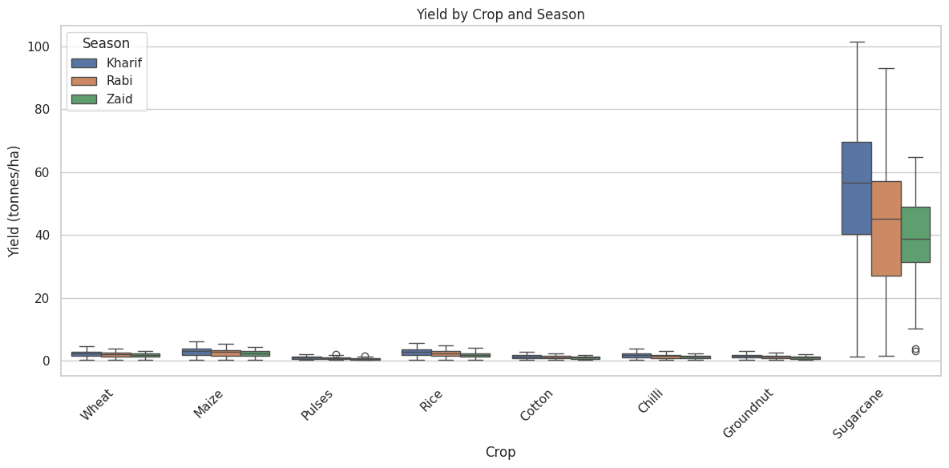
Yield by Crop and Season Graph
Yield by Crop and Season:
This box plot compares crop yield across different seasons. Sugarcane has the highest yield overall, while pulses and cotton have much lower yields. For most crops, Kharif generally shows higher yields than Rabi and Zaid, with some variation and outliers.

Slide 15
Future scope
• Develop Machine Learning models for agricultural yield prediction.
• Build crop recommendation systems based on season,
environmental conditions and farming inputs.
• Develop an interactive dashboard using Power BI or Tableau.
• Integrate real-time weather and market price data.
• Improve water-use optimization using predictive analytics.
• Extend the analysis to more regions and historical data.

Slide 16
Conclusion
The conclusion should summarize:
What the dataset revealed about seasonal agricultural performance.
The most important patterns discovered.
The most useful analytical findings.
Important limitations of the analysis.
How the analysis could support future investigation or decision-making.

Slide 17

VOIS Course completion certificate -
Course name- Data Visualization

Slide 18

.
.
.

