Slide 1

SAVEETHA SCHOOL OF ENGINEERING SIMATS, CHENNAI-602105
CSA1580-Cloud Computing and Big Data Analytics for Cloud API
SUPERVISOR
DR. Gnana Soundari
TITLE
Design and implement Scalable and Cost-Effective Web Applications on AWS
BY
(192210278)-K. Pragnan Kiran

Slide 2
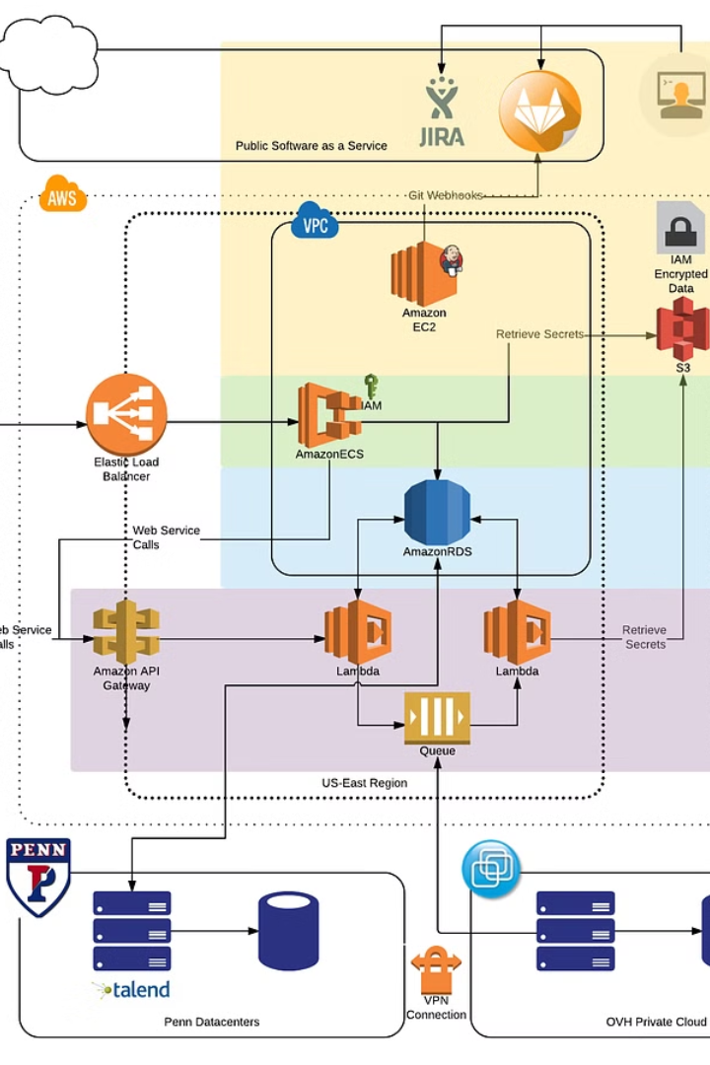
Building Scalable and Cost-Effective Web Applications on AWS
The demand for web applications is growing rapidly. Companies need to build applications that can handle increasing traffic and user demands while remaining cost-effective. Amazon Web Services (AWS) offers a comprehensive cloud platform that empowers developers to build scalable and cost-effective web applications.

Slide 3
The Power of AWS: A Comprehensive Cloud Platform
AWS provides a wide range of services that cater to every stage of the web application development lifecycle, from infrastructure management to application deployment and monitoring.
1
Compute Services
2
Storage Services
AWS offers a variety of compute services, including Amazon EC2, Amazon ECS, and AWS Lambda, that provide the processing power needed to run web applications.
AWS provides a range of storage services, including Amazon S3, Amazon EBS, and Amazon EFS, that allow developers to store data securely and efficiently.
3
Database Services
4
Networking Services
AWS offers a variety of database services, including Amazon RDS, Amazon DynamoDB, and Amazon Redshift, that allow developers to store and manage data effectively.
AWS provides a range of networking services, including Amazon VPC, Amazon Route 53, and AWS Direct Connect, that enable developers to connect and manage their applications securely.

Slide 4
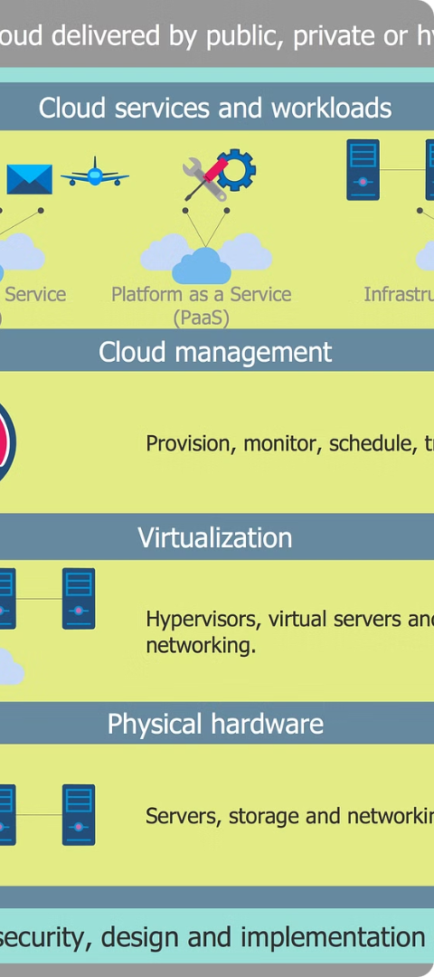
Architecting for Scalability: Designing for Growth
Scalability is essential for web applications that need to handle fluctuating traffic demands. AWS provides a variety of tools and services that help developers design scalable web application architectures.
1
Microservices Architecture
Break down complex applications into smaller, independent services that can be scaled independently.
2
Auto Scaling
Automatically adjust the number of instances running based on real-time traffic patterns.
3
Load Balancing
Distribute incoming traffic across multiple instances to ensure even load distribution.

Slide 5
Cost Optimization Strategies: Maximizing Efficiency
Cost optimization is crucial for building and running cost-effective web applications. AWS offers a variety of tools and strategies that help developers reduce costs.
Reserved Instances
Spot Instances
Serverless Computing
Purchase reserved instances for a discounted rate. This is a great option for applications with predictable workloads.
Bid on spare EC2 instances for a significant cost savings. This is a great option for applications that can tolerate occasional interruptions.
Pay only for the resources used, reducing costs for applications with intermittent workloads.

Slide 6
Choosing the Right AWS Services: A Deep Dive
AWS offers a wide array of services that can be used to build and manage web applications. It's important to choose the right services for your specific needs.
Compute
Amazon EC2, Amazon ECS, AWS Lambda
Storage
Amazon S3, Amazon EBS, Amazon EFS
Databases
Amazon RDS, Amazon DynamoDB, Amazon Redshift
Networking
Amazon VPC, Amazon Route 53, AWS Direct Connect

Slide 7




Implementing a Secure and Reliable Infrastructure
Security and reliability are paramount for web applications. AWS offers a range of tools and services that help developers build secure and reliable infrastructures.
IAM
Control access to AWS resources through user roles and permissions.
Security Groups
Restrict inbound and outbound traffic to your instances.
AWS Shield
Protect your web applications from DDoS attacks.

Slide 8



Monitoring and Performance Tuning: Ensuring Optimal Performance
Monitoring and performance tuning are essential for ensuring optimal performance for web applications. AWS offers a range of tools that help developers monitor and tune their applications.
Amazon CloudWatch
Amazon CloudFront
AWS X-Ray
Monitor key metrics, such as CPU utilization, memory usage, and network traffic.
Optimize content delivery and improve website speed.
Identify and troubleshoot performance bottlenecks in web applications.

Slide 9

Conclusion: Building a Successful Web Application on AWS
AWS offers a comprehensive cloud platform that empowers developers to build scalable, cost-effective, secure, and reliable web applications. By leveraging the power of AWS, you can build successful web applications that meet the ever-growing demands of the modern web.

Slide 10


