Slide 1

Creating a Transactional database for E-commerce Mobile APP
Venkat, Pragna, Navya, Sai Prakash

Slide 2
PROJECT OVERVIEW
The aim of our group's project is to create an effective and transactional database that can accommodate the data required to run an E-commerce Mobile app allowing vendors to list and manage their products and customers to order products at ease.
This project presents a comprehensive overview of our e-commerce mobile application project, a venture aimed at delivering a seamless and user-friendly shopping experience to our customers.
Our goal is to build a robust and effective database that can aid in running an E-commerce mobile application seemingly.

Slide 3
PROJECT requirements
The core project requirements include the following:
Building a transactional database that can handle numerous transactions simultaneously without any latency.
The database should be able to store and manage various details like customer sign-up details, product listings, customer reviews, shipping addresses, and payment details in the form of tables such as customers, products, etc.
To run efficient operations, the system needs to handle dependable and quick requests and the data's security, dependability, and integrity must be guaranteed during implementation.
To effectively serve different goals, this project explores the implementation of relational databases (MySQL) and NoSQL databases (MongoDB).

Slide 4
RDBMS and NoSQL Models: A Brief Overview
RDBMS – Relational Database Management System:
RDBMS stands for Relational Database Management System. It is a type of database management system that stores data in tables and enforces relationships between the tables to maintain data integrity. The data in RDBMS is structured in rows and columns, and tables are related to each other using keys.
RDBMS adheres to ACID properties (Atomicity, Consistency, Isolation, Durability) to ensure the reliability and integrity of transactions.
RDBMS allows the definition of integrity constraints such as primary key constraints, foreign key constraints, unique constraints, and check constraints to maintain the accuracy and consistency of the data.
MySQL is a popular open-source relational database management system. It is widely used for web applications and is known for its speed, reliability, and ease of use.

Slide 5
RDBMS and NoSQL Models: A Brief Overview
NoSQL – Not Only SQL Database:
NoSQL databases, also known as "Not Only SQL" databases, are a type of database management system that diverges from the traditional relational database model. NoSQL databases are designed to handle large volumes of unstructured or semi-structured data and provide more flexibility and scalability than traditional relational databases. NoSQL databases can be categorized into several types, including document-oriented, key-value, column-family, and graph databases.
MongoDB is a popular document-oriented NoSQL database. It stores data in flexible, JSON-like BSON (Binary JSON) documents. Each document can have a different structure, making it suitable for handling evolving and diverse data.

Slide 6
RDBMS Model: MYSQL IMPLEMENTAITON
MySQL Implementation:
For our transactional database, we utilized the robustness and versatility of MySQL, a popular RDBMS, allowed us to efficiently manage and manipulate data associated with the E-commerce application. Our implementation encompassed creating tables, indexing, and enforcing foreign keys to ensure data integrity and enhance query performance.
Why MySQL:
ACID Compliance: MySQL adheres to ACID properties, ensuring reliable processing in transactional database systems, a crucial aspect of our project.
Performance and Scalability: MySQL's scalability makes it suitable for handling large volumes of data and facilitating swift transactions, enabling smooth operations for E-commerce applications. MySQL can deliver fast and responsive database operations.
Security Features: MySQL provides robust security features, including user authentication, access controls, encryption, and auditing capabilities to help protect sensitive coustomer’s information.

Slide 7
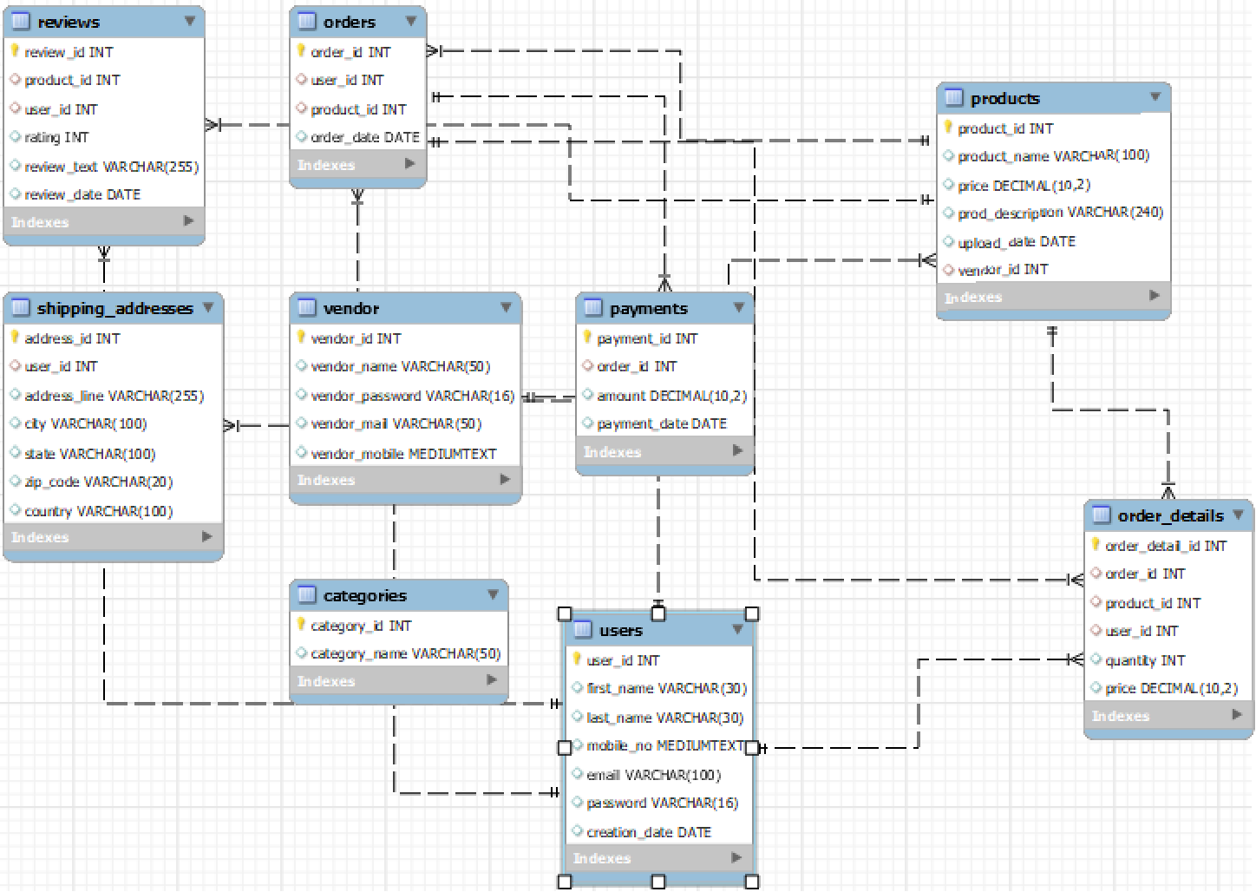
Data stored: The data stored in our MySQL implementation includes:
Products table: Information related to products is stored here.
Users table: Details related to the user’s sign-up are stored.
Categories table: Various product category details are stored.
Order table: Information related to every order is stored here.
Payments table: All payment details are stored in this table.
Shipping_address table: Details related to where the product needs t
to be shipped are stored in this table.
Vendors_table: Information such as vendor_id and vendor_name are stored in this table.
Review_table: Customer’s opinion about the products are stored in this table.

Slide 8
NoSQL Model: Mongo DB IMplementation
No-SQL Implementation:
We chose Mongo DB as our NoSQL database. Mongo DB is a document-oriented model. Mongo DB stores data in BSON (Binary JSON) documents, which are JSON like hierarchical data structures. This document-oriented model is well-suited for representing complex data structures and relationships.
Why Mongo DB:
Flexible schema: MongoDB uses a flexible and dynamic schema, allowing documents in a collection to have different fields including product information and transaction details.
Support for Rich Data Types: MongoDB supports a variety of data types such as product images, reviews, and specifications.
Real-Time Analytics: MongoDB's aggregation framework enables real-time analytics on e-commerce data. This is valuable for generating insights into customer behavior, product popularity, and sales trends.
Inventory and Order Management: MongoDB is well-suited for managing inventory and order information. The ability to represent complex relationships and perform efficient queries allows for effective inventory tracking and order processing.

Slide 9
Comparison b/w RDBMS and NoSQL
 | MySQL | MongoDB
Purpose | In an e-commerce application, one might choose MySQL for transactional consistency. | Mongo DB is preferred for managing product catalogs, and user profiles.
Strengths | Ensures ACID Properties, Scalability | Shema Flexibility and best suitable for unstructured data such as product attributes.
Project Usage | Order processing, User authentication, and authorization. | User profiles and preferences, Logging and Analytics.
It's also common to see hybrid approaches, where both MySQL and MongoDB are used in complementary roles within the same application. The choice depends on specific requirements, performance considerations, and development preferences.

Slide 10
Testing and Results
MySQL Testing:
We initiated testing by populating our MySQL tables with test data. This data consisted of vendors, products, customers, and shipping addresses. Our testing process checked the integrity of foreign key constraints, the creation of indexes, and the efficiency of transaction handling. We also verified the ACID properties, ensuring data consistency and reliability.
Mongo DB Testing:
Post My SQL testing, we moved the relevant data into Mongo DB. We ran a few aggregated queries between different collections to check the total number of vendors, customers, and number of products enlisted and also tested in-built data visualization techniques.
Test Results:
MySQL: Our transactional database showcased robust performance, handling various transactional data efficiently and maintaining data integrity throughout the process.
MongoDB: Our document-based queries demonstrated an impressive speed in revealing complex relationships and patterns within the data. This showed MongoDB’s potential to deliver valuable insights for our E-commerce application.

Slide 11
Challenges and solutions
Challenge-1: Data Consistency
Maintaining consistency between the MySQL and Mongo DB databases was a significant challenge. We had to ensure that all changes made in the transactional database were correctly reflected in the Mongo DB database.
Solution:
We addressed this by creating a mechanism to regularly sync data from the MySQL database to the Mongo DB database, ensuring both databases stay up-to-date and consistent.
Challenge-2: Query Performance
As the number of tables in transactional data grew, so did the complexity of our queries, leading to longer processing times. This could have potentially affected the service provider's operational efficiency.
Solution:
We overcame this challenge by implementing indexes on commonly queried columns in MySQL, significantly speeding up query performance. We also optimized document queries in Mongo DB to enhance their efficiency.

Slide 12
Improvements and Optimizations:
Indexing: We used indexing in MySQL to reduce data access time, thereby improving the system's overall performance.
Normalization: To eliminate data redundancy, we applied normalization rules in our MySQL database. This made our system more efficient and easier to maintain.

Slide 13
Lessons learned and future improvements
Lessons Learned:
Scalability is key: As data volumes grow, systems must be prepared to handle it. We experienced firsthand how MySQL's scalability was crucial to handling increasing data inflow.
Versatility of Databases: We realized the value of using different types of databases (MySQL and MongoDB) for different needs. This provided us with flexibility and efficiency, as each type served a distinct purpose.
Future Improvements:
Real-Time Data Syncing: While our current system syncs data at regular intervals, we envision an upgrade where changes in the MySQL database trigger instant updates in the MongoDB database, ensuring real-time consistency.
Enhanced data Security: There is a need to enhance the security measures to protect sensitive data in the databases, considering the importance of data privacy in the digital age.

Slide 14
Conclusion
In conclusion, our team embarked on a journey to construct a reliable database that can cater to the needs of an E-commerce application that has different needs such as storing user authentication details, enlisting products, shipping addresses, order details, and payment details, and maintaining data integrity.
Understanding the differences between RDBMS and NoSQL models, and designing the databases according to their strengths, has been instrumental to our project's success. It has underscored the importance of using the right tools for specific needs in database management and design.

