Slide 1
Emotional recognition from speech using CNN and four speech features
SIGNALS AND SYSTEMS PROJECT
2026-27
Nisarg Nayi
Yuvraj Singh
Ritesh Jaiswal
Prakhar Agrawal

Slide 2
Litreature Survey
Project aims to recognise human emotion by processing speech input using concepts of mathematics and signal processing
Initial plan for implementation is applying concept of CNN as novelty and exploiting usage of MFCC,Sampling, Fast Fourier Transform, Framing, Windowing,
Pre processing a dataset(RAVDESS) to train the output.

Slide 3
Initial Plan
Project is planned to be implemented in 4 phases
Signals Foundations
P1
Features and Data
P2
Baseline and
Feature Selection
P3
Deep Learning
Core
P4

Slide 4
Phase 1
Understanding audio signals
Concepts to Learn
Audio signal; continuous vs discrete
Amplitude, time-domain, waveform
Sampling, sampling rate, sampling period

Slide 5
Phase 1
Understanding audio signals
Practical Work
Load .wav files
Visualize waveform
See audio as numerical samples

Slide 6
Phase 1
Understanding audio signals
Tools
Python
NumPy
Librosa
Matplotlib

Slide 7
Phase 1
Frequency Analysis of Speech
Concepts to Learn
Frequency; time vs frequency domain
Fourier Transform, FFT
Magnitude spectrum

Slide 8
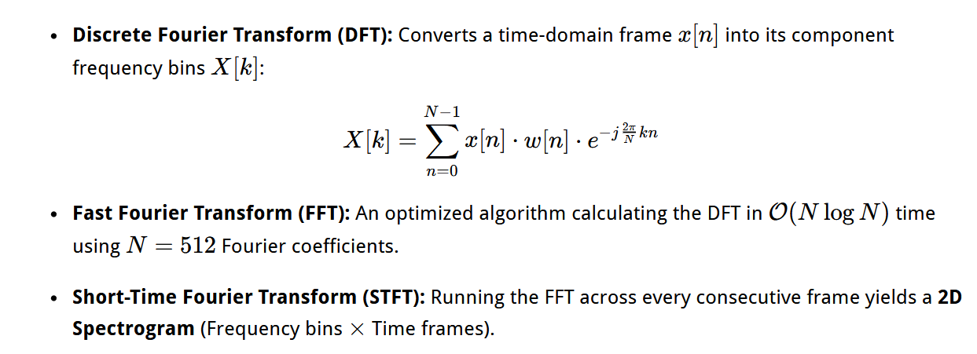

Slide 9
Phase 1
Frequency Analysis of Speech
Practical Work
Waveform → FFT → Frequency spectrum
Analyze dominant frequencies
Energy distribution & speech components

Slide 10
Phase 1
Time Frequency Analysis
Concepts to Learn
STFT, windowing, frames
Spectrogram

Slide 11
Phase 1
Time Frequency Analysis
Practical Work
Audio → STFT → Spectrogram
Read axes: X = time, Y = frequency, colour = energy

Slide 12
Next Evaluation Milestone
This concludes Phase 1 Survey of the course project
Phase 2
Data Set Creation
  Surveying quality of data on RAVDESS and TESS to assess its usecase
Speech Feature Extraction
  Using these learnt fundamentals of Signal Processing and implementing them on orignal dataset to get MFCC, Del MFCC, Spectogram and Chroma.

